Slide 1
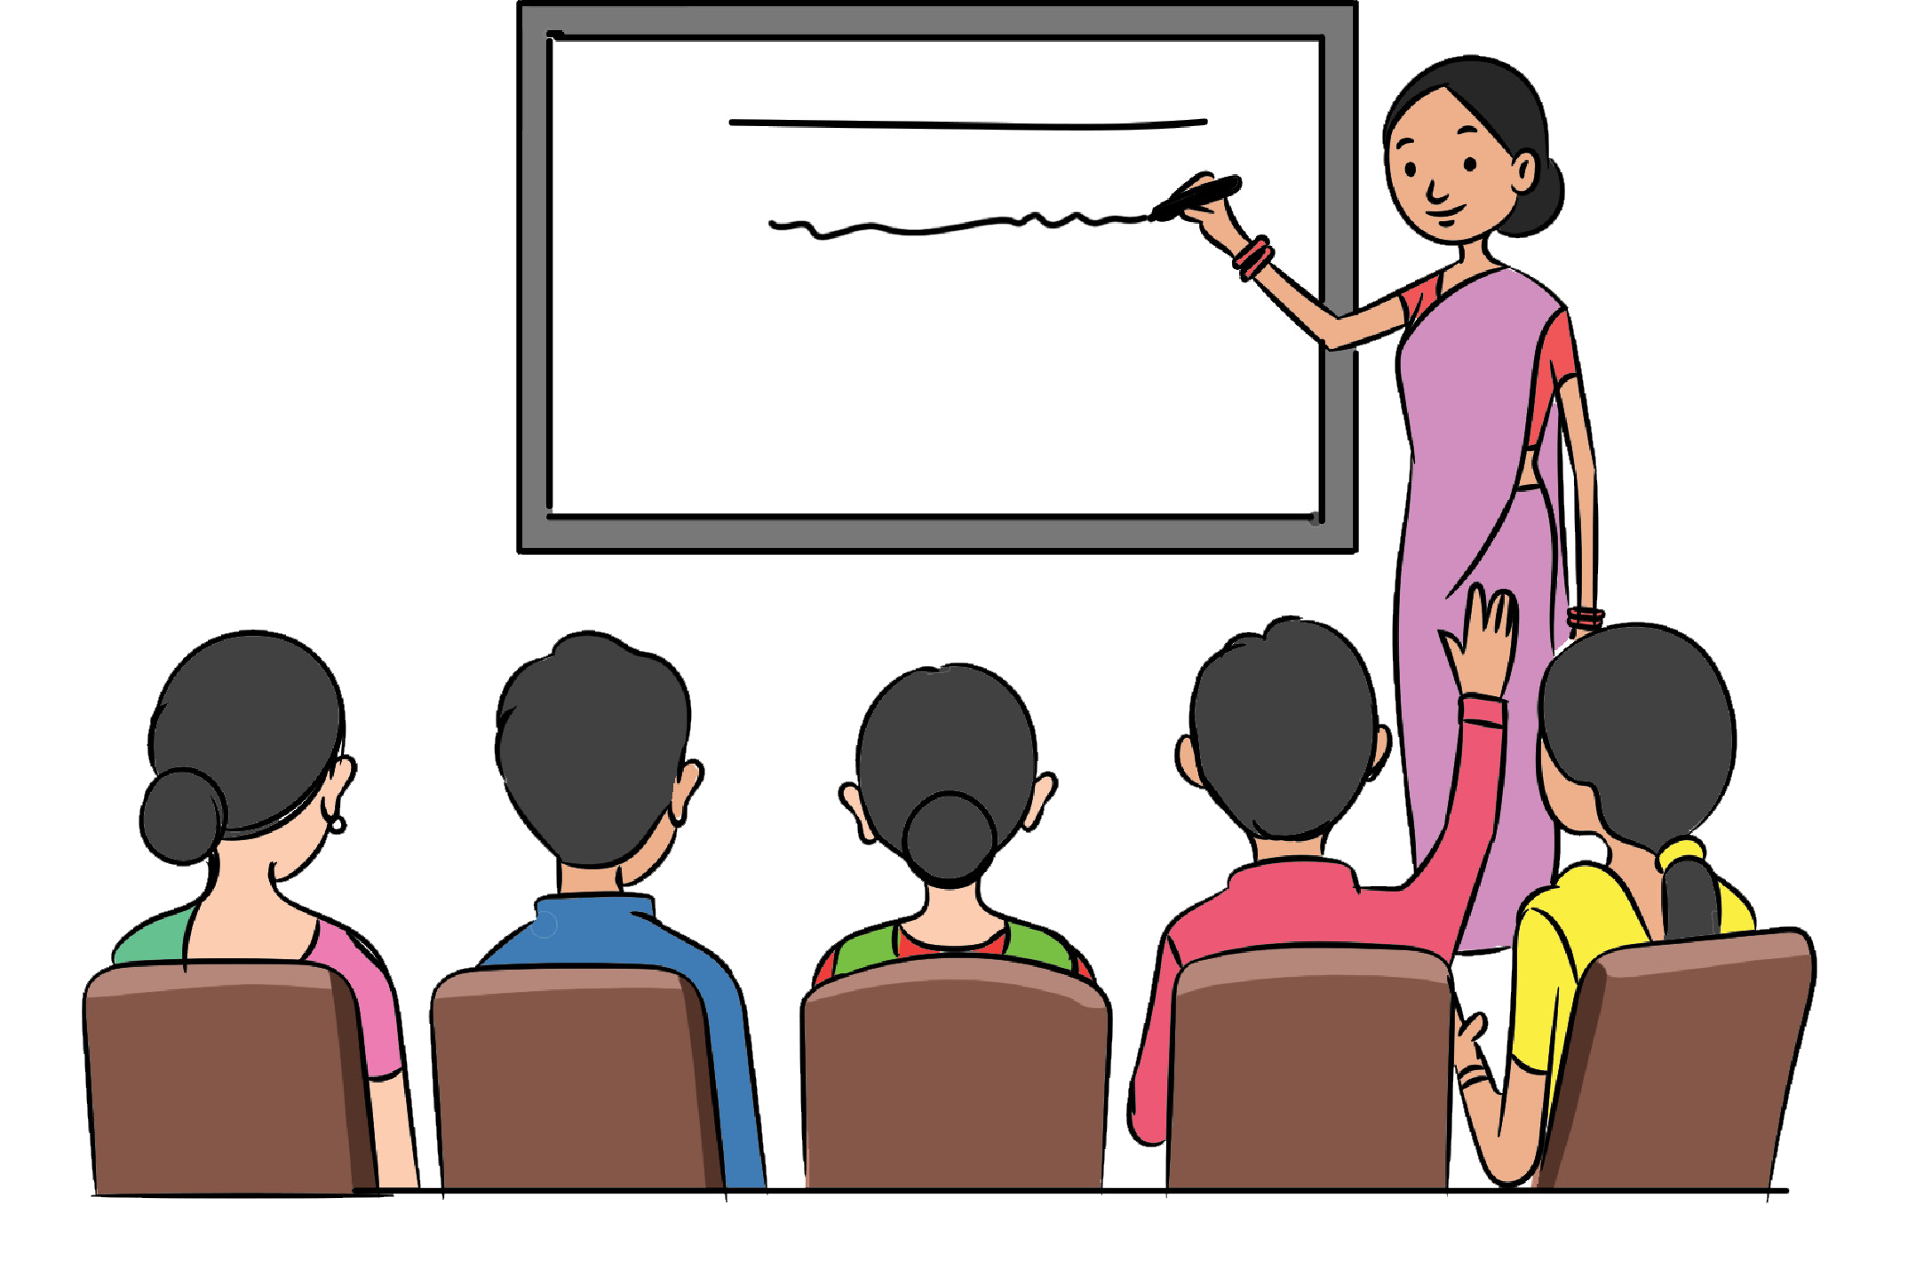
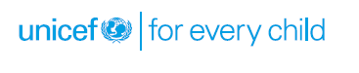
Facilitator’s Guide

Slide 2
Creating positive learning and environment (Role of facilitator)
Continuously kept encouraging the participants to try new options
Kept the participants interested in the exercise
Did not give answers or show them how to divide the square
Helped the creating an interesting and interaction environment
Used even those who were giving up to continue trying

Slide 3
How do adult learn
They understand why something is important to know or do.
They have the freedom to learn in their own way.
Learning is experiential.
The time is right for them to learn.
The process is positive and encouraging.

Slide 4
Learn Styles
Visual leaners rely on pictures. They love graphs, diagrams and illustrations. “Show me” is their motto. They often sit in the front of the classroom to avoid visual obstruction and to watch the facilitator. They want to know what the subject looks like. You can best communicate with them by providing handouts, writing on the board and using phrases like ‘do you see how it works’.

Slide 5
Learn Styles
Auditory learners listen carefully to all sounds associated with the learning. ‘Tell me” is their motto. They will pay close attention to the sound of your voice and all of the subtle messages and they will actively participate in the discussions. You can best communicate with them by speaking clearly, asking questions and using phrases like ‘How does that sound to you?’

Slide 6
Learn Styles
Kinesthetic learners need to physically do something to understand it. Their motto is “Let me do it”. They want to actually touch what they are leaning. They are the ones who will get up and help you with role plays. You can best communicate with them by involving volunteers, allowing them to practice what they are leaning and using phrases like “How do you feel about that”.

Slide 7


Slide 8
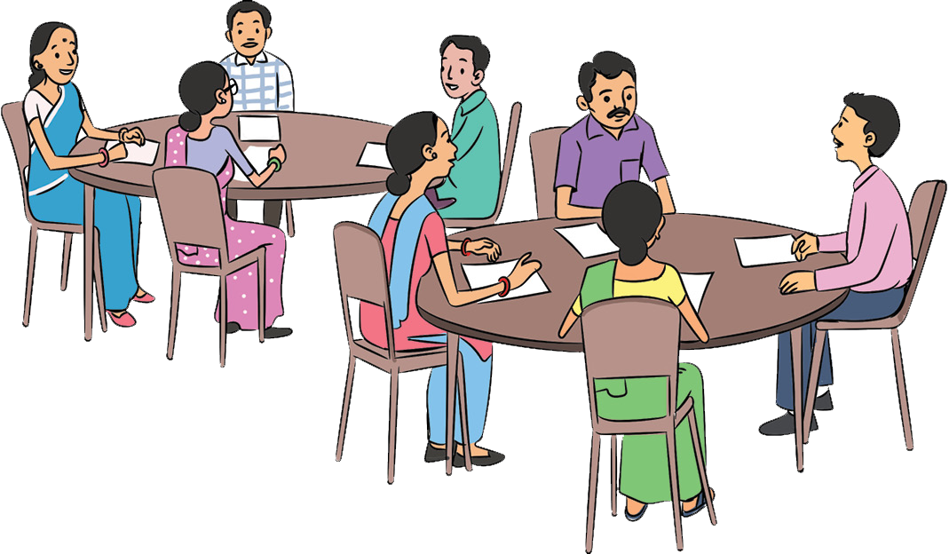
Skills for effective communication
ACTIVITY 2: Giving Examples
Example should be based on the situation and relevant. While giving examples, following points should be kept in mind:
Example should be correct
It should be easy to understand
It should be in local context
It should be related to the topic of discussion
While giving example, one must ensure privacy of the person being cited

Slide 9
Giving Example
Case study 1
“In Nigera, the observation homes have stringent rules. Any child who breaks the rules of the observation home is reprimanded where as children maintaining discipline are encouraged. Therefore, it will be nice if you all also maintain discipline of this observation home. The CWC member also shared that a child was facilitated for being proactive in community service.

Slide 10
Giving Example
Case Study 2
Harsh had been to observation home for about two weeks when this function on Republic day was held. He had been brought to observation home while trying to save his sister from molestation and the molester had got killed. He was finding it difficult to adjust to the environment of the observation home and had been aggressive with other children who had been branding him as a murderer. He even got into scuffle with few of the children there. The CWC members gave example of Harsh to others as to how he had not been adjusting with fellow children and that how all children should behave well and live cordially.

Slide 11
Asking Questions
Exercise: Identify the type of question from the list given below.
1
Do you know that it is important to follow rules of the observation home?
2
Are you getting along with other inmates?
3
What are the challenges that you are facing here?
4
What activities are you undertaking as part of community service?
5
Do you participate in community service?
6
How do you spend your time here?

Slide 12
Asking Questions
1
While asking questions, is it alright to use such words which people cannot understand?
2
Is it OK to ask too many questions in one go?
3
Is it alright to wait for the answer after asking the question?
4
If a particular question has not been understood, should it be repeated in same manner or should it be asked differently?

Slide 13
Listening
Listening is an important skill for effective communication
In order to make people open up and have proper communication, encourage people to give their opinions and ask questions.
It is important to give relevant and contextual examples
Messages should be simple and short. In-between long conversations, summarizing helps to understand the message better.
Communication is not only giving information, but it is also motivating people, praising them, making emotional connects, asking right questions.

Slide 14
Summery
Give due respect to the person
Give correct and complete information
Be sensitive to people’s need, timings and convenience
Maintain confidentiality
Remain positive. Accept people, as they are. Do not try to point out their shortcomings
Do not form opinions or be judgmental
Remain calm and maintain balanced attitude
Maintain relationships
It is important to give correct and complete information at the right time. Incase information is not known, accept the fact that you need to update yourself
Encourage people to ask questions and to make their point of view

