Slide 1

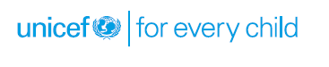
Child Care Institutions under JJ Act

Slide 2
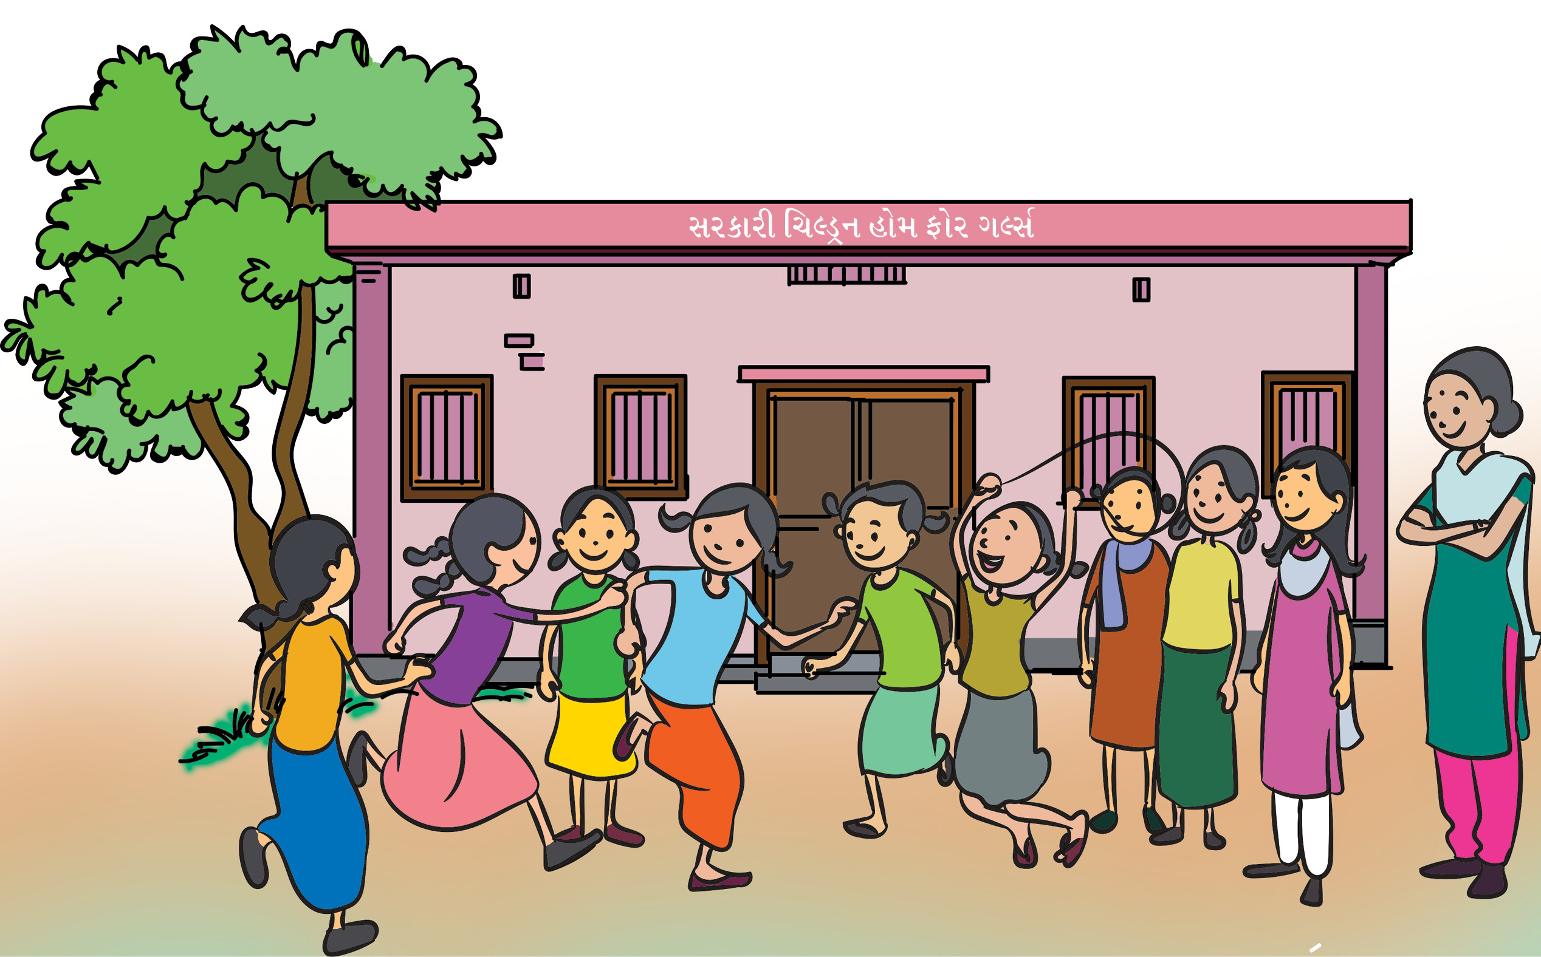
Child Care Institutions under JJ Act
The Juvenile Justice Act provides for the setting up of institutional care structures for the children. The institutions are separate for children in need of care and protection (CNCP) and children in conflict with law (CCL).

Slide 3
{kuzTÞw÷™k nuŒw
What is a child care institution
Types of child care institutions under the Juvenile Justice Act,2015 (JJ Act)
At the end of the section, participants will be able to describe:
Characteristics of various child care institutions
Functioning and process of various child care institutions
Managing and monitoring procedures of child care institutions
Specific roles and responsibilities of officials and staff of various child care institutions

Slide 4
What is ‘child care institution’?
Definition
“Child care institution” means children home, open shelter, observation home, special home, place of safety, Specialised Adoption Agency and a fit facility recognised under this Act for providing care and protection to children, who are in need of such services.” (Section 2 (21), JJ Act 2015)
“Person-in-charge” means a person appointed for the control and management of the Child Care
Institution”

Slide 5
Group Work
Divide the participants in three groups. Assign each group to jot down the specific responsibilities of one of the officials given below and present it to others.
Superintendent of the institution
Probation officer
Child Welfare officer

Slide 6
After the presentation from the groups, discuss with them further from the points given below
Superintendent
The primary responsibly of the Superintendent /Officer in charge is to maintain the functioning of the home.
Ensure compliance with the orders of the Board.
Ensure all legal compliances are met; a nurturing environment is created, where every child's basic needs are catered to and each is given opportunities to develop and be heard
Ensure all arrangements for water storage, power plant, emergency electrical power back up are in place; and handling of equipment is done with care.
Prepare the budget and maintain control over financial matters on monthly basis, and submit to proper authority.

Slide 7
After the presentation from the groups, discuss with them further from the points given below
Probation officer
“Probation officer” means an officer appointed by the State Government as a probation officer under the Probation of Offenders Act, 1958 or the Legal-cum-Probation Officer appointed by the State Government under District Child Protection Unit; [Section 2 (48), JJ Act, 2015]
To conduct social investigation within 15 day from the date of first production on directions of JJB.
To do follow up of Child as per individual care plan
Preparation of ‘Individual Care Plan’ based on child’s necessity with the help of people such as superintendent of Children’s home, Probation Officer, Doctor who examines the child, Family of the child etc.
To evaluate the progress of child in ‘Place of Safety and ensure that there is no ill treatment to child in the CCI.
Following up to evaluate if child kept in place of safety’ has undergone reformative changes (and if the child can be a contributing member of the society) on attaining the age of 21 years and is yet to complete the term of stay.

Slide 8
After the presentation from the groups, discuss with them further from the points given below
Child Welfare Officer
“Child Welfare Officer” means an officer attached to a Children’s Home, for carrying out the directions given by the Committee or the Board.” [Section 2 (17), JJ Act 2015]
CWO will conduct social investigation and must provide an assessment of the family situation of the child in detail, and explain in writing whether it will be in the best interest of the child to restore him to his family.
The Child Welfare Officer discharges the duties of a Probation Officer when one is not available.
The Child Welfare Officer is responsible for acting as a bridge between the children housed in an institution and the JJB, the staff of the institution as well as other external stakeholders.
He or she contributes to the design and implementation of activities and programmes aimed at rehabilitation and social re-integration of the Child in Conflict with Law.

Slide 9
Exercise
Divide the participants in four groups and give them a case study each. Ask the groups to discuss and list out the process of rehabilitation of children discussed in respective case studies.

Slide 10
Case Study 1
Banku is a 14 year old boy, who was a school dropout. He has very little supervision from his mother as she spends a lot of time in the small market where she sells firewood. He was reported to the police by his mother after repeatedly stealing small amounts of money from her.

Slide 11
Case Study 2
A 15 year old boy was arrested on charge of theft for the third time. Although his parents were informed of his arrest they refused to visit him. He was held for 8 days in prison separated from adults before being transferred to the juvenile centre.

Slide 12
Case Study 3
When social workers of a well-known city were doing a survey near a railway station they came across a small girl Sonal begging. She was staying in hutments with other 6 family members. Her mother used to take her for begging because mother felt that people give more money when they see a small girl. They used to move from one platform to another. She was noticed by a social worker.

Slide 13
Case Study 4
Shyam was staying with his uncle as he lost his parents when he was very young .His uncle used to send him for grazing his goats in forest. When he used to see children going to a school, he would recall how he used to study in village school when his parents were alive. One day he met a member from NGO who had visited their village to carry out survey on child labour.
Note for facilitator: Divide the participants into two groups and ask them to discuss whether institutional care provided to children is the last resort for providing support to children? Ask them to note their responses and reasons for the same. Give them 10 minutes to come up with their responses. Add the missing points and elaborate as below:

Slide 14
Why – Institutional care should be the last alternative
It is universally accepted that even the best institution cannot substitute for the nurturing care that a family can give to a child. However, there are some children for whom that may be the only option. So, it is important to improve the quality of child care in institutions, develop small “Group Homes” and simultaneously develop family based alternative services. Studies and experiences have shown that a child who has been deprived of family care and brought up in a large impersonal institution may show some of the following problems.

Slide 15

Why – Institutional Care as a last alternative
EMOTIONAL
DEPRIVATION
SEPARATION
ANXIETY
INTER PERSONAL
RELATIONSHIP
PROBLEMS
MATERNAL
DEPRIVATION
LOW SELF-ESTEEM
DEVELOPMENT
DELAYS
SEGREGATION &
ISOLATION
FROM SOCIETY
ANONYMITY & LACK OF PERSONAL
ATTENTION
FAILURE TO
TRUST
EXCESSIVE
ROUTINISATION
AND
REGIMENTATION
SOME OF
THE NEGATIVE
IMPACTS OF
LONG TERM
INSTITUTIONALISATION
OF THE CHILD
DIFFICULTY IN
MAINSTREAMING & ADJUSTING
IN SOCIETY
PHYSICAL ABUSE
& TRAUMA
Notes:
Illustration to be changed as done in Module page 23 CCI Module

