Slide 1


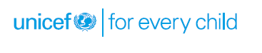
Child Welfare Committee

Slide 2


Objectives
At the end of the section, participants will be able to
Define:
what is Child Welfare Committee
the structure and composition of CWC
the powers and functions of CWC
the procedure in relation to Children in Need of Care and Protection (CNCP)
This slide is not taken in the guj ppt.

Slide 3


Section I
Definition
Time: 45 Min
A Child Welfare Committee is a body notified and constituted under section 27 of the JJ Act,2015 for every district for exercising the powers and to discharge the duties conferred on such Committees in relation to children in need of care and protection under this Act.

Slide 4
Structure and Composition
(Section 27, JJ Act, 2015)
The State Government shall notify one or more Child Welfare Committees for each district, as required.
The Committee shall consist of a Chairperson and four other members as the State Government may think fit to appoint, of whom at least one shall be a woman and another, an expert on the matters concerning children.
For its effective functioning, the Committee shall be provided a Secretary and other staff for secretarial support by the District Child Protection Unit.

Slide 5
Structure and Composition
(Section 27, JJ Act, 2015)
A member of the Committee shall be a person who has been actively involved in health, education or welfare activities pertaining to children for at least seven years or is a practicing professional with a degree in child psychology or psychiatry or law or social work or sociology or human development.
A member shall be appointed for a period of not more than three years. A member can be terminated after an inquiry by the State Government for reasons as prescribed in Sec 27 (7) of the JJ Act,2015.

Slide 6

Structure and Composition
(Section 27, JJ Act, 2015)
The Committee shall function as a Bench and shall have the powers conferred by the Code of Criminal Procedure, 1973 on a Metropolitan Magistrate or, as the case may be, a Judicial Magistrate of First Class.
The District Magistrate shall conduct a quarterly review of the functioning of the Committee.
The District Magistrate shall be the grievance redressal authority for the CWC.

Slide 7
Procedure in relation to the Committee
(Section 28, JJ Act, 2015)
In the event of any difference of opinion among the members of the Committee at the time of taking any decision, the opinion of the majority shall prevail but where there is no such majority, the opinion of the Chairperson shall prevail.
The Committee may act, notwithstanding the absence of any member of the Committee, and no order made by the Committee shall be invalid by reason only of the absence of any member during any stage of the proceeding. Provided that there shall be at least three members present at the time of final disposal of the case.

Slide 8

Group Work
Divide the participants in four groups. Give them a situation of a CNCP and ask them to describe the procedure followed for that CNCP. The situations are given below:

Slide 9
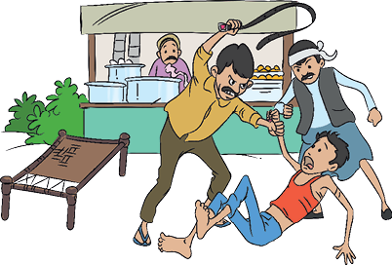
Group Work
Akhilesh is a 13 year old boy who works in a dhaba. He has to work for 12 to 14 hours a day. He is often belted, beaten, hit and kicked brutally and is subjected to the worst kind of physical abuse by his employer. He is often denied food also. In a police raid, he was rescued in a joint raid by police and support from an NGO working against child labour.

Slide 10

Group Work
A new born baby was found wrapped in a newspaper in a dustbin near a hospital. The hospital staff informed the police and the infant was brought before the CWC.
Manju is a 14 year old girl. She was brought to the city from her village by her ‘uncle’ with a promise of a lucrative job.

Slide 11
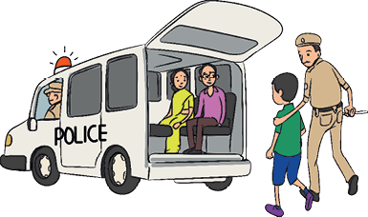
Group Work
Girish is a 15 year old boy. He has been living on a footpath after death of his parents. He lives with a gang of people who drink alcohol, sniff glue and smoke drugs. He was rounded up one day by the police and brought before the CWC.

Slide 12
Procedure in Relation to Children in Need of Care and Protection
The JJ Act prescribes the process for CWC to deal with children in need for care and protection.
Production before the Committee (Section 31, JJ Act, 2015)
Any child in need of care and protection may be produced before the Committee by the following individuals –
Any police officer or special juvenile police unit or a designated Child Welfare Police Officer or any officer of District Child Protection Unit or inspector appointed under any labour law for the time being in force.
Any public servant.

Slide 13
Procedure in Relation to Children in Need of Care and Protection
Childline Services or any voluntary or non-governmental organisation or any agency as may be recognised by the State Government.
Child Welfare Officer or probation officer.
Any social worker or a public spirited citizen.
By the child himself; or
Any nurse, doctor or management of a nursing home, hospital or maternity home.

Slide 14
What inquiry should be done on production of a child on receipt of a report?
Inquiry (Section 36, JJ Act, 2015)
On production of a child or receipt of a report, the Committee shall hold an inquiry on its own or on the receipt of the report and may pass an order to send the child to the children’s home or a fit facility or fit person, and for speedy social investigation by a social worker or Child Welfare Officer or Child Welfare Police Officer.
All children below six years of age, who are orphan, surrendered or appear to be abandoned shall be placed in a Specialised Adoption Agency, where available.

Slide 15
What is the procedure for determination of age of a person brought before the CWC?
Presumption and determination of age (Section 94, JJ Act, 2015)
Where, it is obvious to the Committee, based on the appearance of the person brought before it under any of the provisions of this Act (other than for the purpose of giving evidence) that the said person is a child, the Committee shall record such observation stating the age of the child as nearly as may be and proceed with the inquiry (for C.C.L. sec 14, for N.C.N.C.P sec 36) , without waiting for further confirmation of the age.
In case, the Committee has reasonable grounds for doubt regarding whether the person brought before it is a child or not, the Committee, as the case may be, shall undertake the process of age determination, by seeking evidence by obtaining

Slide 16
What is the procedure for determination of age of a person brought before the CWC?
The date of birth certificate from the school, or the matriculation or equivalent certificate from the concerned examination Board
The birth certificate given by a corporation or a municipal authority or a panchayat;
only in the absence of (i) and (ii) above, age shall be determined by an ossification test or any other latest medical age determination test conducted on the orders of the Committee

Slide 17
Other Functions of the Committee
Any child care institution registered under this section shall be duty bound to admit children, subject to the capacity of the institution, as directed by the Committee, whether they are receiving grants from the Central Government or, as the case may be, the State Government or not.
The open shelters shall send information every month, in the manner as may be prescribed, regarding children availing the services of the shelter, to the Committee and the District Child Protection Unit.

