Slide 1
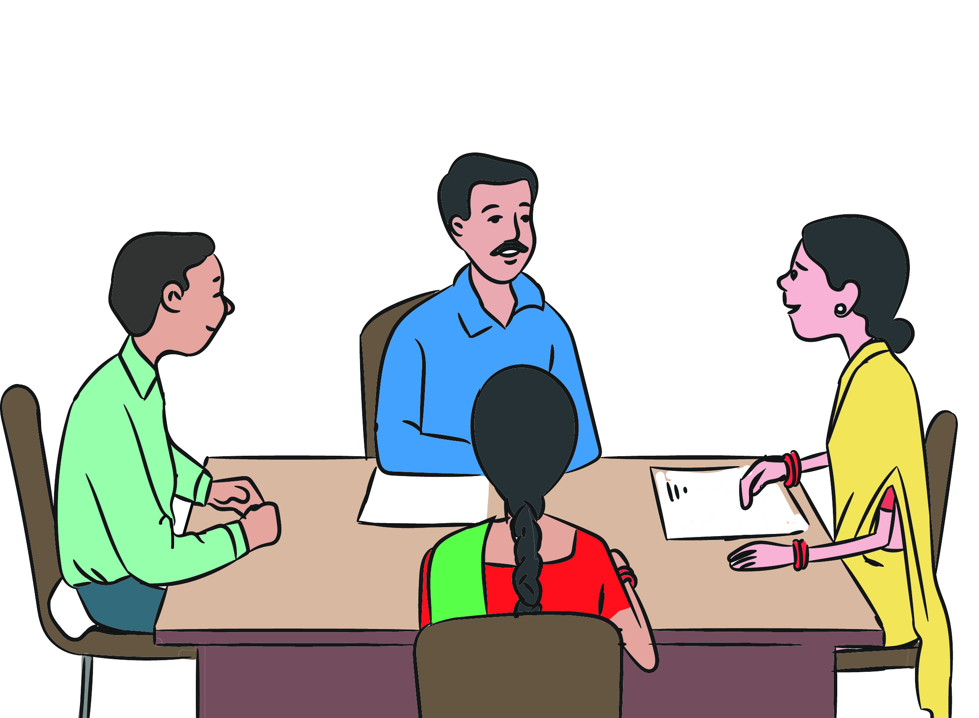
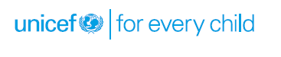
Juvenile Justice Board

Slide 2

Definition
Juvenile Justice Board is a competent authority set up under Section 4 of the Juvenile Justice Act, for exercising the powers and discharging its functions relating to children in conflict with law under this Act.

Slide 3

Other Important Responsibilities
Conducting inquiry for declaring fit persons regarding care of CCL.
Conducting at least one inspection visit every month of residential facilities for CCL and recommend action for improving the quality of services
Order the police for registration of first information report for offences committed against any CCL
Conducting regular inspection of jails meant for adults to check if any child is lodged in such jails and take immediate measures for transfer of such a child to the observation home.
Board shall make an order to destroy relevant record of conviction after the expiry of relevant period.

Slide 4
Changes Brought about in JJ Act 2015 for Dealing with Children in Conflict with Law
Different procedures for different categories of CCL- Based on age and nature of offence [Section 6, 14, 15, 18, 19 and 20]
Transfer of cases involving CCL from Board to Children’s Court [Section 18(3)]
Retrospective Effect w.r.t. claim of juvenility: claim of juvenility can be raised before any court and any stage, even after disposal [Section 9 (2)]
Any other court to forward cases of CCL brought before it to JJB for further inquiry and disposal [Section 9(1)]
Cases of CCL disposed by any court other than JJB to be forwarded to JJB for appropriate orders/sentence [Section 9(3)]
Pending proceedings before a Board/Court to continue as per the old law [Section 25]

Slide 5


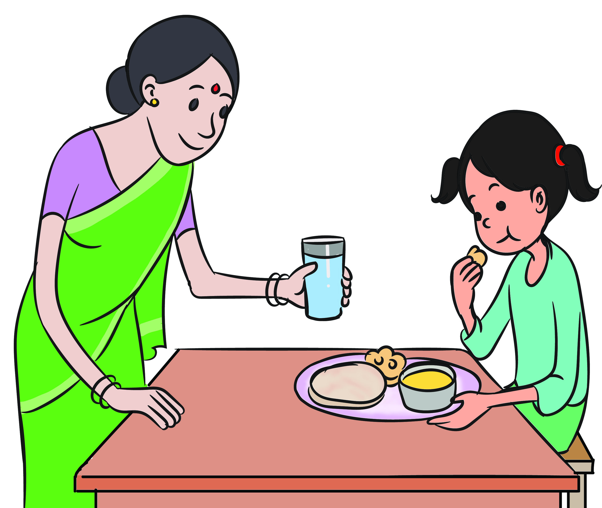
Procedure at Police Station
DOs (Section 10 & Rule 8)
Child to be taken to Child Friendly Corner/room.
Child should be produced before JJB within 24 hours.
CWPO should be in plain clothes and not in uniform.
Use of any coercion or force on the child is prohibited.
Inform the child promptly and directly of the charges levelled against him through his parent or guardian.

Slide 6
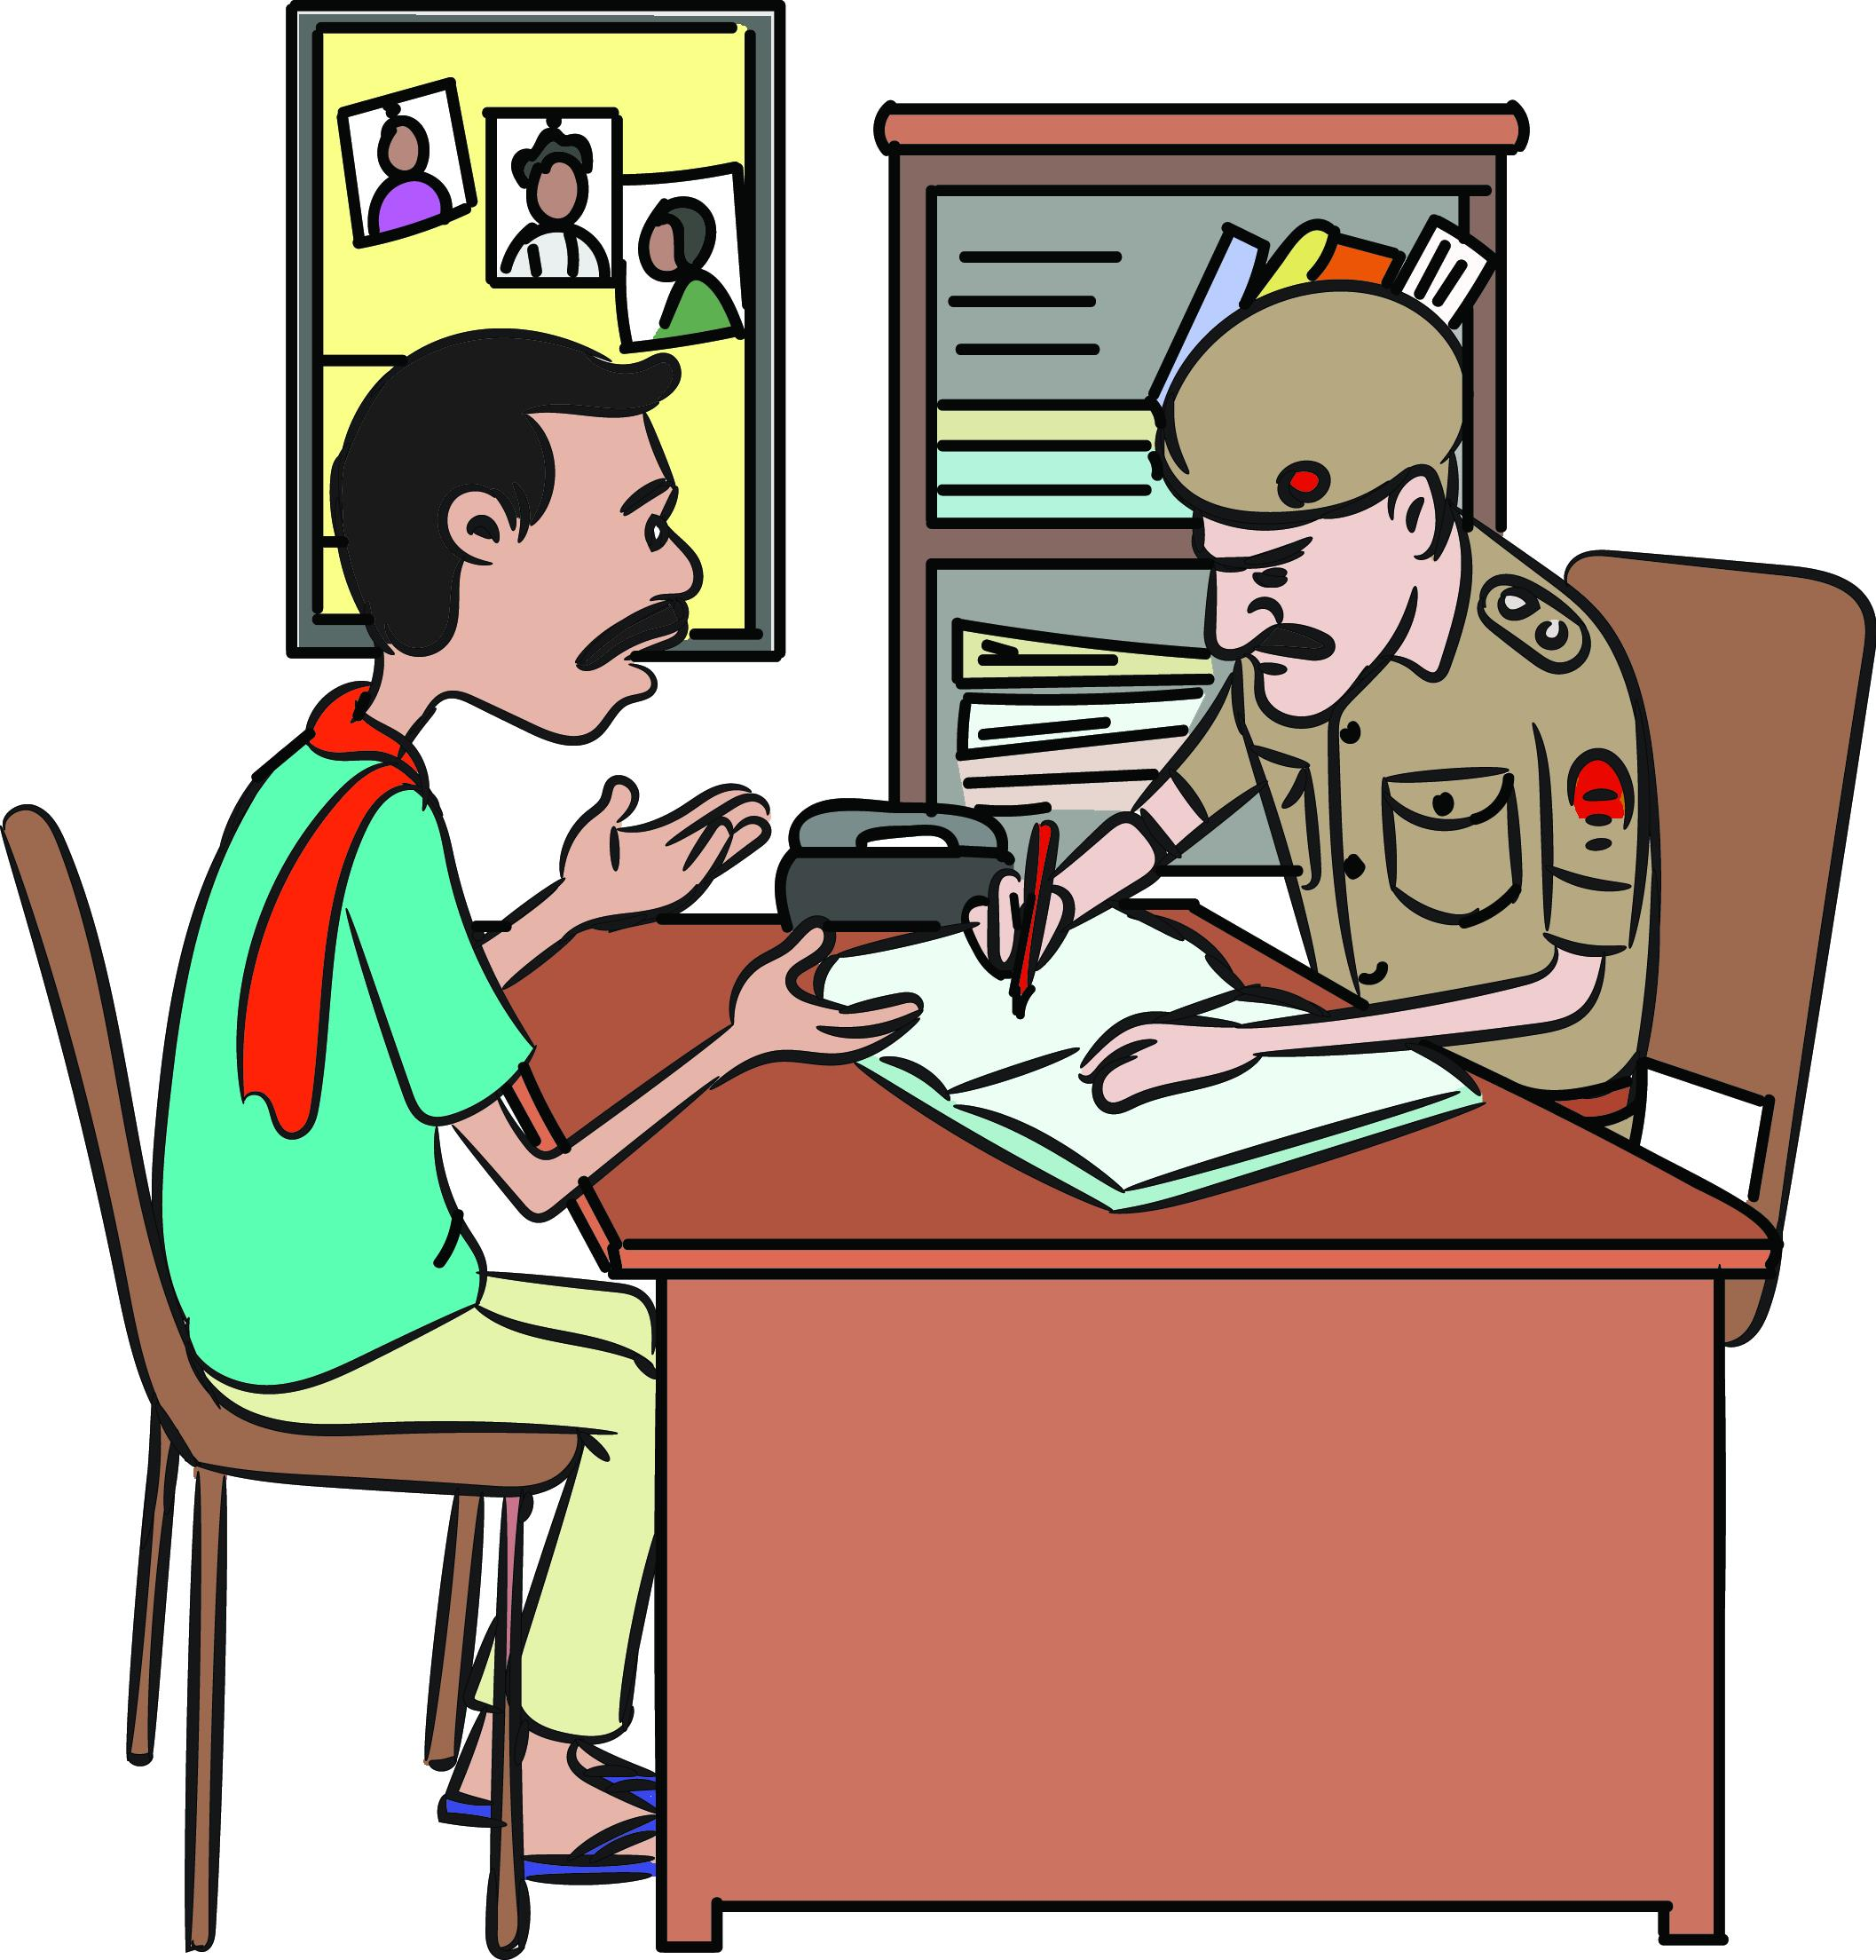
Procedure at Police Station
DOs (Section 10 & Rule 8)
Copy of FIR should be provided to child or copy of the police report should be given to the parent or guardian.
Provide appropriate medical assistance, assistance of interpreter or a special educator, or any other assistance which the child may require.
Inform the District Legal Services Authority (DLSA) for providing free legal aid to the child.

Slide 7
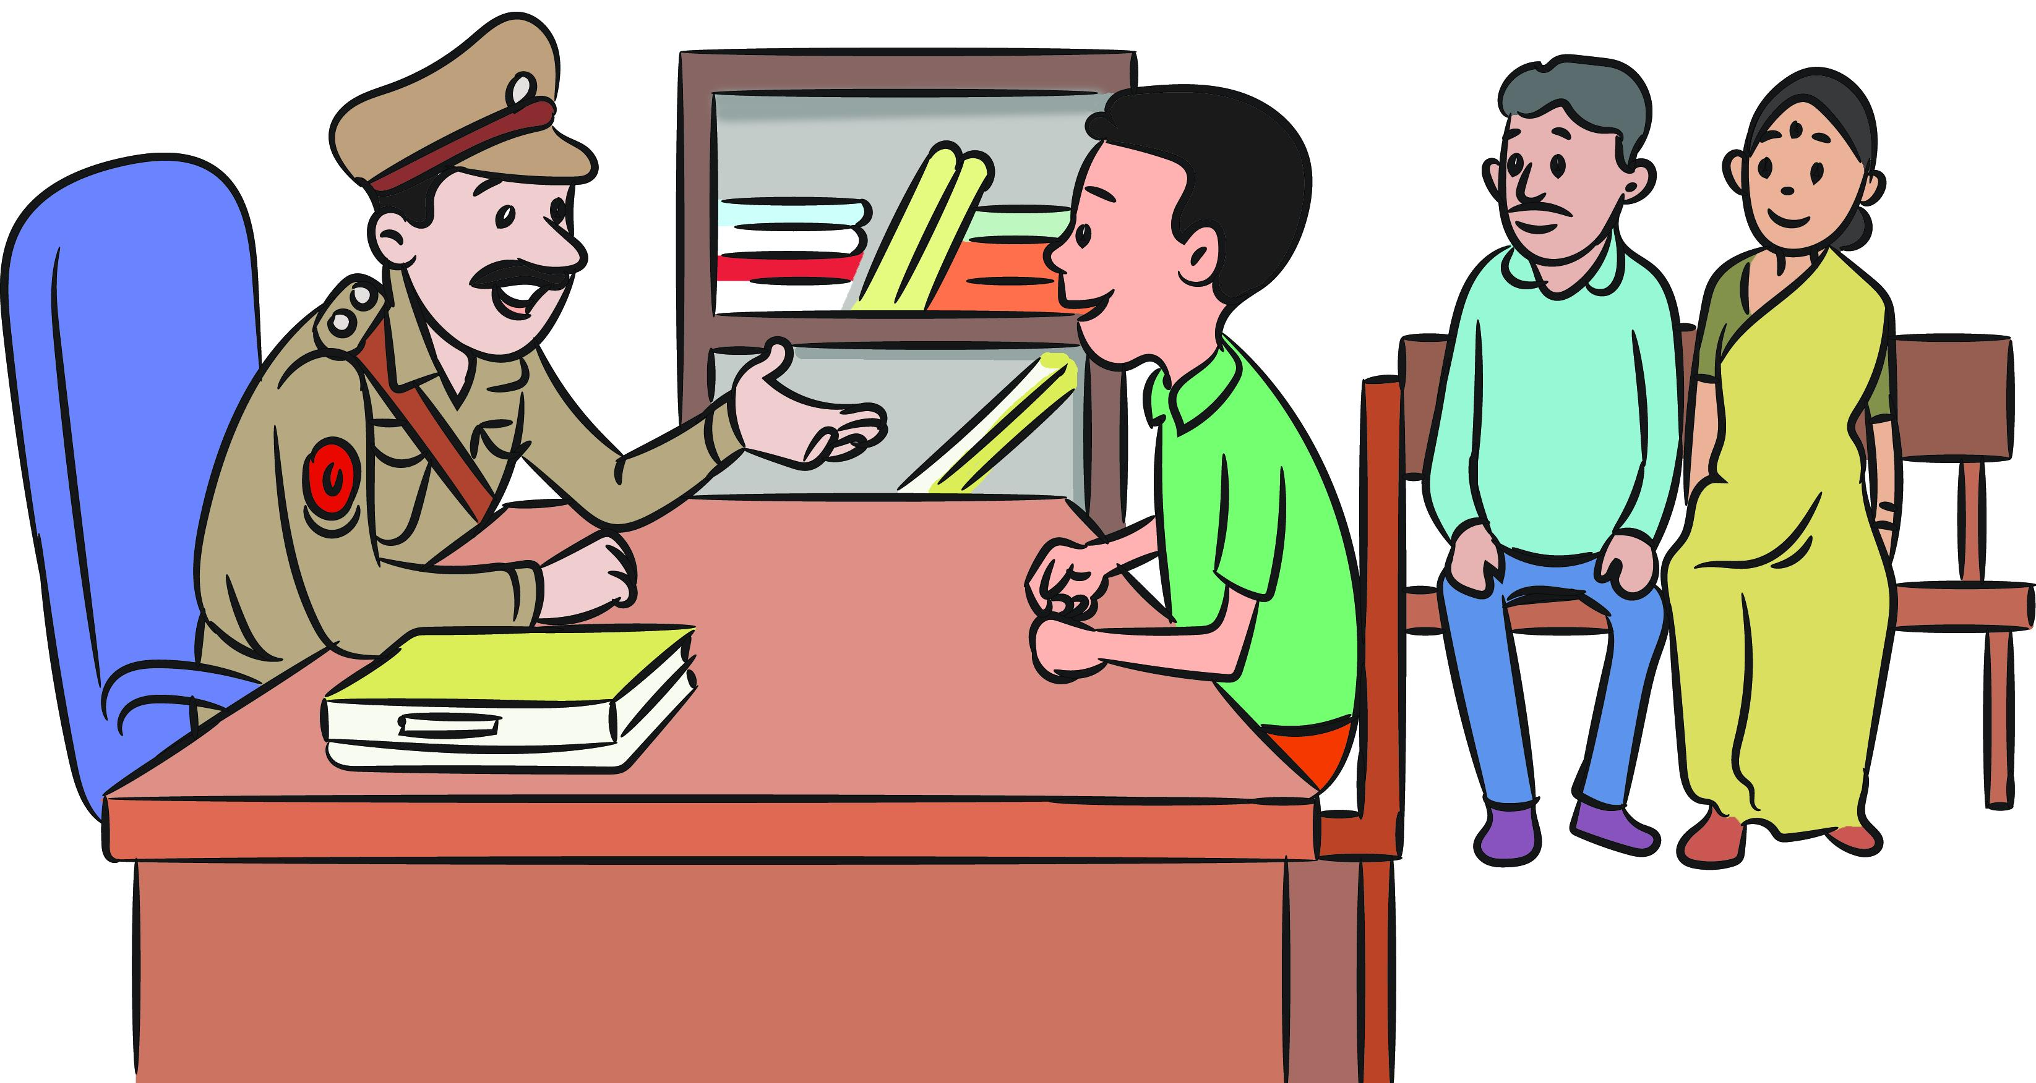


Procedure at Police Station
Don’t (Section 10 & Rule 8)
No FIR is to be registered against a CCL except in a Heinous offence or offence committed jointly with adult.
Child should not to be kept in Police Station or lock up or an adult jail.
Child will not be hand cuffed/chained/fettered.
Child shall not be asked to sign any statement.
Child shall not be compelled to accept his guilt.
No joint proceedings of child in conflict with law along with a person who is not a child (Section 23)

Slide 8
Procedure for Juvenile Justice Board
Types of Trial
(Sections 14 & 15)
Petty offence: Summary Trial
Serious offence: Trial as in Summons Case.
Heinous offence: Trial as in Summons Case.
JJB while passing the orders shall
(Section 18)
Obtain social investigation report (SIR) from Probation officer or CWO.
Include an individual care plan prepared by Probation Officer or CWO.

Slide 9
Procedure for Juvenile Justice Board
Types of orders by JJB (Section 18)
to go home after advice or admonition;
participate in group counselling or similar activities;
perform community service;
child or parents or the guardian to pay a fine;
be released on probation of good conduct and placed under the care of parent/ guardian / Fit Person/ Fit Facility/ Fit Person executing a bond with or without surety for the good behaviour and child’s well-being for any period not exceeding 3 years;
be released on probation of good conduct and placed under the care and supervision of any Fit Facility for ensuring the good behaviour and child’s well-being for any period not exceeding 3 years;

Slide 10
Procedure for Juvenile Justice Board
Types of orders by JJB (Section 18)
be sent to a Special Home, for such period, not exceeding 3 years, for providing reformative services including education, skill development, counselling behaviour modification therapy, and psychiatric support during the period of stay in the Special Home.

Slide 11
Procedure for Juvenile Justice Board
Attend school
Attend a vocational training centre
Attend a therapeutic centre
Prohibit the child from visiting, frequenting or appearing at a specified place
Undergo a de-addiction programme
In addition to above, JJB may also pass orders to

Slide 12
What are the Procedures in Relation to Children in Conflict with Law?
Activity: Group Work through Situational Analysis
The three groups formed earlier will be allotted one case story each and the participants need to write down the procedures to be followed in relation to children in conflict with law.

Slide 13

Situation 1
Police apprehended a 16-year old boy Sunil who has stolen money from the shop where he was working.

Slide 14
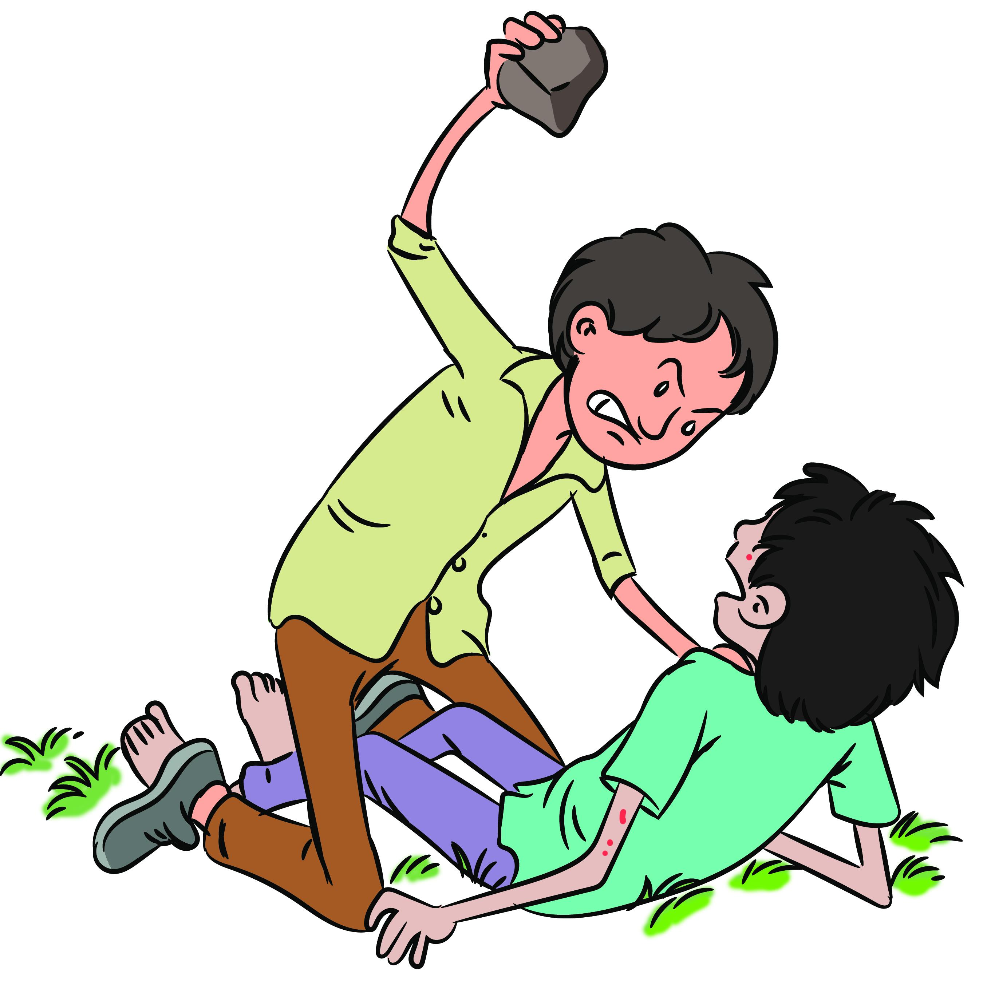
Situation 2
Nagendra is a 15-years old boy who has been alleged for murdering his friend during a quarrel. Police has apprehended him for this offence.

Slide 15

Situation 3
Ranjeet is a 17-year old boy and has been alleged for gang rape and murder.
Ask each of the group to present one by one and discuss with the help of the pointers given below.

Slide 16

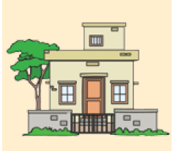
Serious or Heinous Offences
Observation Home

Slide 17
Activity: Group Work
In the previous situational analysis of Sunil, Nagendra and Ranjit, it was proved that they have committed the offence. Now the group will discuss internally and put down what orders can be passed for their cases. Also, the groups will present their observations and points followed by a discussion by the facilitator with the help of the pointers given below.

Slide 18


