Slide 1
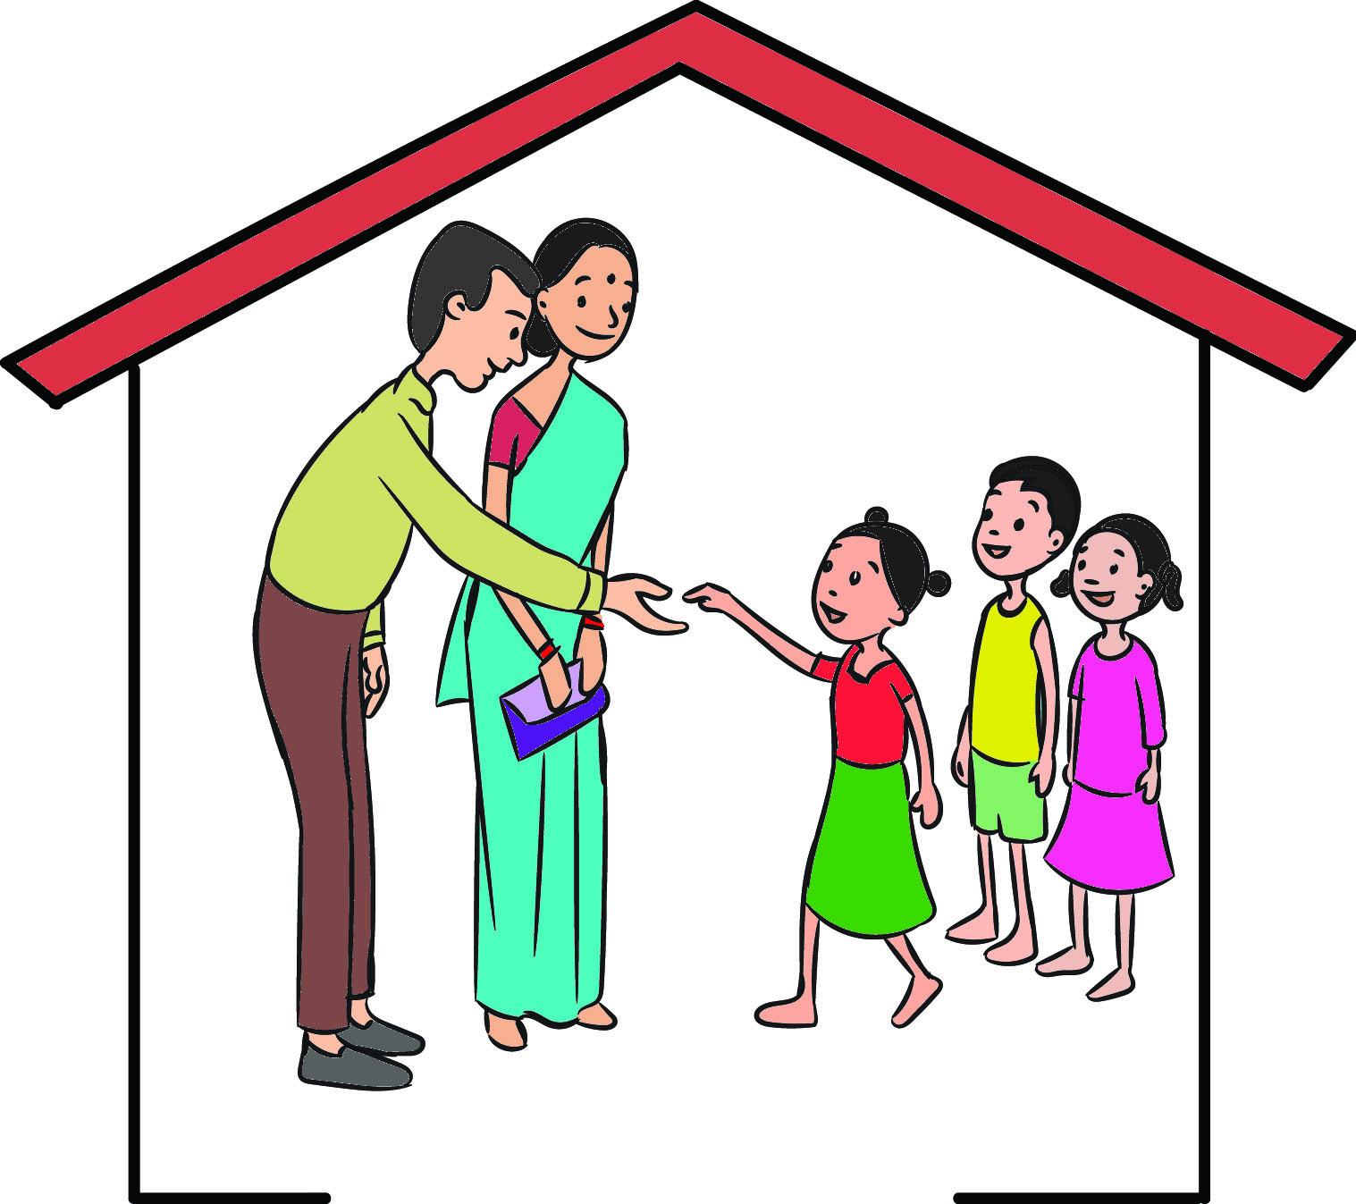
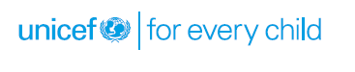
DCPU

Slide 2
Structure and Functionaries
The District Child Protection Officer is the nodal person in the DCPU.
Other key functionaries include the Protection Officer (Institutional Care), Protection Officer (Non-Institutional Care), Legal cum Probation Officer, Social Workers, Counsellors and Outreach Workers.

Slide 3
Group Work-DCPU Roles and Responsibilities
Responsibilities under Juvenile Justice (Care and Protection of Children) Model Rules, 2016
Functions under ICPS
DCPU’s nodal role in non-institutional care for children
Responsibilities under POCSO Rules, 2012
Notes:
The word group is replaced by dcpu in guj. Ppt.

Slide 4
Responsibilities under Juvenile Justice
(Care and Protection of Children) Model Rules, 2016
Conduct review of the child placed in the place of safety every year and forward the report to the Children’s Court
Submit a monthly report to the State Child Protection Society (SCPS).
Notify the State Government about a vacancy in JJB, CWC six months before such a vacancy arises.
Review reports submitted by Inspection Committees and resolve the conflicts.

Slide 5
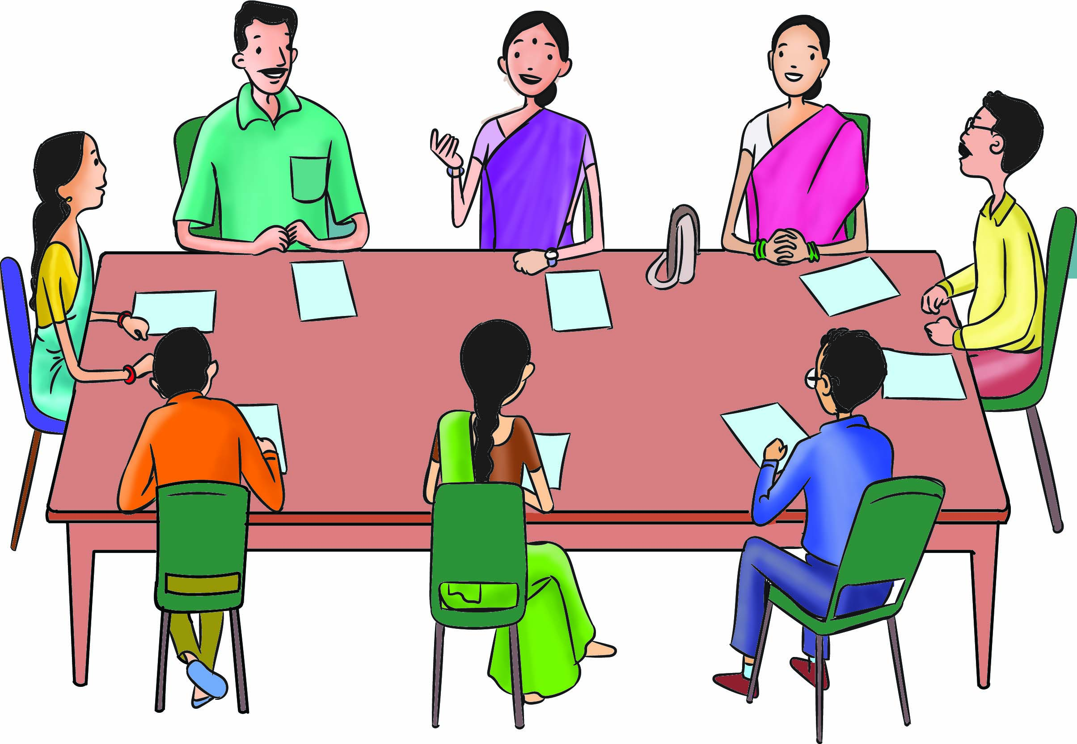
Coordination and Liaising
Ensure inter-departmental coordination and liaise with the relevant departments of the State Government and State Child Protection Society (SCPS) and other DCPUs in the State.

Slide 6
Maintaining Database
Child Care Institutions ( CCIs)
Specialised adoption agencies (SAA)
Open shelter
Registered foster parents
After care organisations and institutions
Fit persons and fit facilities

Slide 7
Maintaining Database
Medical and counselling centres
De-addiction centres
Hospitals
Recreational facilities such as performing arts
Open schools
Education facilities
Apprenticeship and vocational training programmes and centres
CWC
Fine arts and facilities for children with special needs at the district level and forward the same to JJB
Children’s Courts and SCPS training programmes and centres

Slide 8
Maintaining Database
Special educators
Mental health experts
Translators
Counsellors
Psychologists or psycho-social workers
CWC
Children’s Court
Interpreters
SCPS

Slide 9
Monitoring and Supervision
Develop parameters and tools for effective monitoring and supervision of ICPS in the district
Supervise and monitor all institutions/agencies providing residential facilities to children in district

Slide 10
Officials of DCPU
District Child Protection Officer- Chairperson
Protection Officer (Non-Institutional Care)- Member
Chairperson/, Child Welfare Committee- Member
Representative of SAA- Member
Representative of a Voluntary Organisation working in the area of Child Protection Member

Slide 11
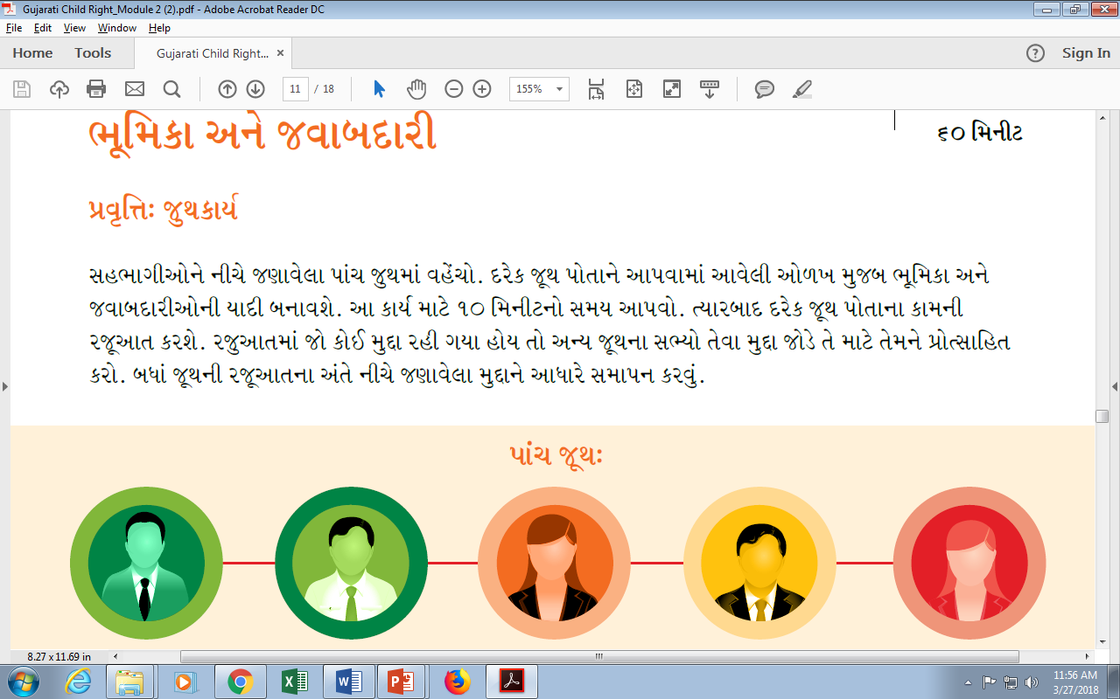
Five Groups
1 DCPO (District Child Protection Officer)
2 Protection officer (Institutional Care)
3 Protection officer (Non Institutional Care)
4 Legal cum probation officer
5 Counselor, Social Worker, Outreach worker

Slide 12
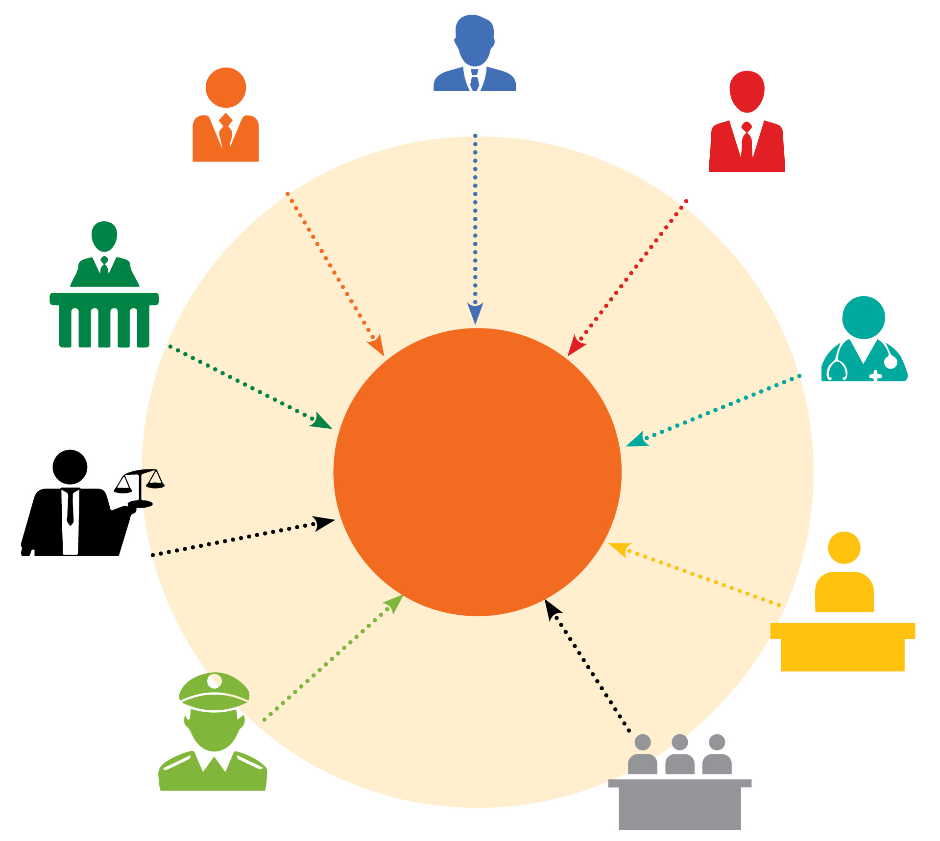
Which departments/officials DCPO needs
to coordinate with and network?
Listen to the responses and summarize as per the table below
Education Officer
District Labour Officer
Child Development Project Officer (CDPO)
District Magistrate
Line departments/officers with which the DCPO coordinates and networks
Chief Medical Officer (CMO)
District Judge
Municipal Authorities
Superintendent of Police
Members of Zila Parishad and other local bodies

Slide 13

Which departments/officials DCPO needs
to coordinate with and network?
Besides, he/she also coordinates with
Other authorities at district level who have direct or indirect impact on child protection programs/
services.
Voluntary Organizations
Child Welfare Committee
Hospitals/
Nursing Homes
Juvenile
Justice Board
ChildLine
Services

Slide 14
Some of the Broader Issues could be
Convergence with other departments mentioned in ICPS scheme at the implementation level
Lack of measures to strengthen family for the holistic development of the child
Need for mainstreaming of ICPS with existing structures and programmes in the states
Training of the associated personnel, both on roles and responsibilities as well as on sensitization in handling the children.
Single window approach not visible
Lack of sufficient prevention mechanism to reduce cases of CNCP and CCL
Lack of innovation in programme

Slide 15
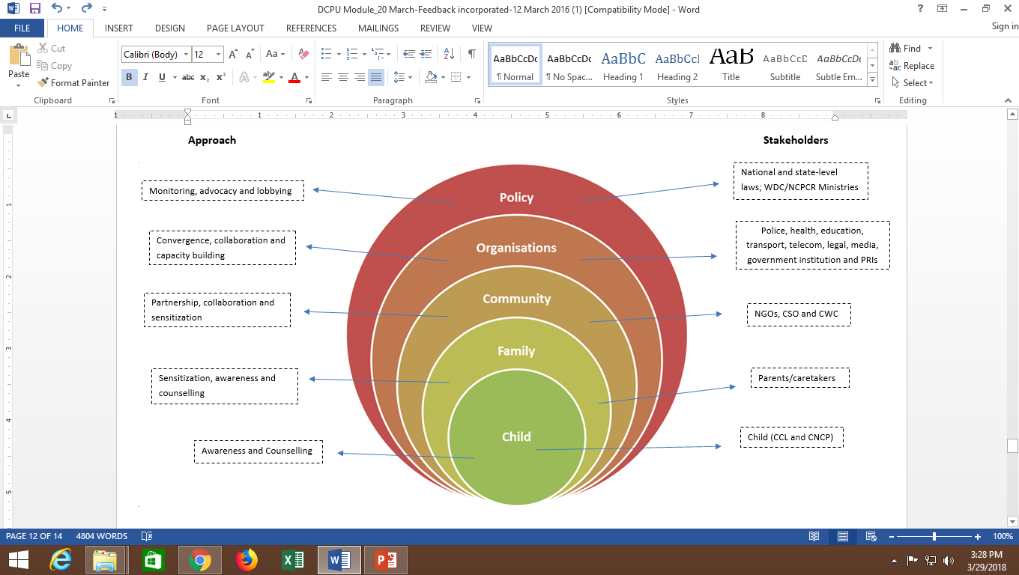
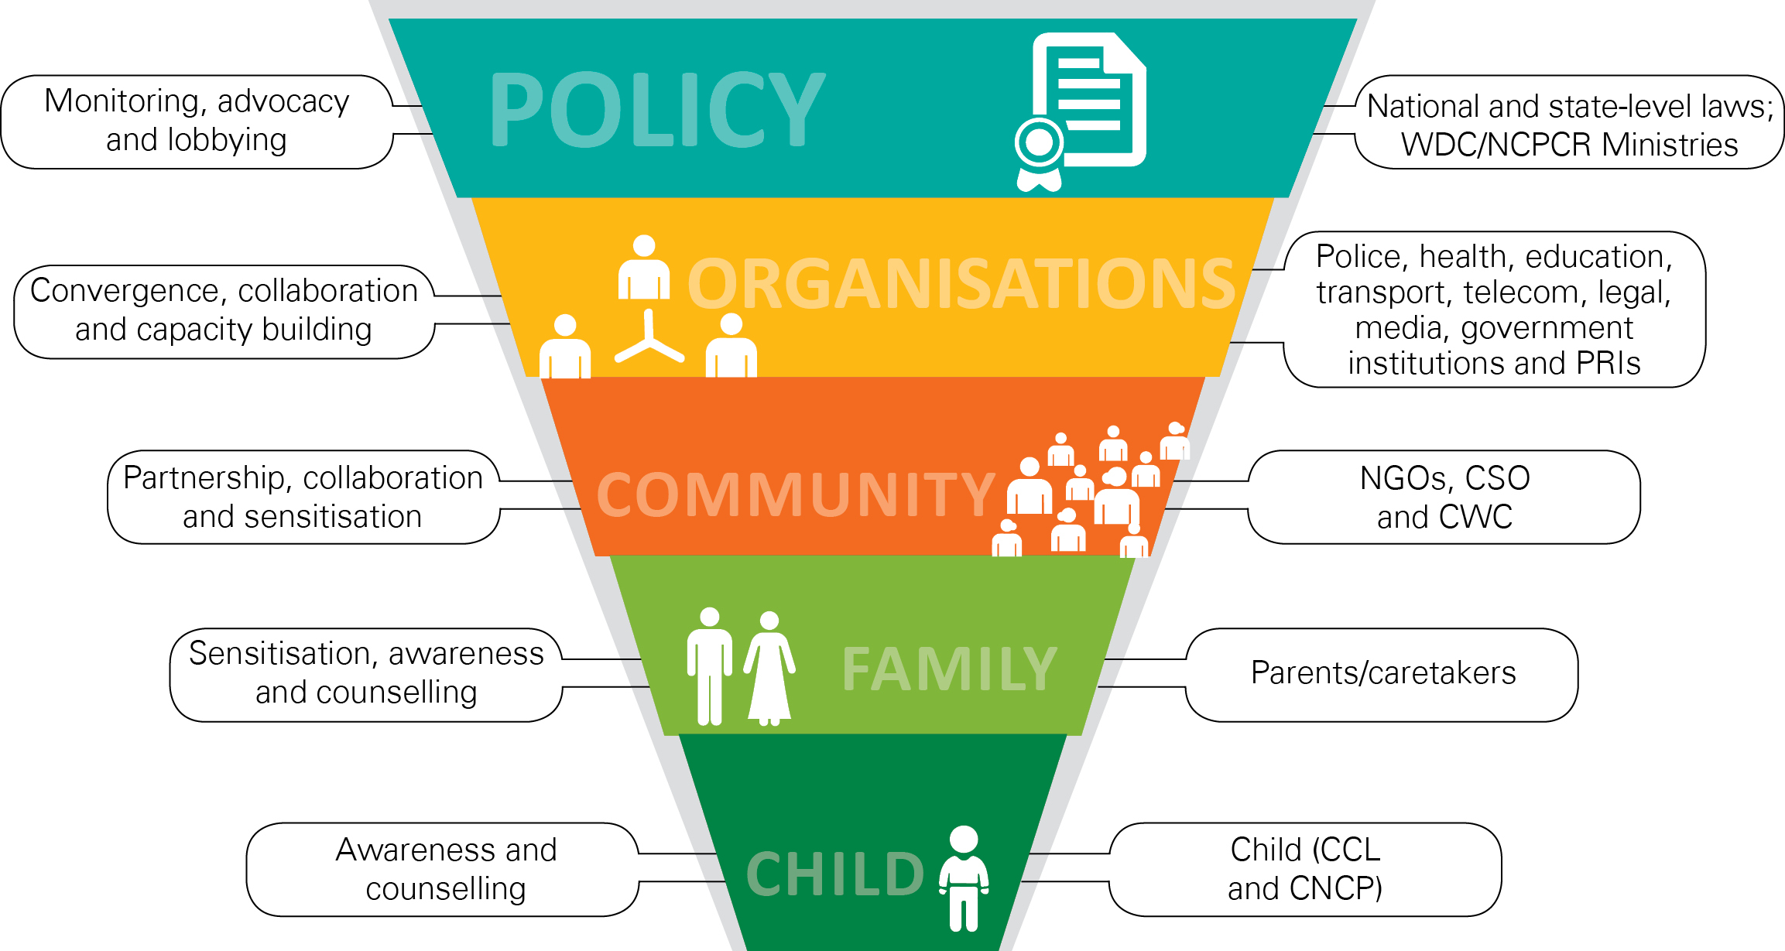
SEM Model
Notes:
Illustration to be replaced with One made in Introduction to child rights module

Slide 16

Case Study
1
A mother delivered twin girls in a hospital. The Father paid the hospital fee of Rs 90000. The parents had a criminal history as they had cheated many people. The police was on look out for them. To avoid the borrowers and the police, the couple ran away from the hospital leaving both the babies in the hospital and no one to look after them. They had submitted false papers to hospital so no information was available about them. The hospital was looking after babies as the hospital fee had been paid. The doctor was ready to look after the babies on humanitarian ground. But the child protection unit did necessary legal paper work and custody of babies was given to special adoption agency. They are now safe and if their biological parents do not turn up in stipulated time they will be given away to adoptive couples.

Slide 17
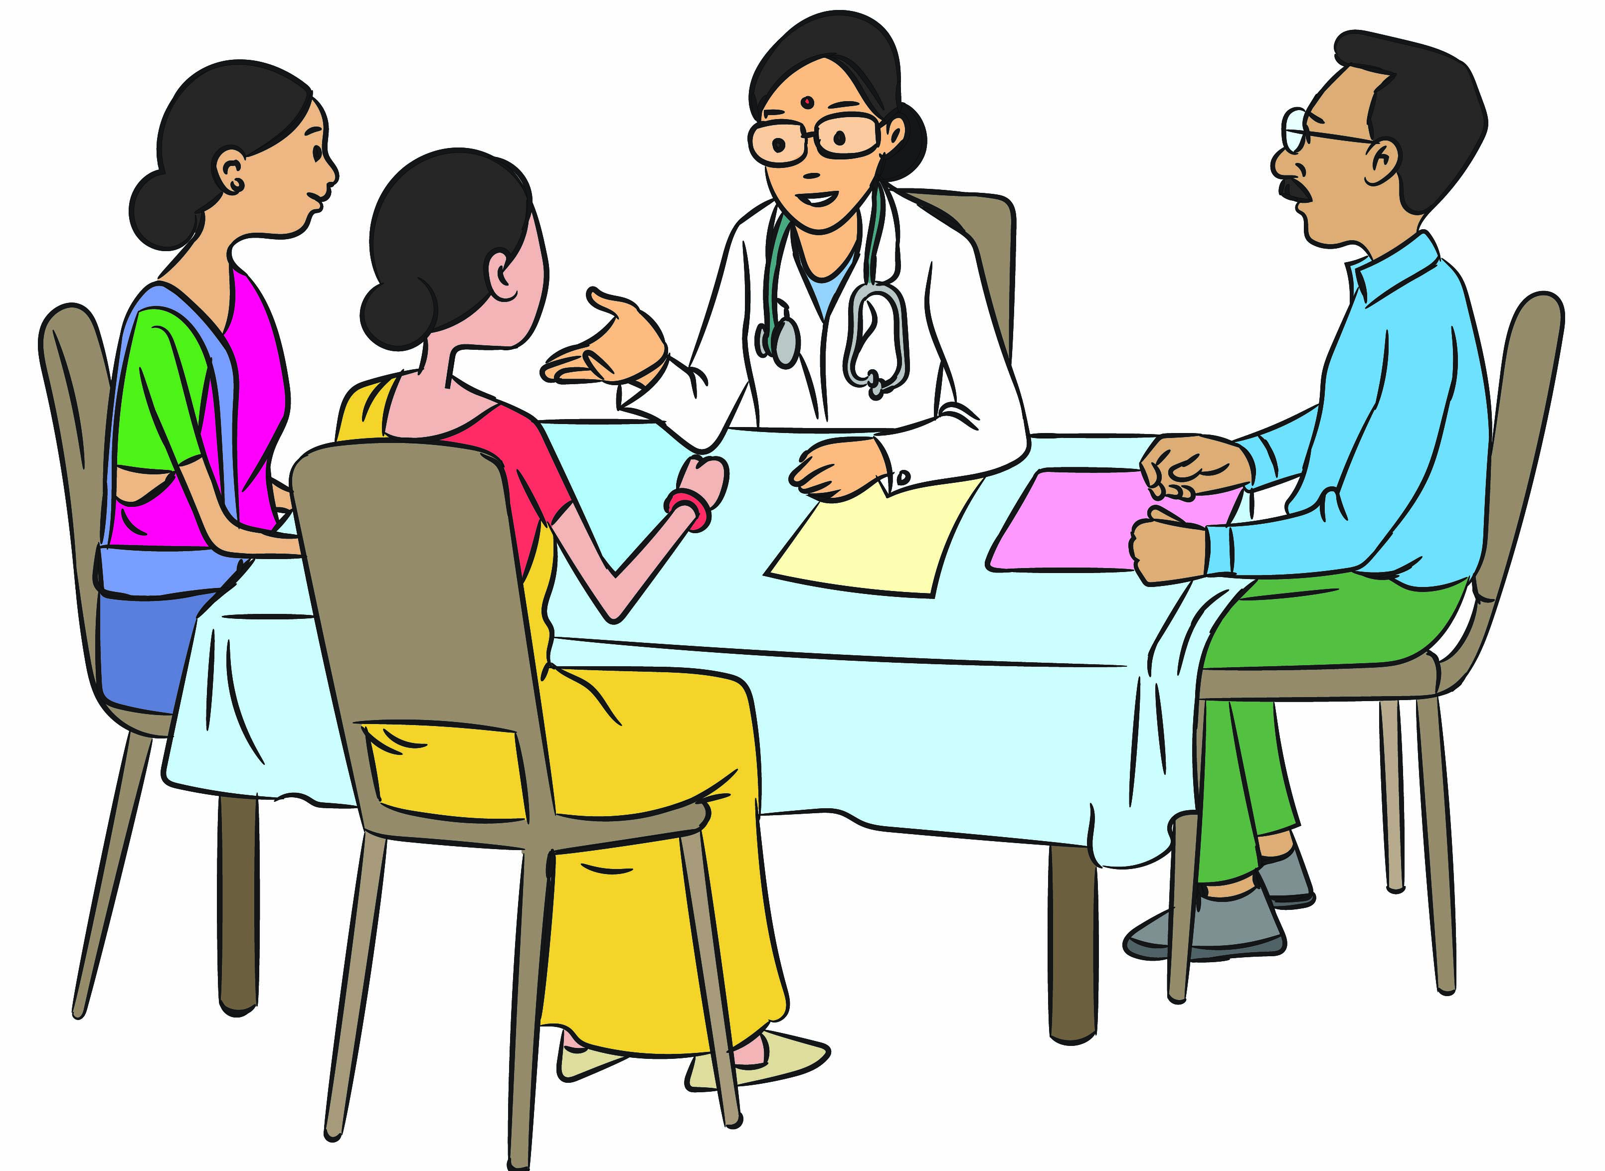
Case Study
Discussion points: What process should DCPU follow for the children to be eligible for adoption?

Slide 18
2
Case Study
Rama was a disabled 8 year old girl staying in a small town in Gujarat. Once she visited a famous temple in a city with her parents. Once there, her father told her that since she could not climb the stairs, she should continue to sit on steps while her parents went up the shrine and would return soon. When her parents did not return after a long time, she started crying. The policemen on duty noticed her and tried to search her parents. When the parents could not be found, Rama was sent to concerned child welfare committee. The district child protection unit tried finding her parents through advertisement in newspaper but got no response from anyone. The process for “free for adoption” was initiated in her case. Today she is staying happily with her adoptive parents.

Slide 19
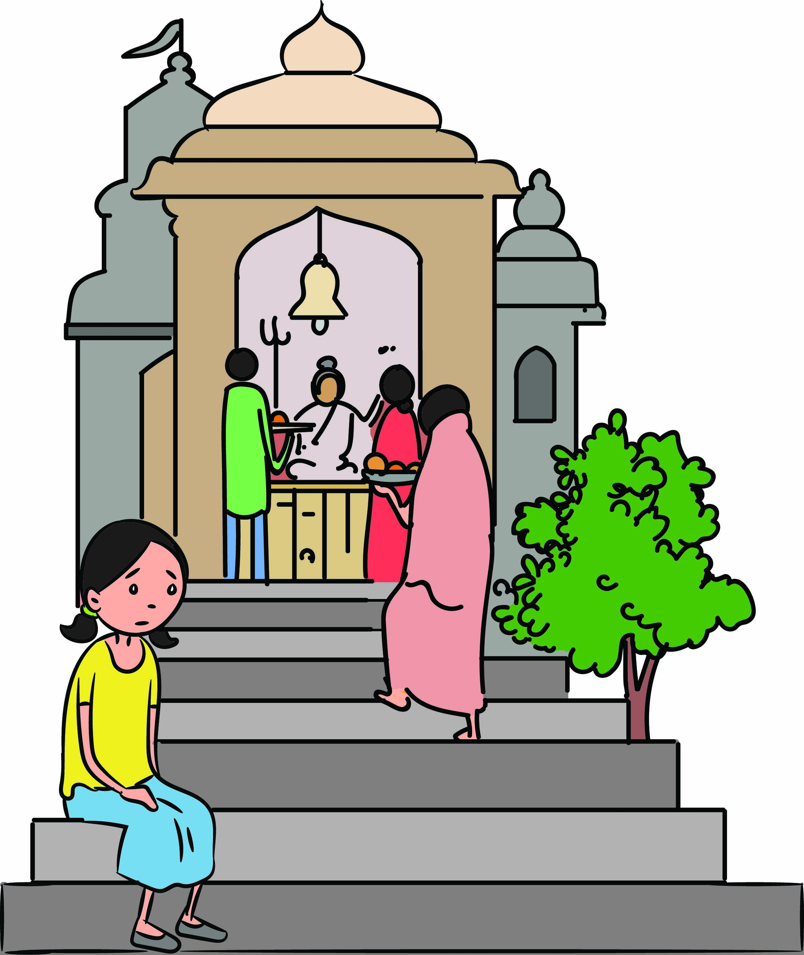
Case Study
Discussion points: What procedures were followed by the DCPU for making Rama “free for adoption”?

Slide 20
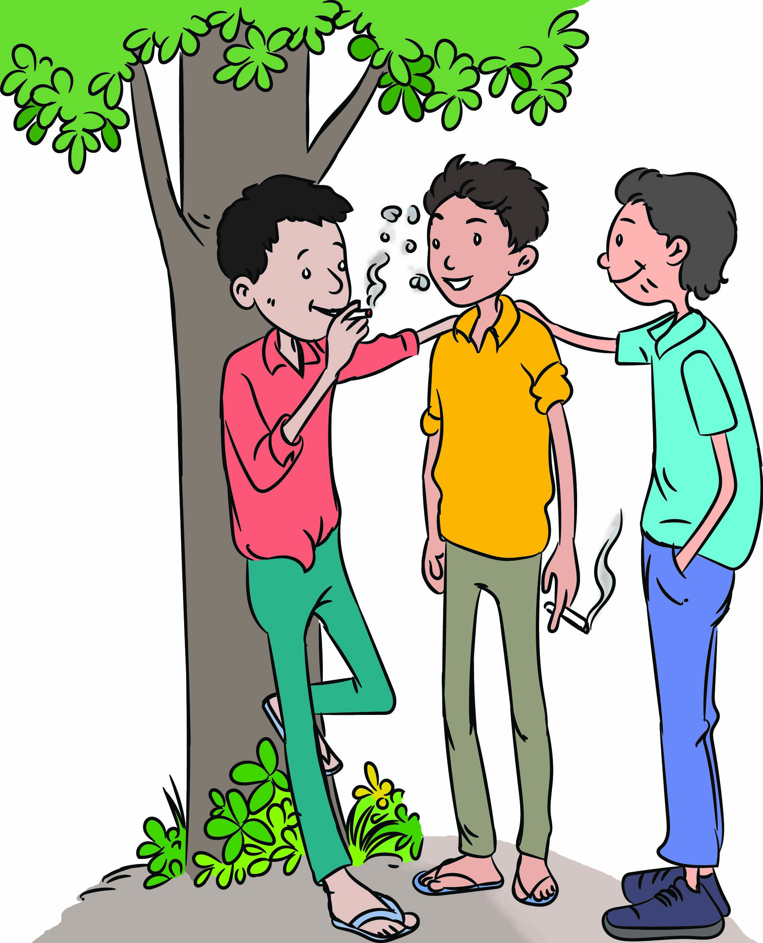
3
Case Study
In a small town of Gujarat there was a poor family of 4 members. While the father, mother and elder brother went for work whole day, the younger child Ramesh was left alone at home. Ramesh fell into bad company and started stealing for better lifestyle. Once he was caught trying to steal an expensive watch and was handed over to police.
Discussion points: What
procedure should be followed
in Ramesh’s case?

Slide 21
4
Case Study
Raju is a 14 year old boy from an educated family of a big city. His father is a successful businessman and mother runs a beauty parlour. Each night, the parents return from work late and Raju is alone after he returns from school. Every day, he spends his time with his friends from the rich neighborhood. For few months, he has been taking drugs and is now addicted. The pocket money given by his parents does not suffice to buy his drugs need. He has started stealing lately. Once he Is caught and police sends him to JJB.

Slide 22
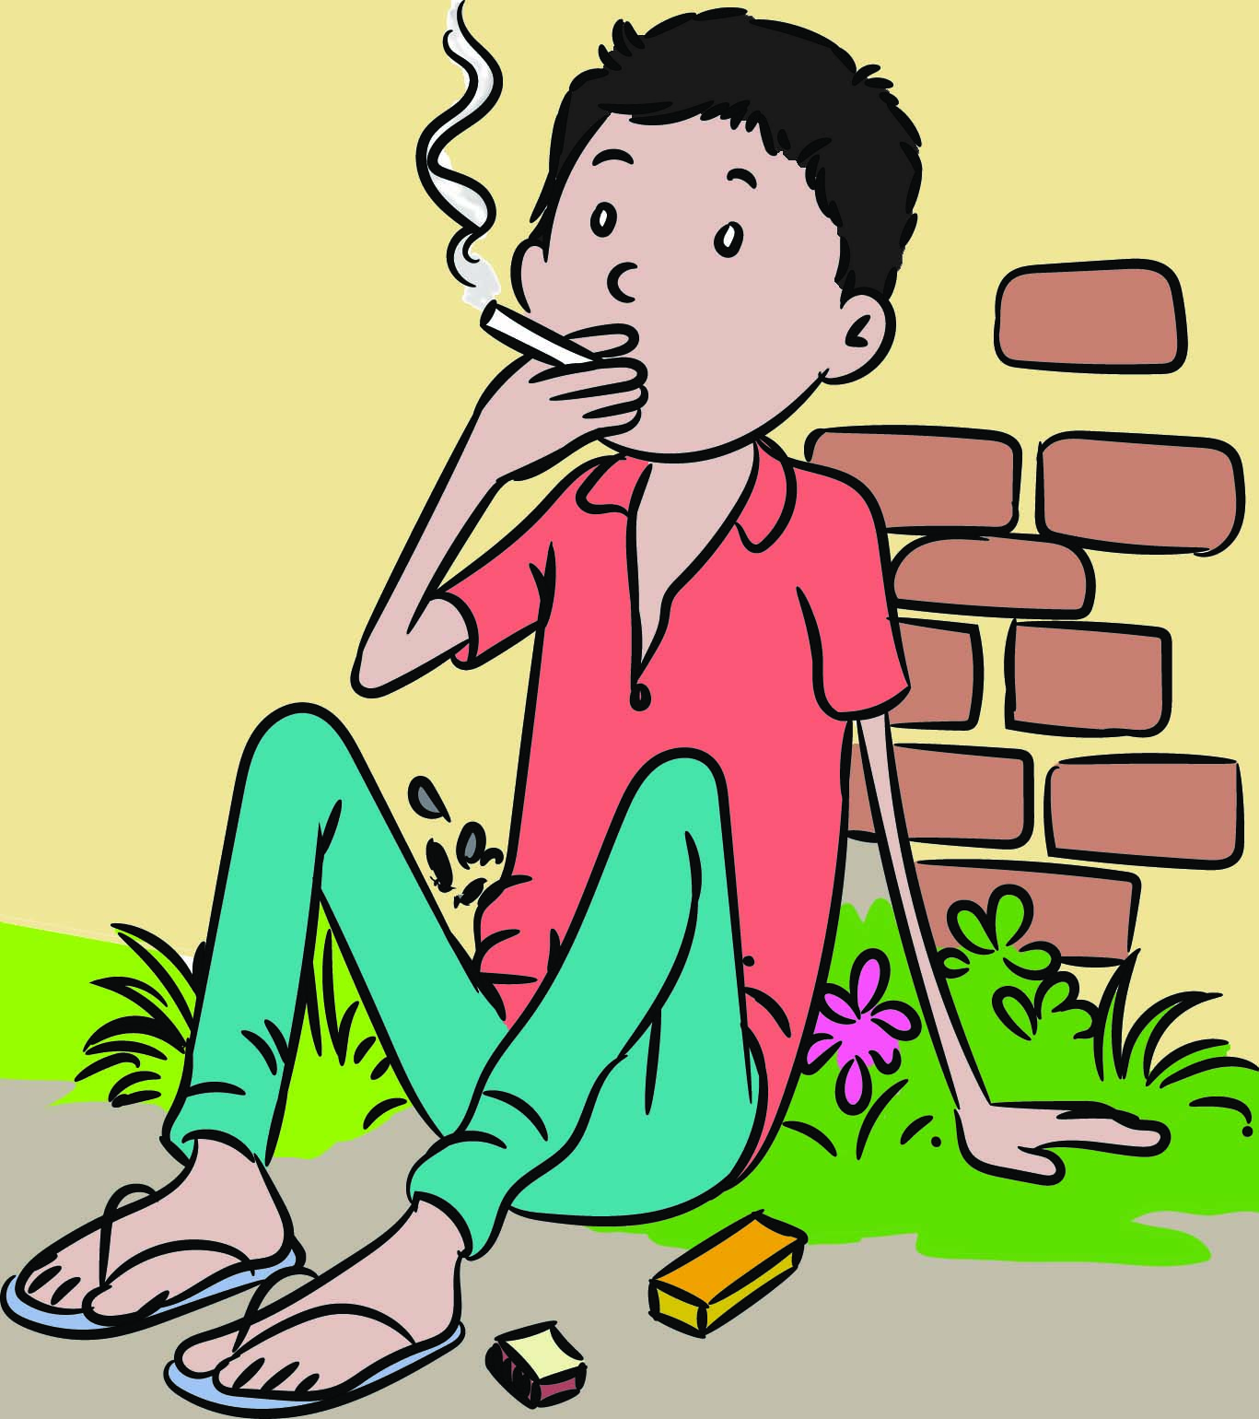
Case Study
Discussion Point: What procedures should be followed in this case?

