Slide 1
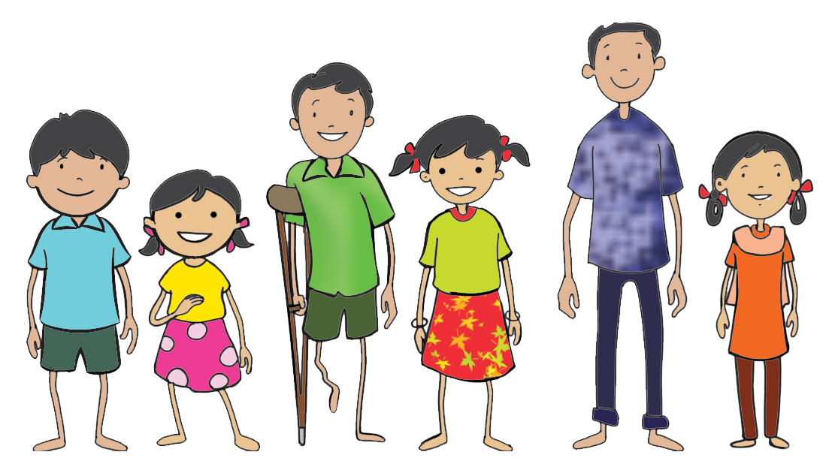
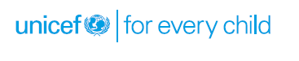
Introduction to Children’s Rights
and Protection Laws

Slide 2
Definition
According to the United Nations Convention for the Rights of the Child(UNCRC)(Article 1) defines a 'child' as a person below the age of 18
The Juvenile Justice (CARE AND PROTECTION OF CHILDREN ACT, 2015) [Section2 (12)], prescribes that a “child” means a person who has not completed 18 years of age.

Slide 3


Objectives
By the end of the section, participants will be able to describe
What are child Rights and child protection?
Who are the children in need of protection?
Who is responsible for their protection?
Which of these needs are non-negotiable entitlements that every child should have?
What are the legal measures and delivery structures and systems in place?

Slide 4
Definition of Child Rights
UNCRC defines Child Rights as the minimum entitlements and freedoms that should be afforded to every citizen below the age of 18 regardless of race, national origin, colour, gender, language, religion, opinions, origin, wealth, birth status or ability and therefore apply to all people everywhere
These rights encompass freedom of children and their civil rights, family environment, necessary healthcare and welfare, education, leisure and cultural activities and special protection measures
All children have these rights and they are all equally important

Slide 5
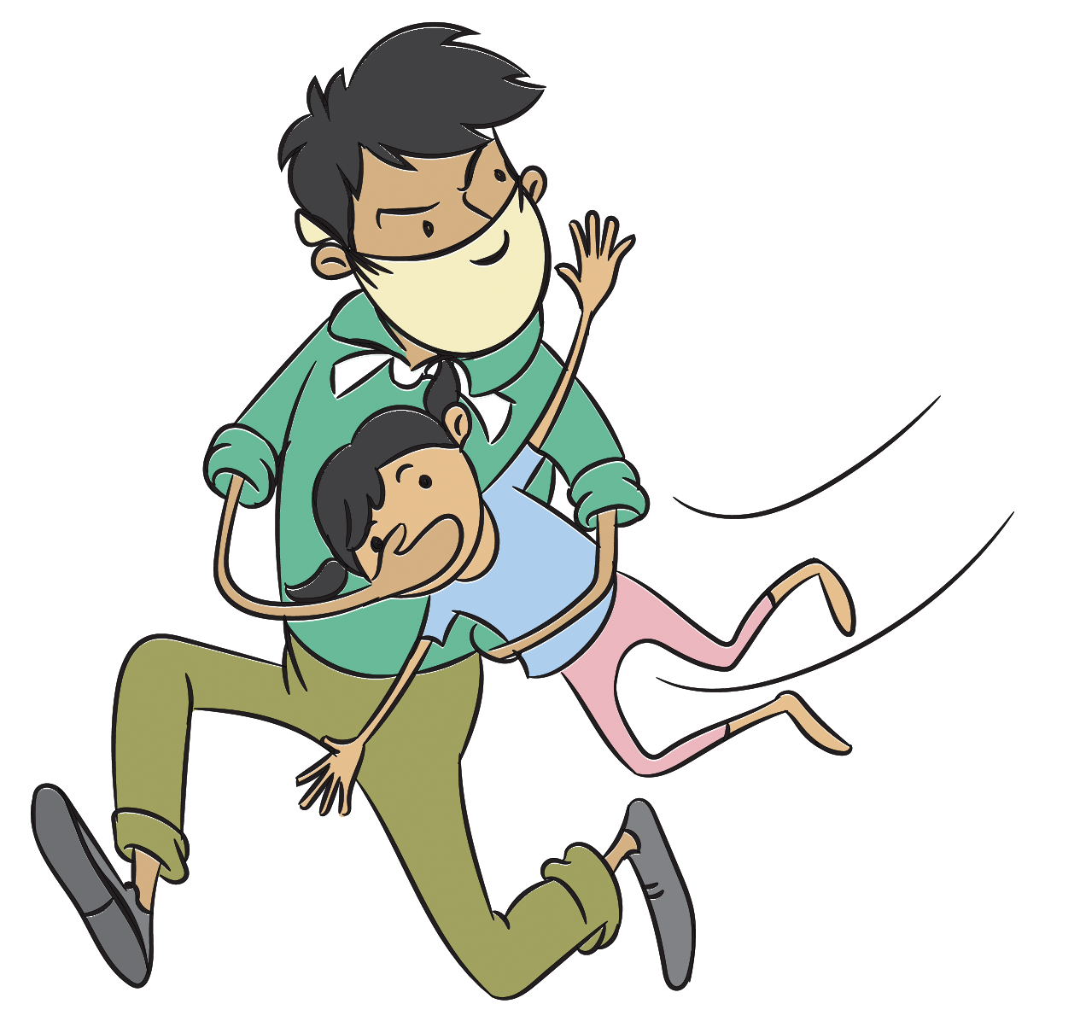
Why do children need separate rights?
Children as an agency need separate rights which may be different from the needs of adults because.
Children are vulnerable
Children are often abused
Children are often not regarded as full human beings
Children need special protection

Slide 6
Principles of Child Rights
Principles of child rights and human rights
Universality
Indivisibility
Non discrimination
Survival and development
Best interest
of the child
Participation

Slide 7

How Child Rights are Violated
Violations of the right to protection
Child sexual abuse
Child labour, bonded, on the street
Orphaned, abandoned
Child marriage- cycle of deprivation
Corporal punishment, violence
Trafficking, child beggary
Children/families affected by HIV/AIDS, disasters

Slide 8
Child rights from ‘need based’ to ‘rights based’
Shift from Needs based to | Rights based approach
Welfare Some have to left out Institutional and Residential Care Custodial care in institutions Segregatopm and Isolation Beneficiary and Recipient Clear obligation. Active participation. Focus is on the specific immediate situation. Certain groups have expertise to meet children's needs. | Development and Empowerment All have same rights Non-Institutional and Family based alternatives Holistic Development through quality child care institutions Inclusion and mainstreaming Participant and partner I his/her own development and decisions No one has definite obligations Minimal participation Analyses root cause All adults can play a role in achieving children's right

Slide 9
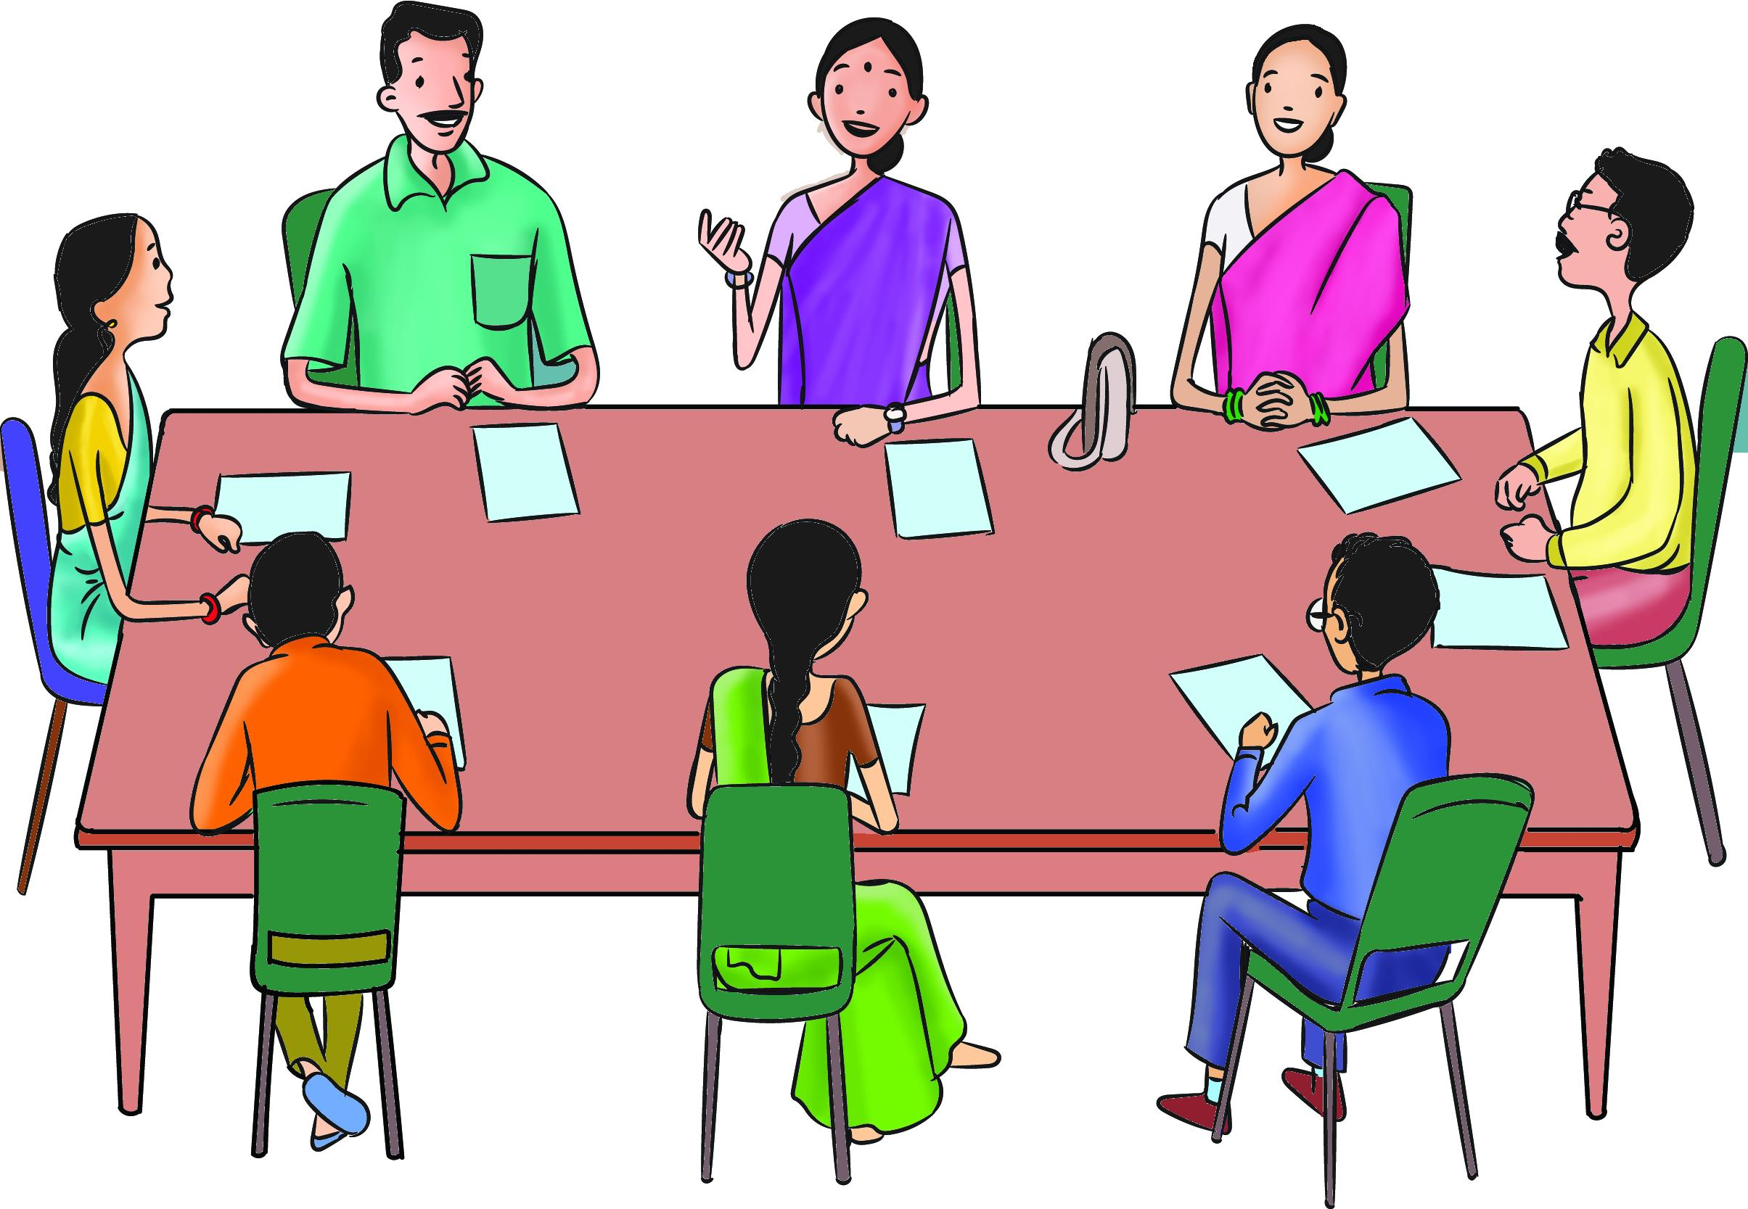
Children in Need of Protection
Case let 1
Group work and discussion
Narayan and Naina live in a village with their nine year old son Rajesh who is differently abled. The couple thinks that their son should not go out and play with other children as he may get hurt. Their neighbours
think that Rajesh should not
play with their children as
he may bring bad luck to
them. Does Rajesh need help?
Notes:
Note for the facilitator: The facilitator should guide the participants for possibility of looking at the provisions of the Act and understand how child in need for care and protection are defined.

Slide 10
Children in Need of Protection
Case let 2
Suresh and Sapna are both HIV positive. They have a daughter named Roshni. She is seven years old and goes to school. Children at the school have starting mocking at her and teachers also make her sit at the last bench. Does Roshni need protection?

Slide 11
Children in Need of Protection
Case let 3
Nandlal and Sunita live in a small village that has a primary school. Their daughter Pooja has completed class five. But the middle school is 3 KM away in another village. Her parents do not want to send her 3 Km away and want her to discontinue studies.

Slide 12
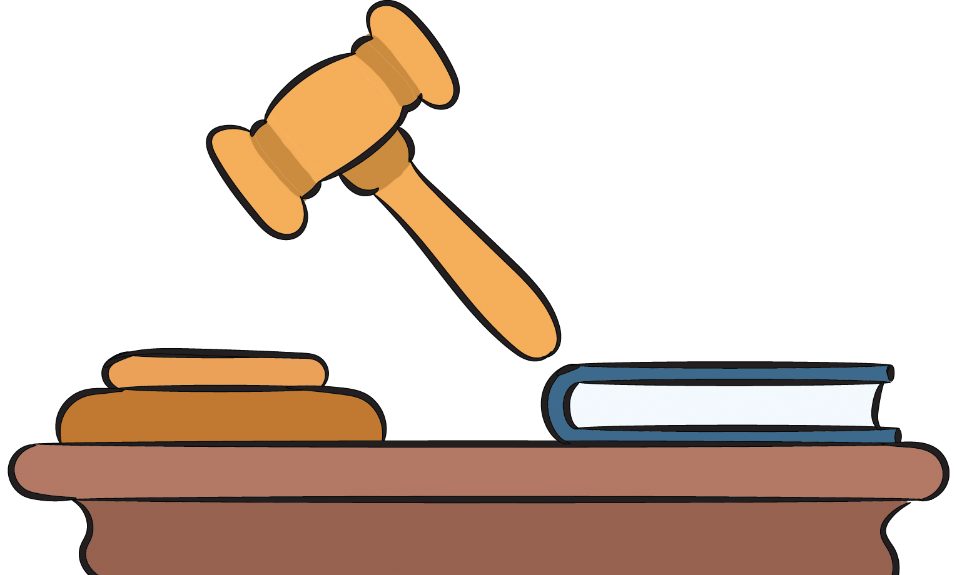
Non-negotiable Entitlements
UNCRC: Principles of Human Rights and Child Rights
Universality and Non-discrimination.
Indivisibility.
Survival and development.
Participation and best interest
of the child.

Slide 13
Fundamental rights and directive principles to protect children as per constitution of India
Fundamental Rights related to Children
Article 15 (3) – State should make special provisions for children.
Article 21 A –free and compulsory education to all children of 6-14 years.
Article 23 – Prohibits trafficking of human beings including children.
Article 24 –no child below 14 years of age can engage in hazardous occupation.
c

Slide 14
Fundamental rights and directive principles to protect children as per constitution of India
Directive Principles related to Children
Article 39 (e) & (f) -the state policies are directed towards securing the tender age of children
Article 45 -early childhood care and education to all children below 6 years
Article 51 A -fundamental duty of parents/ guardian to provide opportunities of education to their child or ward aged 6-14 years.
c

Slide 15
Objectives of Juvenile Justice
(Care and Protection of Children) Act, 2015
To achieve objectives of UNCRC, Beijing Rules and other related international instruments
To provide proper care, protection, development, treatment, social reintegration of CCL and CNCP
Specify procedural safe guards for children in conflict with law
To address challenges in the existing act

Slide 16
Children in Need of Care and Protection (CNCP)
Child to be produced before CWC within 24 hours
Mandatory Reporting of child found separated from guardian
Non reporting will be considered as punishable offence
CWC shall meet at least 20 days in a month
DM shall conduct a quarterly review of functioning of CWC

Slide 17
Institutional Care
Mandatory registration of CCIs within 6 months from the date of commencement of the Act.
Failure of compliance will be
considered as punishable offence.
Application of registration to be disposed within Six months (otherwise it will be regarded as dereliction of duty and will invoke departmental proceedings).

Slide 18
Punishments listed under POCSO
Sexual offences against children
  Penetrative sexual assault
  Aggravated penetrative sexual assault
  Sexual assault
  Aggravated sexual assault
  Sexual harassment
Using child for
pornographic purposes
Abetment of and attempt
to commit offence
Failure to report or
record a case
False complaint or
false information

Slide 19
Objectives
At the end of the section, the participants will be able be describe the features of ICPS.
ICPS indicates a shift of focus from Scheme Approach to Project Approach. It emphasis Family-based Non institutional care

Slide 20
Delivery structure -ICPS
National Level
Ministry of Woman
& Child Development
Central Adoption
Resource Agency
(CARA)
Central Project Support Unit (CPSU)
NIPCCD
ChildLine India Foundation

Slide 21
Components
Institutional Care
Non-Institutional Care
MIS: Child Tracking System & Missing Children Website
Emergency
Outreach Services

