Slide 1
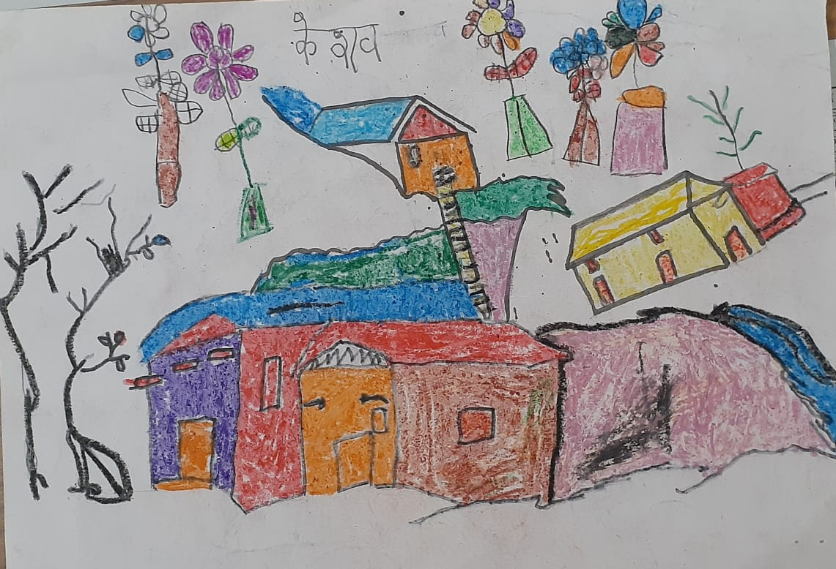
System Strengthening and PSS in Madhya Pradesh

Slide 2
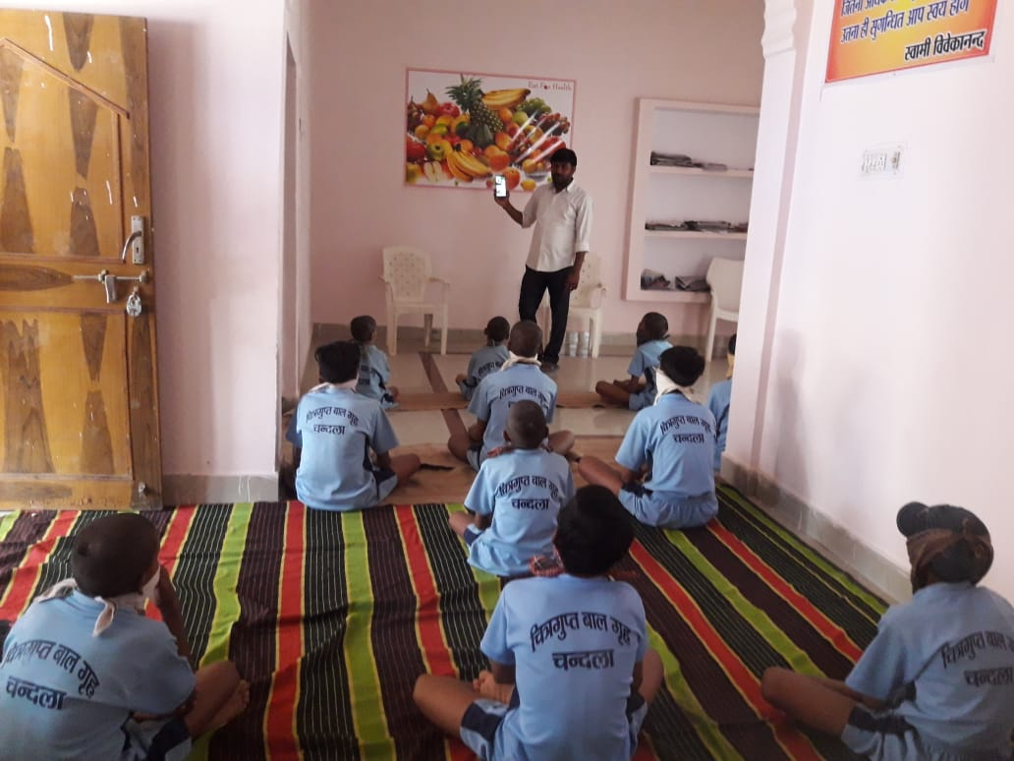
Joint Initiatives with DWCD
Issuance of Departmental Orders: pre and post SC directives
Orientation of DWCD functionaries [4000] on key protection issues particularly prevention of risks in times Covid
Capacity building of CCI staff on prevention and protection from COVID, including PSS for children [210 participants]
Orientation of all CWC members on SC order, their responsibilities including addressing challenges at the ground level [135 participants]
Trained team of Counsellors [68] across 52 districts; and issues referred are duly taken up
Regular monitoring and follow up
CP Services being provided by structures on a roster basis; CWCs and JJBs functional online

Slide 3
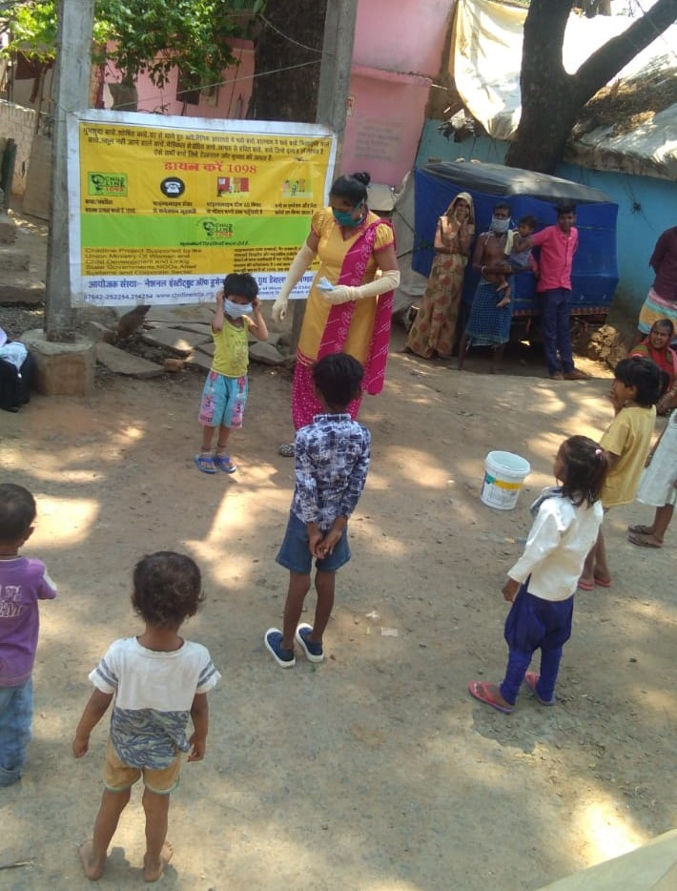
Joint Initiatives with HC JJC
Directions issued in compliance with SC Order to District Courts and DWCD
Weekly compliance sent by DWCD
Fortnightly compliance by District Courts
Children in conflict with law given bail
Constituted a team [DLSA Secy, Visiting Judge and Principal Magistrate] for monitoring CCIs – issues of noncompliance are reported to Dept and actions are ensured
Principal Magistrates regularly monitoring CCLs in OHs

Slide 4
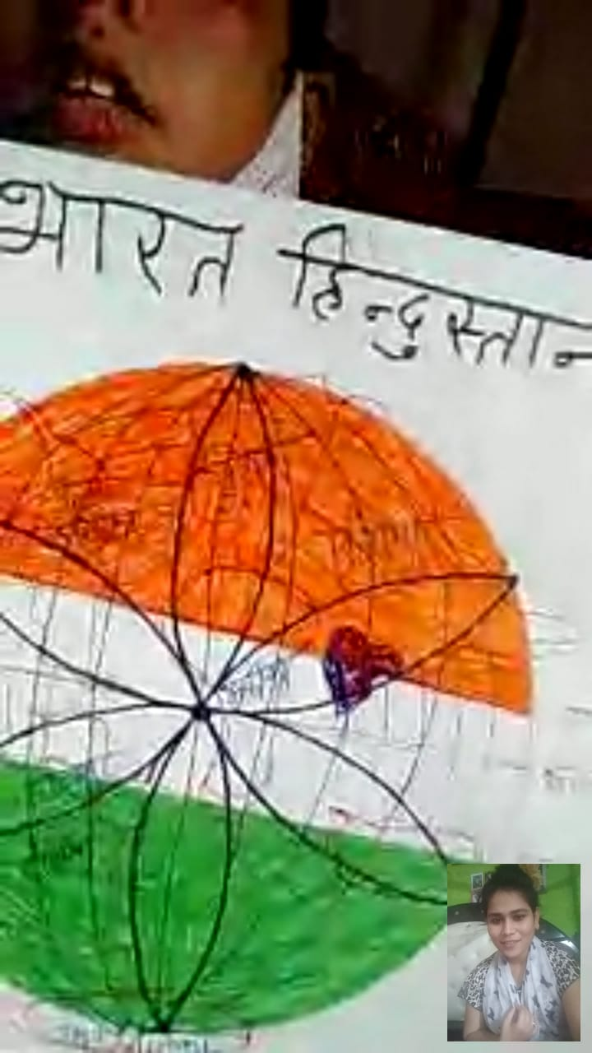
Proactive Coordination and Collaborative Actions with key CP structures
Increased Efficiency and accountability towards children
Touching the lives of children
OUTCOMES

Slide 5
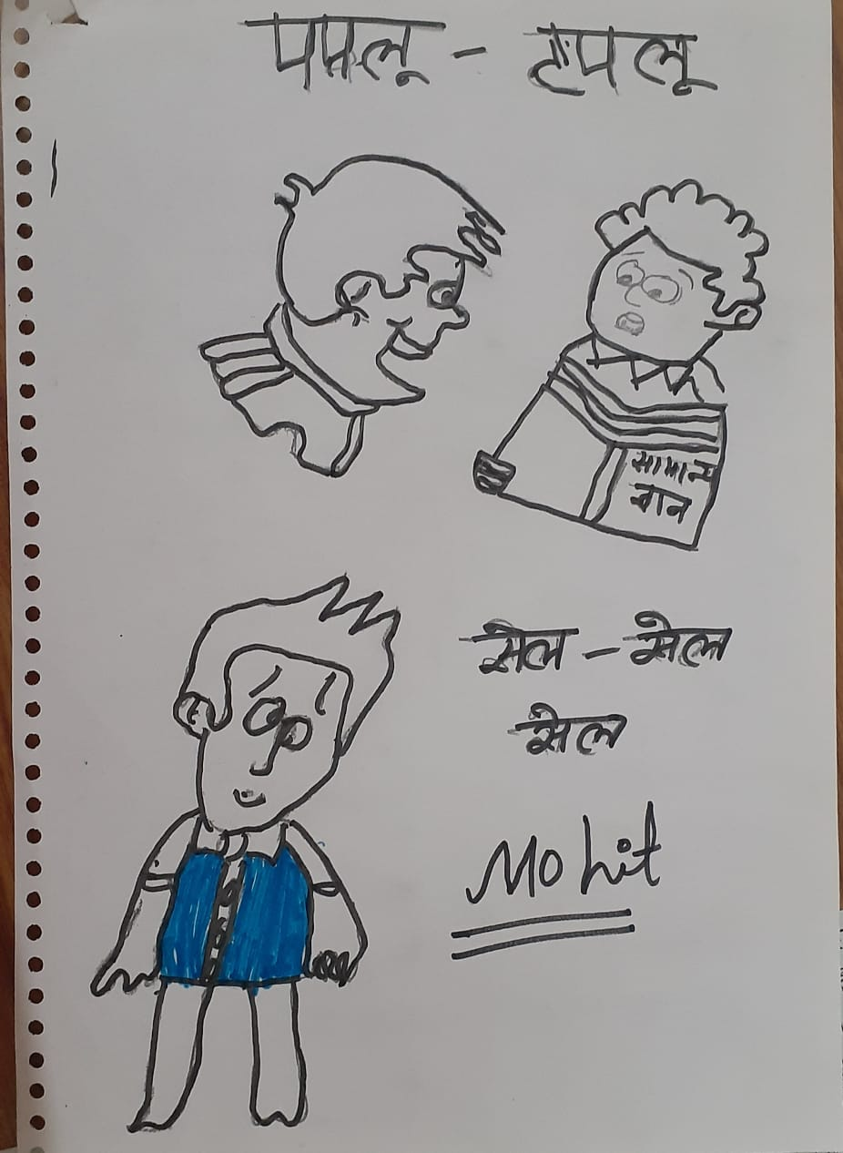
MHPSS support to children in CCIs and community
The Process:
Trained counselors (DCPU, Childline, CCIs, CSOs) identified for PSS
Online technical orientation and refresher training on COVID prevention, addressing anxieties faced by children [NIMHANS]
Developed resource material for the counselors including tele-counselling tips
The System:
Every district and every CCI has counselor/s assigned
Group sessions and individualized counselling [2220 group counselling 35%F; 2570 individuals (771F, 1799M)]
MIS developed: weekly reporting, detailed case reporting and case studies
Regular updates including challenges or concerns
Immediate actions from the Directorate ensured

Slide 6
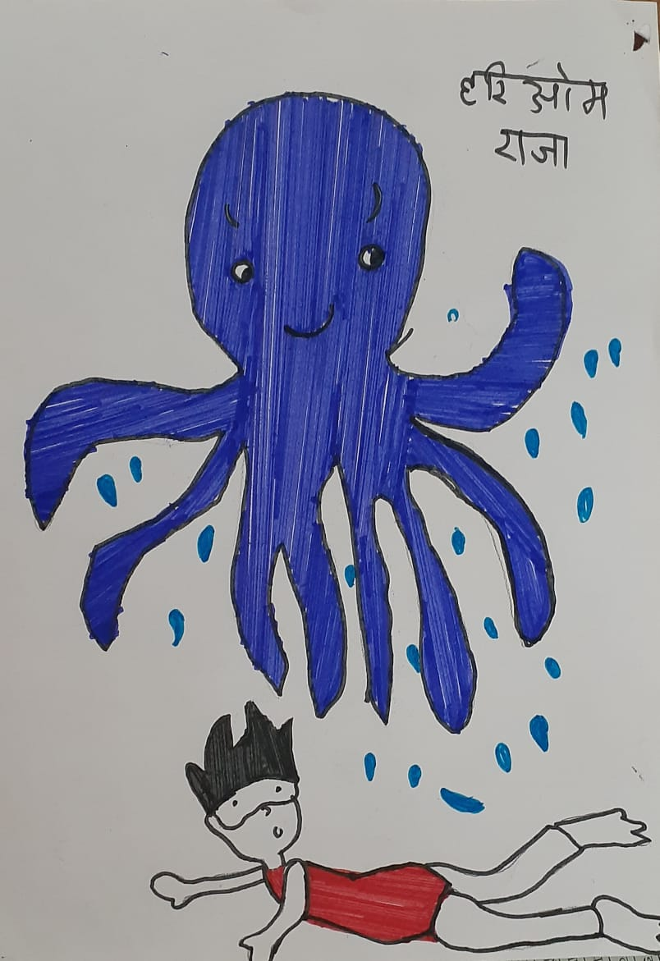
Reflections
They have a space to voice their emotions – a shift now from anxiety to looking forward
Creating a positive environment in CCIs and they are kept creatively engaged
Counsellors create a ‘plan’ – either a task or creative activity; enthusiastic response
Life skills elements are also interwoven in the sessions – and these are highly appreciated and children themselves talk of changes they are observing in themselves
Most children desire to pursue some vocational training
Children require counselling support regularly whether it Corona times or otherwise
Their counselling needs are mostly simple, not complex – being listened to, trustable and be friendly
A person with empathy and experience of working with children can do the trick…
Lot of people who are working with children can become effective counsellors
Engagement of a good counsellor strengthens feedback loop, without breaking confidentiality
The visible benefits of PSS during COVID will help in sustaining service and ensuring its quality

Slide 7
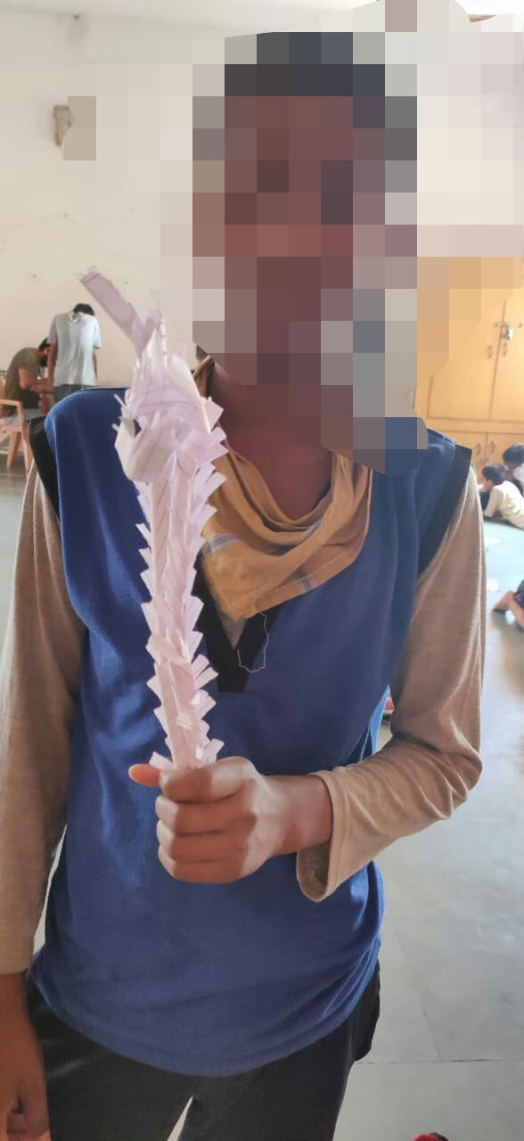
Challenges
Limited reach to community
Difficulty/longer time for rapport building due limitations of the medium
Care givers presence inhibit participation of children
Expanding PSS
Building capacities of NSS youth leaders [208] from 52 districts on providing peer PSS
Building PSS skills of teachers through Diksha portal in collaboration with Dept of Edu

