Slide 1
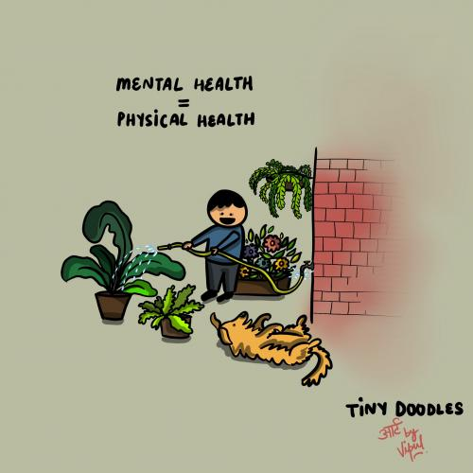

Strengthening Mental Health & Psychosocial Support for Children during COVID-19 Response
C4D Section, New Delhi
May 2020

Slide 2

Existing MH &PSS tools

Slide 3

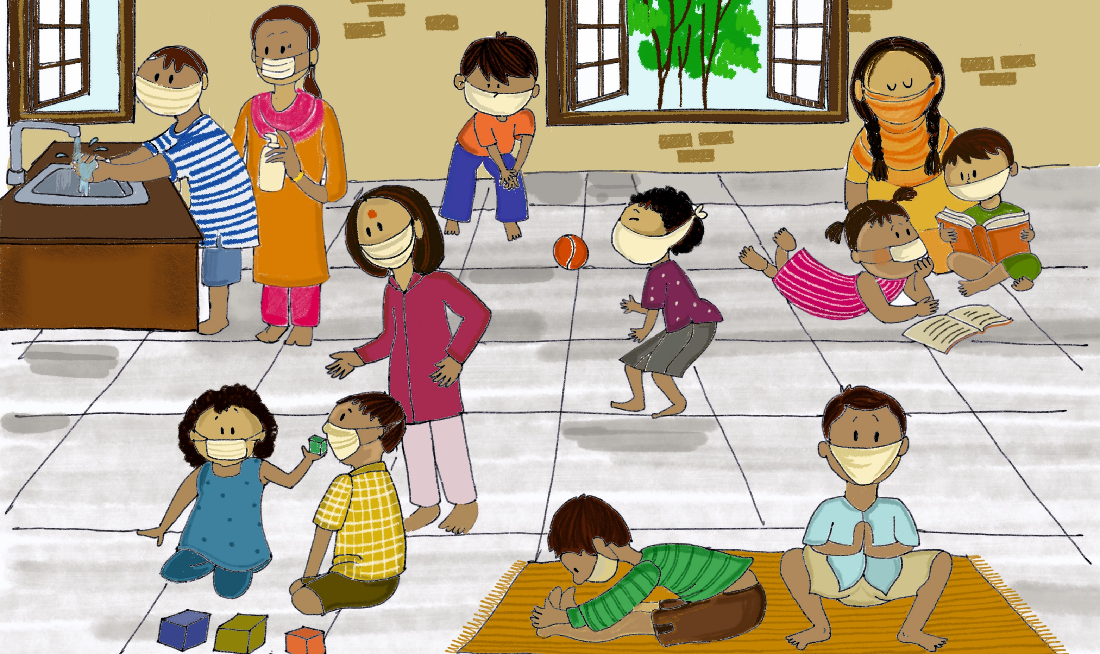
Psychosocial Support for Children during COVID-19
A Manual for Parents and Caregivers

Slide 4
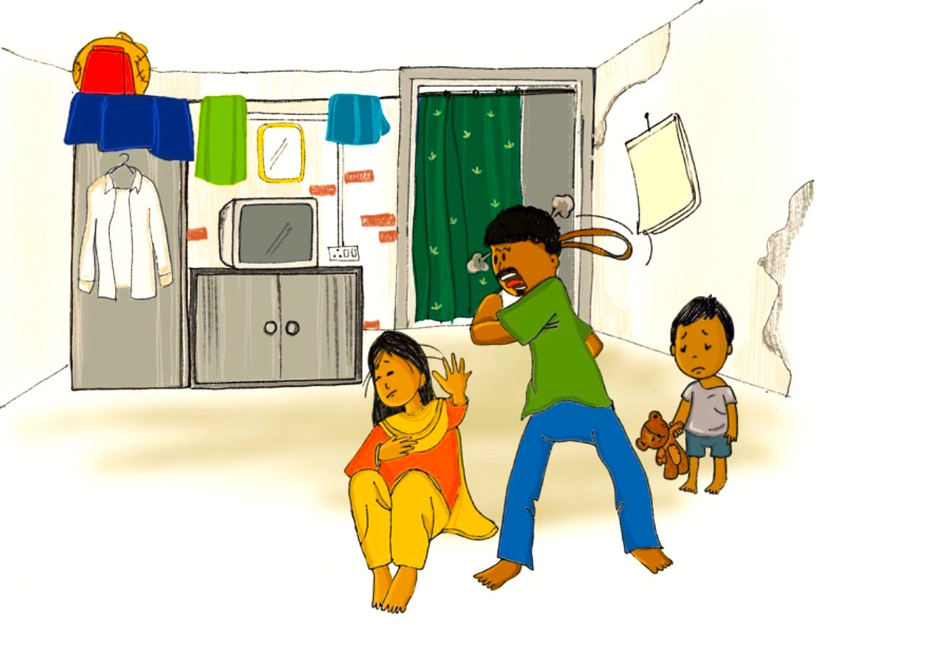
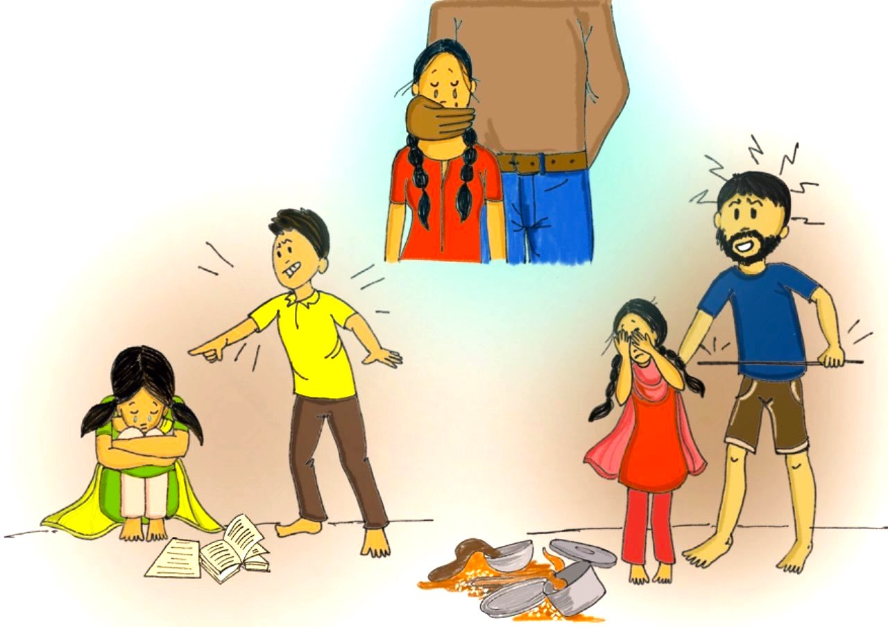
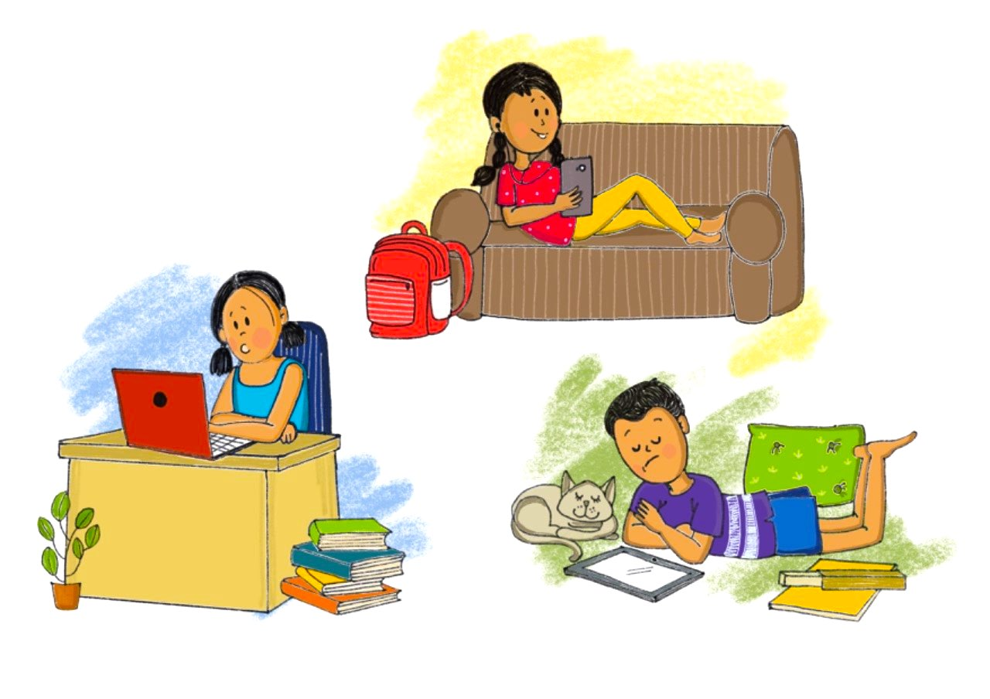
Violence, Abuse and exploitation
Domestic violence
Excessive screen time

Slide 5

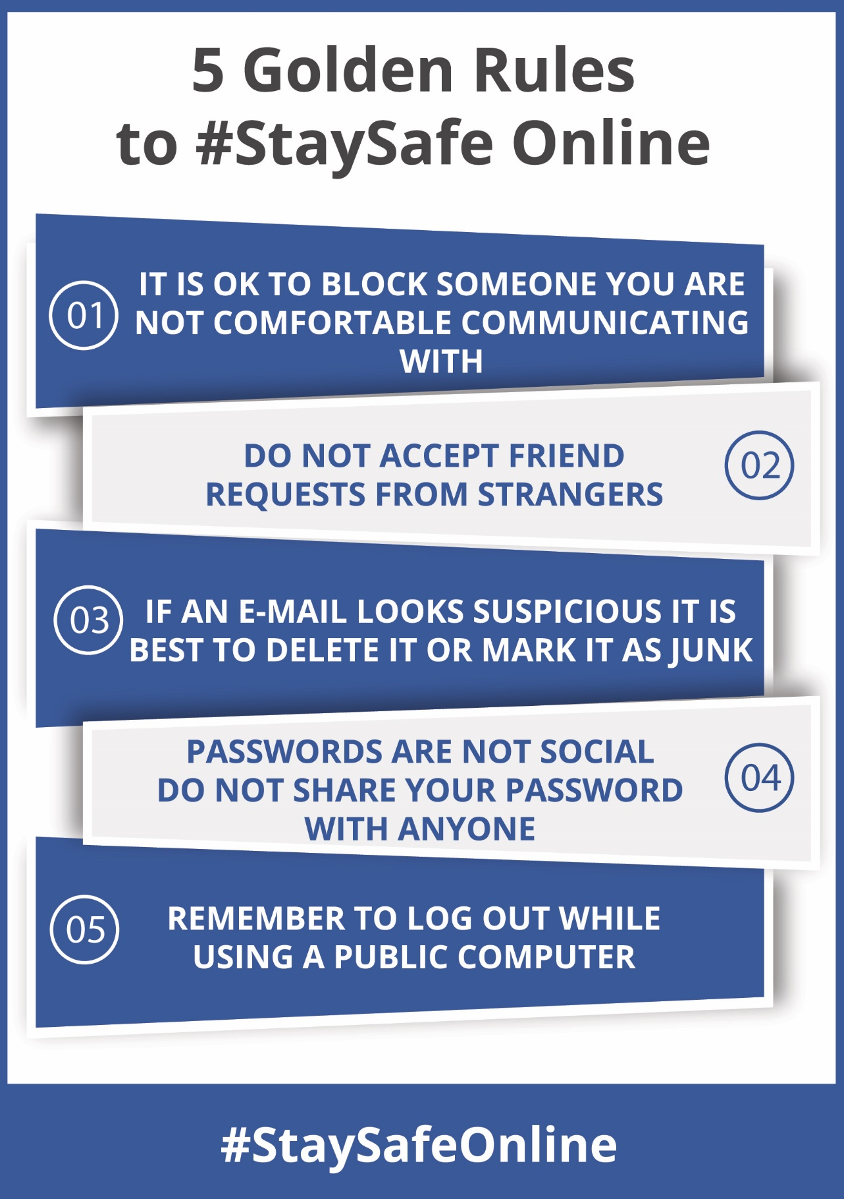
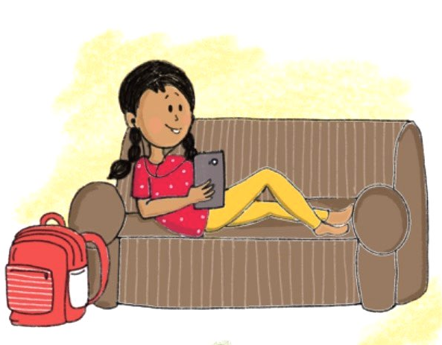
Let children be online, connect with friends!
Teach children these 5 golden rules to keep safe online.

Slide 6
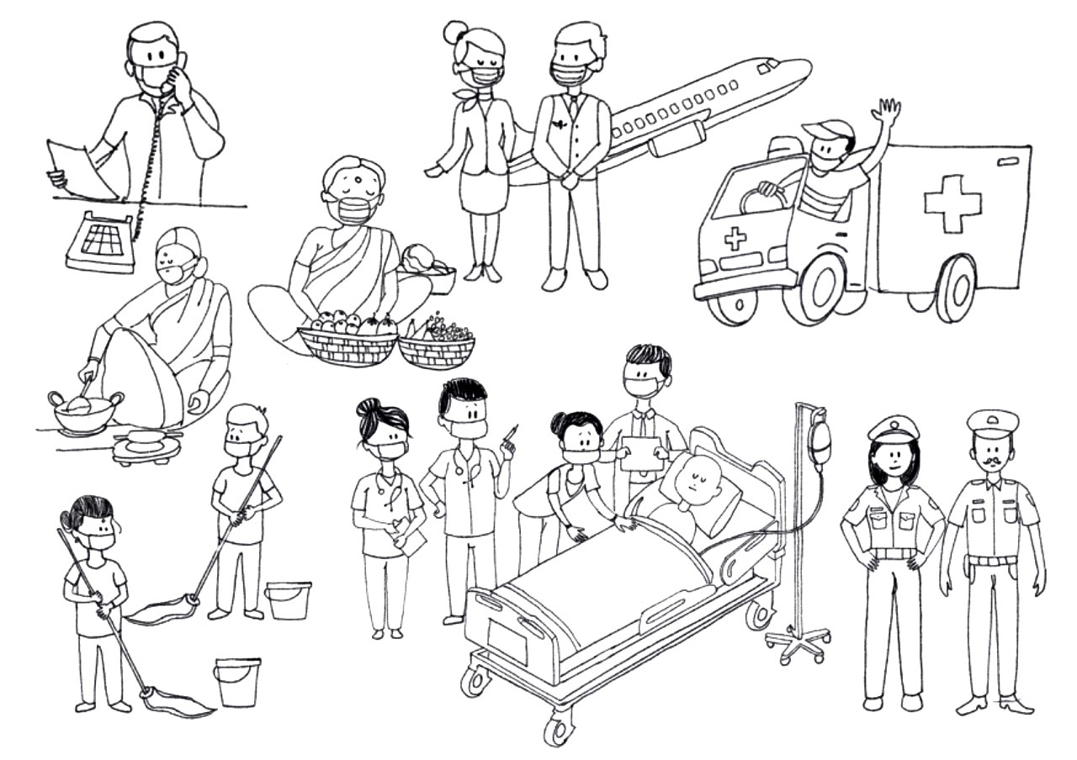
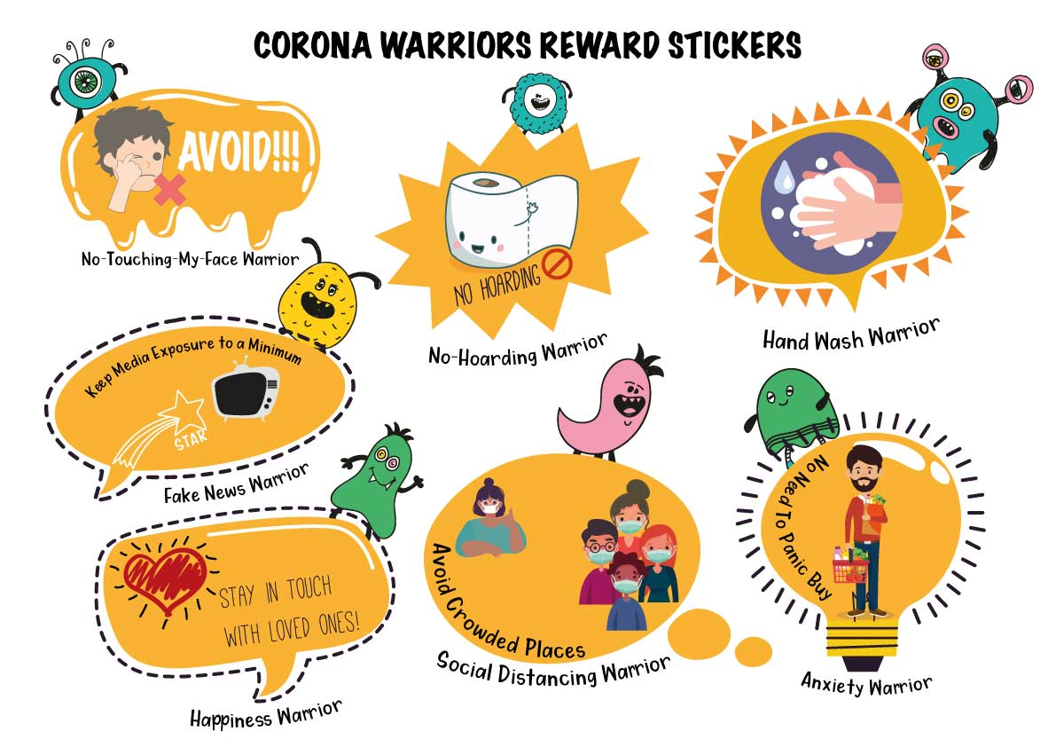
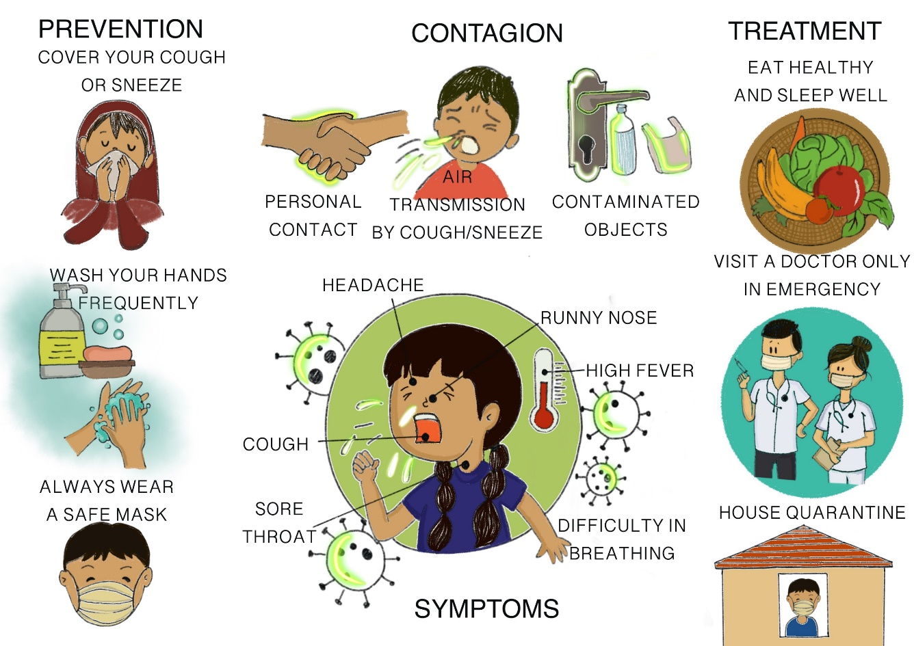
Toolkit for Children

Slide 7
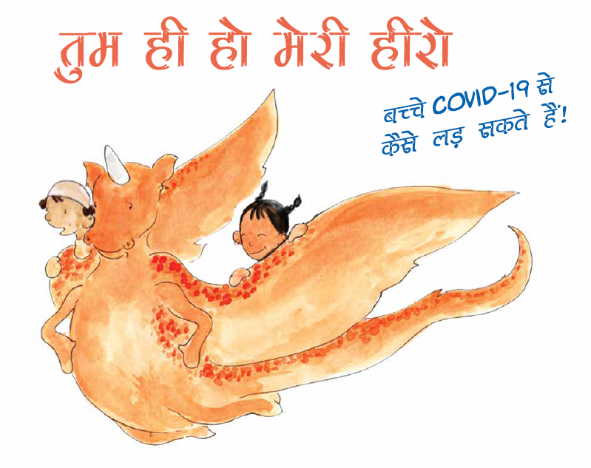
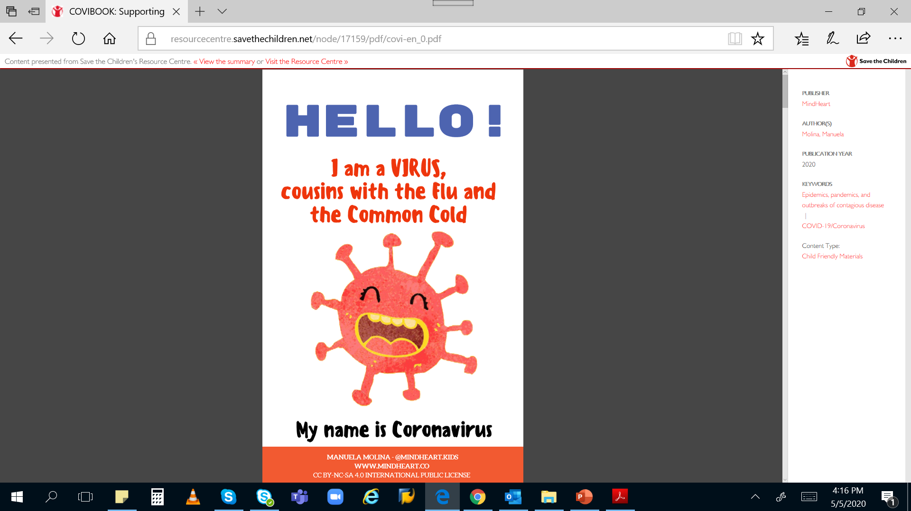

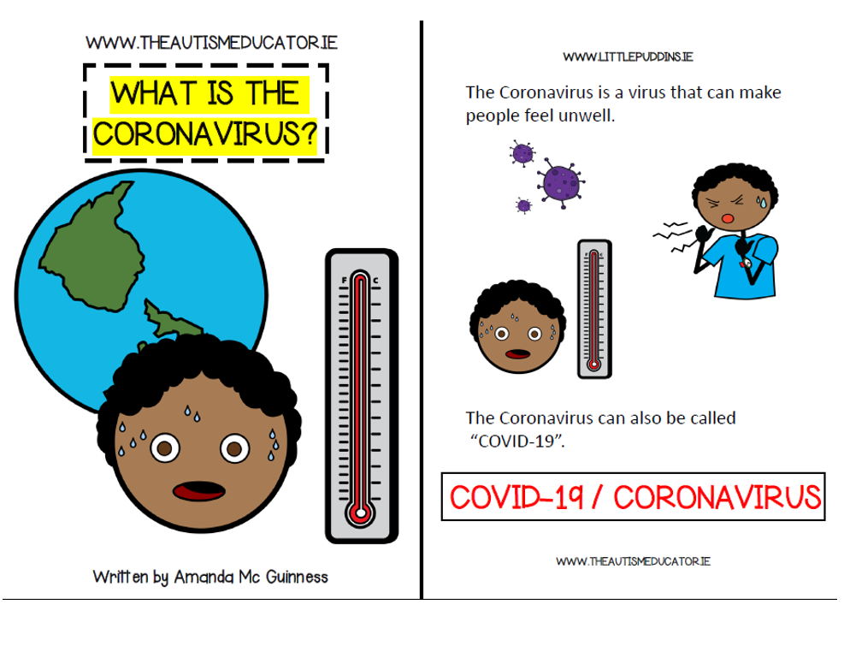

Slide 8
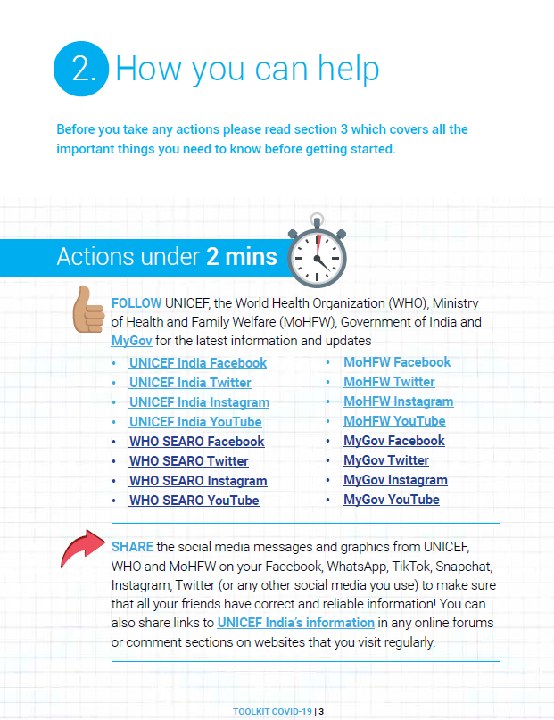
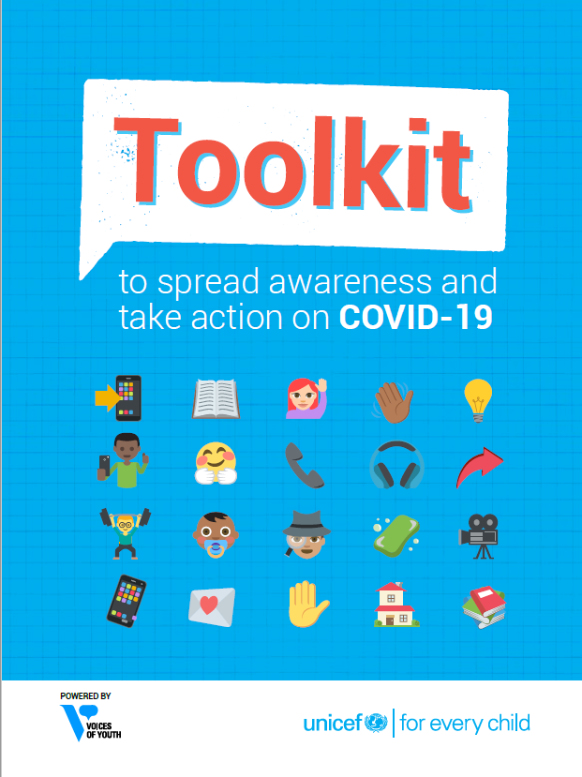
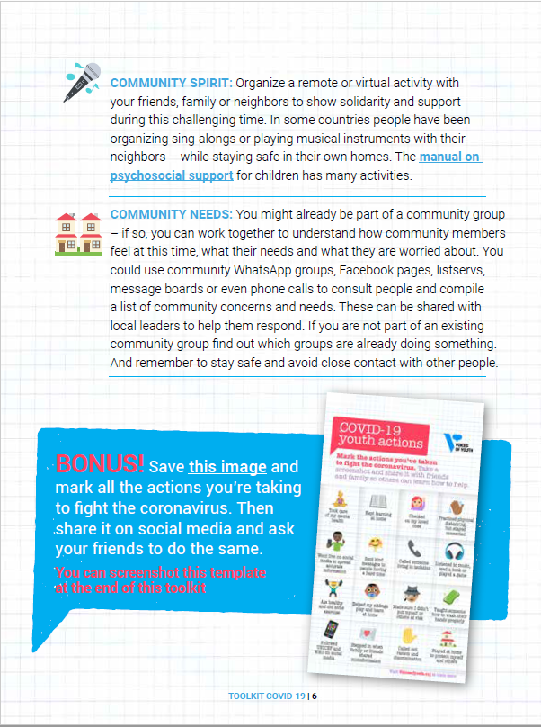
UNICEF Toolkit to spread awareness and take action 0n COVID-19

Slide 9
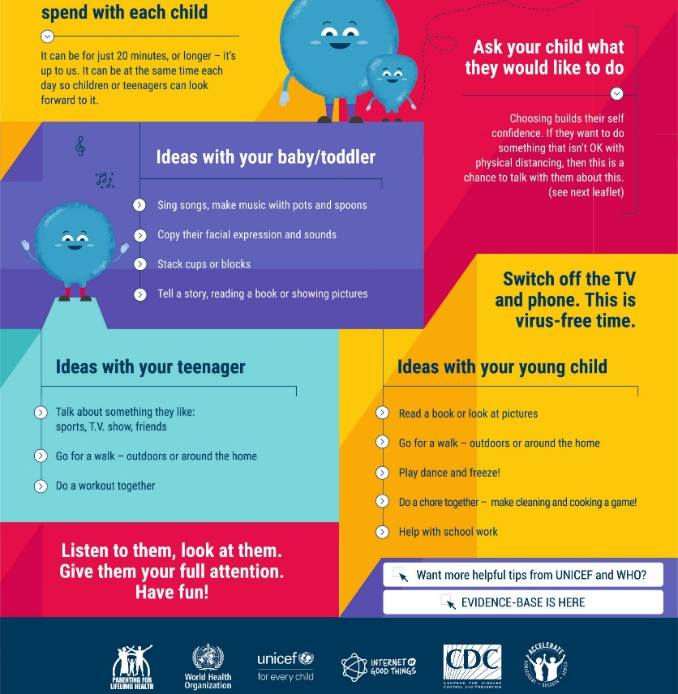
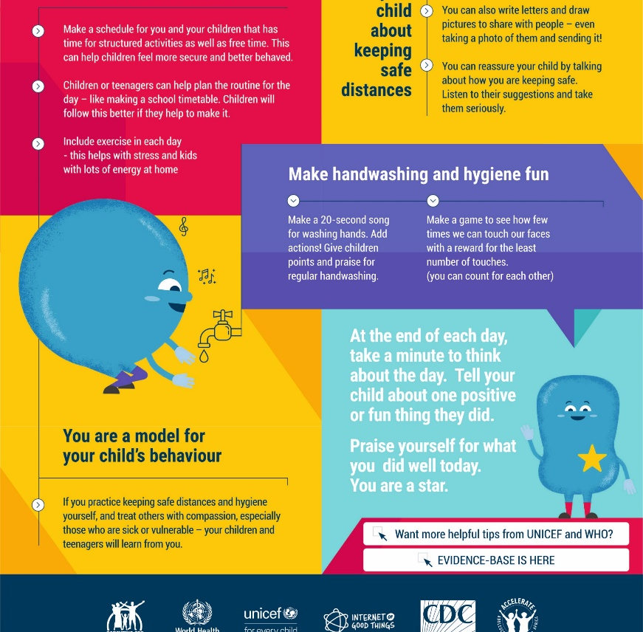
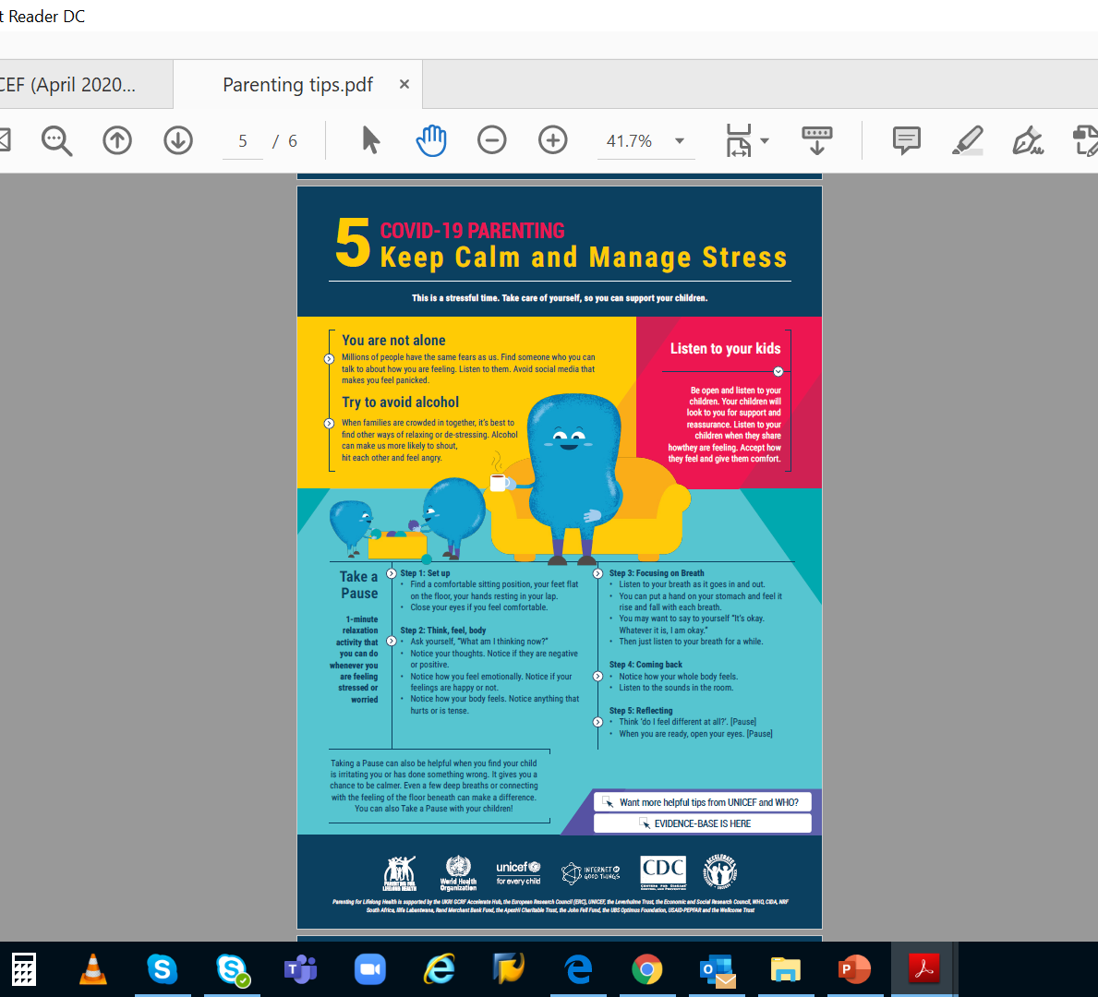
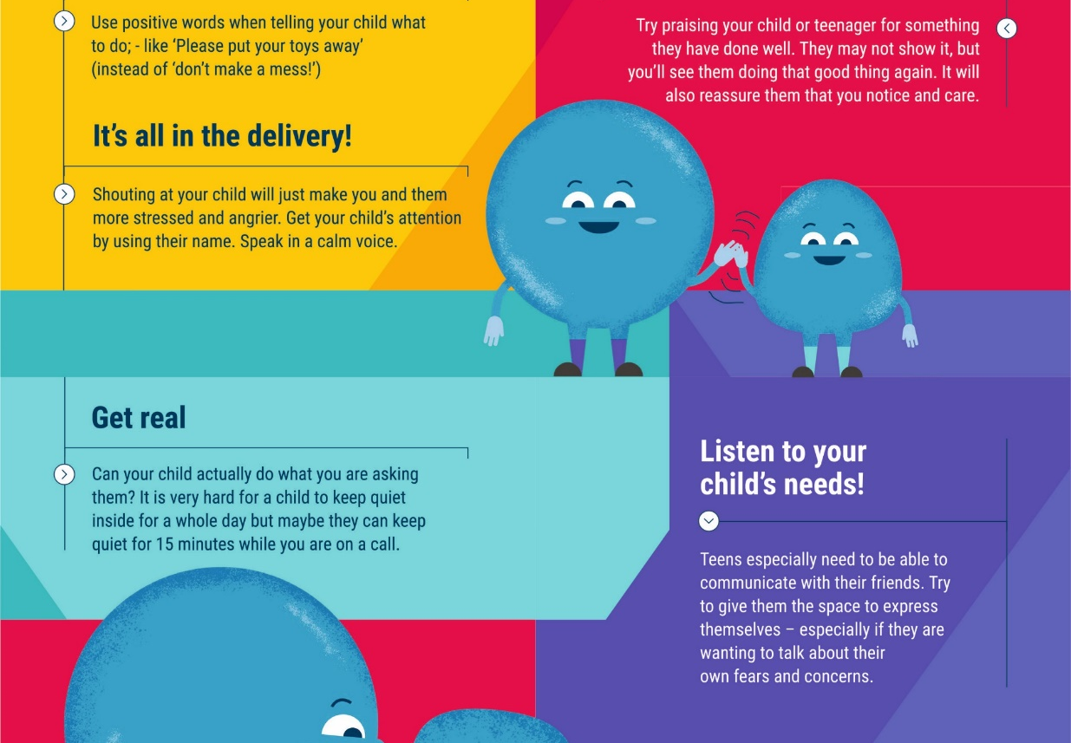
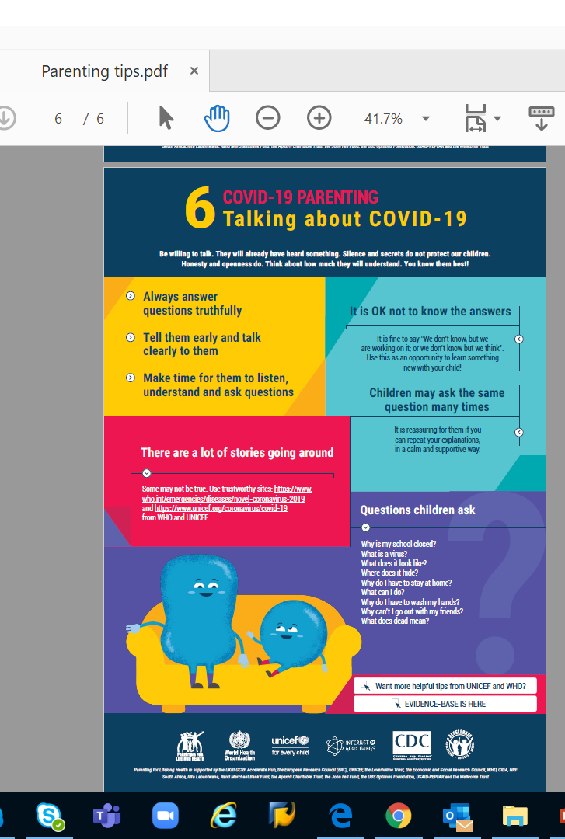
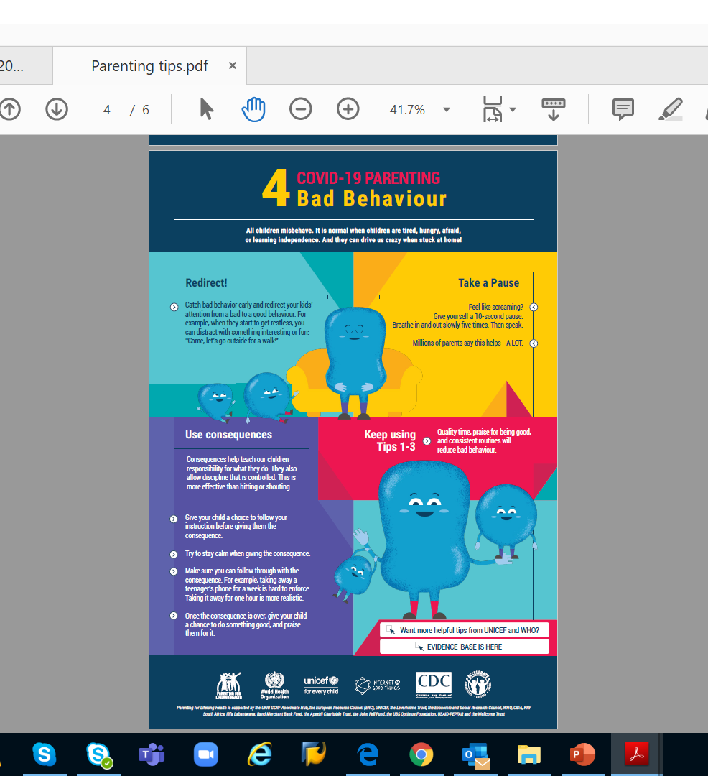
PARENTING TIPS
Information on common reactions for caregivers under stress and positive coping strategies. This may include information on the impacts of losing livelihoods, social isolation,

Slide 10
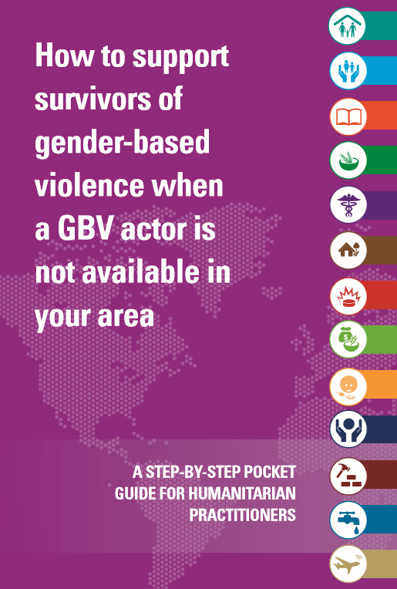
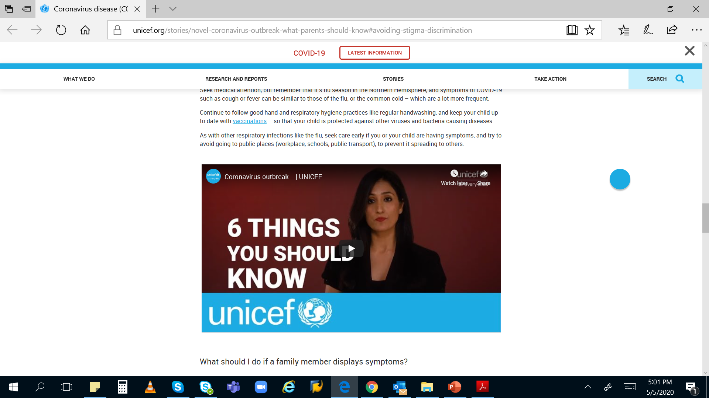
GBV pocket book
What parents should know

Slide 11
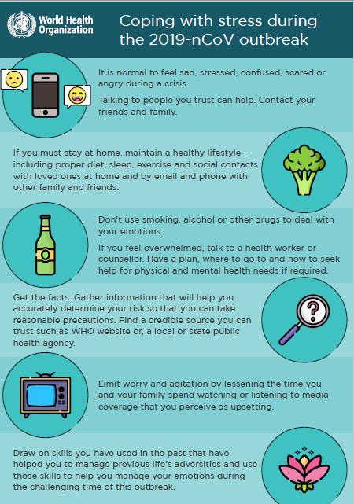
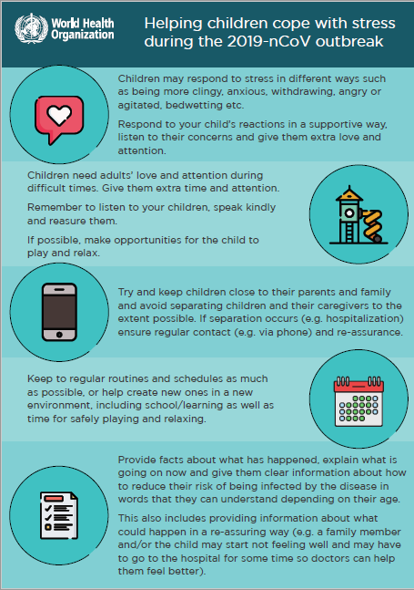
MANAGING STRESS

Slide 12
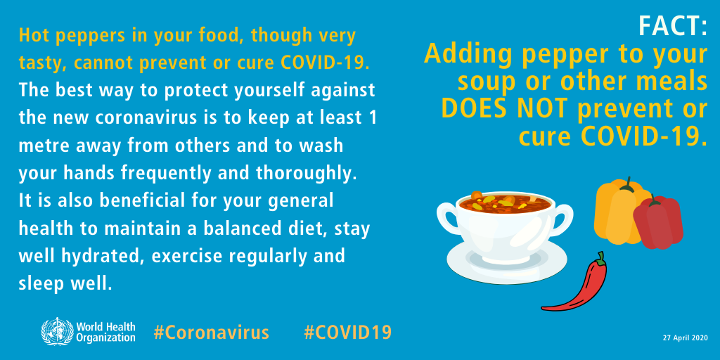
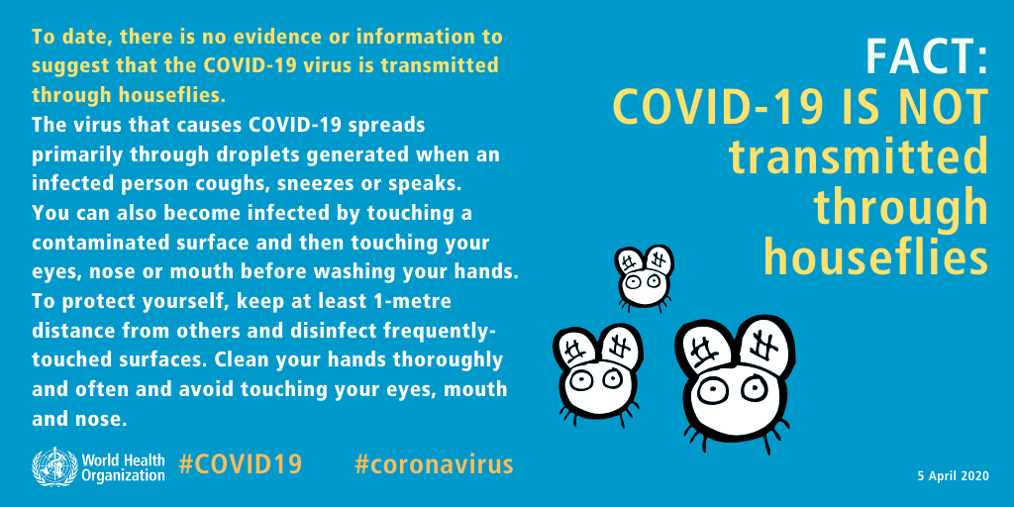
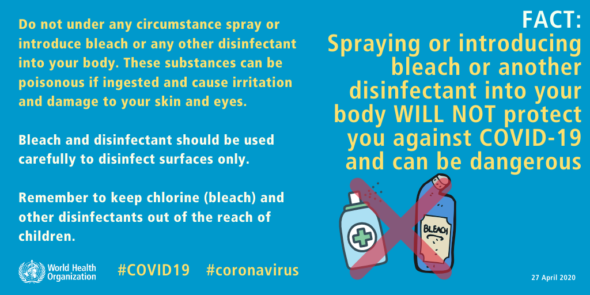

MYTH BUSTERS

Slide 13
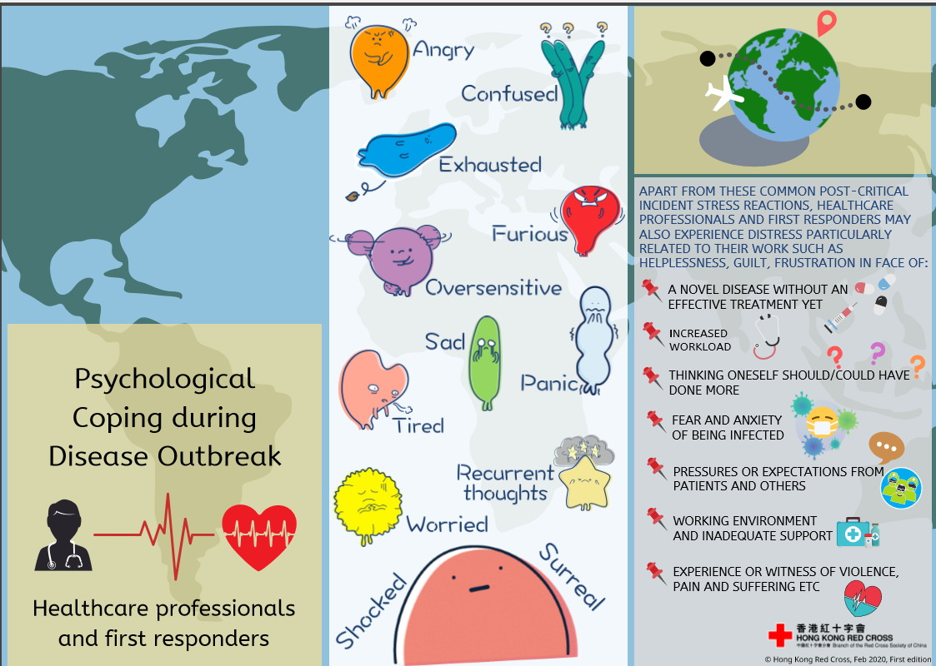
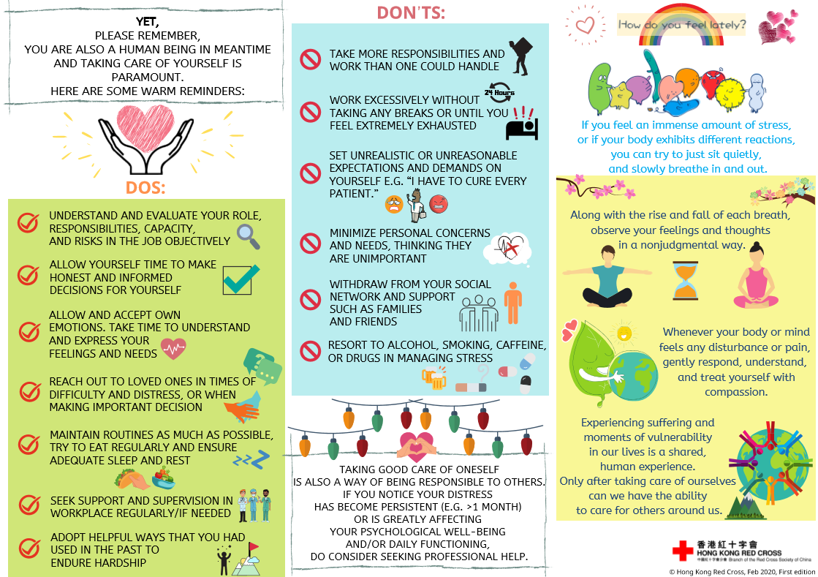
PSYCHOLOGICAL COPING TIPS

Slide 14
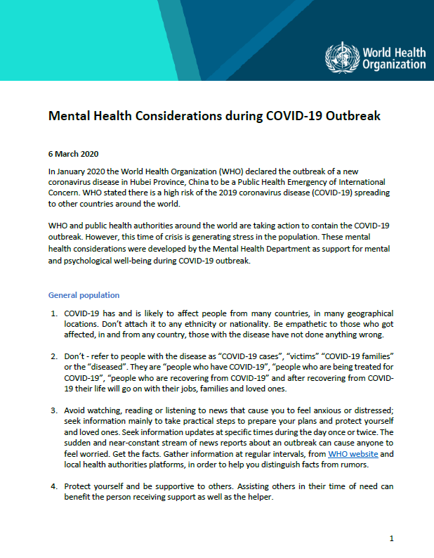
WHO MENTAL HEALTH GUIDANCE BY STAKEHOLDER
Stay informed:
Find the latest information from WHO on where COVID-19 is spreading:
https://www.who.int/emergencies/diseases/novel-coronavirus-2019/situation-reports/
Advice and guidance from WHO on COVID-19
https://www.who.int/emergencies/diseases/novel-coronavirus-2019
https://www.epi-win.com/

Slide 15
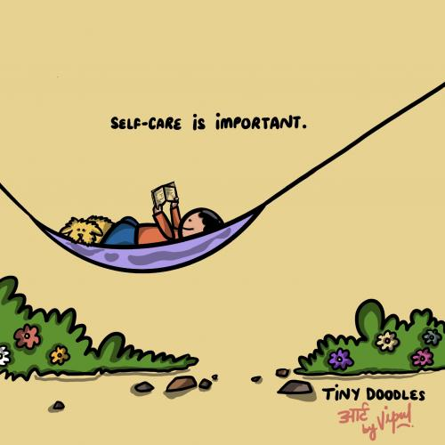
Strengthen & integrate PSS in RCCE?

Slide 16
NORMALISE - caregivers’ feelings of worry, uncertainty and stress during this time as they take on additional responsibilities and tasks
WORK - with the local health community and traditional healers around health advice, positive messaging and counteracting misinformation
PROVIDE - practical tips to support children’s wellbeing and learning and help parents and caregivers take care of their own wellbeing during this stressful time
SUPPORT - children to continue learning to help them feel positive about the future and ready to return to school as soon as they reopen
EXPLORE - local educational resources that are available
INVITE - children to participate in household activities that can promote learning such as cooking, sewing, building projects etc

Slide 17
PSS MESSAGES FOR URBAN SLUMS
PARENTS
EMPATHIZE - children and adolescents are feeling and absorbing the stress, fear and anxiety around them. Empathize and understand these emotions.
LISTEN and UNDERSTAND - Be patient and try to understand the emotion of children if they behave differently (irritated, aggressive, do not want to speak, sleep or eating habit changes)
ENGAGE - children in creative and interactive activity (playing and drawing can facilitate this process. Help children find positive ways to express disturbing feelings such as anger, fear and sadness
Your family may be facing many challenges including loss of livelihoods. Discuss with your children and assure them that together you will try to get over this phase.
If children have access to smart phone and internet, allow them to use these for studying and talking to friends. However, talk to them about being safe online.
ROUTINE - Keep regular routines and schedules as much as possible
DISCOURAGE - If children witness violence at home, or are the target of the violence, it causes trauma and distress and may lead to disruptive behavior
Use of alcohol/ other narcotic substances within the family and community.
EXPLAIN – No one should be stigmatized or signaled for having the disease
Doctors, nurses and other service providers are helping others in this difficult time. We must respect them.
AVOID - watching, reading, listening or discussing too much about COVID-19 and persuade children to divert their attention to other topics as well
ACTION - when sick go to hospital. If there has been a death, children may need specialized help. Call CHILDLINE 1098 to speak to a counsellor
For specialised help call NIMHANS 08046110007 (Toll free)
HEALTH CARE WORKERS
ORGANISE - Access to a range of supports, including psychological first aid, to people in acute distress after exposure to an extreme stressor.
USE - Channels such as the media to provide accurate information that reduces stress and enables people to access humanitarian services.
MANAGE - To feel stressed in the current situation. Stress and the feelings associated with it are by no means a reflection that you cannot do your job or that you are weak. Managing your stress and psychosocial wellbeing during this time is as important as managing your physical health.
ENSURE - Take care of your basic needs and ensure rest and respite during work or between shifts, eat sufficient and healthy food, engage in physical activity, and stay in contact with family and friends. Avoid tobacco, alcohol or other drugs. In the long term, these can worsen your mental and physical wellbeing.
SUPPORT - Some workers may unfortunately experience avoidance by their family or community due to stigma or fear. This can make an already challenging situation far more difficult. If possible, staying connected with your loved ones including through digital methods is one way to maintain contact. Turn to your colleagues, your manager or other trusted persons for social support- your colleagues may be having similar experiences

