Slide 1
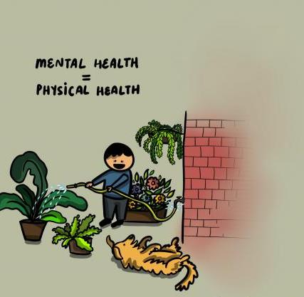

STRENGTHENING MENTAL HEALTH & PSYCHOSOCIAL SUPPORT DURING COVID-19 RESPONSE
C4D Section, New Delhi
May 2020

Slide 2
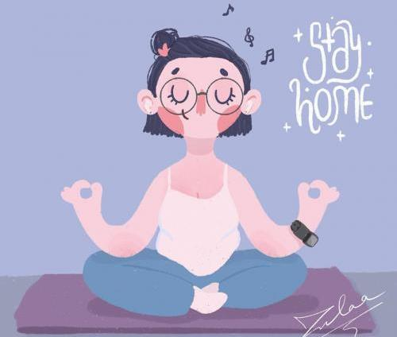
EXISTING MH & PSS TOOLS

Slide 3


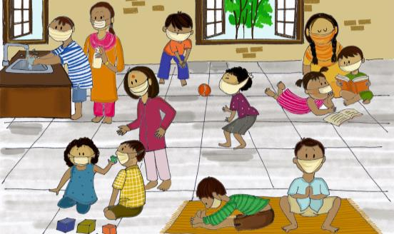
Psychosocial support for children during COVID-19
A Manual for Parents and Caregivers

Slide 4
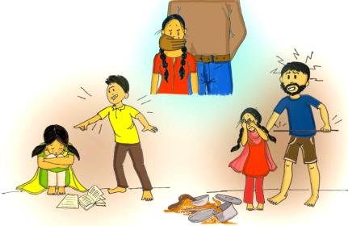
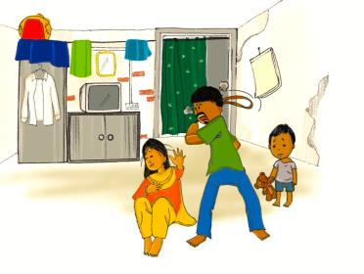
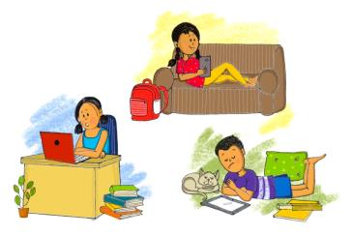
Violence, Abuse and Exploitation
Domestic Violence
Excessive screen time

Slide 5

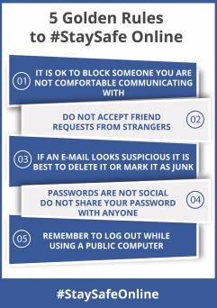
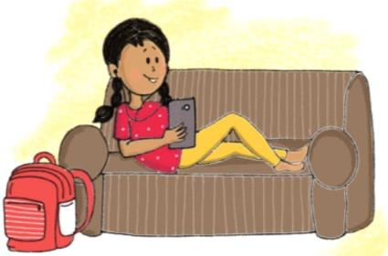
LET CHILDREN BE ONLINE,
connect with friends!
Teach children these 5 GOLDEN RULES to keep safe online.

Slide 6
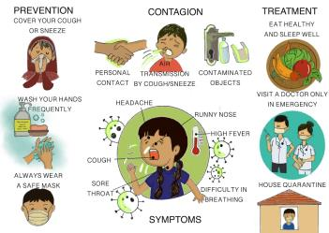
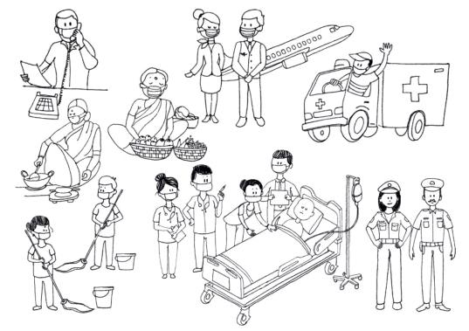
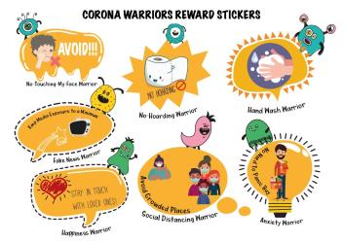
Toolkit for Children

Slide 7



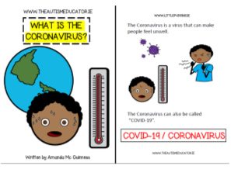
E-book and Audiobook
Comic Books

Slide 8
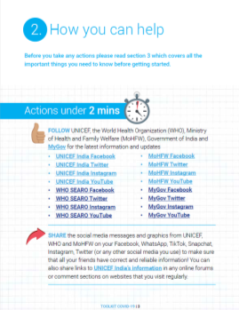

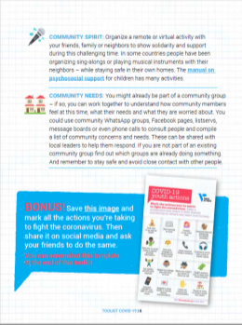
UNICEF TOOLKIT
To spread awareness and take action on COVID-19

Slide 9
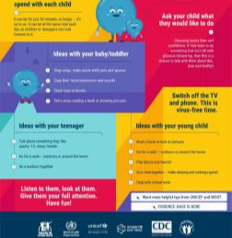
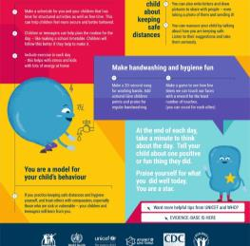
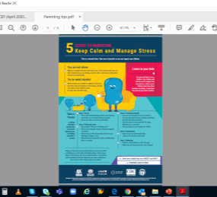
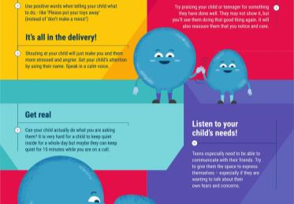
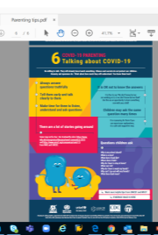
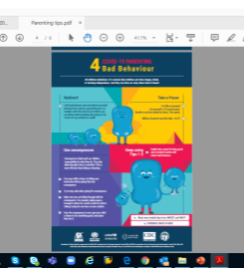
Parenting Tips
Information on common reactions for caregivers under stress and positive coping strategies. This may include information on the impacts of losing livelihoods, social isolation

Slide 10

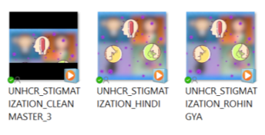



WHAT PARENTS SHOULD KNOW
S&D FILMS
GBV
pocket book
children’s booklet on s&d

Slide 11
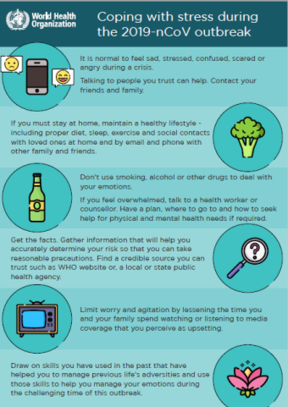
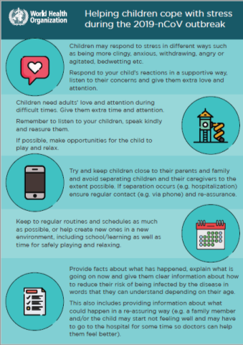
Managing Stress

Slide 12




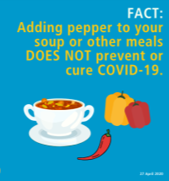

Myth Busters

Slide 13
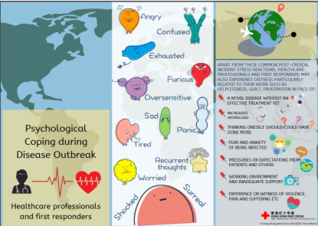
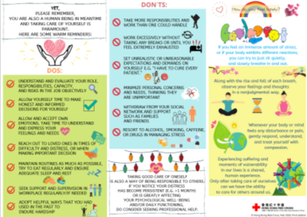
Psychological Coping Tips

Slide 14
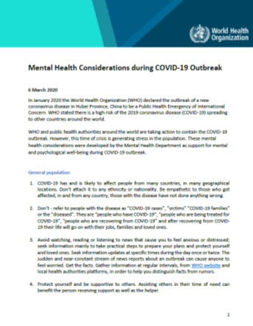
WHO mental health guidance by stakeholder
Stay informed:
Find the latest information from WHO on where COVID-19 is spreading:
https://www.who.int/emergencies/diseases/novel-coronavirus-2019/situation-reports/
Advice and guidance from WHO on COVID-19
https://www.who.int/emergencies/diseases/novel-coronavirus-2019
https://www.epi-win.com/

Slide 15
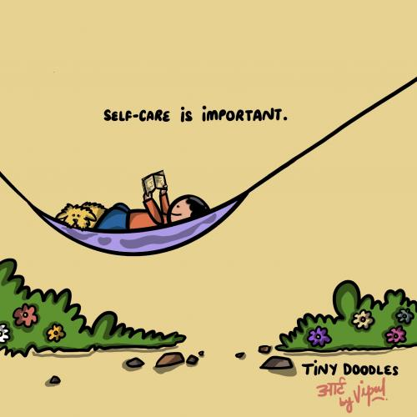
Strengthen & integrate PSS in RCCE

Slide 16
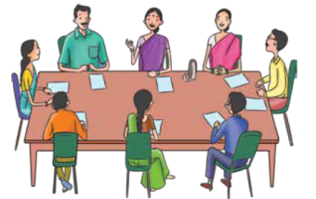
Coordinate efforts by different stakeholders to mobilise communities.
Assess the political, social and security environment at the earliest possible stage.
Talk with a variety of key informants and formal and informal groups, learning
how local people are organising and how different agencies can participate in the relief effort.
Facilitate the participation of marginalised people.
Establish safe and sufficient spaces early on to support planning discussions and the dissemination of information.
Promote community mobilisation processes.
Identify human resources in the local community.
COMMUNITY MOBILISATION AND SUPPORT
Facilitate conditions for community mobilisation, ownership and control of emergency response in all sectors

Slide 17

Facilitate the process of community identification of priority actions through participatory rural appraisal and other participatory methods.
Support community initiatives, actively encouraging those that promote family and community support for all emergency-affected community members, including people at greatest risk.
Encourage and support additional activities that promote family and community support for all emergency-affected community members and, specifically, for people at greatest risk.
Provide short, participatory training sessions where appropriate, coupled with follow-up support.
When necessary, advocate within the community and beyond on behalf of marginalised and at-risk people.
COMMUNITY MOBILISATION AND SUPPORT
Facilitate conditions for community mobilisation, ownership and control of emergency response in all sectors

Slide 18
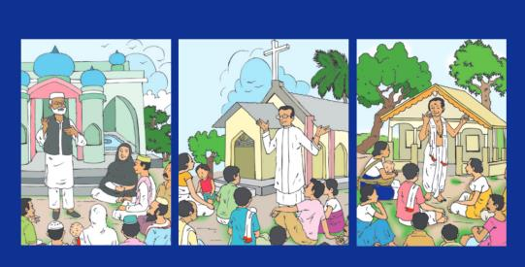
FAITH BASED LEADERS
Facilitate conditions for appropriate communal cultural, spiritual and religious healing practices
Approach local religious and spiritual leaders and other cultural guides to learn their views on how people have been affected and on practices that would support the affected population.
Exercise ethical sensitivity.
Learn about cultural, religious and spiritual supports and coping mechanisms.
Disseminate the information collected among humanitarian actors at sector and coordination meetings.
Facilitate conditions for appropriate healing practices.

Slide 19
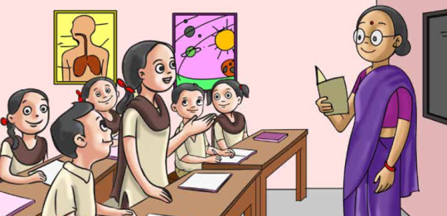
Education
Strengthen access to safe and supportive education
Promote safe learning environments.
Make formal and non-formal education more supportive and relevant.
Strengthen access to quality education for all.
Prepare and encourage educators to support learners’ psychosocial well-being.
Strengthen the capacity of the education system to support learners experiencing psychosocial and mental health difficulties.

Slide 20
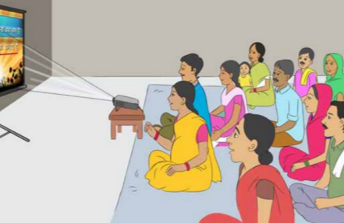
Dissemination of information
Provide information to the affected population on the emergency, relief efforts and their legal rights
Facilitate the formation of an information and communication team.
Regularly assess the situation and identify key information gaps and key information for dissemination.
Develop a communication and campaign plan.
Create channels to access and disseminate credible and valid information to the affected population.
Ensure coordination between communication personnel working in different agencies.

Slide 21
Allow yourself time to heal
Parents are often so focused on taking care of their families, that they do not take the time to take care of themselves. Allow yourself time and space to express your feelings about what happened
Be patient with your emotional state, as it is normal after a trauma to experience mood fluctuations
Ask for and provide support
Spend time talking with other adults who will understand what you are going through. While it is always a good idea to seek support from loved ones, remember that those in your typical support system may be compromised if they experienced the same event. If this is the case, you may want to find out about local support groups
Avoid making major life decisions
Your life choices also affect children. While it may be tempting to move or change jobs after a traumatic event, it is usually best to avoid making major life decisions during times of stress and turmoil
Listen to children, trust them and take their views into consideration while making decision
Based on NIMHANS guidance

Slide 22
PSS MESSAGES FOR URBAN SLUMS
Parents
EMPATHISE and understand feeling and the stress, fear and anxiety being absorbed by children and adolescents
Be patient and try to LISTEN AND UNDERSTAND the emotion of children if they behave differently (irritated, aggressive, do not want to speak, sleep or eating habit changes)
ENGAGE children in creative and interactive activity (playing and drawing can facilitate this process. Help children find positive ways to express disturbing feelings such as anger, fear and sadness.
Keep regular ROUTINES and schedules as much as possible
DISCOURAGE - If children witness violence at home, or are the target of the violence, it causes trauma and distress and may lead to disruptive behavior
Use of alcohol/ other narcotic substances within the family and community
EXPLAIN – No one should be stigmatised or signaled for having the disease
Doctors, nurses and other service providers are helping others in this difficult time. We must respect them.
AVOID watching, reading, listening or discussing too much about COVID-19 and persuade children to divert their attention to other topics as well
ACTION - when sick go to hospital. If there has been a death, children may need specialised help. Call CHILDLINE 1098 to speak to a counsellor
For specialised help call NIMHANS 08046110007 (Toll free)

Slide 23




PSS MESSAGES FOR URBAN SLUMS
Health care workers
SUPPORT Some workers may unfortunately experience avoidance by their family or community due to stigma or fear. This can make an already challenging situation far more difficult. If possible, staying connected with your loved ones including through digital methods is one way to maintain contact. Turn to your colleagues, your manager or other trusted persons for social support- your colleagues may be having similar experiences
ORGANISE Access to a range of supports, including psychological first aid, to people in acute distress after exposure to an extreme stressor.
MANAGE To feel stressed in the current situation. Stress and the feelings associated with it are by no means a reflection that you cannot do your job or that you are weak. Managing your stress and psychosocial wellbeing during this time is as important as managing your physical health.
USE Channels such as the media to provide accurate information that reduces stress and enables people to access humanitarian services.
ENSURE Take care of your basic needs and ensure rest and respite during work or between shifts, eat sufficient and healthy food, engage in physical activity, and stay in contact with family and friends. Avoid tobacco, alcohol or other drugs. In the long term, these can worsen your mental and physical wellbeing.

Slide 24
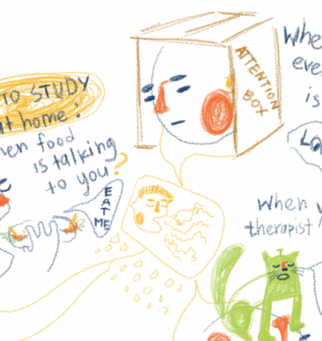

Thank You

