Slide 1

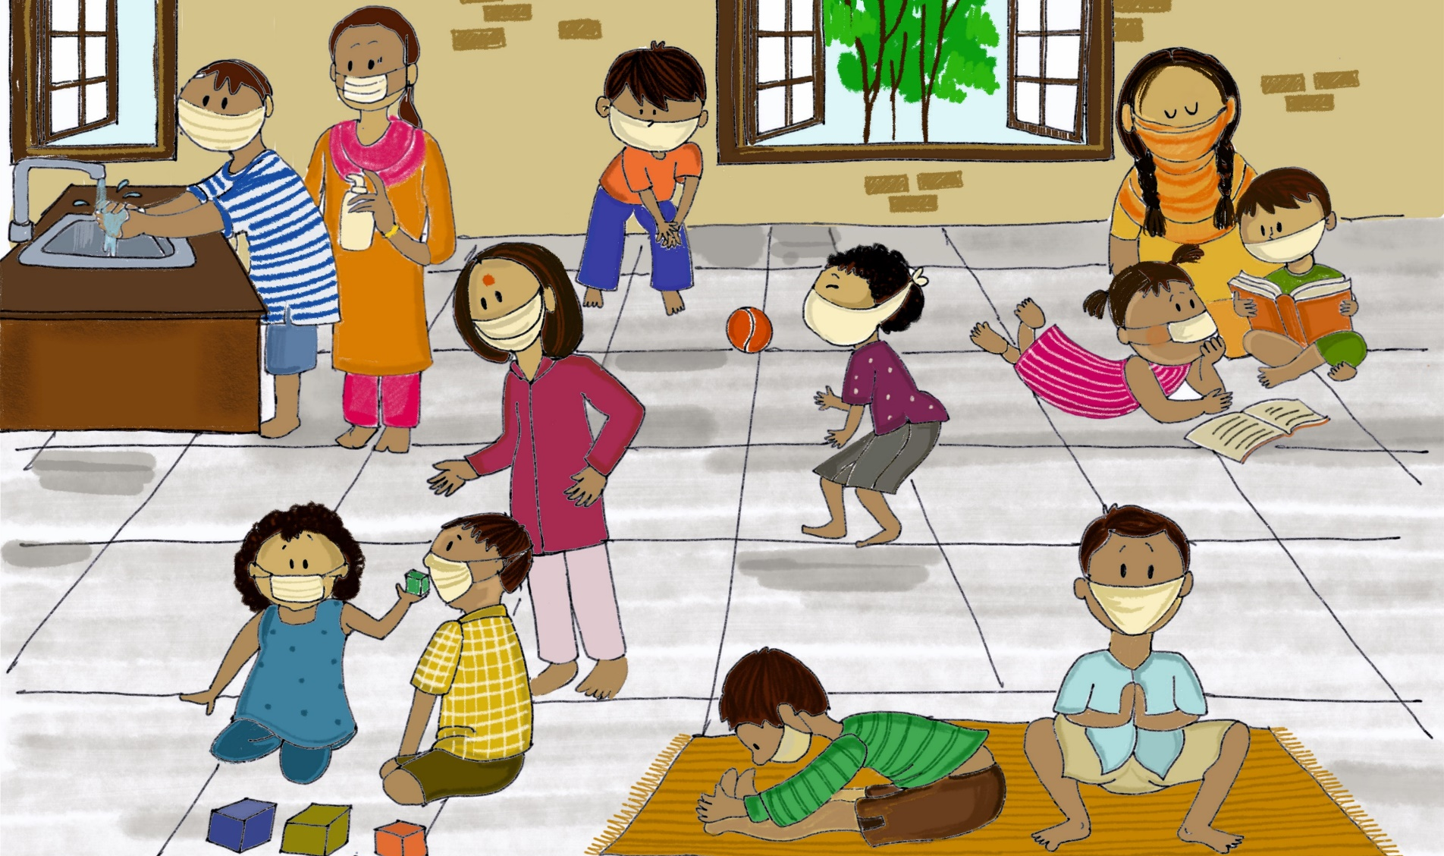
Mental Health and Psychosocial Support for Children during COVID-19
Arupa Shukla, C4D Specialist, New Delhi

Slide 2
Common reactions and behaviors in epidemics
Fear of being sick, and of the way in which one dies
Fear of symptoms and diseases that are easily treated
Fear of falling ill and dying keep people from approaching health workers or health facilities
Fear of losing livelihood, not being able to work during isolation, and of being fired because the employer is afraid of contamination etc.
Feeling of helplessness and depression due to being isolated
Mistrust and anger of everyone associated with the disease
Stigmatization and fear of patients, healthcare workers and caregivers
Refuse approaches by volunteers and medical workers; threatening them verbally or physically
Refuse to care for unaccompanied or separated minors due to fear of contamination
Belief that prayer is the only thing that will save people

Slide 3
Rumors related to nCoV
Some of the rumors circulating in the nCoV outbreak are:
The virus only attacks old people and spares young people and children
The virus can be transmitted through pets and people should abandon their pets
The use of mouthwash, antibiotics, cigarettes, and liquor with high alcohol can kill nCoV
Going to a sauna and firing of fireworks can prevent nCoV
The disease is premeditated and nCoV is a bioweapon designed to target a specific population
Food items are contaminated and will spread the virus
Patients hide their disease because they intentionally want to spread virus to others

Slide 4
What is Psychosocial stressors during COVID-19?
Stress is common
It is common and normal for individuals to feel stressed and worried in response to any disease outbreak.
Specific stressors particular to the COVID-19 pandemic are:
Rumours and misinformation (social media)
Closure of schools and children’s activity spaces
Travel restrictions
Possibility of or actual physical isolation and quarantine
Deterioration of trust in government agencies and social networks
Avoidance of health facilities
Risk of relapse in pre-existing health conditions (including mental health)
Common symptoms of other health problems can lead to fear of infection

Slide 5
What is Social stigma
Be kind to all people affected
Discrimination towards persons who have been infected
and their family members
Social stigma towards those treating and caring for patients
Social stigma towards specific ethnic groups, population groups
or nationalities

Slide 6






Preparedness will improve and accelerate the response
Overarching principles
MHPSS should be considered a cross-cutting issue amongst all sectors and emergency pillars involved in the response
Addressing MHPSS considerations will be key to stopping transmission and preventing the risk of long-term repercussions on the population’s well-being.
Hope, safety, empathy, social connectedness and self- and community efficacy should be embedded across every intervention.
Clear coordination mechanisms and integration of MHPSS technical expertise are critical.
Local actors need to be supported with both accurate knowledge and facts about COVID-19 as well as MHPSS skills.
MHPSS responses must be grounded in the context, to evolve and adapt to the needs of each population over the course of the outbreak.
People with mental health, substance abuse or psychosocial disabilities need continued/uninterrupted access to care and support during the outbreak.
Notes:
Explain MHPSS: Mental Health and Psychosocial Support.

Slide 7
Messages to the general public
1. People who are affected by COVID-19 have not done anything wrong, and they deserve our support, compassion and kindness.
2. To reduce stigma, do not label people as COVID-19 patients, to ensure that they are not defined by COVID-19.
3. The sudden and near-constant stream of news reports about an outbreak can cause anyone to feel worried. Get the facts, not rumours and misinformation. Gather information at regular intervals, from the WHO website and local health authorities’ platforms, in order to help you distinguish facts from rumours. Facts can help to minimize fears.
4. Protect yourself and be supportive of others. Assisting others in their time of need can benefit the helper as well as the person receiving the support.
5. COVID-19 has affected, and is likely to affect, people from many countries and in many geographical locations. Do not attach a label of COVID-19 to any ethnicity or nationality. Be empathetic to all those who are affected, in and from any country.
Notes:
Do not refer to people with the disease as “COVID-19 cases”, “victims”, “COVID-19 families” or “the diseased”. They are “people who have COVID-19”, “people who are being treated for COVID-19” or “people who are recovering from COVID-19”, and after recovering from COVID-19 their lives will go on with their jobs, families and loved ones.
Minimize watching, reading or listening to news that causes you to feel anxious or distressed; seek information only from trusted sources and mainly in order to take practical steps to prepare your plans and protect yourself and loved ones. Seek information updates at specific times during the day, once or twice a day.
For example, check in by phone on neighbours or people in your community who may need some extra assistance. Working together as one community can help to create solidarity in addressing COVID-19 together.

Slide 8
Messages to carers of children
1. Children feel relieved if they can express and communicate their feelings in a safe and supportive environment.
2. Keep children close to their parents and family, if it is considered safe for the child, and avoid separating children and their caregivers as much as possible. If a child needs to be separated from their primary caregiver, ensure that appropriate alternative care is provided and that a social worker, or equivalent, will regularly follow up on the child.
3. Maintain familiar routines in daily life as much as possible, or create new routines, especially if children must stay at home. Provide engaging age-appropriate activities for children, including activities for their learning.
Notes:
Help children find positive ways to express feelings such as fear and sadness. Every child has their own way of expressing emotions. Sometimes engaging in a creative activity, such as playing or drawing, can facilitate this process.
Further, ensure that during periods of separation regular contact with parents and caregivers is maintained, such as twice-daily scheduled phone or video calls or other age-appropriate communication (e.g. social media depending on the age of the child).
As much as possible, encourage children to continue to play and socialize with others, even if only within the family, when advised to restrict social contract.

Slide 9
Messages to healthcare workers
1. Managing your mental health and psychosocial well-being during this time is as important as managing your physical health.
2. Try and use helpful coping strategies such as ensuring sufficient rest and respite during work or between shifts, eat sufficient and healthy food, engage in physical activity and stay in contact with family and friends. Avoid using unhelpful coping strategies such as tobacco, alcohol or other drugs. In the long term, these can worsen your mental and physical well-being.
3. Turn to your colleagues, your manager or other trusted persons for social support – your colleagues may be having similar experiences to you.
4. Use understandable ways to share messages with patients with intellectual, cognitive and psychosocial disabilities.
Notes:
For health workers, feeling under pressure is a likely experience for you and many of your colleagues. It is quite normal to be feeling this way in the current situation. Stress and the feelings associated with it are by no means a reflection that you cannot do your job or that you are weak.
This is a unique and unprecedented scenario for all workers. Even so, using strategies that have worked for you in the past to manage times of stress can benefit you now. You are most likely to know how to de-stress and you should not be hesitant in keeping yourself psychologically well. This is not a sprint; it’s a marathon.
Some healthcare workers may unfortunately experience avoidance by their family or community due to stigma or fear. This can make an already challenging situation far more difficult. As far as possible, stay connected with your loved ones; digital methods are one means of maintaining contact.’

Slide 10
Messages to older adults and their carers
1. Provide practical and emotional support through informal networks (families and peers) and health professionals.
2. Share simple facts about what is going on and give clear information about how to reduce the risk of infection in words that older people with/without cognitive impairment can understand. Repeat the information whenever necessary. Instructions need to be communicated in a clear, concise, respectful and patient way.
3. Be prepared and know in advance where and how to get practical help if needed, such as calling a taxi, having food delivered and requesting medical care.
4. Keep regular contact with loved ones (e.g. via phone or other means).
Notes:
Older adults, especially in isolation and those with cognitive decline/dementia, may become more anxious, angry, stressed, agitated and withdrawn during the outbreak or while in quarantine.
It may also be helpful for information to be displayed in writing or pictures. Engage their family and other support networks in providing information and helping them to practise prevention measures (e.g. handwashing, etc.)
Make sure that you have up to two weeks’ supply of all the regular medicines that you may require.
Keep to regular routines and schedules as much as possible or help create new ones in a new environment, including regular exercising, cleaning, daily chores, singing, painting or other activities.

Slide 11

Messages to people in isolation or quarantine
1. Try as much as possible to keep to your personal daily routines or create new ones. Engage in healthy activities that you enjoy and find relaxing. Exercise regularly, maintain regular sleep routines and eat healthy food. Keep things in perspective and use IT to connect with loved ones.
2. If health authorities have recommended limiting your physical contact to contain the outbreak, you can still stay socially connected via e-mail, social media, video conferencing and telephone.
Notes:
Minimize watching, reading or listening to news that causes you to feel anxious or distressed; seek information only from trusted sources and mainly in order to take practical steps, or to prepare your plans and protect yourself and loved ones. Seek information updates only at specific times during the day, once or twice a day. Get the facts, not rumours and misinformation. Gather information from the WHO website in order to help you distinguish facts from rumours. Facts can help to minimize fears. Check WHO Myth Busters.
Assisting others in their time of need can benefit the helper as well as the person receiving the support’. For example, check in by phone on neighbours or people in your community who may need some extra assistance. Working together as one community can help to create solidarity in addressing COVID-19 together.

Slide 12
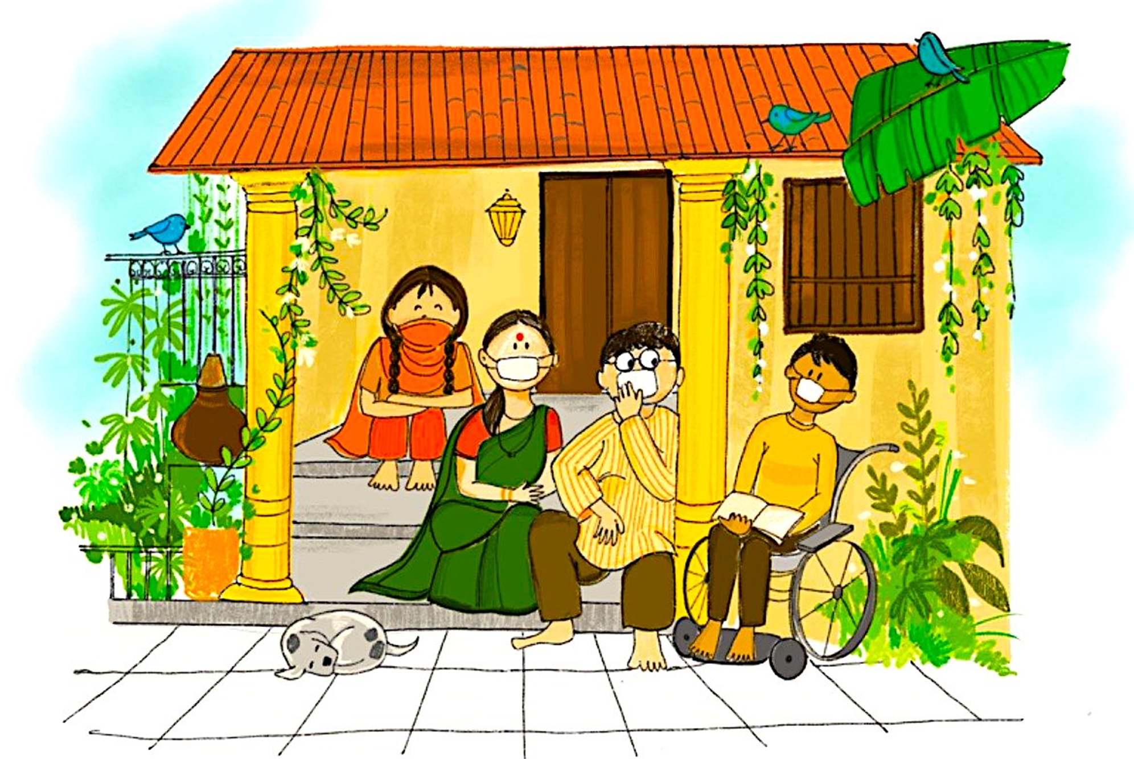

Slide 13

Helping Children deal with stressful events
Listen: Give children opportunities to talk about what they are feeling. Encourage them to share concerns and ask questions
Comfort: Use simple tools to comfort and calm children, for e.g. telling stories, singing with them and playing games. Praise them frequently for their strengths, such as showing courage, compassion and helpfulness
Reassure children that you are prepared to keep them safe. Provide them with correct information through valid sources
Listen
Comfort
Reassure

Slide 14
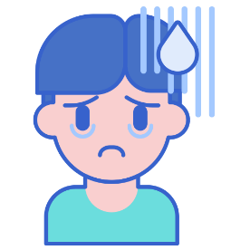
Recognizing signs of psychological distress needing specialized help
Some children may also face serious mental health issues due to ongoing pandemic. They may exhibit the following signs:
Difficulties in sleeping and eating
Nightmares
Being withdrawn or aggressive
Complain of pain in stomach or headache without physical reason
Having fears, being afraid to be left alone
Clinging, depending behaviours
New fears manifest (for instance of the dark)
Decreased interest in playing and engaging in playful activities
Being sad, crying more than usual or for no apparent reason
Please remember these children need specialized help from trained professionals. Call:
CHILDLINE 1098
Child Welfare Committee/District Child Protection Unit
NIMHANS 08046110007

Slide 15

Talking to children about COVID 19
Children need adults to help them understand what is going on.
Talk to children about what is happening in a way that they can understand.
Keep it simple and appropriate for each child’s age.
Next few pages give you simple tips to take care of both physical and emotional needs of children and how to talk to them about COVID-19
For credible sources of information, verified by Ministry of Health and Family Welfare, Government of India, the caregivers and parents can call on National Helpline 1075 (toll-free) or 011-23978046. You can also write to: ncov2019@gov.in or ncov2019@gmail.com

Slide 16

Talking to children about rumors related to Coronavirus disease (COVID-19)
MYTHS & MISCONCEPTIONS on COVID-19
Parents and caregivers need to be mindful about myths and rumors that are circulating. Make sure they themselves understand the harms of spreading fake information in their own adult circles and around children.
The following information is NOT TRUE:
The virus attacks only old people and children and spares young people
The virus is transmitted through pets and people should abandon their pets
The use of mouthwash, antibiotics, cigarettes, and liquor with high alcohol can kill CVOID-19
Going for a steam bath, outside in the sun, can prevent you from getting infected with corona virus
All food items are contaminated and will spread the corona virus
There is no need to worry as Indians have higher immunity and are exposed to many diseases than people in the wester countries
Corona virus does not survive in warm/hot weather
Always use credible sources of information verified by Ministry of Health and Family Welfare, Government of India

Slide 17
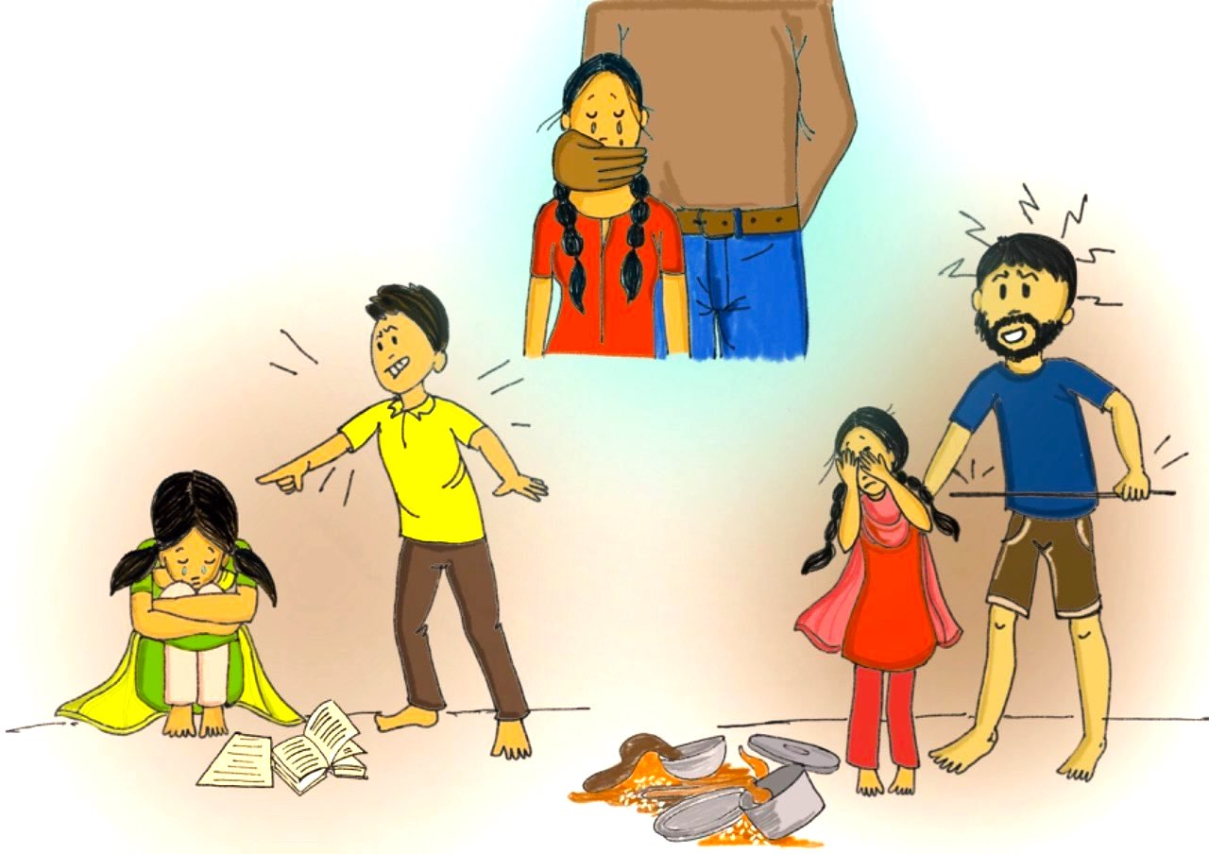
Handling heightened risks of violence, abuse and exploitation against children
Do you see any of these situations around you?

Slide 18
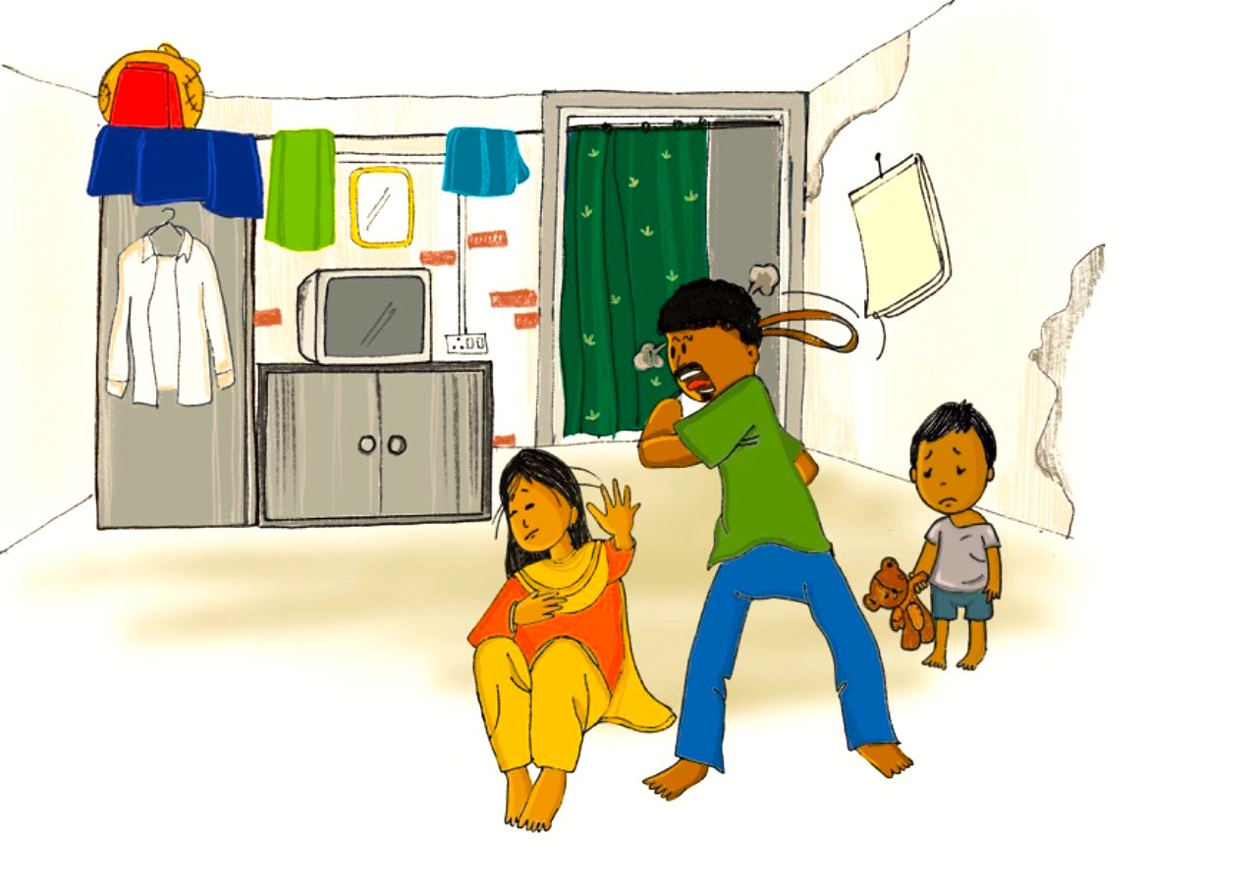
Handling heightened risks of violence, abuse and exploitation against children
Do you see any of these situations around you?

Slide 19
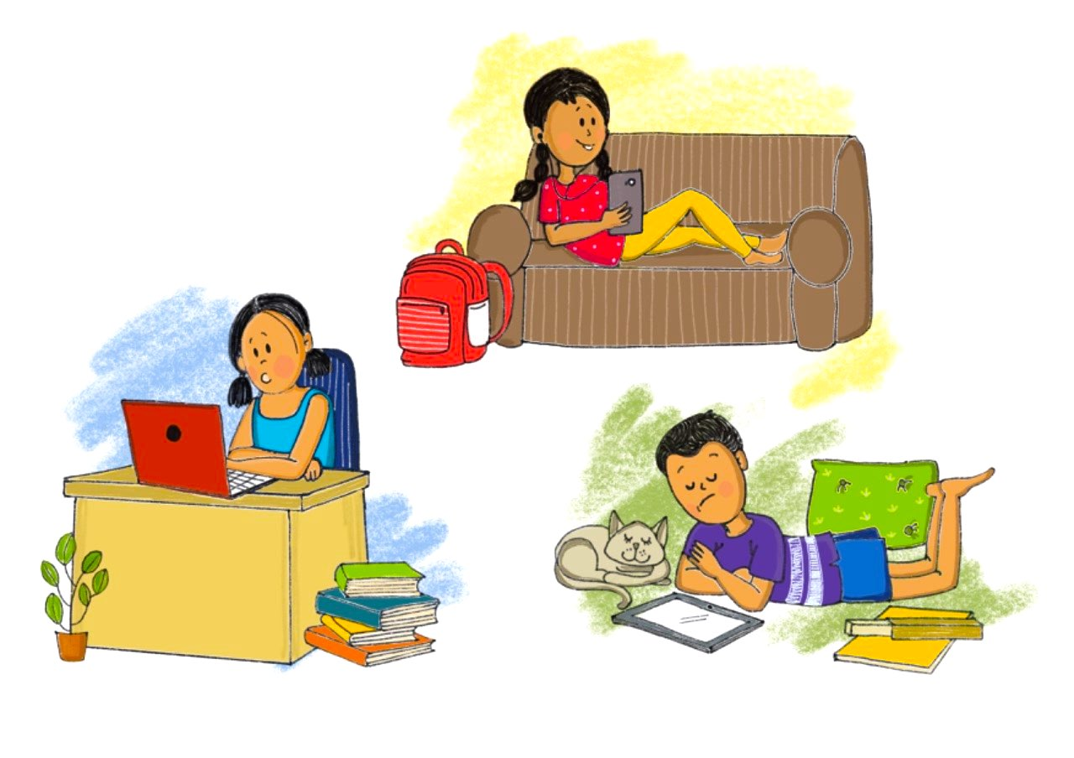
Handling heightened risks of violence, abuse and exploitation against children
Do you see any of these situations around you?

Slide 20
Increased risk of violence, abuse and exploitation
High stress in family due to social isolation, economic hardship and loss of livelihood increase risks of domestic violence and child abuse, including spanking or beating children, or using harsh language
School closures and movement restrictions means children are forced to spend much more time at home with adults and caregivers who are already stressed and worried
Sexual abuse can happen to any child or adolescent at any time or place. Be vigilant and aware.
Children spend more of their time online – and face the risk of exposure to online sexual abuse and grooming for sexual exploitation, cyberbullying and other online threats
Children in quarantine or isolation may be away from adult supervision, which may also increase protection risks.
Children with disabilities
Children with disabilities may have stronger reactions to ongoing pandemic. They might have more intense distress, worry or anger because they have less control over day-to-day well-being than other people. The same is true for children with other physical, emotional, or intellectual limitations. They may need extra words of reassurance, more explanations about the event, and more comfort and other positive reinforcements of messages. Talk to them, ensure their needs are taken care of and they are able to participate in all activities.

Slide 21

Keep children safe
Speak calmly and firmly to your child if she/he misbehaves, or undertakes any risky behavior.
Younger children who are throwing a tantrum more than usual, being defiant or acting out may actually be feeling anxious. Pick a calm, undistracted time and gently ask how they’re feeling and make sure to respond to outbursts in a calm, consistent, and comforting way.
Try to understand the situation and the reason behind a certain negative behavior.
Maintain a regular routine and give children specific responsibilities.
Build your relationship with them on mutual trust and respect. If you are concerned that your child may be at serious risk, talk to her/him about the possibility of asking for external support. Call CHILDLINE 1098.
Teach children about personal safety rules – their body belongs to them and any uncomfortable touch or gesture made by anyone which makes them feel unsafe is not acceptable.
Always trust/believe children if they report sexual abuse to you.
In case of sexual abuse of children always report and seek help. Call CHILDLINE 1098 or police helpline or Child Welfare Committee.
If you are facing domestic violence, seek help. Call women’s helpline 1091 or police 100.
Also refer to helpline numbers provided in Annexure 1 for domestic violence.

Slide 22

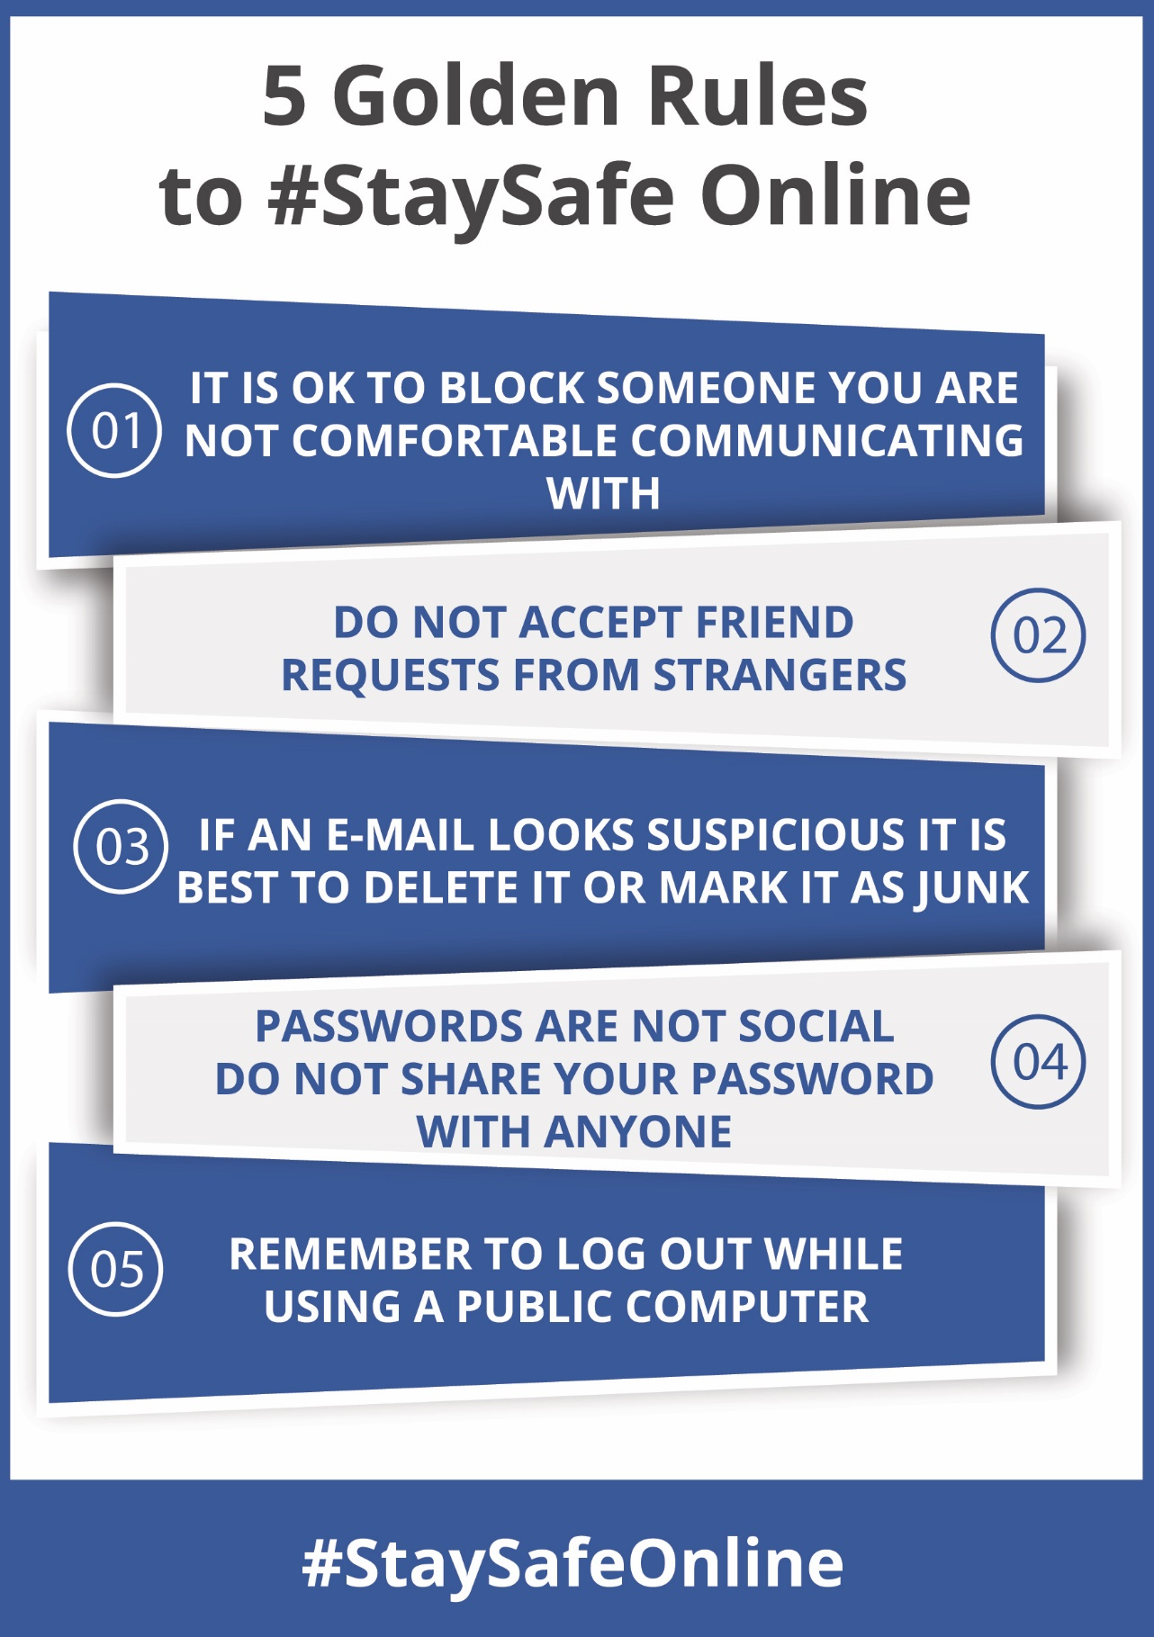
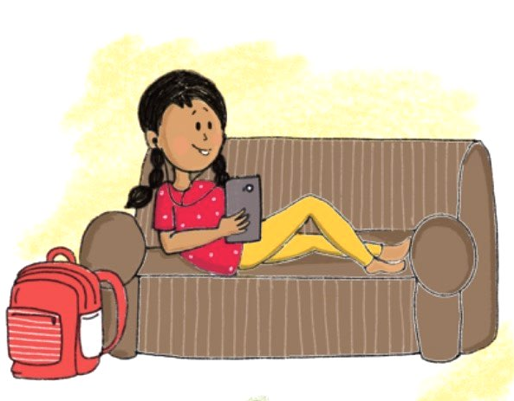
Let children be online, connect with friends!
Teach children these 5 golden rules to keep safe online.

Slide 23
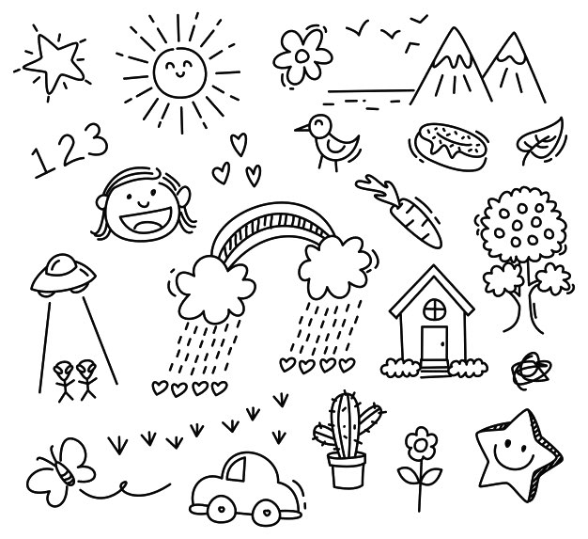
Toolkit For Age Group 6-10 years

Slide 24
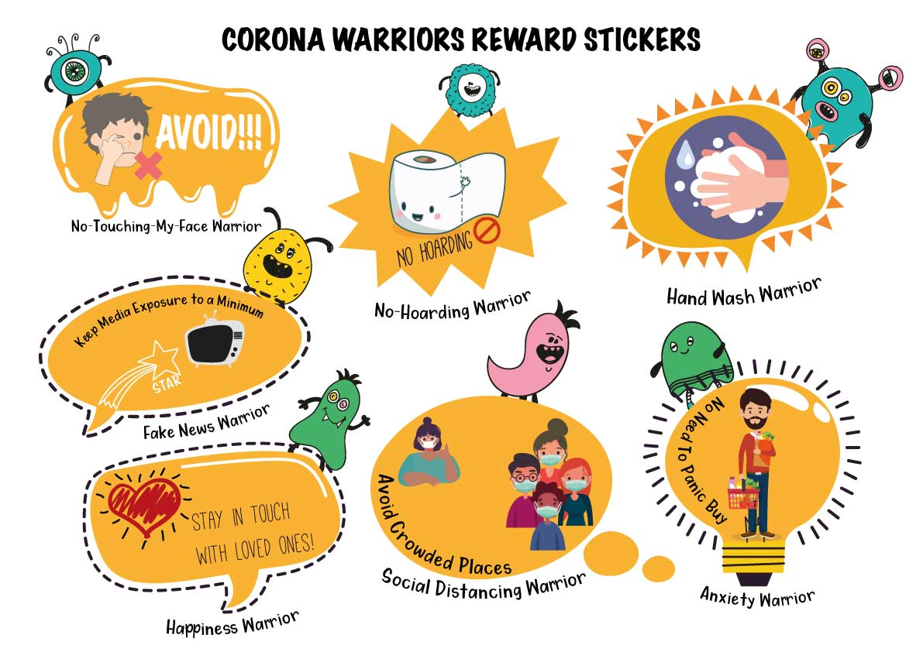

Slide 25
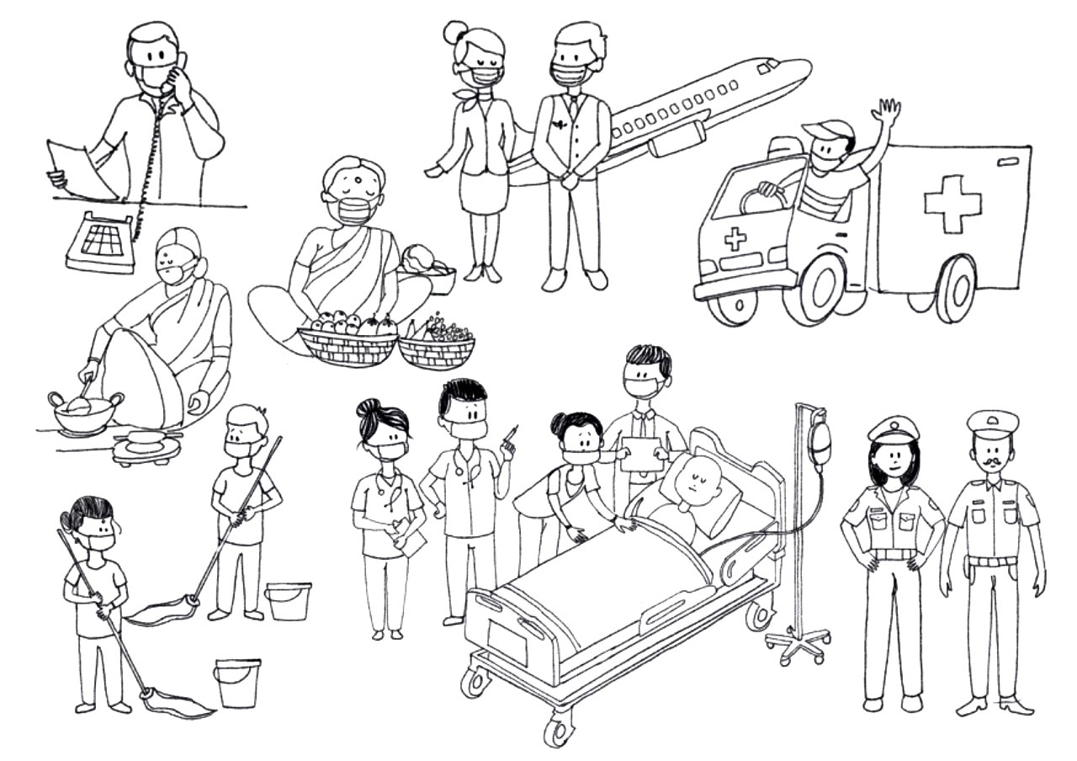
Heroes Fighting Coronavirus

Slide 26
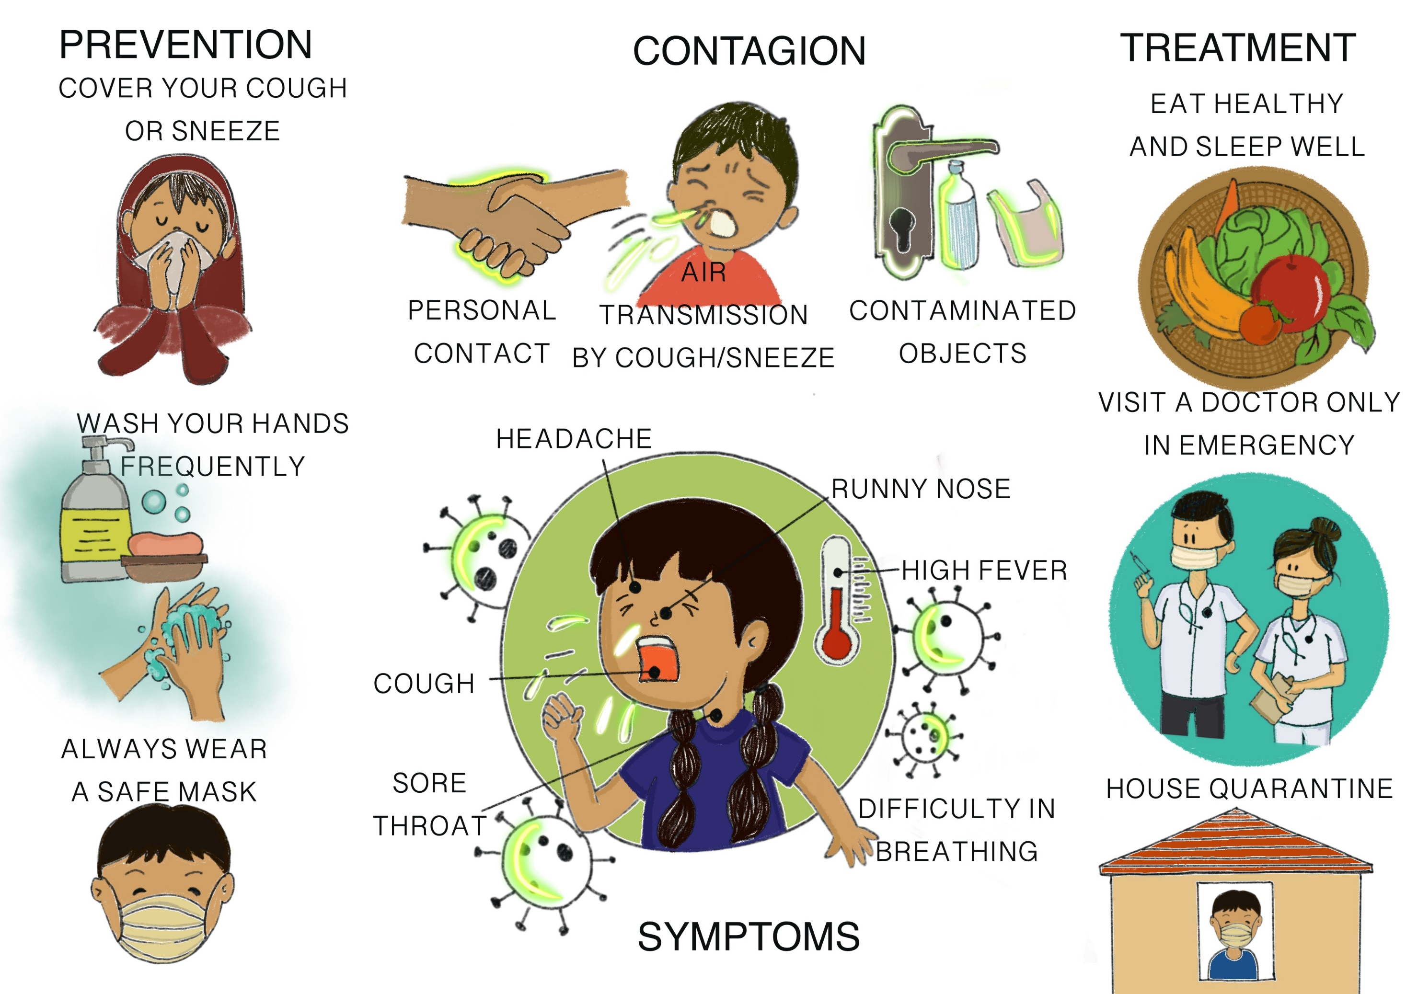
Infographic poster

Slide 28
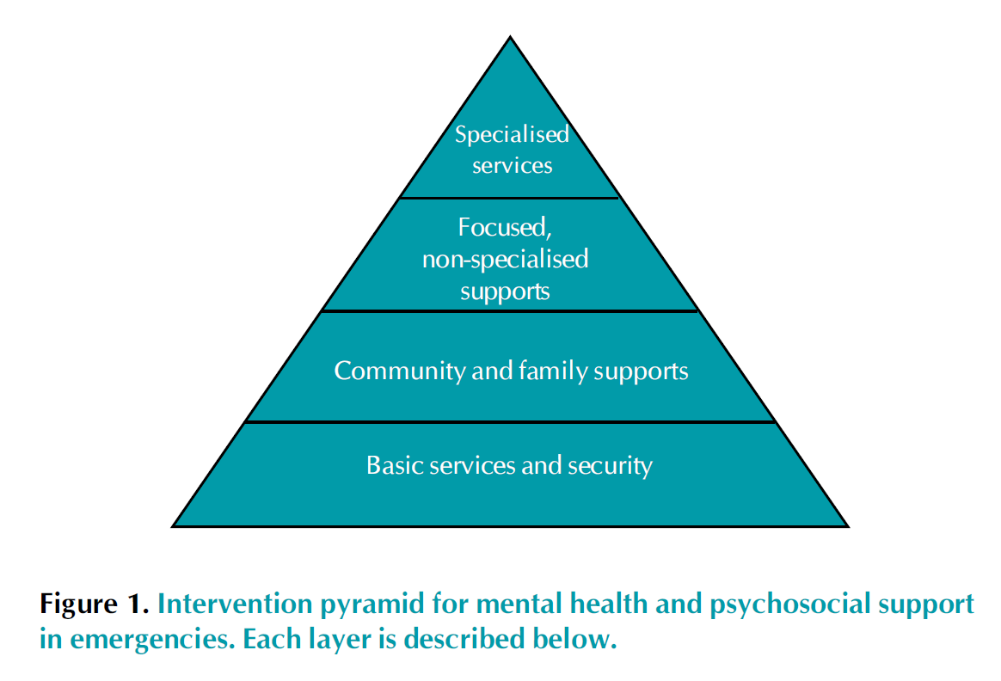

Slide 29
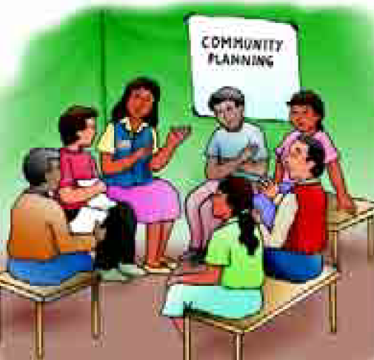
COMMUNITY MOBILISATION AND SUPPORT - Facilitate conditions for community mobilisation, ownership and control of emergency response in all sectors
Coordinate efforts by different stakeholders to mobilise communities.
Assess the political, social and security environment at the earliest possible stage.
Talk with a variety of key informants and formal and informal groups, learning
how local people are organising and how different agencies can participate in the
relief effort.
Facilitate the participation of marginalised people.
Establish safe and sufficient spaces early on to support planning discussions and the dissemination of information.
Promote community mobilisation processes.
Identify human resources in the local community.
Facilitate the process of community identification of priority actions through
participatory rural appraisal and other participatory methods.
Support community initiatives, actively encouraging those that promote family
and community support for all emergency-affected community members, including
people at greatest risk.
Encourage and support additional activities that promote family and community
support for all emergency-affected community members and, specifically, for people
at greatest risk.
Provide short, participatory training sessions where appropriate, coupled with
follow-up support.
When necessary, advocate within the community and beyond on behalf of
marginalised and at-risk people.

Slide 30
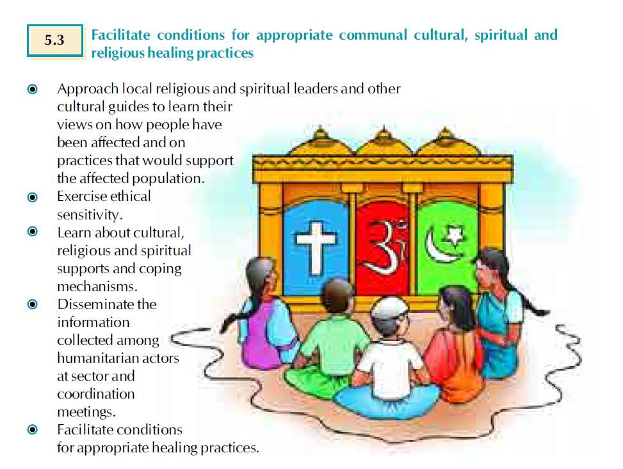

Slide 31
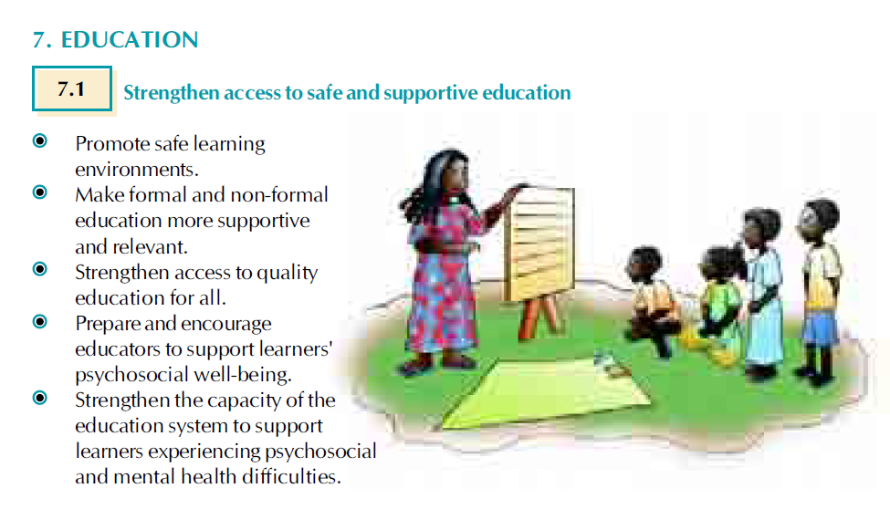

Slide 32
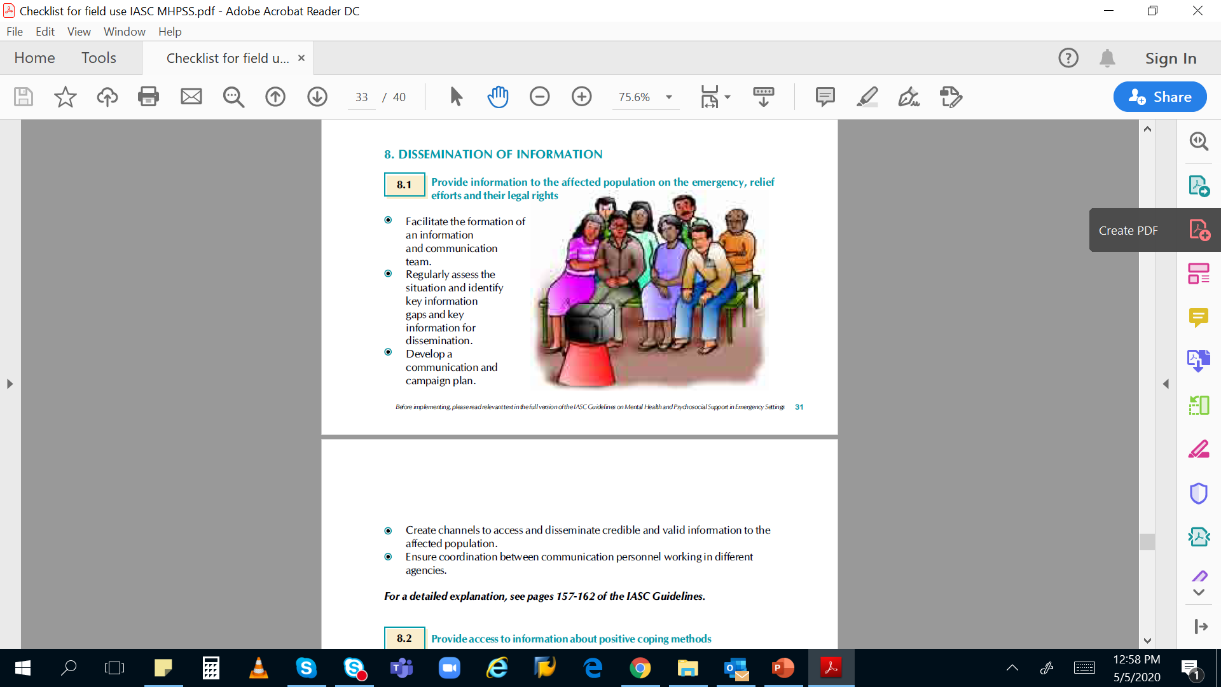

Slide 33
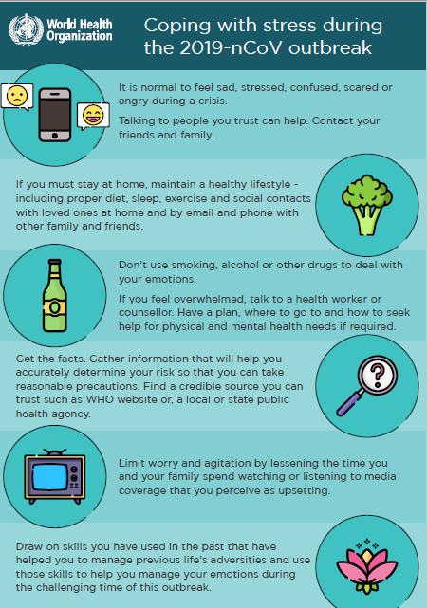
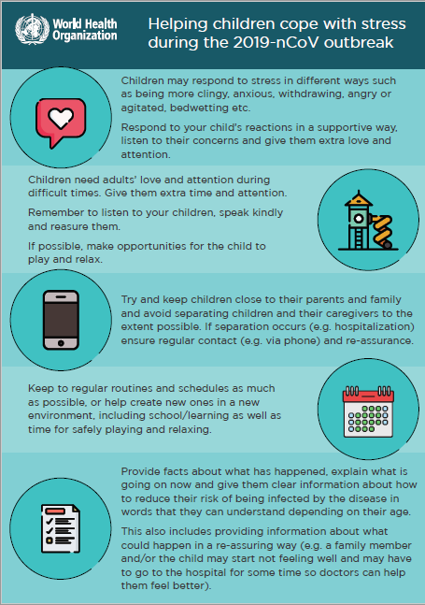
MANAGING STRESS

Slide 34
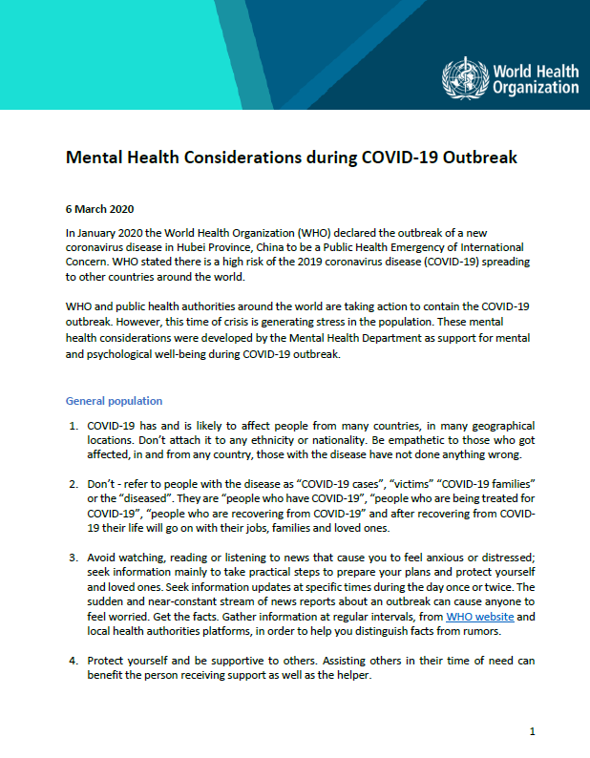
WHO GUIDANCE IN MH CONSIDERATIONS
Stay informed:
Find the latest information from WHO on where COVID-19 is spreading:
https://www.who.int/emergencies/diseases/novel-coronavirus-2019/situation-reports/
Advice and guidance from WHO on COVID-19
https://www.who.int/emergencies/diseases/novel-coronavirus-2019
https://www.epi-win.com/

Slide 35
Communication Considerations in Epidemics
When interacting consider:
Age, as children need things explained in simpler language
Gender e.g. women may prefer to talk to women and men to men
Culture e.g. some groups may prefer not to hold eye contact
Faith e.g. when people need to pray or what they can eat
Needs and disabilities where assistance may be required

Slide 36
Key psychosocial phrases conveying interest and empathy
I understand your concerns ...
You have the right to be (sad, angry ...) ….
I hear what you are saying ...
I understand that you are worried ...
In this situation, your reaction is normal ...
Maybe we can discuss possible solutions ...
What we can offer is …
I am concerned about you ...
With your consent, we would like to …

Slide 37
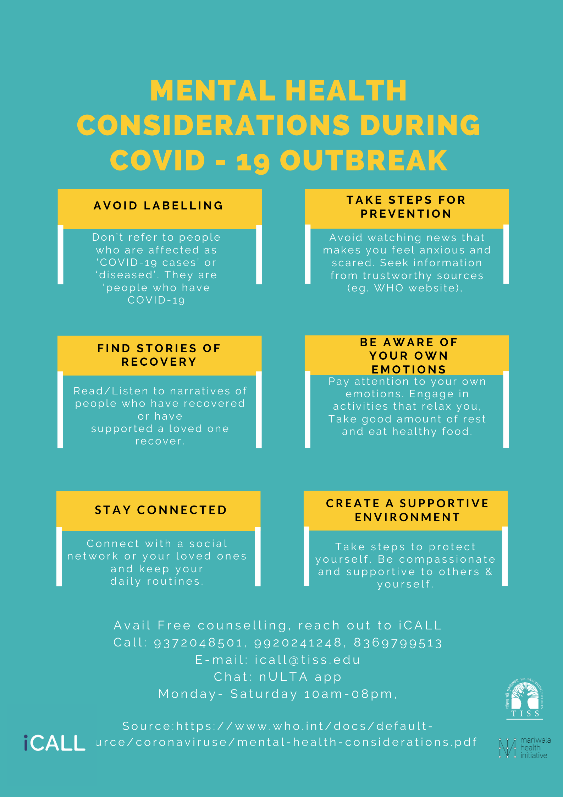

Slide 38
Handling Social isolation
Staying at home can be quite nice for some time, but can also be boring and restricting. Here are some ways to keep positive and cheerful.
1.Be busy. Have a regular schedule. Help in doing some of the work at home.
2.Distract yourself from negative emotions by listening to music, reading, watching anentertaining programme on television. If you had old hobbies like painting, gardening orstitching, go back to them. Rediscover your hobbies.
3.Eat well and drink plenty of fluids.
4.Be physically active. Do simple indoor exercises that will keep you fit and feeling fit.
5.Sharing is caring. Understand if someone around you needs advice, food or otheressentials. Be willing to share.
6.Elderly people may feel confused, lost and need help. Offer them help by getting themwhat they need, their medicines, daily needs etc.
7.If you have children at home, keep them busy by allowing them to help in the householdchores - make them feel responsible and acquire new skills.

Slide 39
Focus on facts, reject rumours and theories
1.Knowledge is power; the more you know about a certain issue, the less fearful you mayfeel. Make sure to access and believe only the most reliable sources of information forself-protection.
2.Do not follow sensational news or social media posts which may impact your mentalstate. Do not spread or share any unverified news or information further.
3.Do not keep discussing all the time about who got sick and how. Instead learn aboutwho got well and recovered.
4.Stick to the known advice- hand hygiene and keeping a physical distance from others. Itis being careful about yourself, and also about care of others.
5.A common cold is not Corona infection. The symptoms of Corona have been welldescribed. Follow etiquette of sneezing, coughing, avoiding spitting in public places etc.
6. In most people, the Corona infection causes mild symptoms and the person only needs to follow social distancing till he/she stops being infective, usually 2 weeks. Mild infection does not require a person to be admitted in hospital. Only people who have breathing difficulties need to be in hospital. Most people recover.

Slide 40
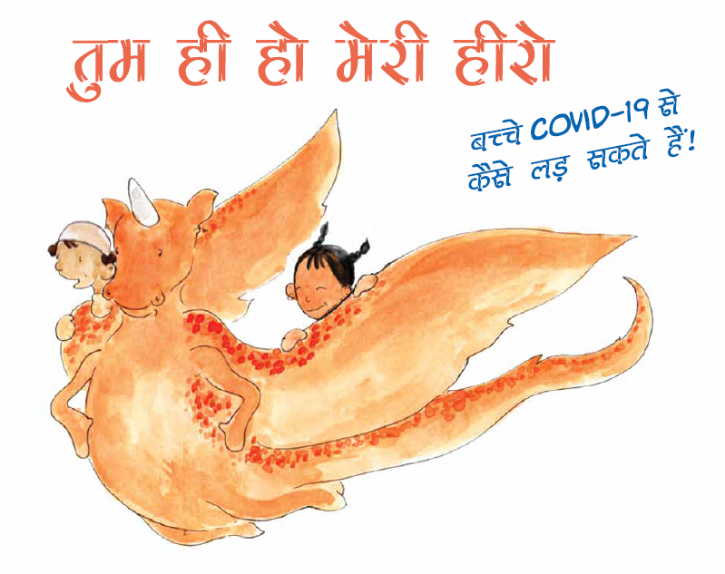
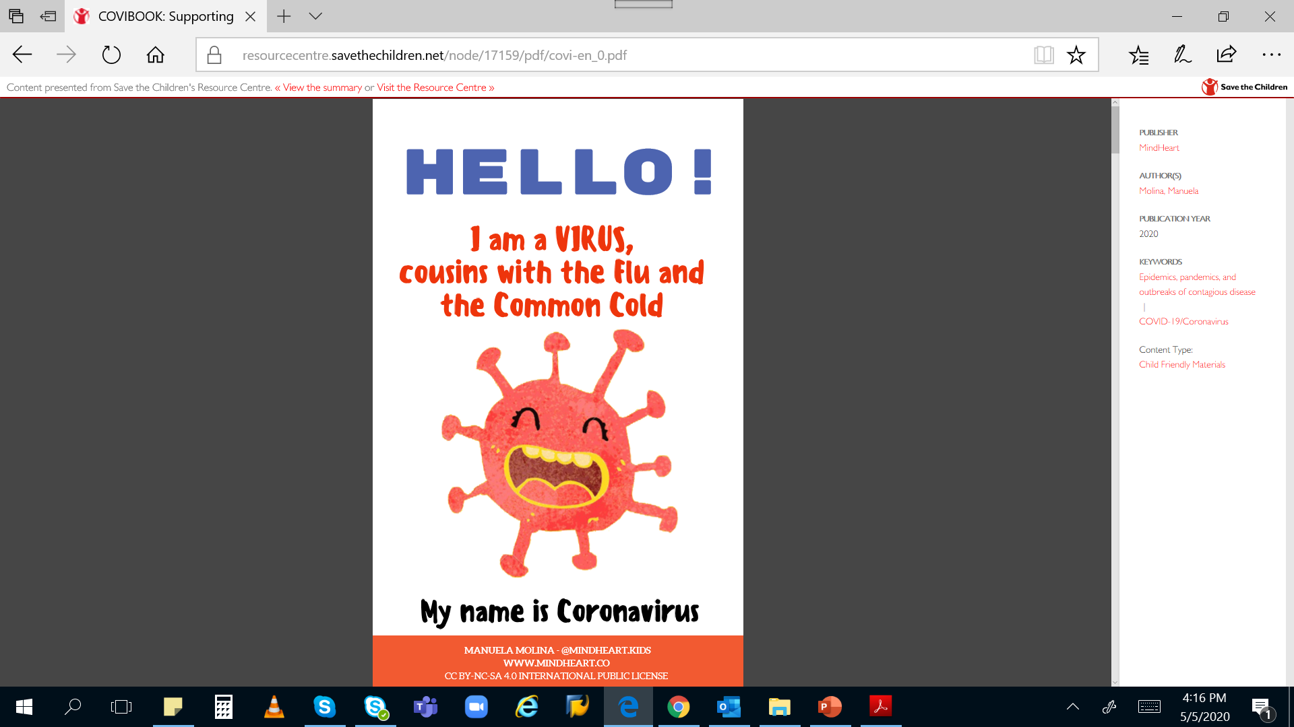

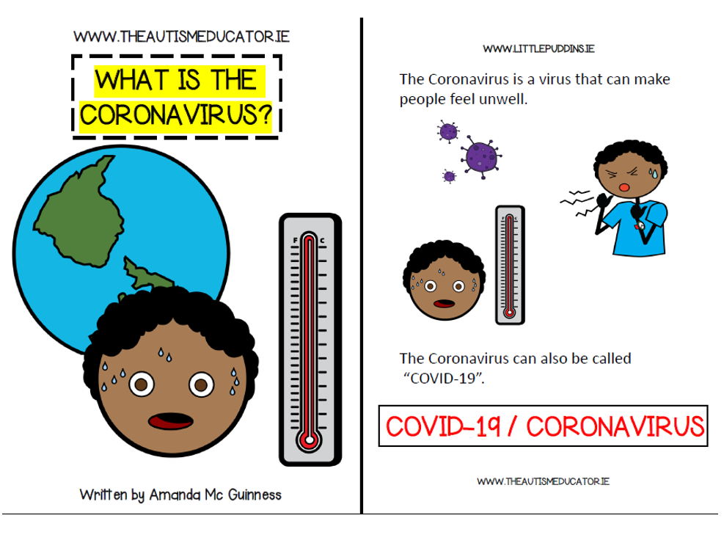

Slide 41
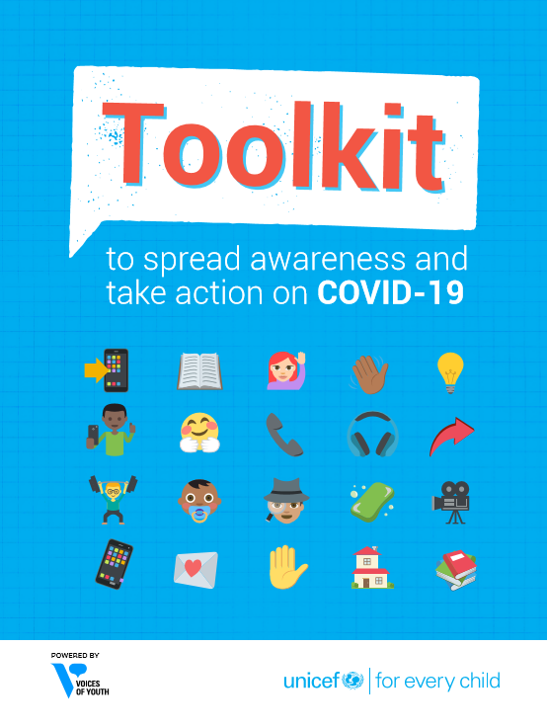
UNICEF Toolkit to spread awareness and take action 0n COVID-19

Slide 42
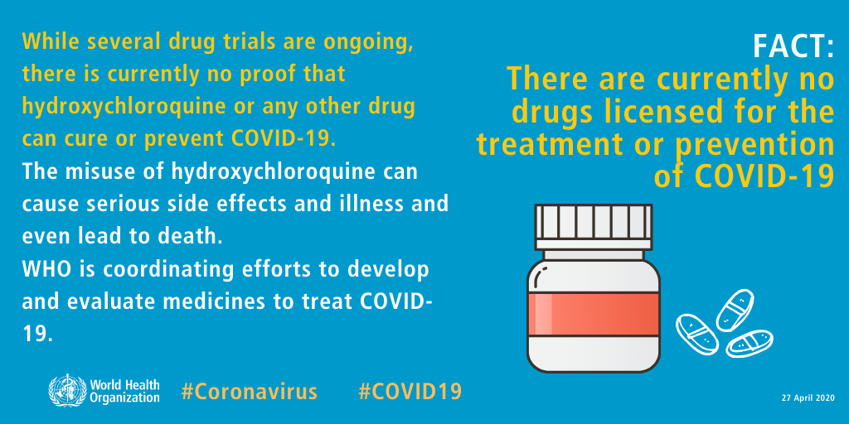
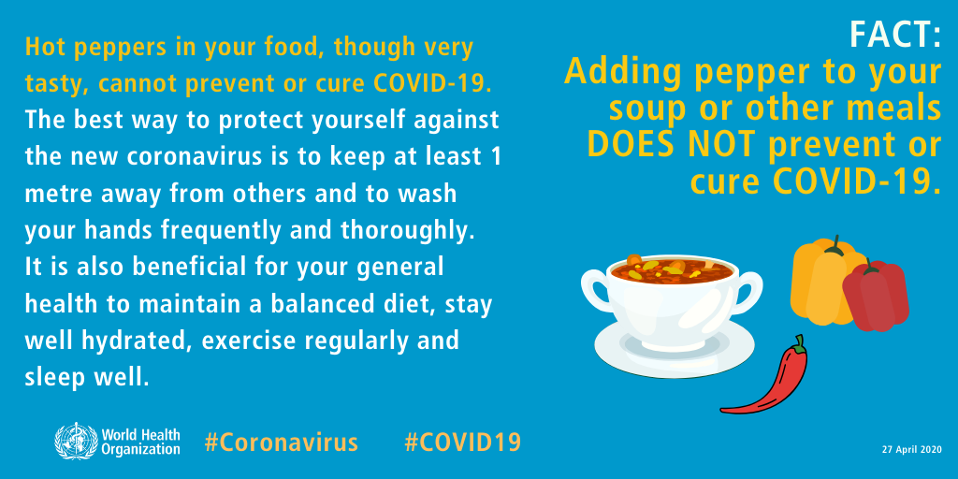
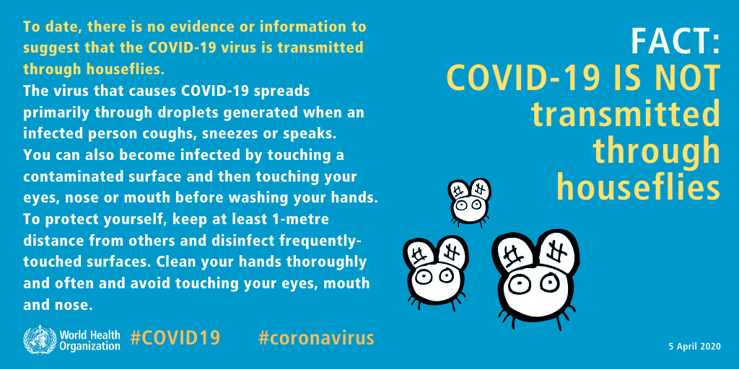
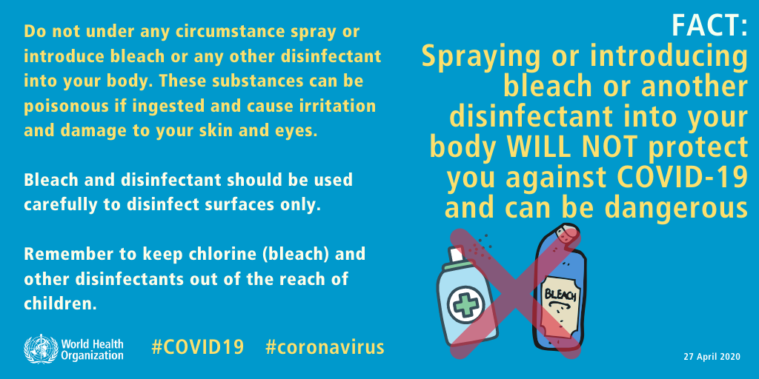
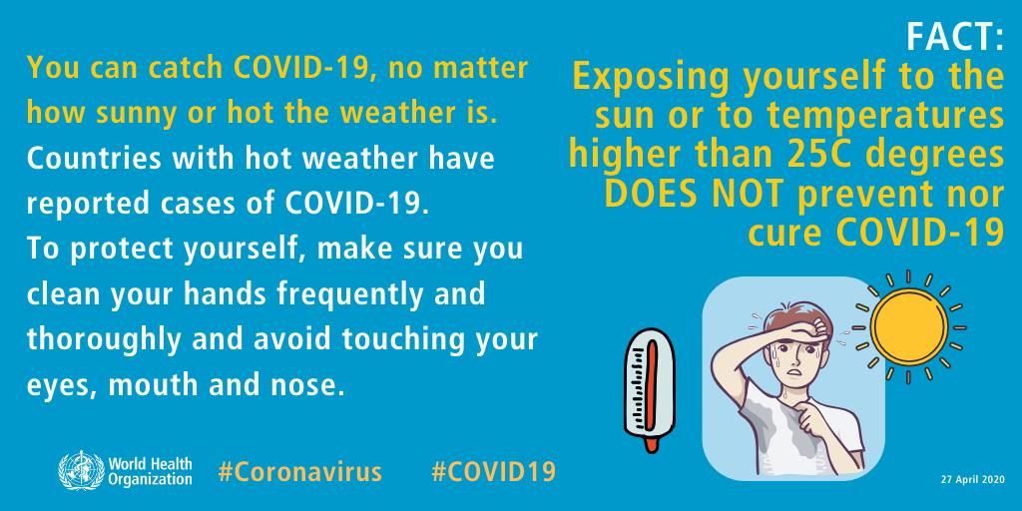
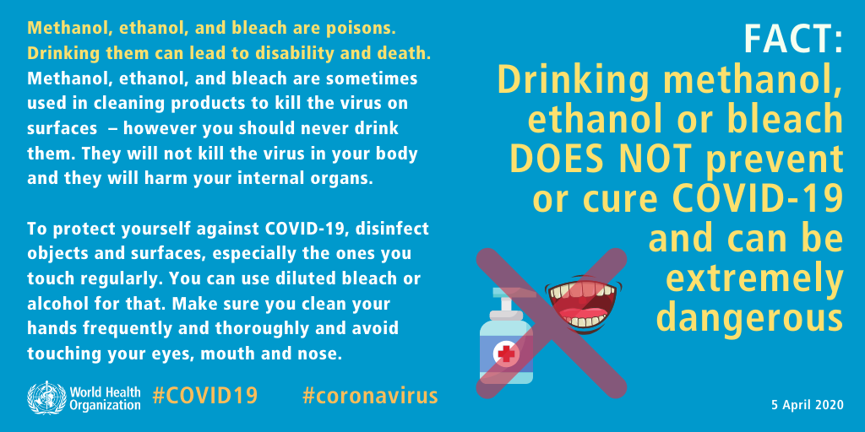
MYTH BUSTERS

Slide 43
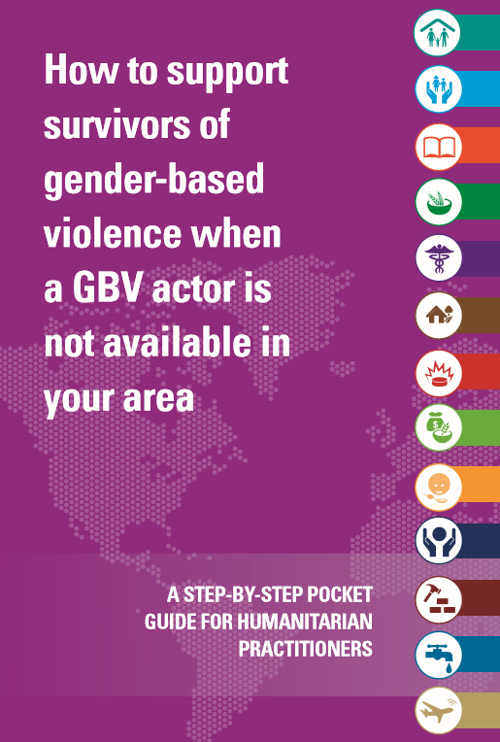
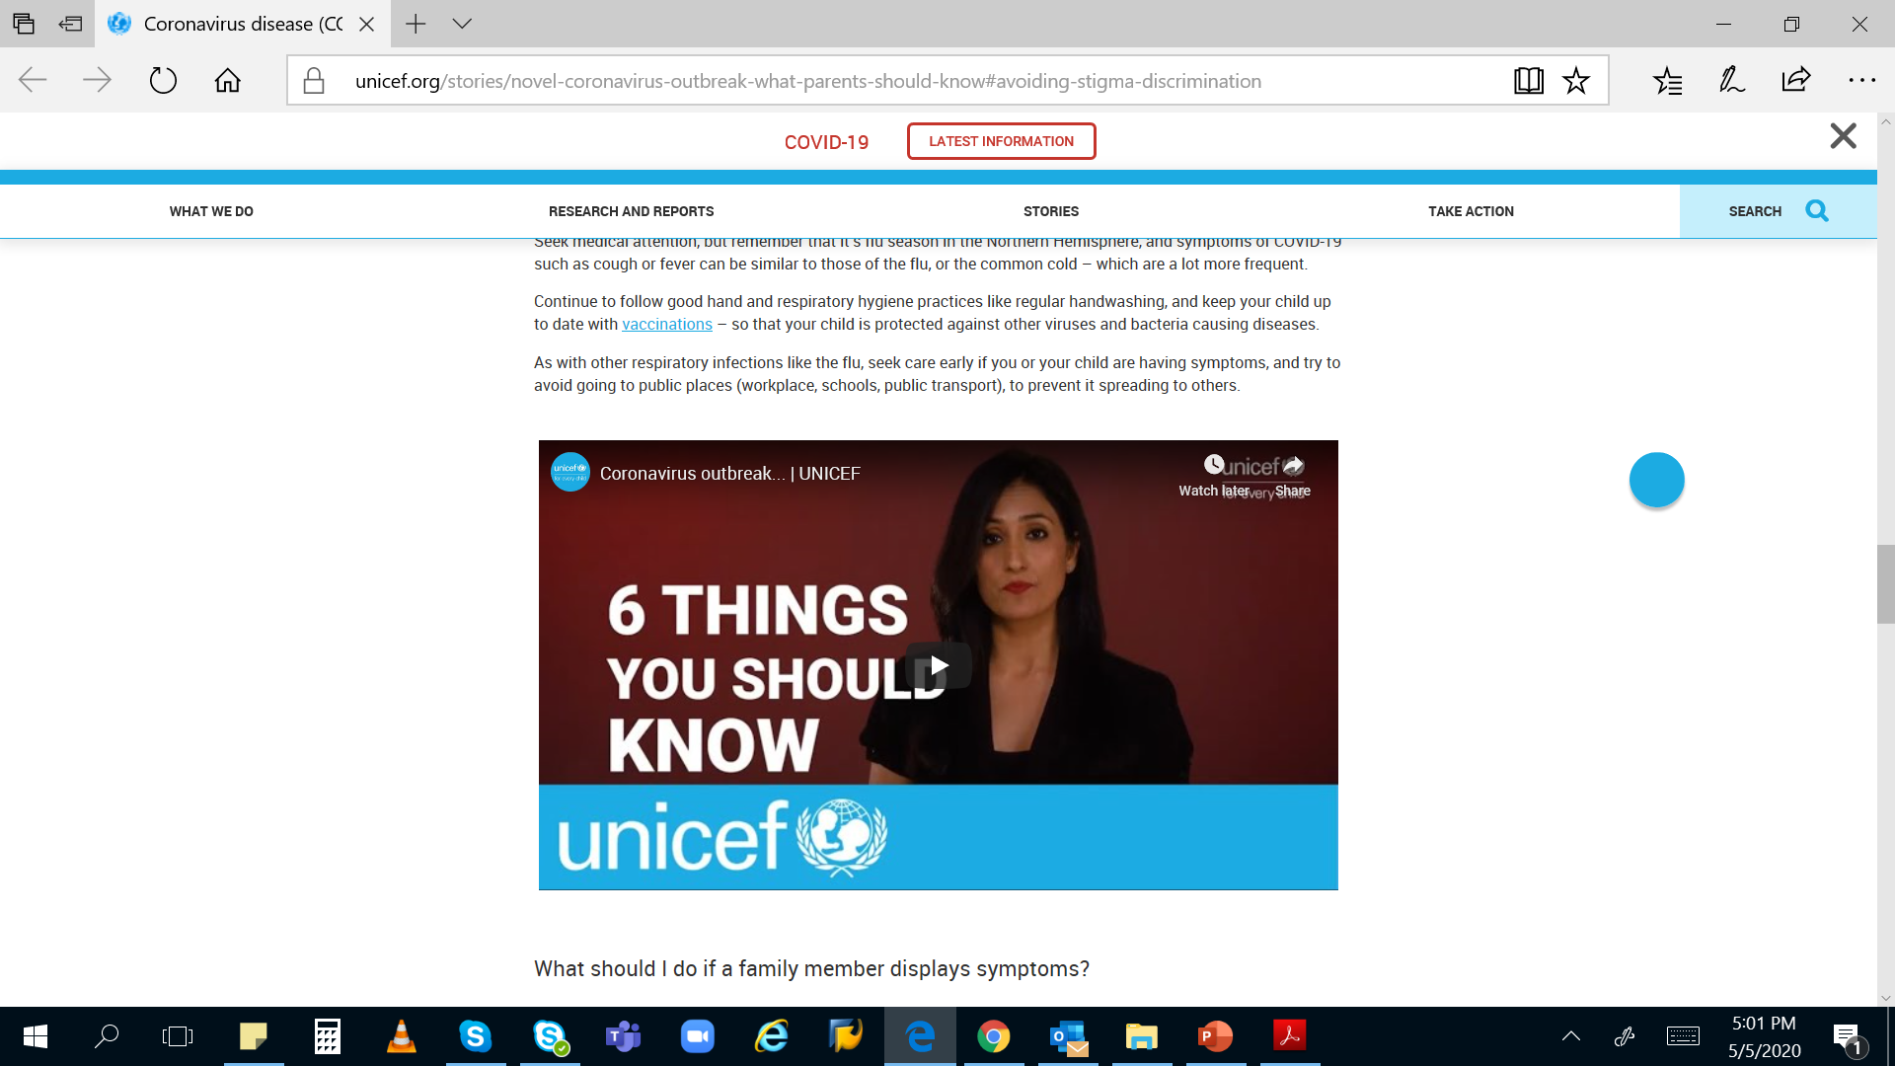
GBV pocket book
What parents should know

Slide 44
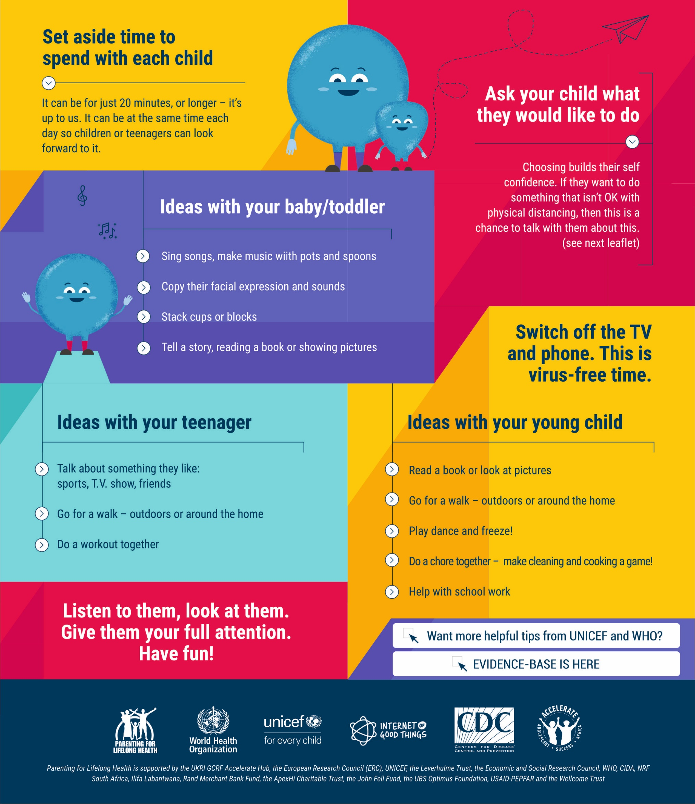
COVID-19 PARENTING: QUALITY TIME
Can’t go to work? Schools closed? Worried about money? It is normal to feel stressed and overwhelmed.
School shutdown is also a chance to strengthen relationships with our children and adolescents. Quality time is free and fun. It makes children feel loved and secure, and shows them that they are important.

Slide 45
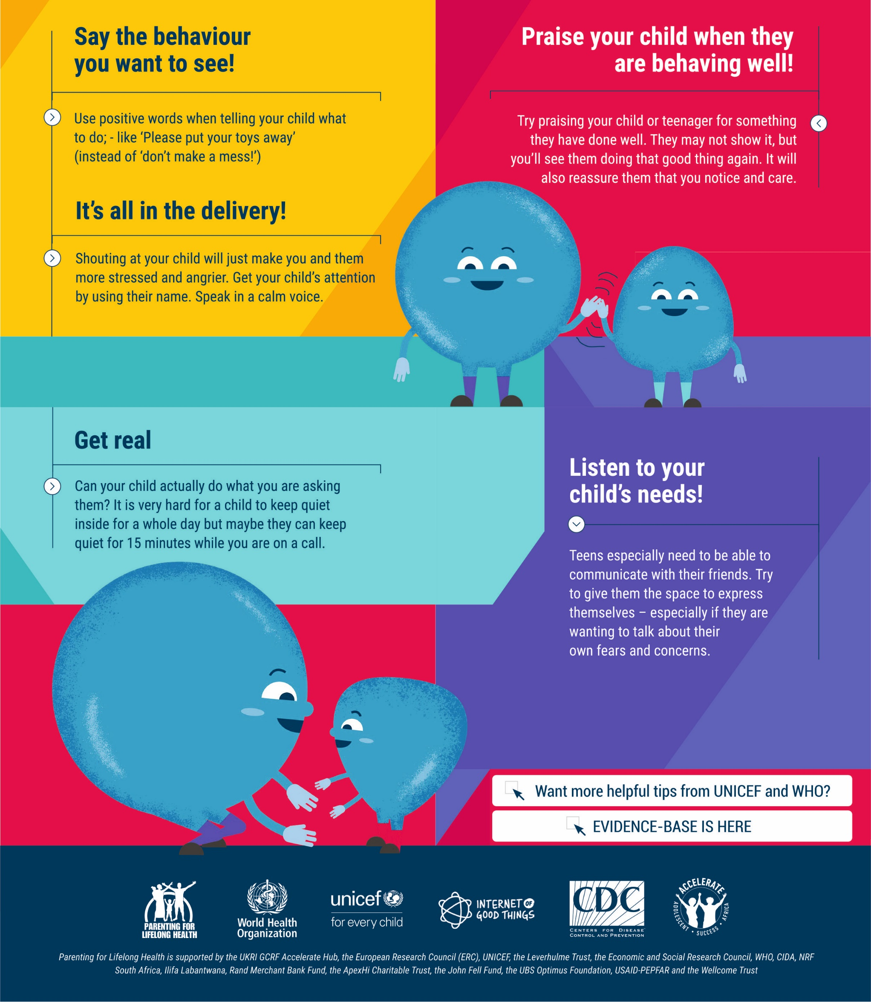
COVID-19 PARENTING: KEEPING IT POSITIVE
It’s hard to feel positive when our kids or teenagers are driving us crazy. We often end up saying. “Stop doing that!” But children are much more likely to do what we ask if we give them positive instructions and lots of praise for what they do right.

Slide 46
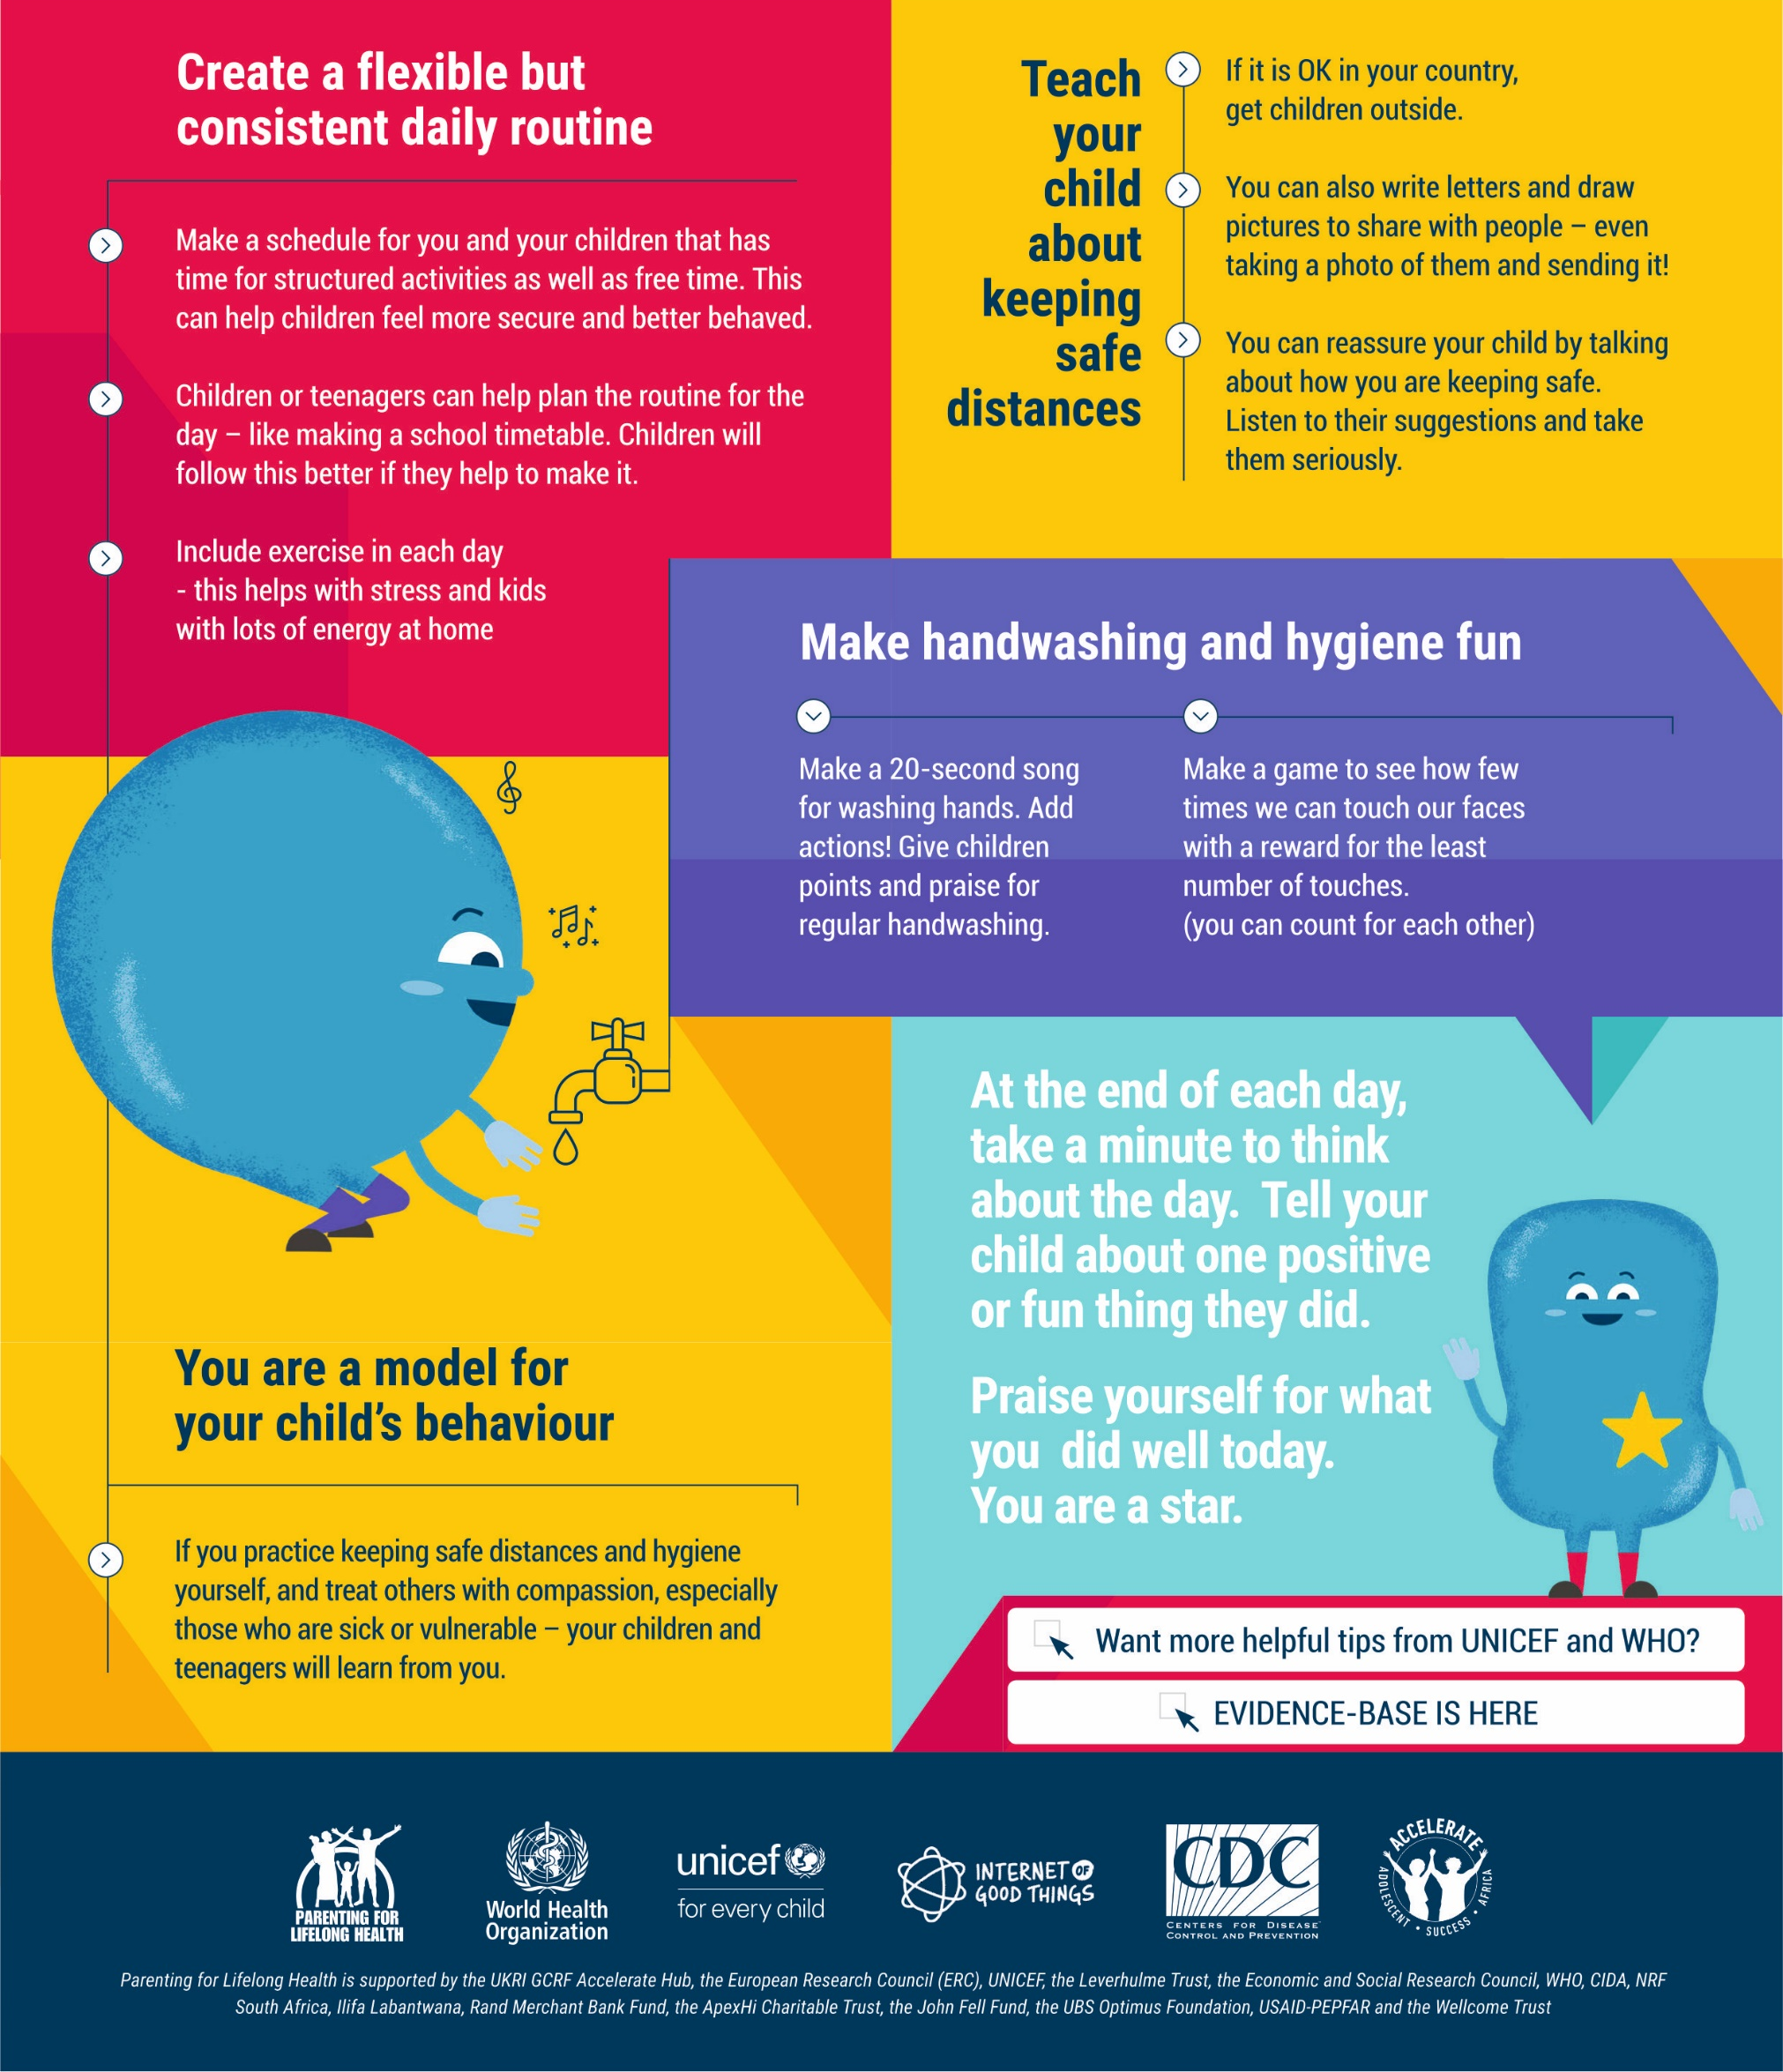
COVID-19 PARENTING: STRUCTURE UP!
Covid-19 has taken away our daily work, home and school routines. This is hard for children, teenagers and for you. Making new routines can help.

Slide 47
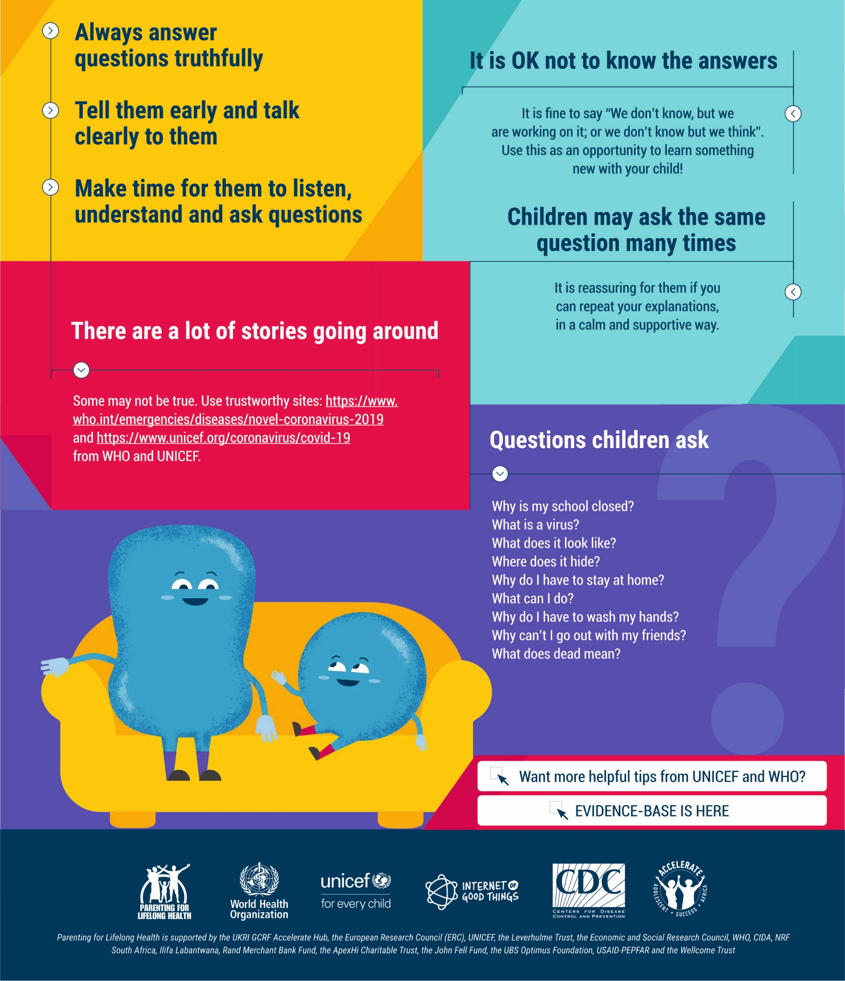
COVID-19 PARENTING: HONESTY & OPENNESS WHEN GIVING INFORMATION
Be willing to talk. They will have already heard something. Silence and secrets do not protect our children. Honesty and openness do. Think about how much they will understand. You know them best!

Slide 48
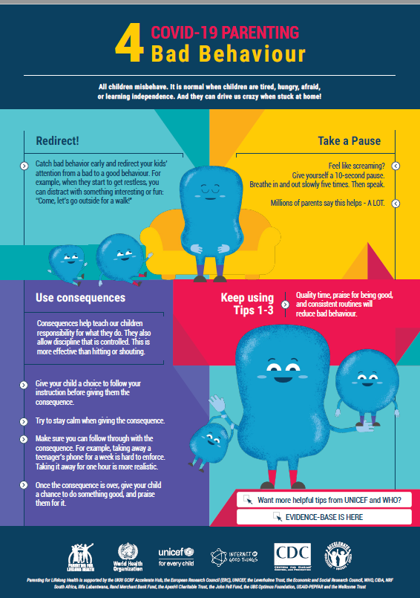
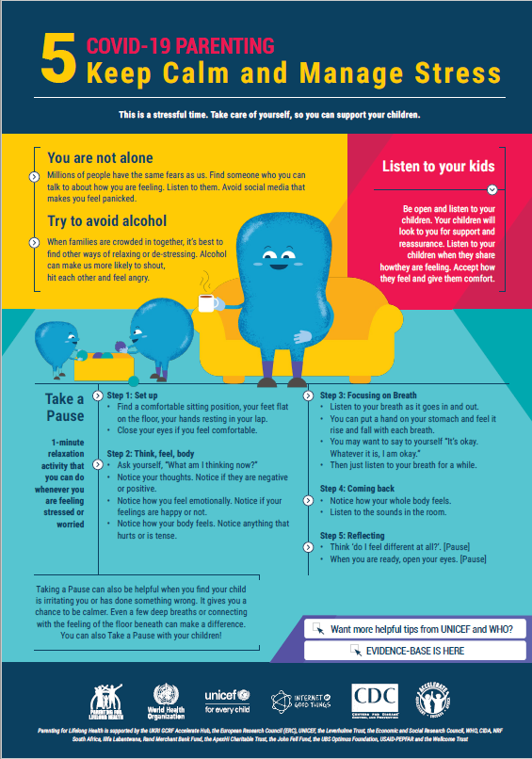
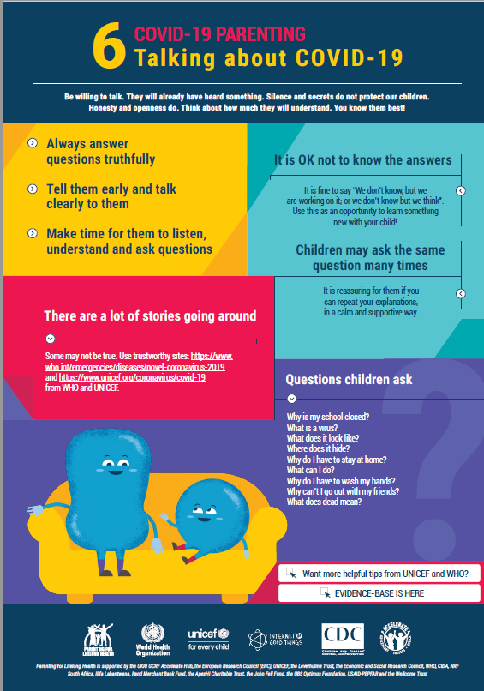
PARENTING TIPS
Information on common reactions for caregivers under stress and positive coping strategies. This may include information on the impacts of losing livelihoods, social isolation,

Slide 49
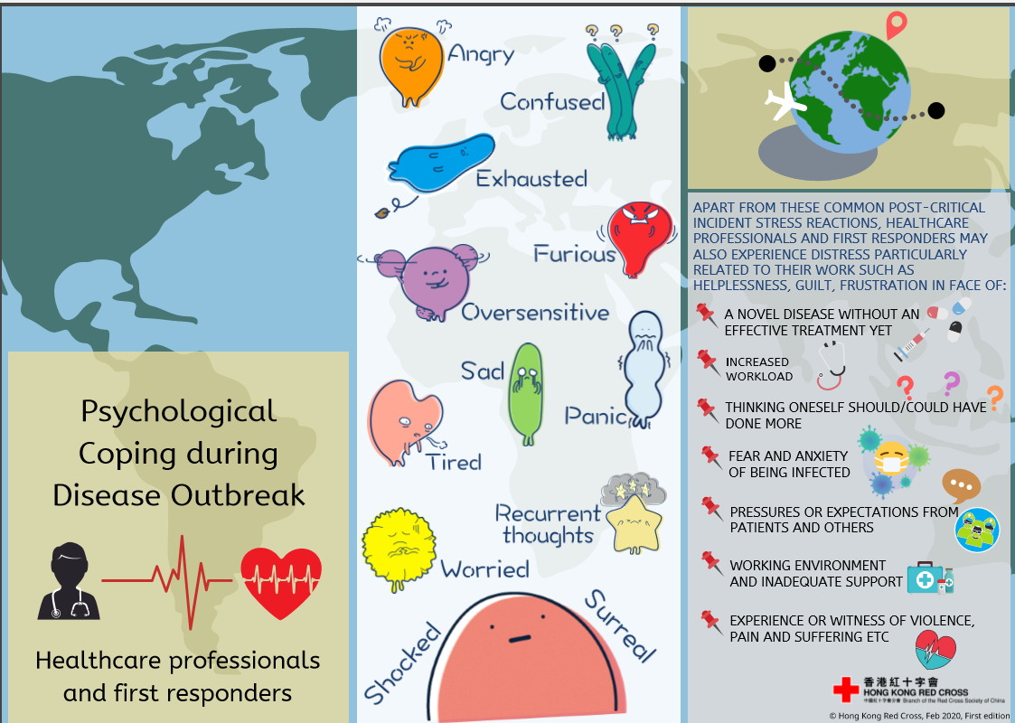

Slide 50
