Slide 1


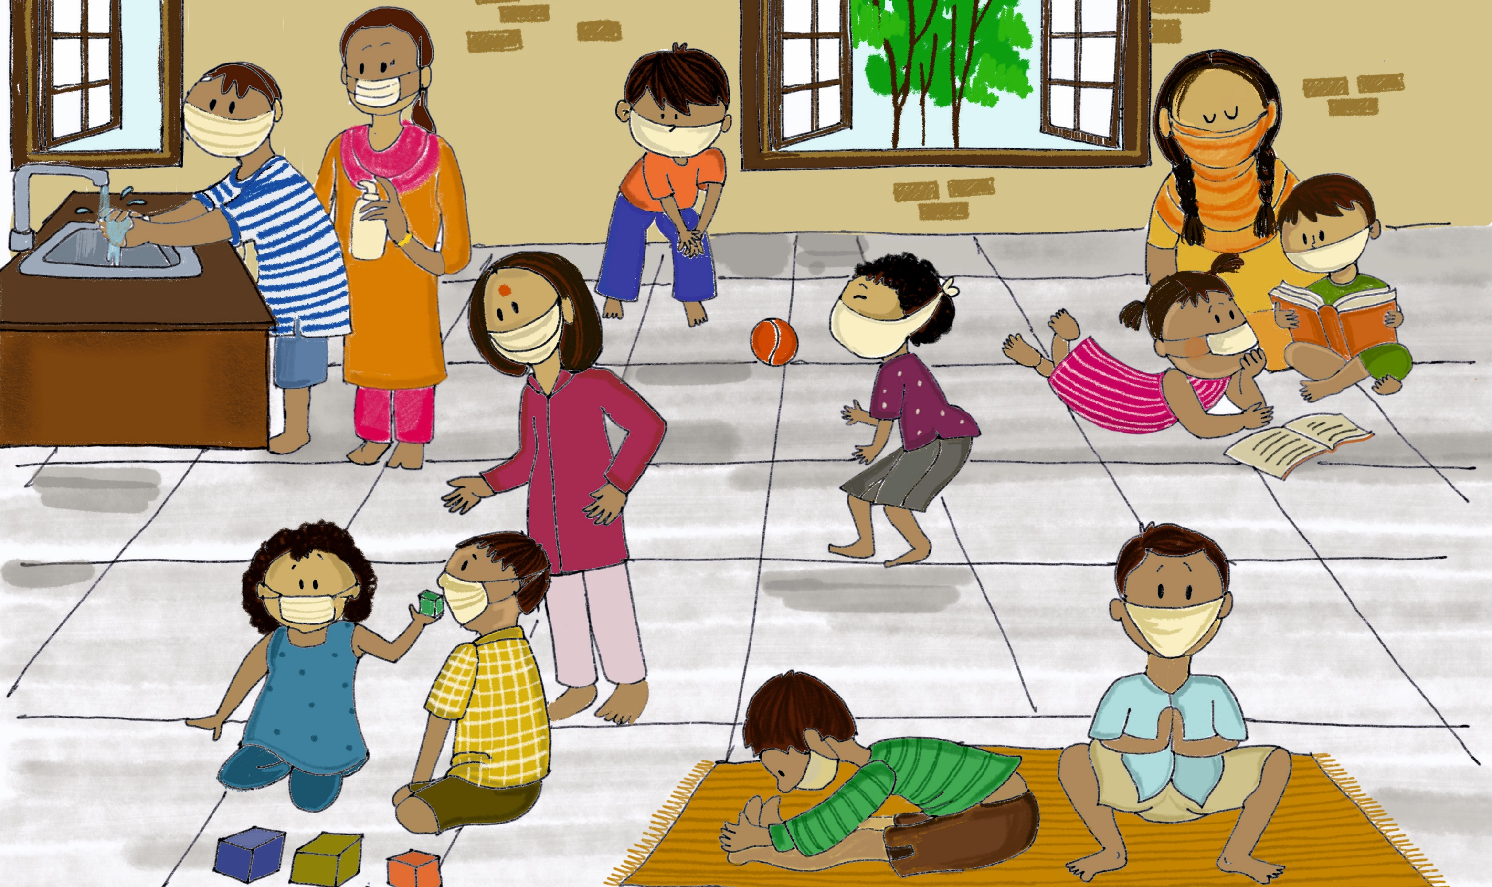
Psychosocial Support for Children during COVID-19
A Manual for Parents and Caregivers

Slide 2
FOREWORD
As COVID-19 pandemic continues to expand in India and in the world, only one thing is certain: the current outbreak will have profound impact not only in the health and economic situation, but also on the psychosocial well-being of societies across nations.
The impacts will be felt differently among different population groups. Among these, one group will face additional challenges to understand, absorb, and deal with the changes that COVID-19 are bringing to our world: the children.
In the current context of lock down and restriction of movements, children have constrained access to socialization, play, and even physical contact, critical for their psychosocial wellbeing and development. School closures are preventing children from access to learning and limiting their interactions with peers. Children may feel confused and at loss with the current situation, leading to frustration and anxiety, which will only increase with the overexposure to mass and social media, specially among adolescents. Some adults may struggle to find ways to explain and communicate with children about the current situation in a way that is understandable by this age group, which will add frustration and disquietude.
COVID-19 is also bringing new stressors on parent and caregivers. This can hamper their capacity to provide care and remain engaged with their children. Being very keen observers of people and environments, children will notice, absorb and react to the stress in their caregivers and community members, which unavoidably will affect their well-being.
And the above is only the beginning. Levels of stress will be exponentially higher among vulnerable families. For children who are deprived of parental care in Child Care Institutions or in alternative care, children living in the streets, or children migrants and on the move, for example, the situation will be particularly challenging. Prior experiences in public health emergencies have demonstrated that there is a high likelihood of an increase of violence, including gender-based violence, domestic violence or corporal punishment against children and woman. With the current movement restrictions, girls and boys victims of violence will face obstacles to seek out for help and have access to support systems.

Slide 3

Is with the intention of addressing some of the effects of COVID-19 on the wellbeing of the children, that UNICEF with CHILDLINE has worked on this publication. The purpose of this Manual is to provide parents, caregivers, support persons, and children and adolescent themselves, a tool that will enable them to understand what is COVID-19 and how it can be prevented, help them manage related stress, fear and anxiety, and recognize the increased risk of violence, which can help to them to stay safe. The Manual, which is designed for two different age cohorts: 6 to 10, and 11 to 19, contains activities and play methods to keep children engaged positively and provide them platforms to express their emotions.
This tool has been developed in support to CHILDLINE, which as part of the Minister of Woman and Child Development (MWCD), is at the forefront of the provision of relief and emotional and psychosocial support to children across the country in distress. The Manual, however, is intended to be open for use to all frontline workers and NGO partners to psycho-educate parents, caregivers and children themselves.
Childhood is a critical period in any human’s life, which marks the foundation of the personality and emotional resilience’s capacity of any person. In this difficult time, let’s all commit to mitigate the effects of COVID-19 on those whom deserve the most protection: the children.
Soledad Herrero
Chief, Child Protection Section
UNICEF India Country Office

Slide 4
MESSAGE
Friends,
COVID 19 has forced most of us to be confined inside our homes. Human history will record this period as a time of unparalleled separation and crisis but also of great courage, learning and collaboration. Each one of us is having to review/ rethink the way they function and their way of life itself. As we have seen across the world in multiple situations of crisis, children being the most vulnerable are often the worst affected. To fight Covid19, the country is under lockdown to contain the spread of the pandemic. However, CHILDLINE’s message to every child in distress or concerned adult has been from day 1 – ‘We are not locked down!’ As India’s exclusive emergency helpline for children, how could 1098 possibly be?
CHILDLINE has seen a spike in calls by 50% since the lockdown including people calling in for information on the pandemic. Amongst these a percentage of calls have required reaching out and physically intervening including for nutrition, shelter and medical assistance, and also to prevent or protect from abuse, violence and exploitation such as abandonment, physical abuse, child labour, child marriage and so on. Despite the constraints and challenges encountered while doing so in these circumstances, CHILDLINE has reached out to the child, comforted, provided immediate help and connected to the concerned authorities for long term assistance. We would like to place on record our gratitude to the Ministry of Women and Child Development, State Governments and District Administrations/Child Protection Services, who have helped us to help children.
While the medical and economic consequences of COVID 19 are critical and well known, 1098’s work with children keeps reminding us, that the importance of psychological and emotional wellness to fight this fight, will determine their well being for the rest of their lives. This is especially so for children regardless of where they are now– in their families, isolation facilities, child care institutions or in foster care.

Slide 5

Psycho-education therefore, of parents and caregivers, to support children in these difficult times and build their resilience is imperative. This manual aims at providing parents and caregivers simple tools to help achieve this; to connect emotionally with children, understand their concerns, be aware of any situation leading to violence and abuse, and to thereby create an environment which is as normalised and joyful as it can possibly be. I hope the entire CHILDLINE family as well as child protection functionaries and thousands of other volunteers will find this useful to help children and their families/ caregivers tide over these times in a happy, engaged constructive way. A big ‘Thank you” to UNICEF for this and for the constant unconditional support! I also hope we are taking care of ourselves and taking precautions to keep safe as we fulfil our commitment towards children.
As we say in CHILDLINE “a single call can change a life”… So stay well, stay fighting and please call 1098 if you are/see, a child in distress!
Harleen Walia
Deputy Executive Director
ChildLine India Foundation

Slide 6
In the context of COVID-19, this manual focuses on psychosocial care of children and prevention of violence in spaces where children stay (child care institutions, families, temporary isolation facilities, NGO shelters, etc.)

Slide 7

What is this manual about?
It is natural for children to feel stress, anxiety, grief, and worry during an ongoing pandemic like COVID-19. Fear and anxiety about their own health and the health of loved ones can be overwhelming and cause strong emotions. In today’s digital world, children also access different kinds of information and news through social media and digital platforms, some of them may not be factually true, causing further stress and anxiety. It is enhanced when children are not able to go out, play, attend school or interact freely. For those children and families who are subjected to quarantine or isolation there may be an increased risk of violence and abuse. When stress levels go up for adults and children, there is a greater risk of gender based violence and other forms of violence against children.
Role as parent or caregiver:
To promote an environment where children can grow up and develop their full potential having fun and being safe and healthy.
To facilitate a space where children are listened to, they can express their thoughts and feelings, and are free to ask any question and are answered honestly.
This manual will help you:
To understand the implications of the pandemic on the mental health and psychosocial wellbeing of children, including the increased risk of violence and abuse.
To provide resources for caregivers to help engage with children positively and effectively.

Slide 8
How to use the manual?
The manual contains simple methods to manage anxiety and stress among children. These are recreational and relaxing. Before using them, make sure children are in a calm and relaxing environment. Follow the instructions given before each activity. However, do not force children or adolescents to go through any of these activities if they do not want to. They should be allowed to participate on their own.
The activities described in the manual can be used with two age groups of children, the younger children (6-10 years) and adolescents (11-19 years). These are suggestive activities, and parents and caregivers are encouraged to add many more similar ones. However some activities may be used for both age groups, for example creating a story board.
Use the activities and information packages provided in this manual to talk to children about COVID 19 and its effects. Enable them to express their emotions freely. Set up a particular time of the day to conduct the activities.
If the pages for coloring cannot be printed for children, they may be shown to them on a smart phone or computer, and encouraged to draw and colour on their own. Topics depicted in the manual are suggestive; children should be allowed to explore their creativity, and you can also adjust and create additional activities with the materials provided.
CHILDLINE functionaries and NGO frontline workers can support parents and caregivers to carry out the activities.

Slide 9
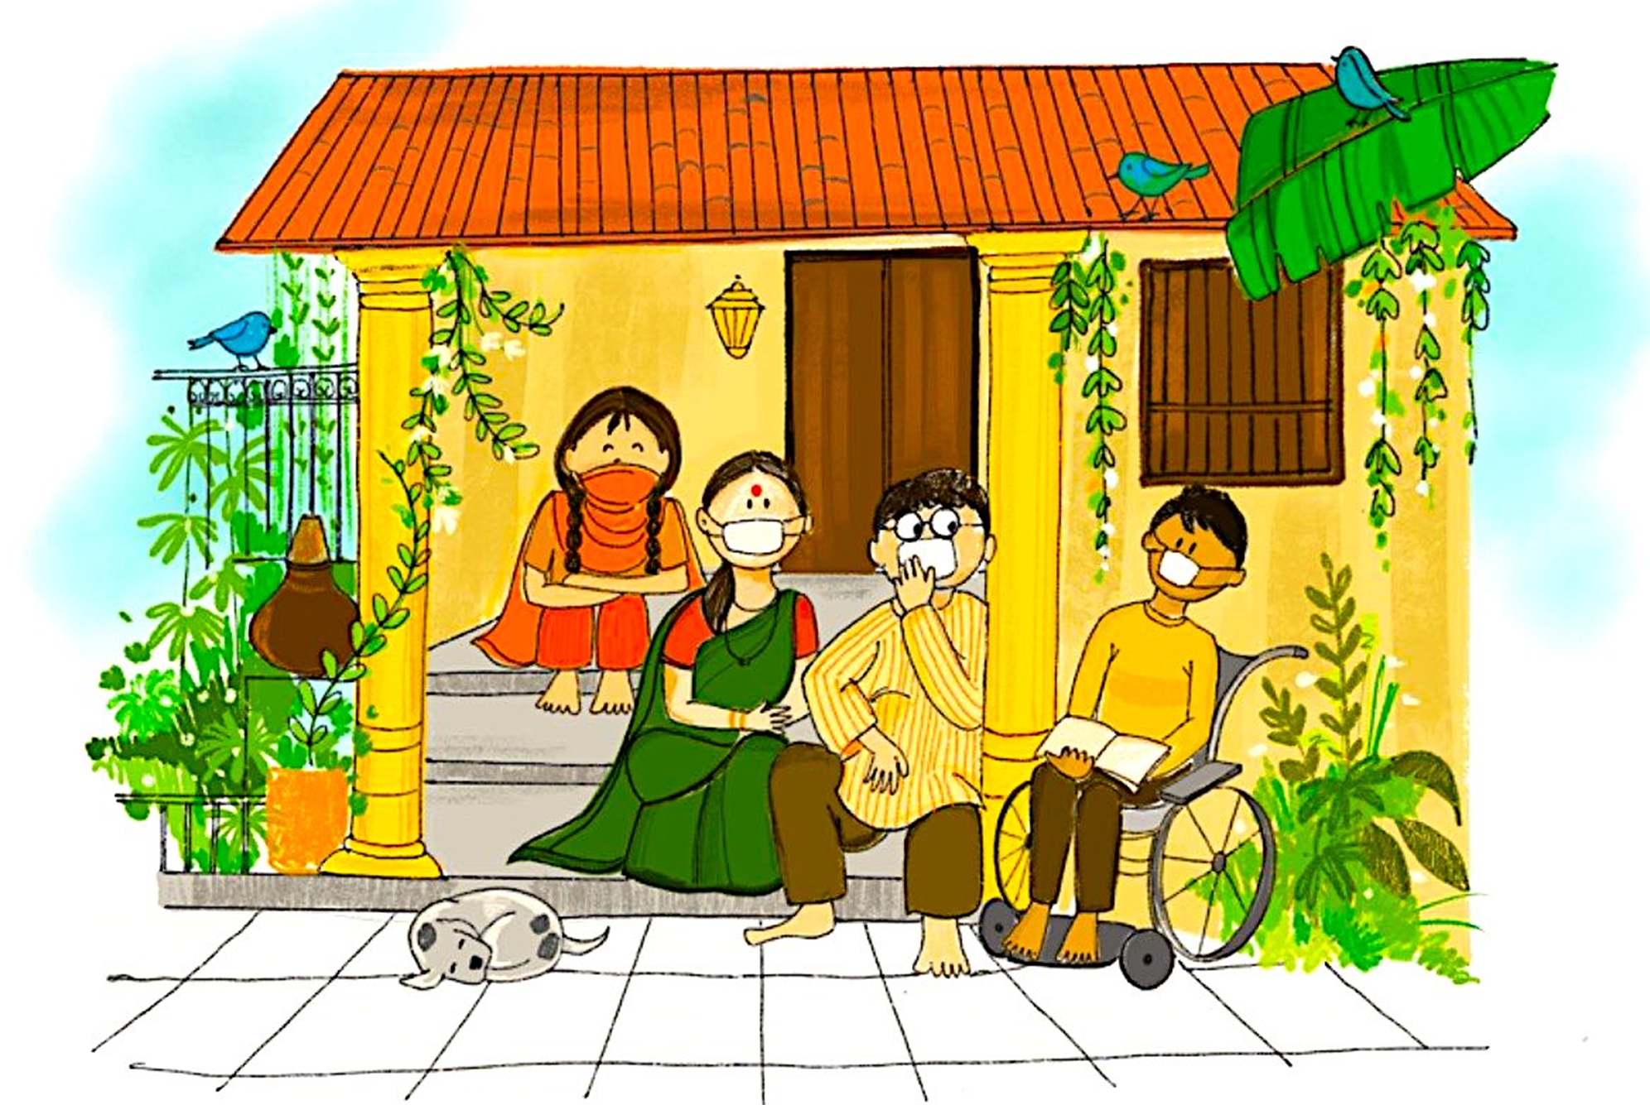

Slide 10

What does it contain?
Contents:
Understanding emotional needs of children
Understanding emotional needs of most vulnerable children
Helping Children deal with stressful and painful events
Recognizing signs of psychological distress needing specialized help
Talking to children about COVID-19
Talking to children about rumors related to COVID-19
Handling heightened risks of violence, abuse and exploitation
Toolkit for Age Group 6-10 years
Toolkit for Age Group 11-19 years
Counseling Activities and Worksheets for Children and Adolescents

Slide 11
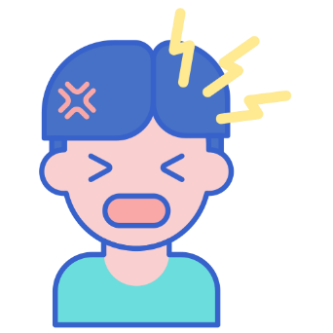
Psychosocial and Mental health well-being of children
during COVID-19 pandemic
Understanding emotional needs of children
Children may express psychological distress (anxiety, sadness) by acting out in a different way - each child behaves differently. Some may become silent while other may feel and express anger and hyperactivity. Caregivers need to be patient with children and understand their emotions.
All emotions are valid emotions, and as caregivers we need to understand them with empathy.
Sometimes engaging in a creative interactive activity, such as playing and drawing can facilitate this process. Help children find positive ways to express disturbing feelings such as anger, fear and sadness.
Keep regular routines and schedules as much as possible.
If children are witnessing violence at home, or if they are the target of the violence, it causes trauma and distress and may lead to disruptive behaviour.
Explain to them that nobody should be stigmatized or signaled for having the disease.
Avoid watching, reading, listening or discussing too much news about the COVID-19 and persuade children to divert their attention to other topics as well.
If someone is sick in the family/ child care institution and have been taken to hospital, or if there has been a death, children may experience added anxiety and may need specialized help. Talk to professional counsellors or call CHILDLINE 1098
Call NIMHANS toll free number 08046110007 for specialized help

Slide 12






Understanding emotional needs of most vulnerable children
Children who are most vulnerable face more challenges and may therefore need more care and attention. Some of these children do not have strong support systems and emotional references. The fear and stress caused by COVID-19 may increase their sense of insecurity and cause even more serious mental health issues if not addressed in a timely manner.
This includes:
Children in child care institution (CCIs) or without parental care
Street connected children
Children of migrant workers put into isolation facilities
Children in other NGO shelters etc.
I am alone
Insecure
Nobody cares for me
Don’t
trust
Scared

Slide 13

Helping Children deal with stressful events
Listen: Give children opportunities to talk about what they are feeling. Encourage them to share concerns and ask questions
Comfort: Use simple tools to comfort and calm children, for e.g. telling stories, singing with them and playing games. Praise them frequently for their strengths, such as showing courage, compassion and helpfulness
Reassure children that you are prepared to keep them safe. Provide them with correct information through valid sources
Listen
Comfort
Reassure

Slide 14
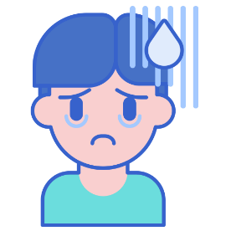
Recognizing signs of psychological distress needing
specialized help
Some children may also face serious mental health issues due to ongoing pandemic. They may exhibit the following signs:
Difficulties in sleeping and eating
Nightmares
Being withdrawn or aggressive
Complain of pain in stomach or headache without physical reason
Having fears, being afraid to be left alone
Clinging, depending behaviours
New fears manifest (for instance of the dark)
Decreased interest in playing and engaging in playful activities
Being sad, crying more than usual or for no apparent reason
Please remember these children need specialized help from trained professionals. Call:
CHILDLINE 1098
Child Welfare Committee/District Child Protection Unit
NIMHANS 08046110007

Slide 15

Talking to children about COVID 19
Children need adults to help them understand what is going on.
Talk to children about what is happening in a way that they can understand.
Keep it simple and appropriate for each child’s age.
Next few pages give you simple tips to take care of both physical and emotional needs of children and how to talk to them about COVID-19
For credible sources of information, verified by Ministry of Health and Family Welfare, Government of India, the caregivers and parents can call on National Helpline 1075 (toll-free) or 011-23978046. You can also write to: ncov2019@gov.in or ncov2019@gmail.com

Slide 16
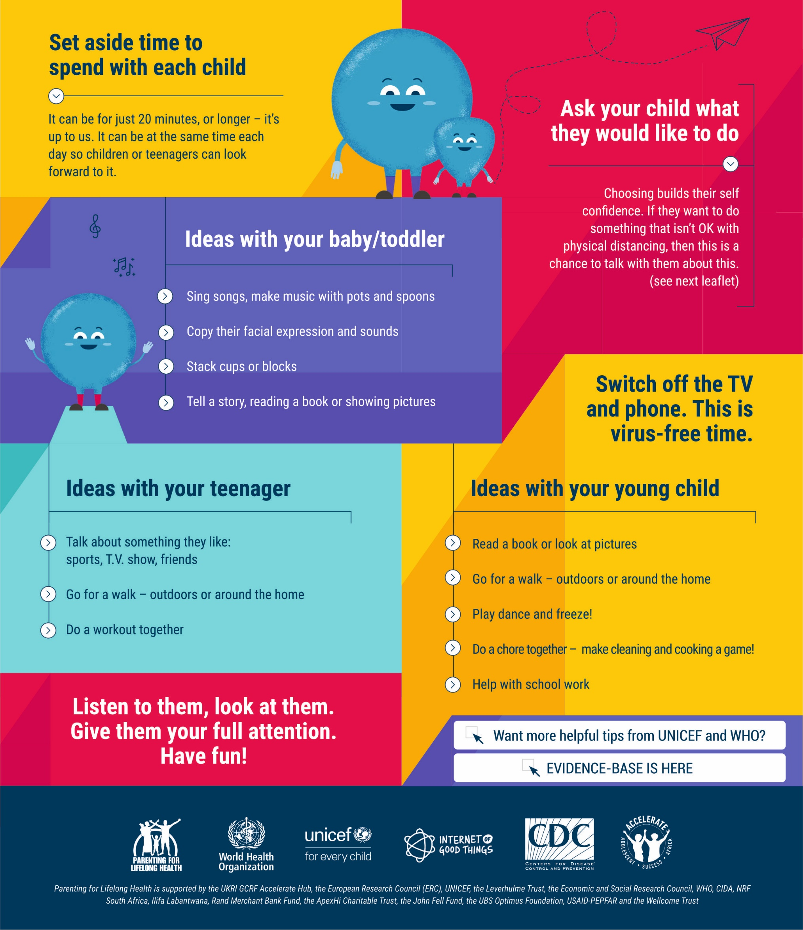
COVID-19 PARENTING: QUALITY TIME
Can’t go to work? Schools closed? Worried about money? It is normal to feel stressed and overwhelmed.
School shutdown is also a chance to strengthen relationships with our children and adolescents. Quality time is free and fun. It makes children feel loved and secure, and shows them that they are important.

Slide 17
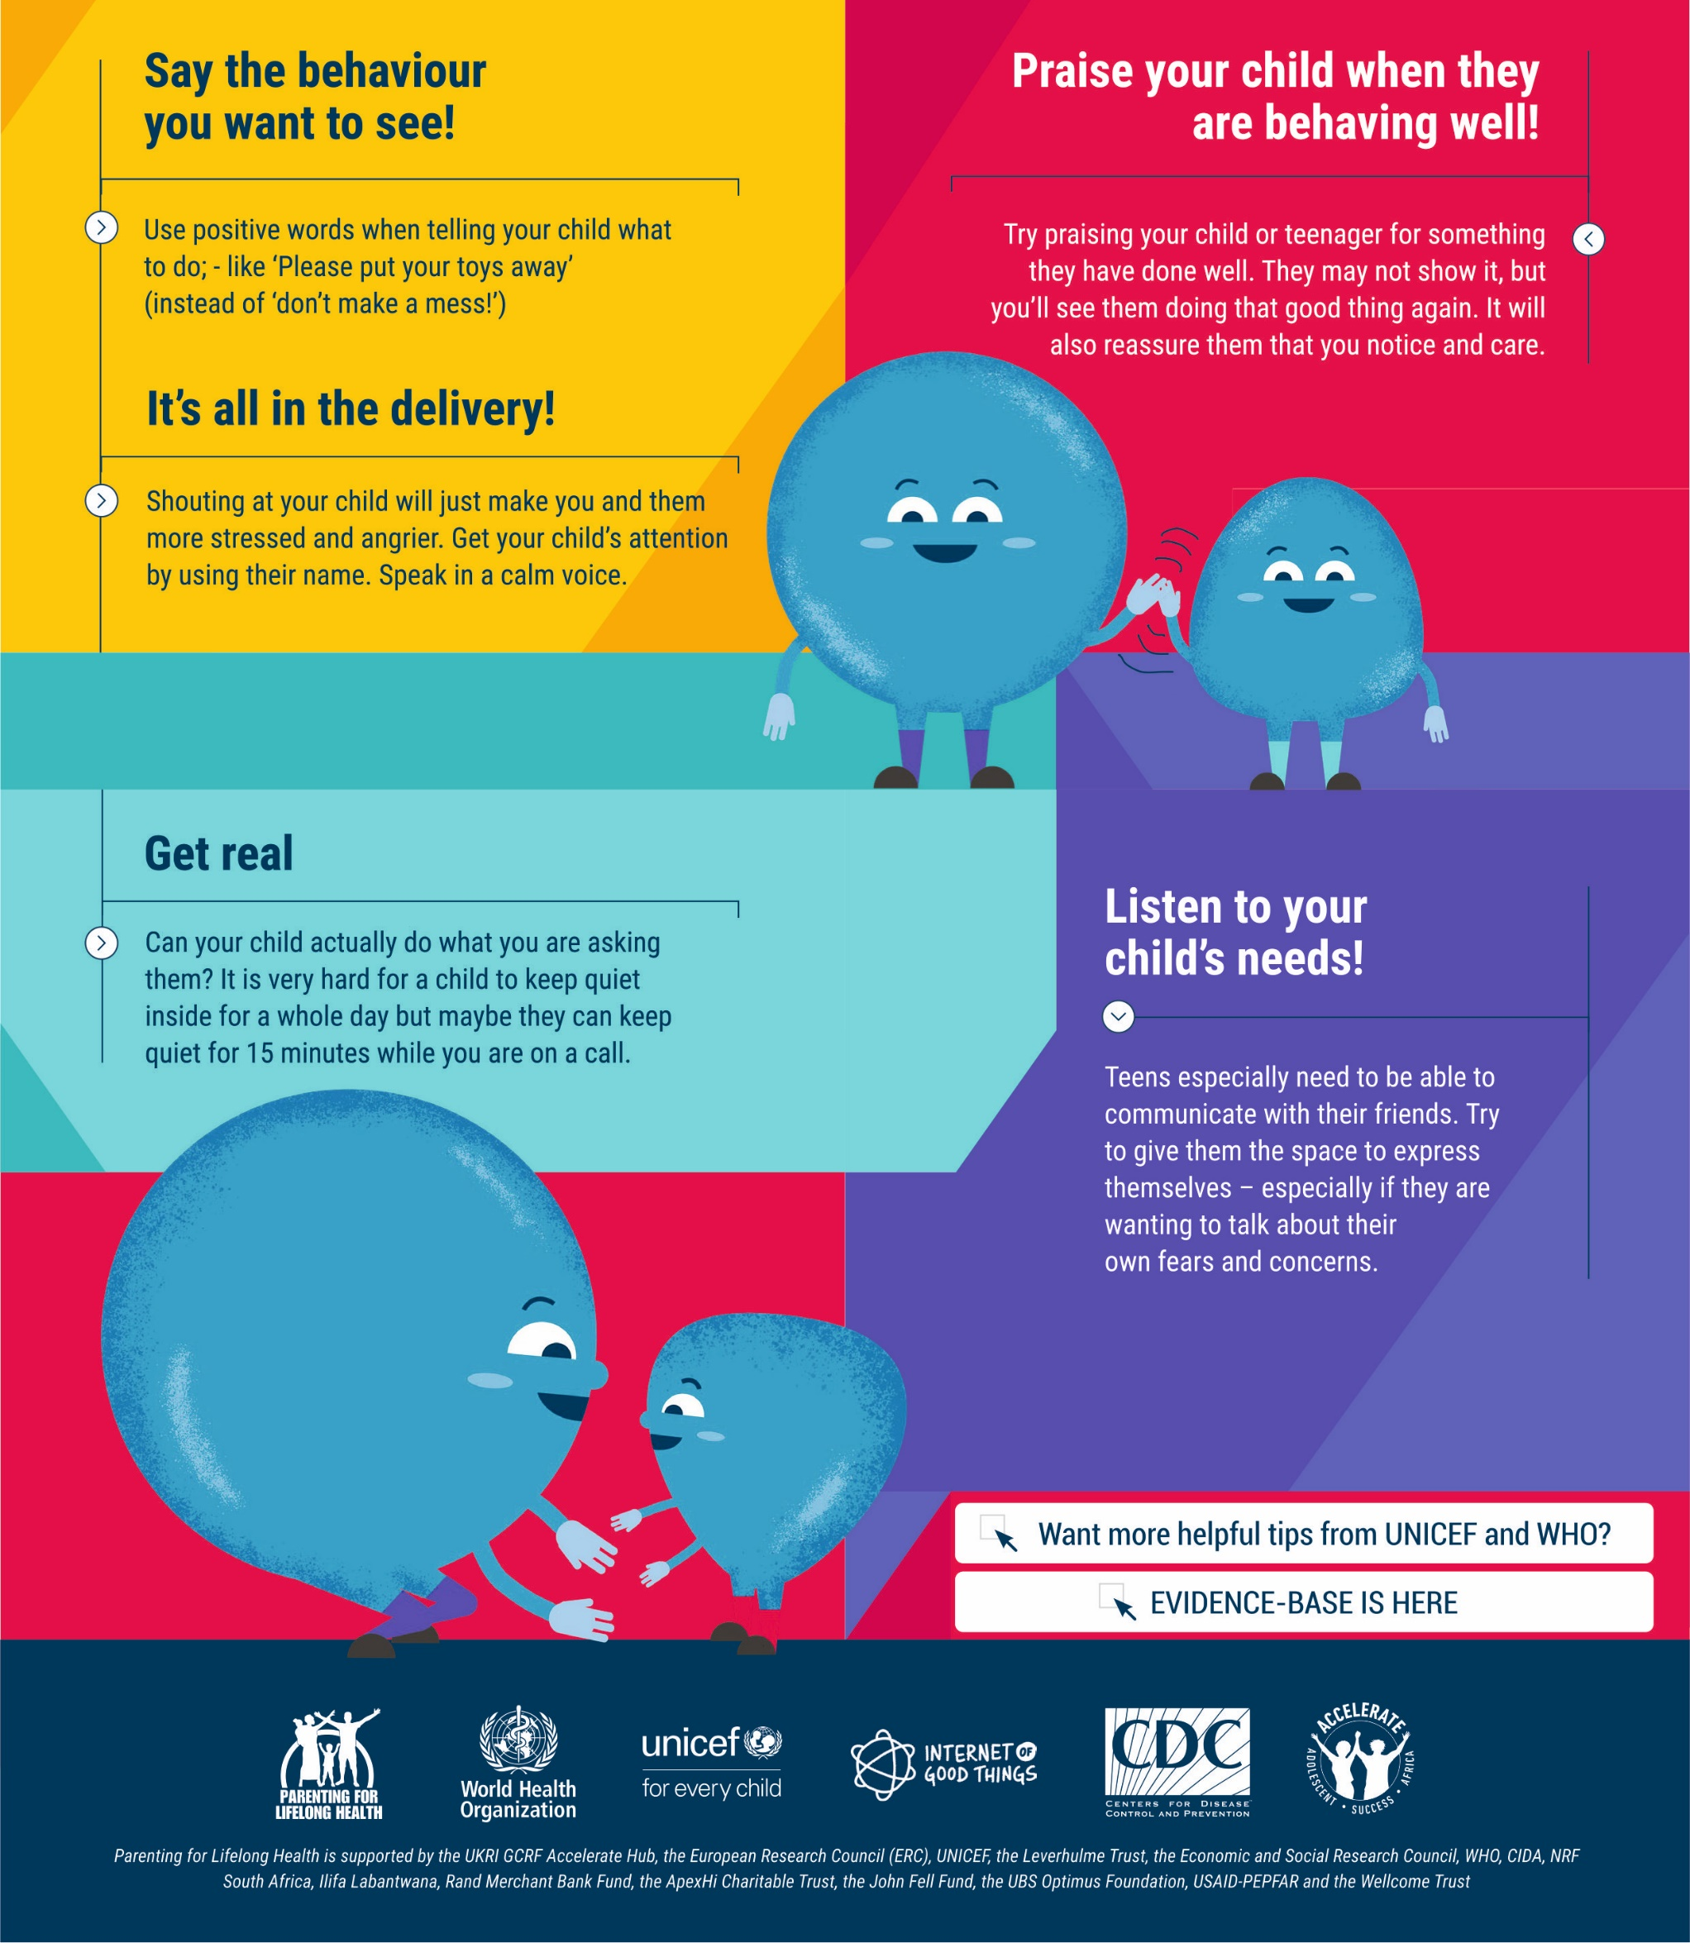
COVID-19 PARENTING: KEEPING IT POSITIVE
It’s hard to feel positive when our kids or teenagers are driving us crazy. We often end up saying. “Stop doing that!” But children are much more likely to do what we ask if we give them positive instructions and lots of praise for what they do right.

Slide 18
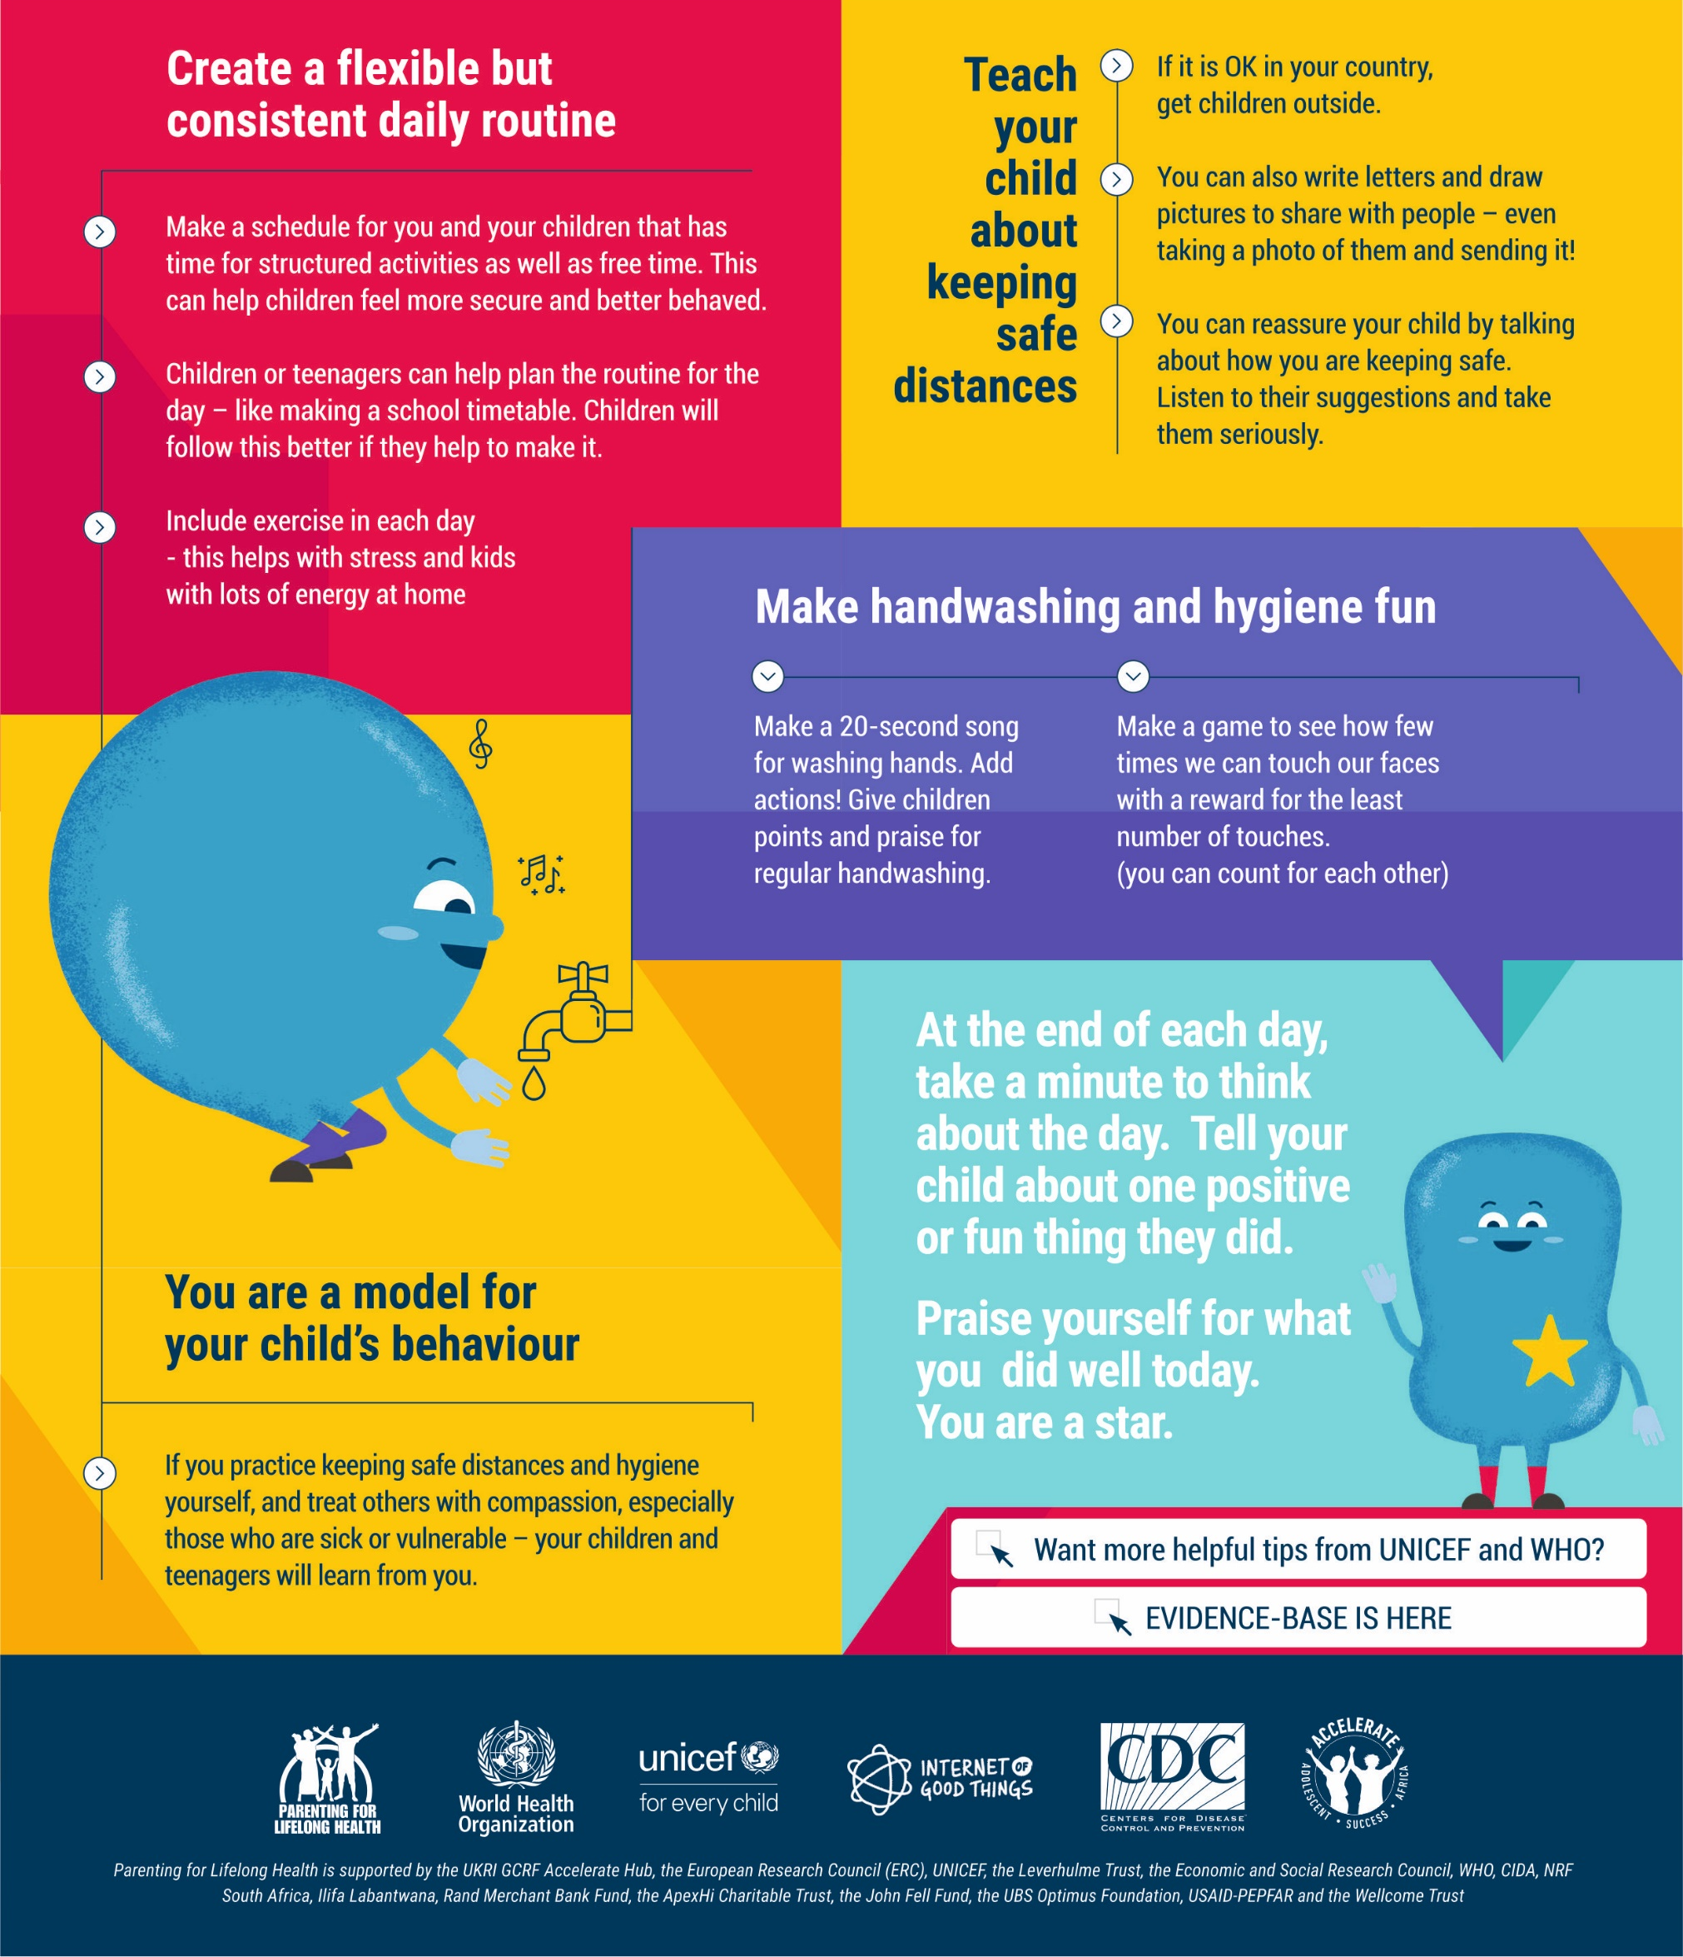
COVID-19 PARENTING: STRUCTURE UP!
Covid-19 has taken away our daily work, home and school routines. This is hard for children, teenagers and for you. Making new routines can help.

Slide 19
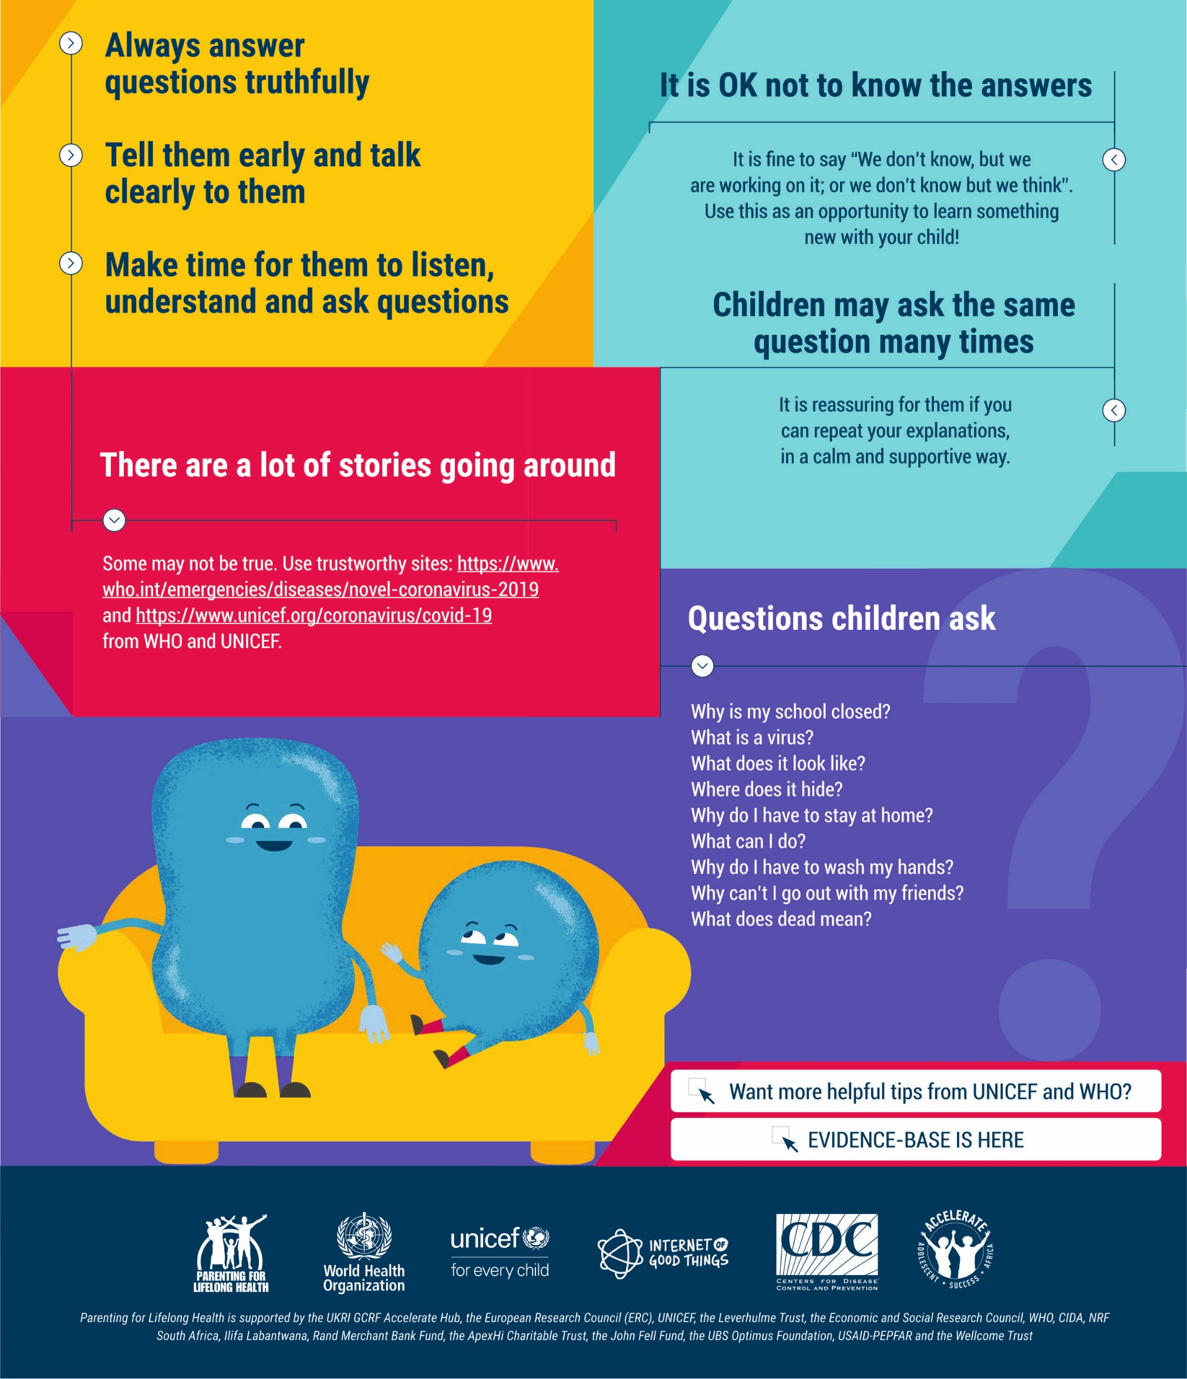
COVID-19 PARENTING: HONESTY & OPENNESS WHEN GIVING INFORMATION
Be willing to talk. They will have already heard something. Silence and secrets do not protect our children. Honesty and openness do. Think about how much they will understand. You know them best!

Slide 20

Talking to children about rumors related to
Coronavirus disease (COVID-19)
MYTHS & MISCONCEPTIONS on COVID-19
Parents and caregivers need to be mindful about myths and rumors that are circulating. Make sure they themselves understand the harms of spreading fake information in their own adult circles and around children.
The following information is NOT TRUE:
The virus attacks only old people and children and spares young people
The virus is transmitted through pets and people should abandon their pets
The use of mouthwash, antibiotics, cigarettes, and liquor with high alcohol can kill CVOID-19
Going for a steam bath, outside in the sun, can prevent you from getting infected with corona virus
All food items are contaminated and will spread the corona virus
There is no need to worry as Indians have higher immunity and are exposed to many diseases than people in the wester countries
Corona virus does not survive in warm/hot weather
Always use credible sources of information verified by Ministry of Health and Family Welfare, Government of India

Slide 21
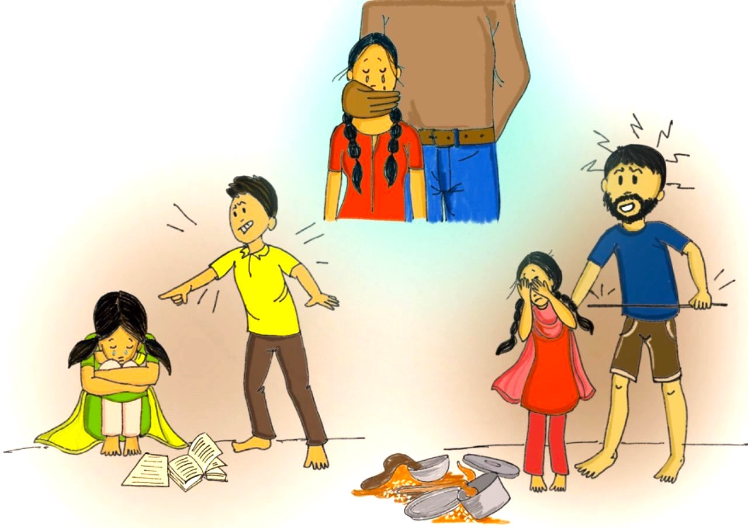
Handling heightened risks of violence, abuse and exploitation
against children
Do you see any of these situations around you?

Slide 22
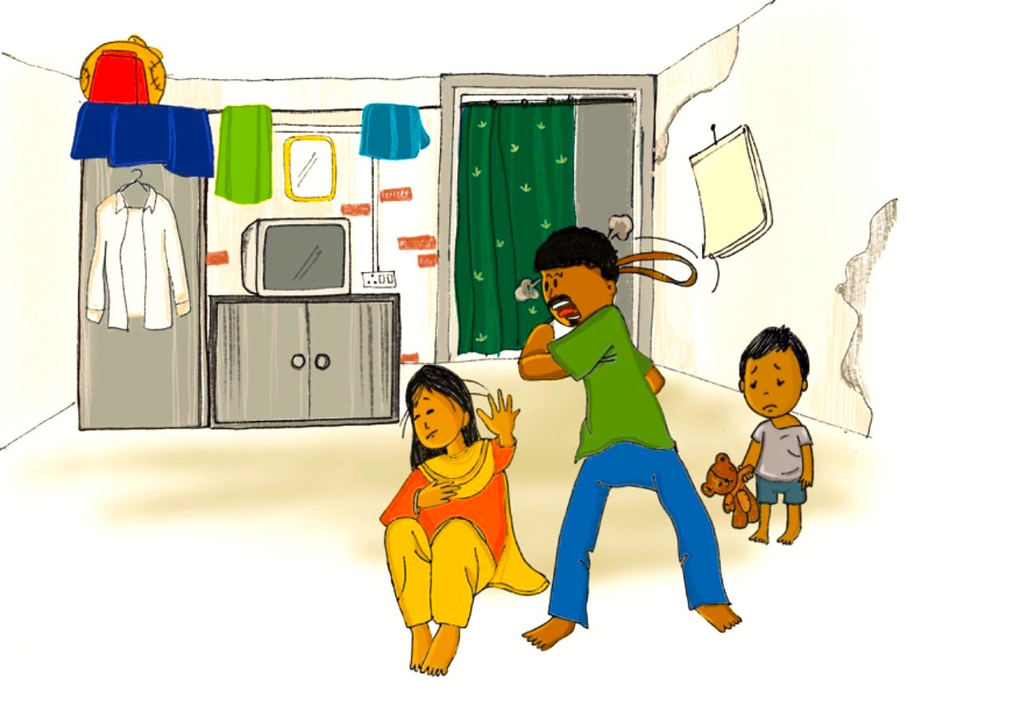
Handling heightened risks of violence, abuse and exploitation
against children
Do you see any of these situations around you?

Slide 23
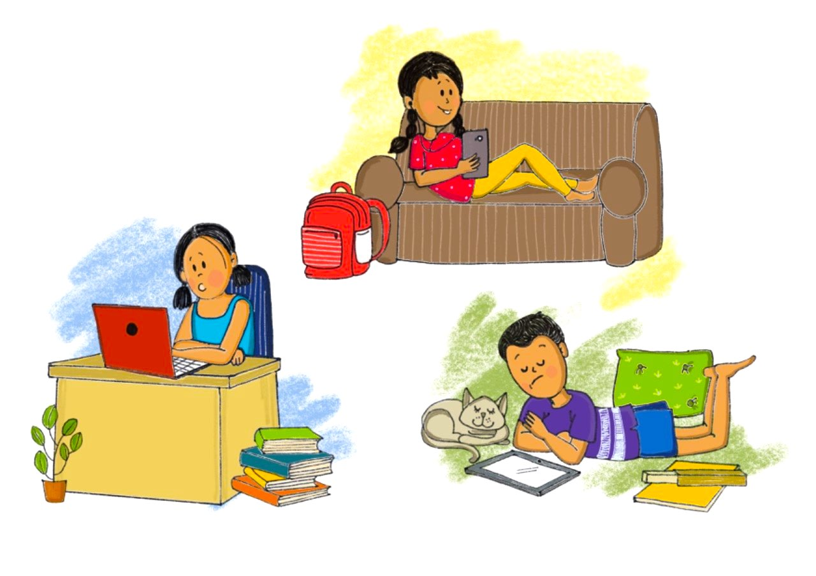
Handling heightened risks of violence, abuse and exploitation
against children
Do you see any of these situations around you?

Slide 24
Increased risk of violence, abuse and exploitation
High stress in family due to social isolation, economic hardship and loss of livelihood increase risks of domestic violence and child abuse, including spanking or beating children, or using harsh language
School closures and movement restrictions means children are forced to spend much more time at home with adults and caregivers who are already stressed and worried
Sexual abuse can happen to any child or adolescent at any time or place. Be vigilant and aware.
Children spend more of their time online – and face the risk of exposure to online sexual abuse and grooming for sexual exploitation, cyberbullying and other online threats
Children in quarantine or isolation may be away from adult supervision, which may also increase protection risks.
Children with disabilities
Children with disabilities may have stronger reactions to ongoing pandemic. They might have more intense distress, worry or anger because they have less control over day-to-day well-being than other people. The same is true for children with other physical, emotional, or intellectual limitations. They may need extra words of reassurance, more explanations about the event, and more comfort and other positive reinforcements of messages. Talk to them, ensure their needs are taken care of and they are able to participate in all activities.

Slide 25

Keep children safe
Speak calmly and firmly to your child if she/he misbehaves, or undertakes any risky behavior.
Younger children who are throwing a tantrum more than usual, being defiant or acting out may actually be feeling anxious. Pick a calm, undistracted time and gently ask how they’re feeling and make sure to respond to outbursts in a calm, consistent, and comforting way.
Try to understand the situation and the reason behind a certain negative behavior.
Maintain a regular routine and give children specific responsibilities.
Build your relationship with them on mutual trust and respect. If you are concerned that your child may be at serious risk, talk to her/him about the possibility of asking for external support. Call CHILDLINE 1098.
Teach children about personal safety rules – their body belongs to them and any uncomfortable touch or gesture made by anyone which makes them feel unsafe is not acceptable.
Always trust/believe children if they report sexual abuse to you.
In case of sexual abuse of children always report and seek help. Call CHILDLINE 1098 or police helpline or Child Welfare Committee.
If you are facing domestic violence, seek help. Call women’s helpline 1091 or police 100.
Also refer to helpline numbers provided in Annexure 1 for domestic violence.

Slide 26

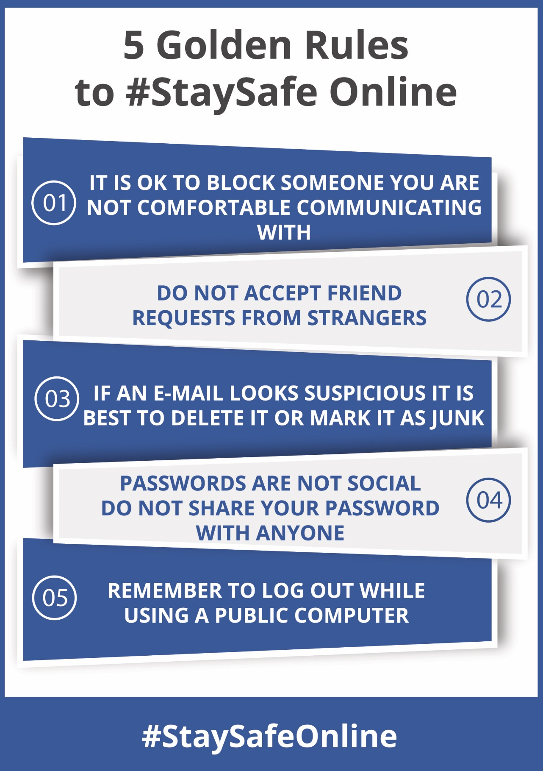
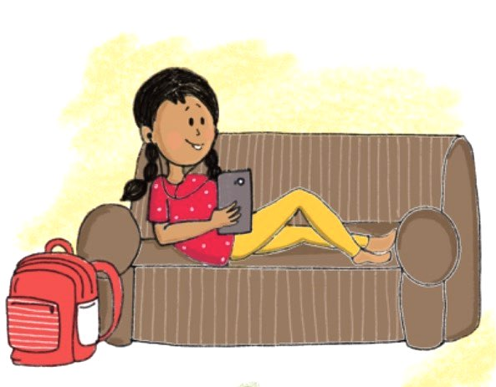
Let children be online, connect with friends!
Teach children these 5 golden rules to keep safe online.

Slide 27
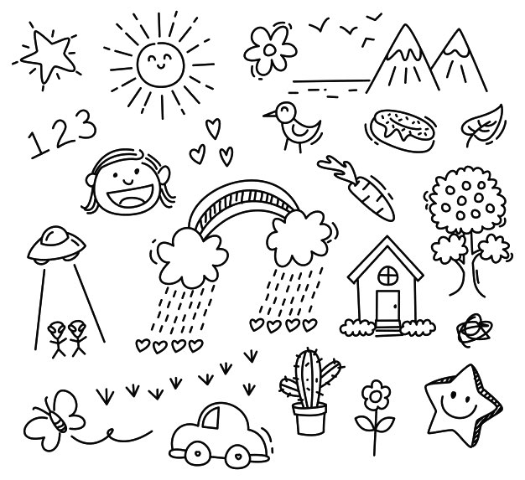
Toolkit For Age Group 6-10 years

Slide 28
Activities You Can Do With Children
(For Age Group 6-10 years)
This manual provides resources to help calm the minds of children and help them cope with the stresses they face by engaging in solution oriented, future focused, creative activities.
The following creative activities are available in this document for engaging with adolescents aged 6-10 years.
Creative Printable with messaging (7 Corona Warriors Reward Stickers and 3 Gratitude Coloring Sheets).
Infographic Poster & Worksheet explaining Symptomatology, Contagion and Prevention for Covid-19
Handout for Caregivers with Covid-19 Messaging on Do’s and Don’ts
Word Wizards (Storytelling activities on Covid-19)

Slide 29
Coronavirus reward stickers
Cue for Parents and Caregivers:
Parents and Caregivers can use these stickers as cut-outs and initiate conversations about positive and healthy behaviors to fight the virus for a 6-10 year old child.
Set positive reinforcements for children for following safe and hygienic practices and not giving into fear or anxiety
Remember children don’t need to know every little detail. Unless children ask specifically, there’s no reason to volunteer information that might worry them.
Keep a sense of perspective, engage in solution-focused thinking and balance this with mindful acceptance.
Very young children may be oblivious to the facts of the situation, but they may still feel unsettled by the changes in routine, or pick up on the fact that people around them are worried and upset.
Check in with younger children periodically and give them the chance to process any worries they may be having.

Slide 30
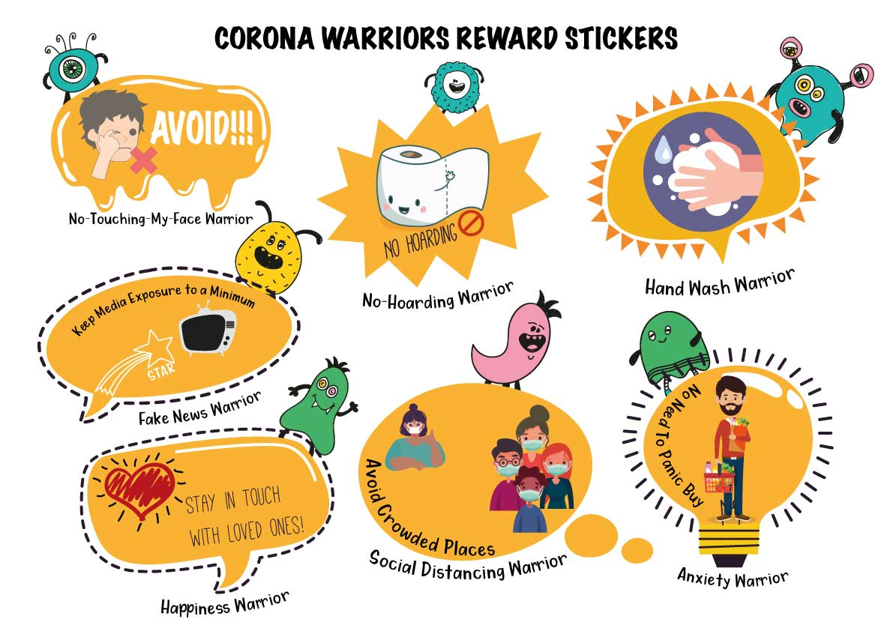

Slide 31
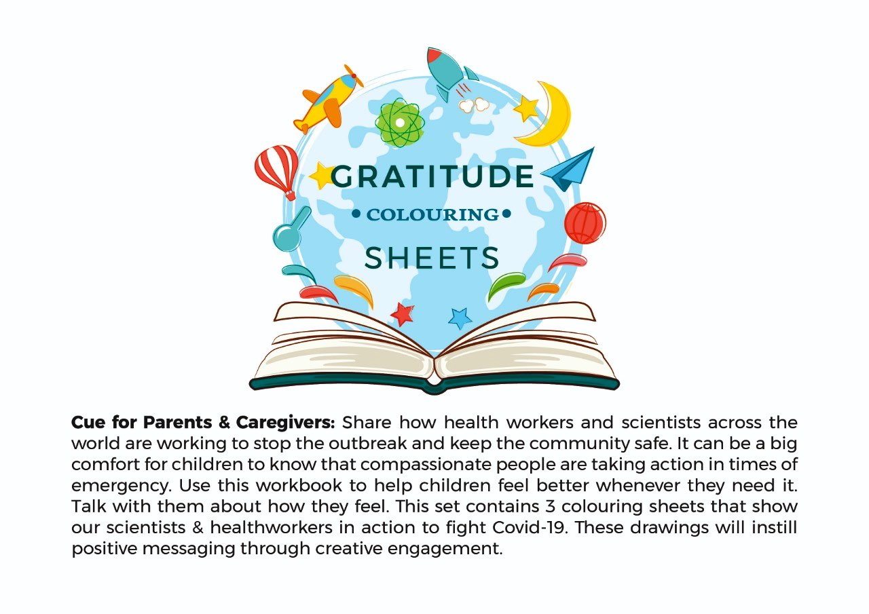
Cue for Parents & Caregivers: Share how health workers and scientists across the world are working to stop the outbreak and keep the community safe. It can be a big comfort for children to know that compassionate people are taking action in times of emergency. Use this workbook to help children feel better whenever they need it. Talk with them about how they feel. This set contains 3 colouring sheets that show our scientists & health workers in action to flight Covid-19. These drawings will instill positive messaging through creative engagement.
If you are unable to print the sheets, show them to children and encourage them to draw and colour.

Slide 32
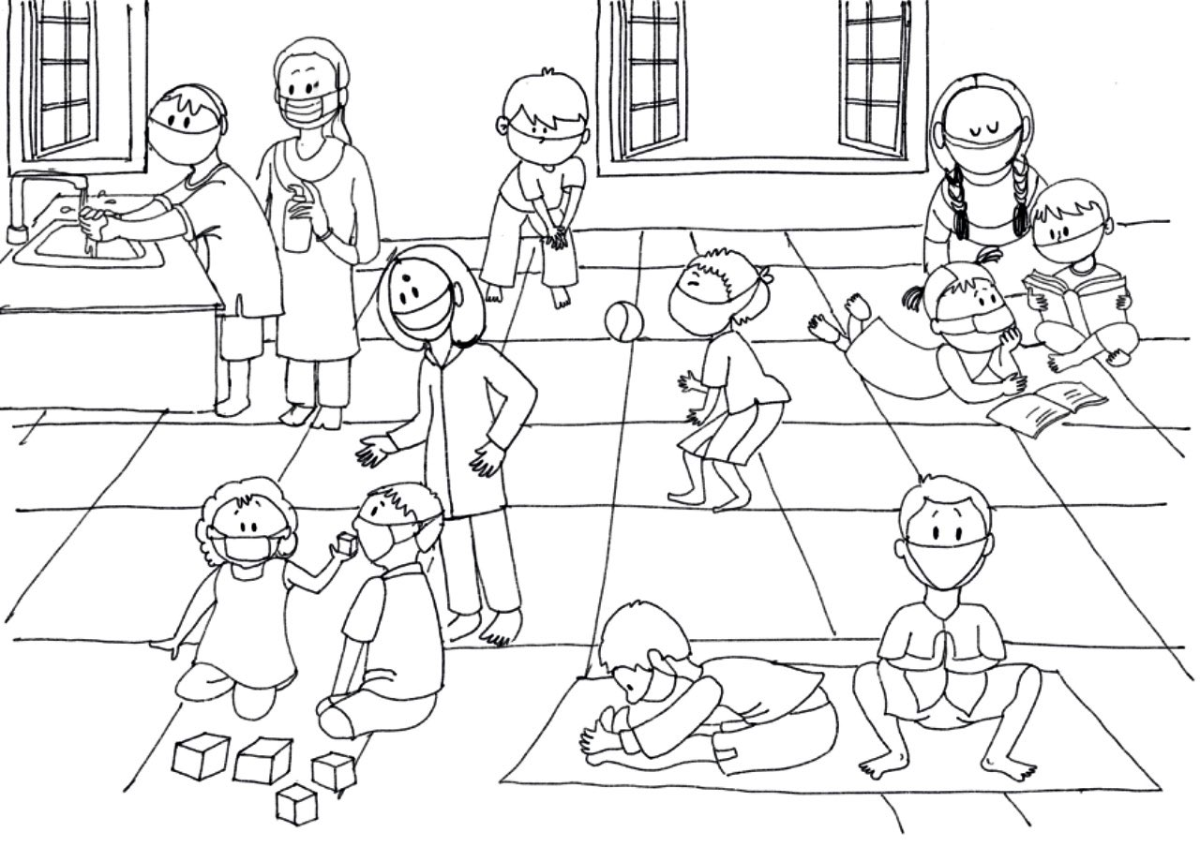
Child Friendly Spaces in Times of Corona

Slide 33
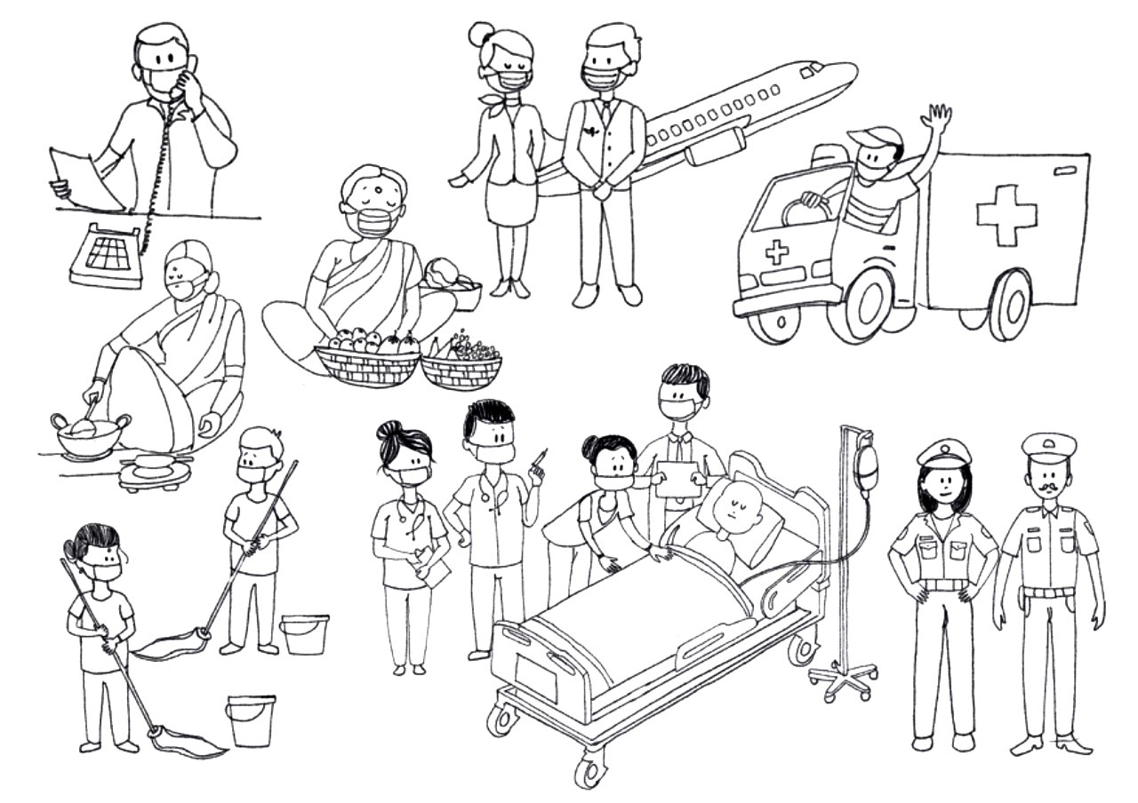
Heroes Fighting Coronavirus

Slide 34
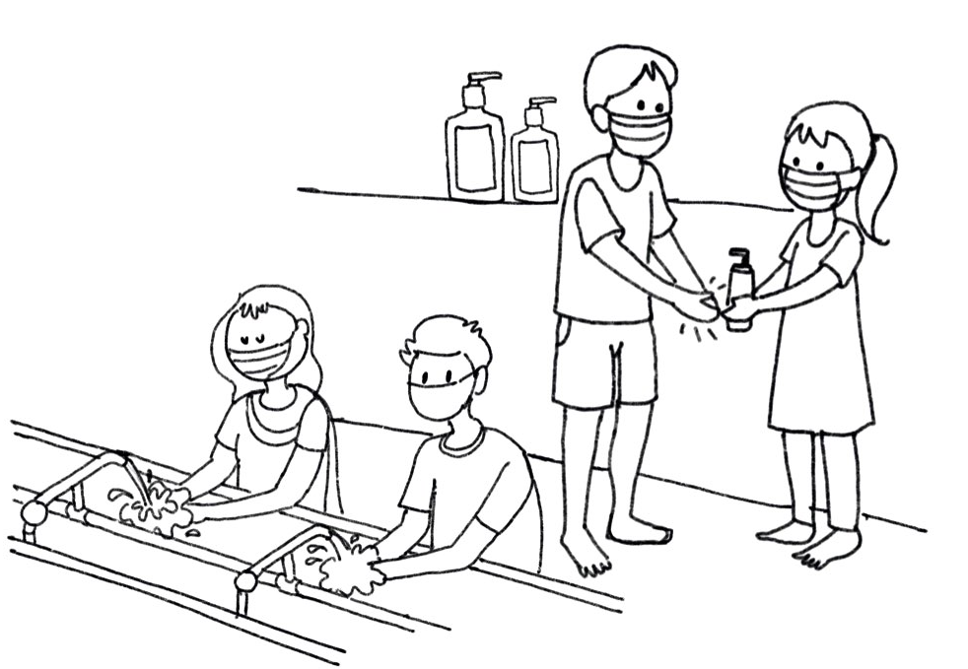
Staying safe from coronavirus

Slide 35
Infographic Poster and Worksheet
Cue for Parents and Caregivers:
This part of the document provides an Infographic Poster for awareness building activities and Worksheet (based on the same poster) explaining Symptomatology, Contagion and Prevention for Covid-19. The infographic based awareness poster can be used by parents and caregivers. The same poster is also provided as a worksheet tool. Once the caregiver has explained the infographic poster, the tool can be distributed as a simple print-out for children to reinforce the learnings in any language they choose as a lesson plan.
Parents and caregivers can use the following key points in their awareness building session when explaining the poster:
‘DO THE FIVE’ and help stop coronavirus from spreading by following these 5 basic steps:
1. HANDS: Wash them often (regularly for 20 seconds, with soap and water or alcohol-based hand rub.)
2. ELBOW: Cough into it
3. FACE: Don’t touch it (with unclean hands)
4. SPACE: Keep safe distance (1 meter or 3 feet) with people who are unwell and show signs of flu
5. HOME : Stay at Home
NOTE: It is important to tell children that these 5 basic steps must be followed by all. Demonstrate by following yourself.

Slide 36
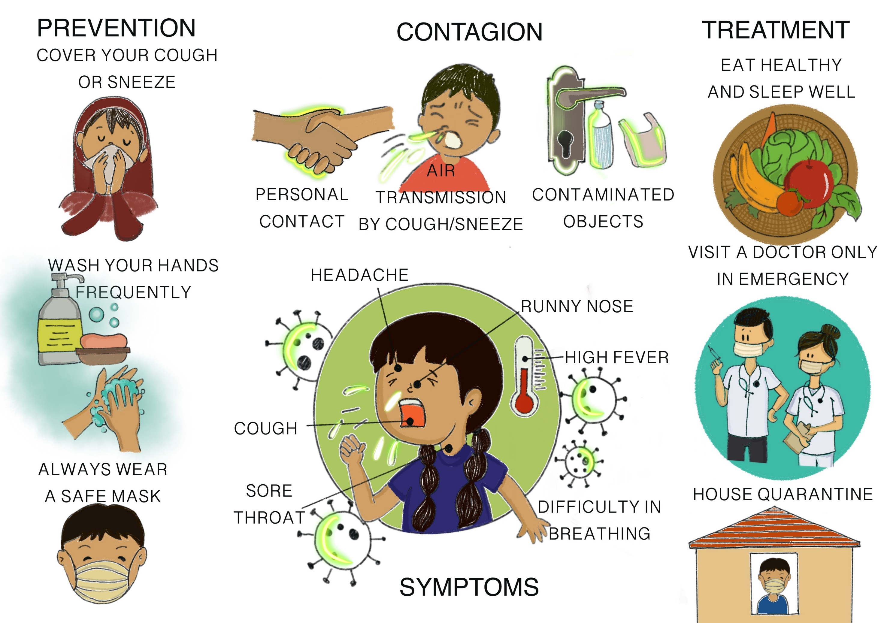
Infographic poster

Slide 37
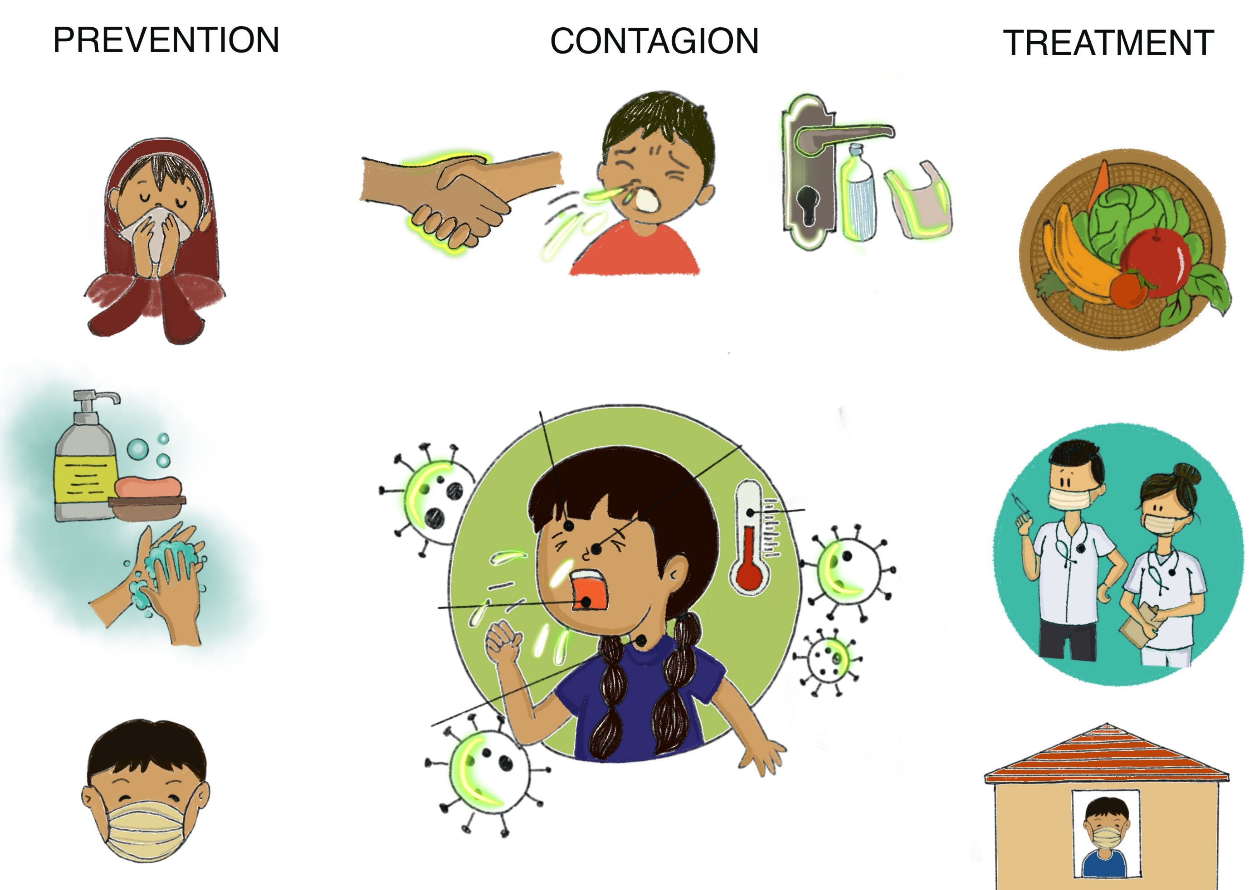
Fill the worksheet with the help of a parent or caregiver

Slide 38
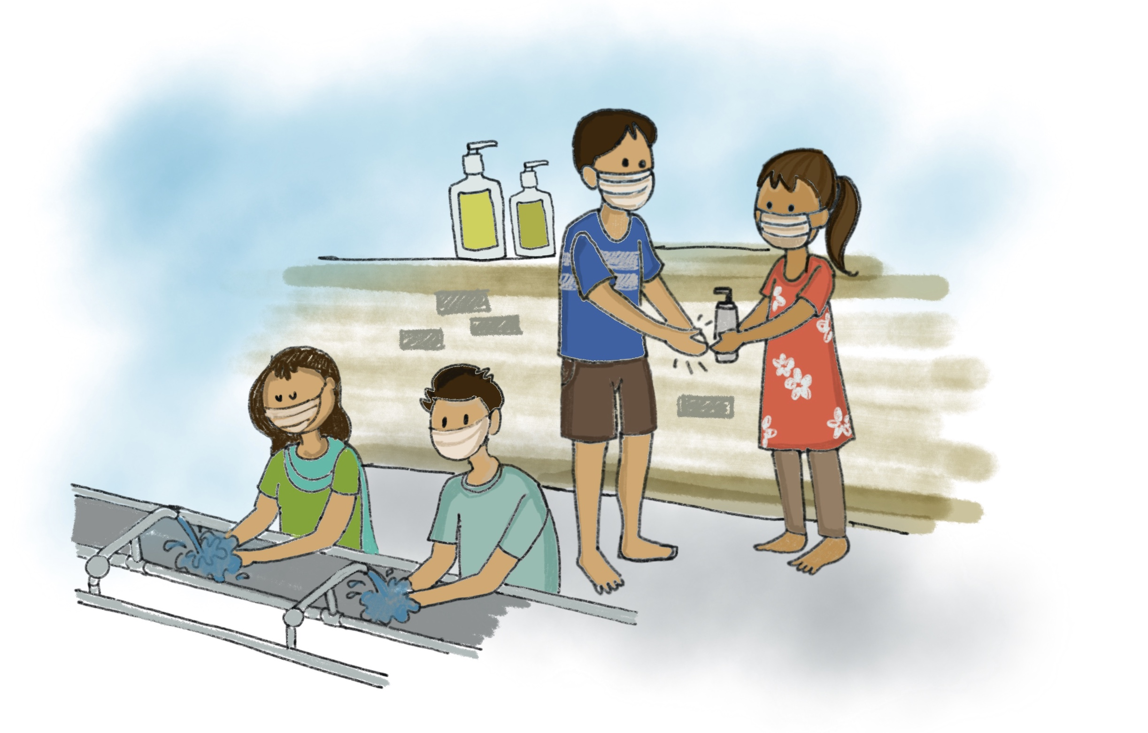
Handout for caregivers with covid-19 messaging on do’s and don’ts
This section provides child-friendly tips on “How to talk to children about coronavirus disease 2019 (COVID-19) - Do’s and Dont’s”
Make sure you talk positively and emphasize on the importance of effective prevention measures, including following safe tips on handwashing. Remember to not make the conversation scary or fear-based for the child.

Slide 39
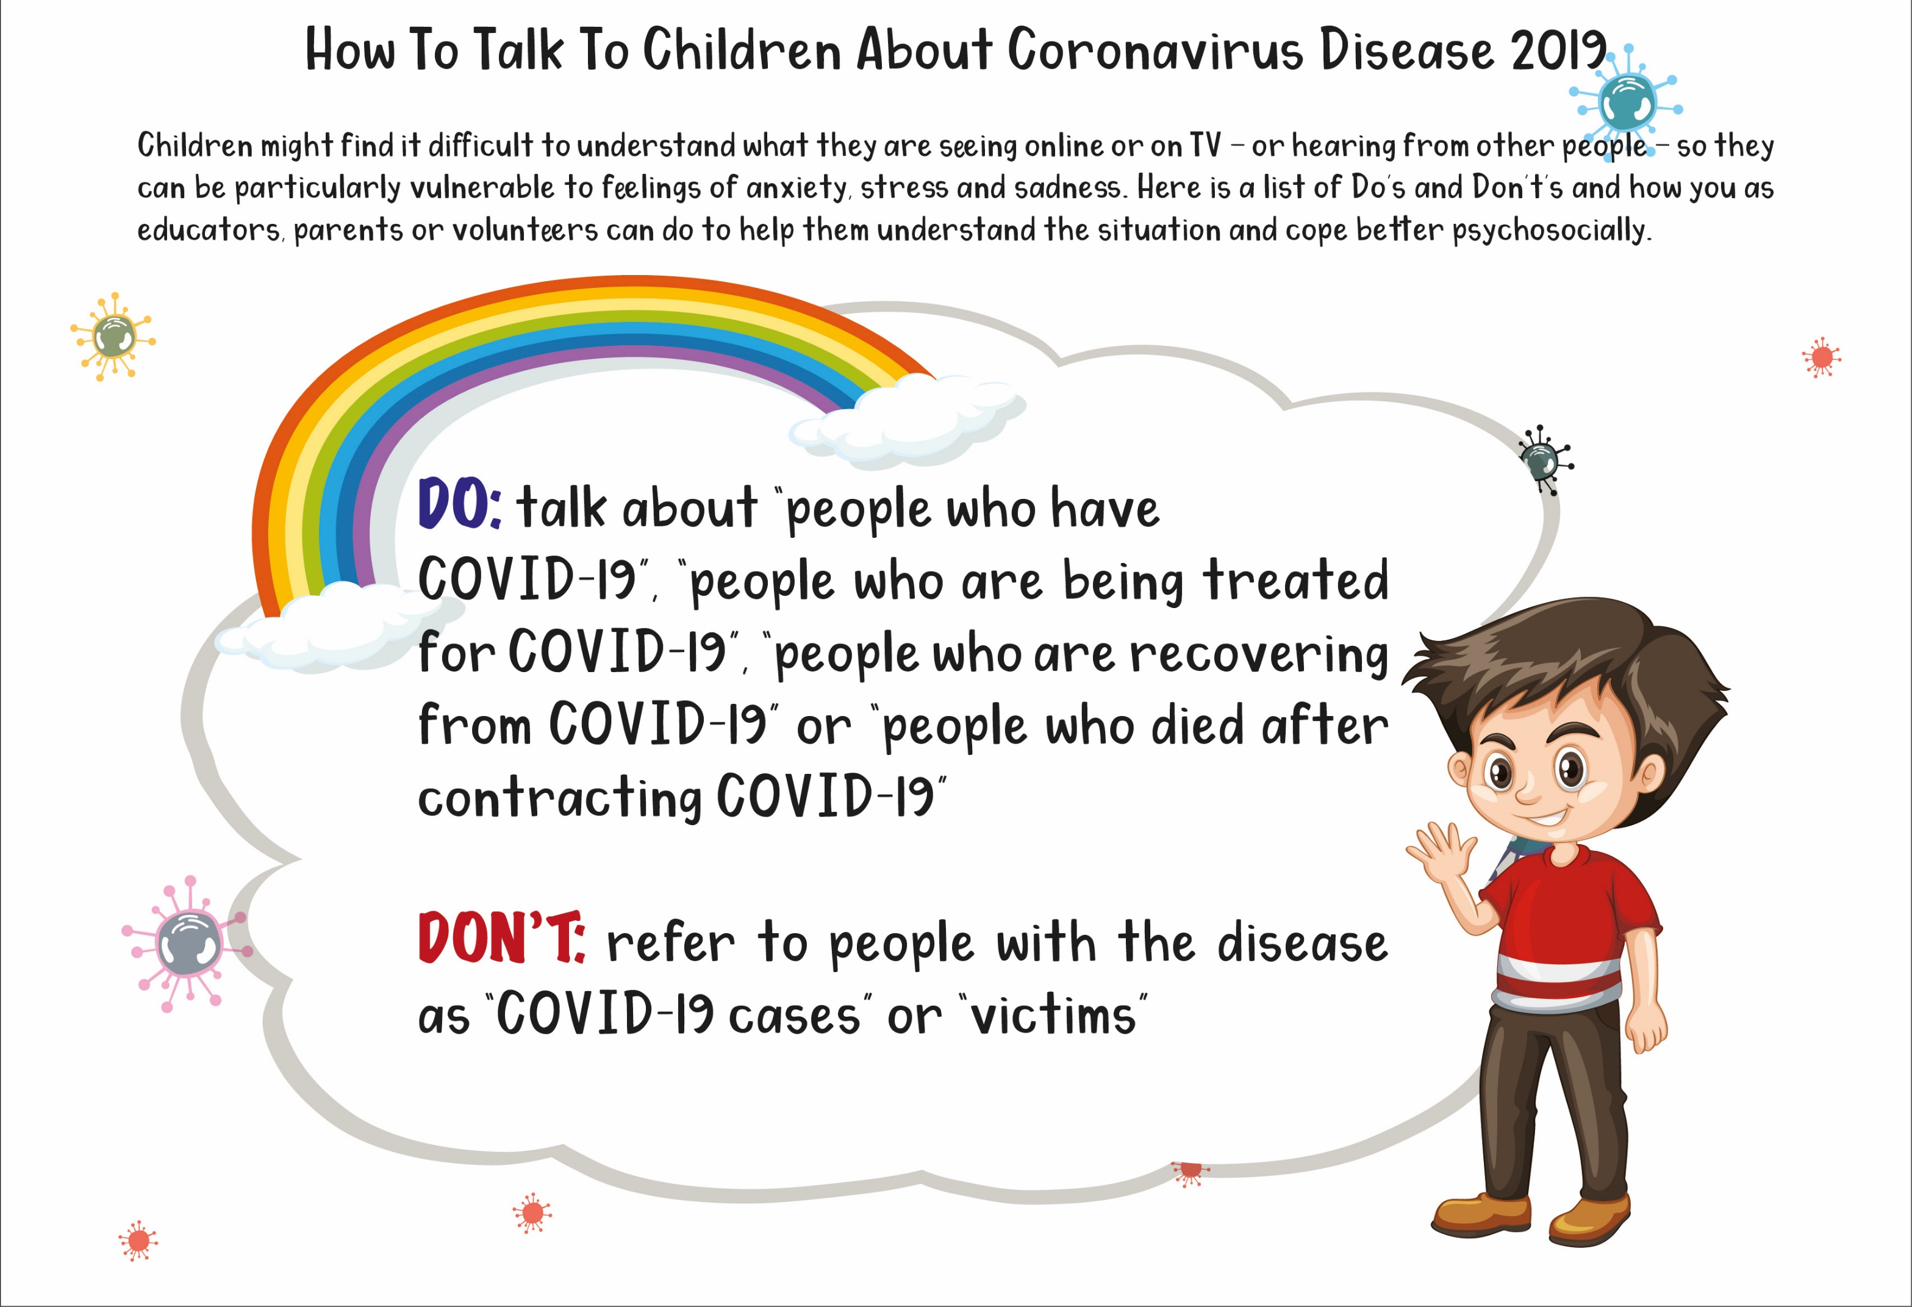

Slide 40
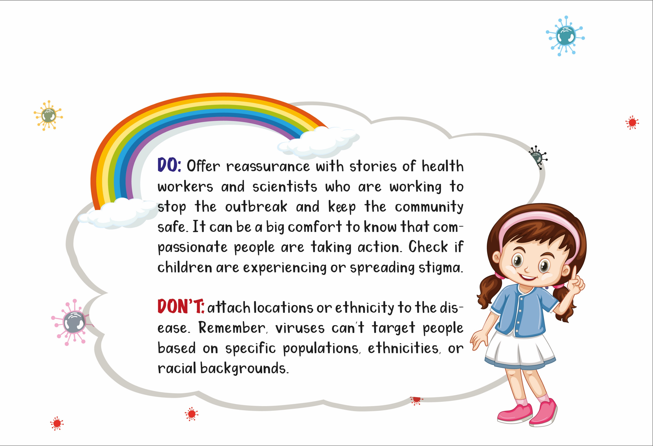

Slide 41
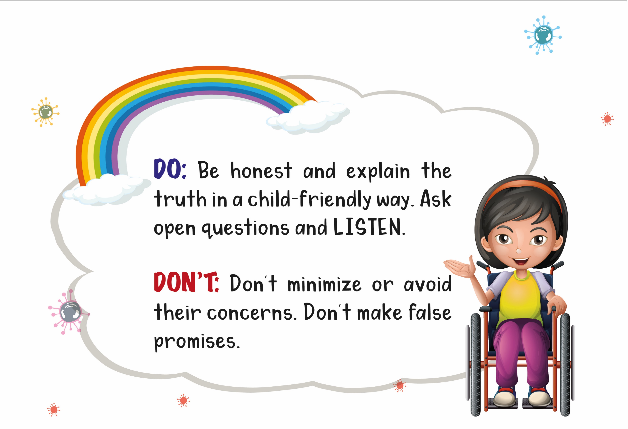

Slide 42
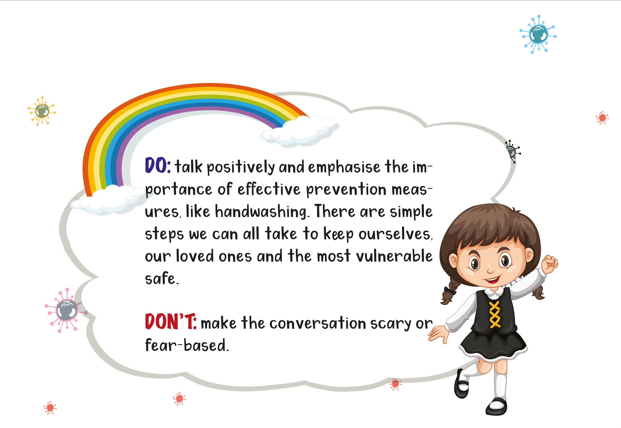

Slide 43
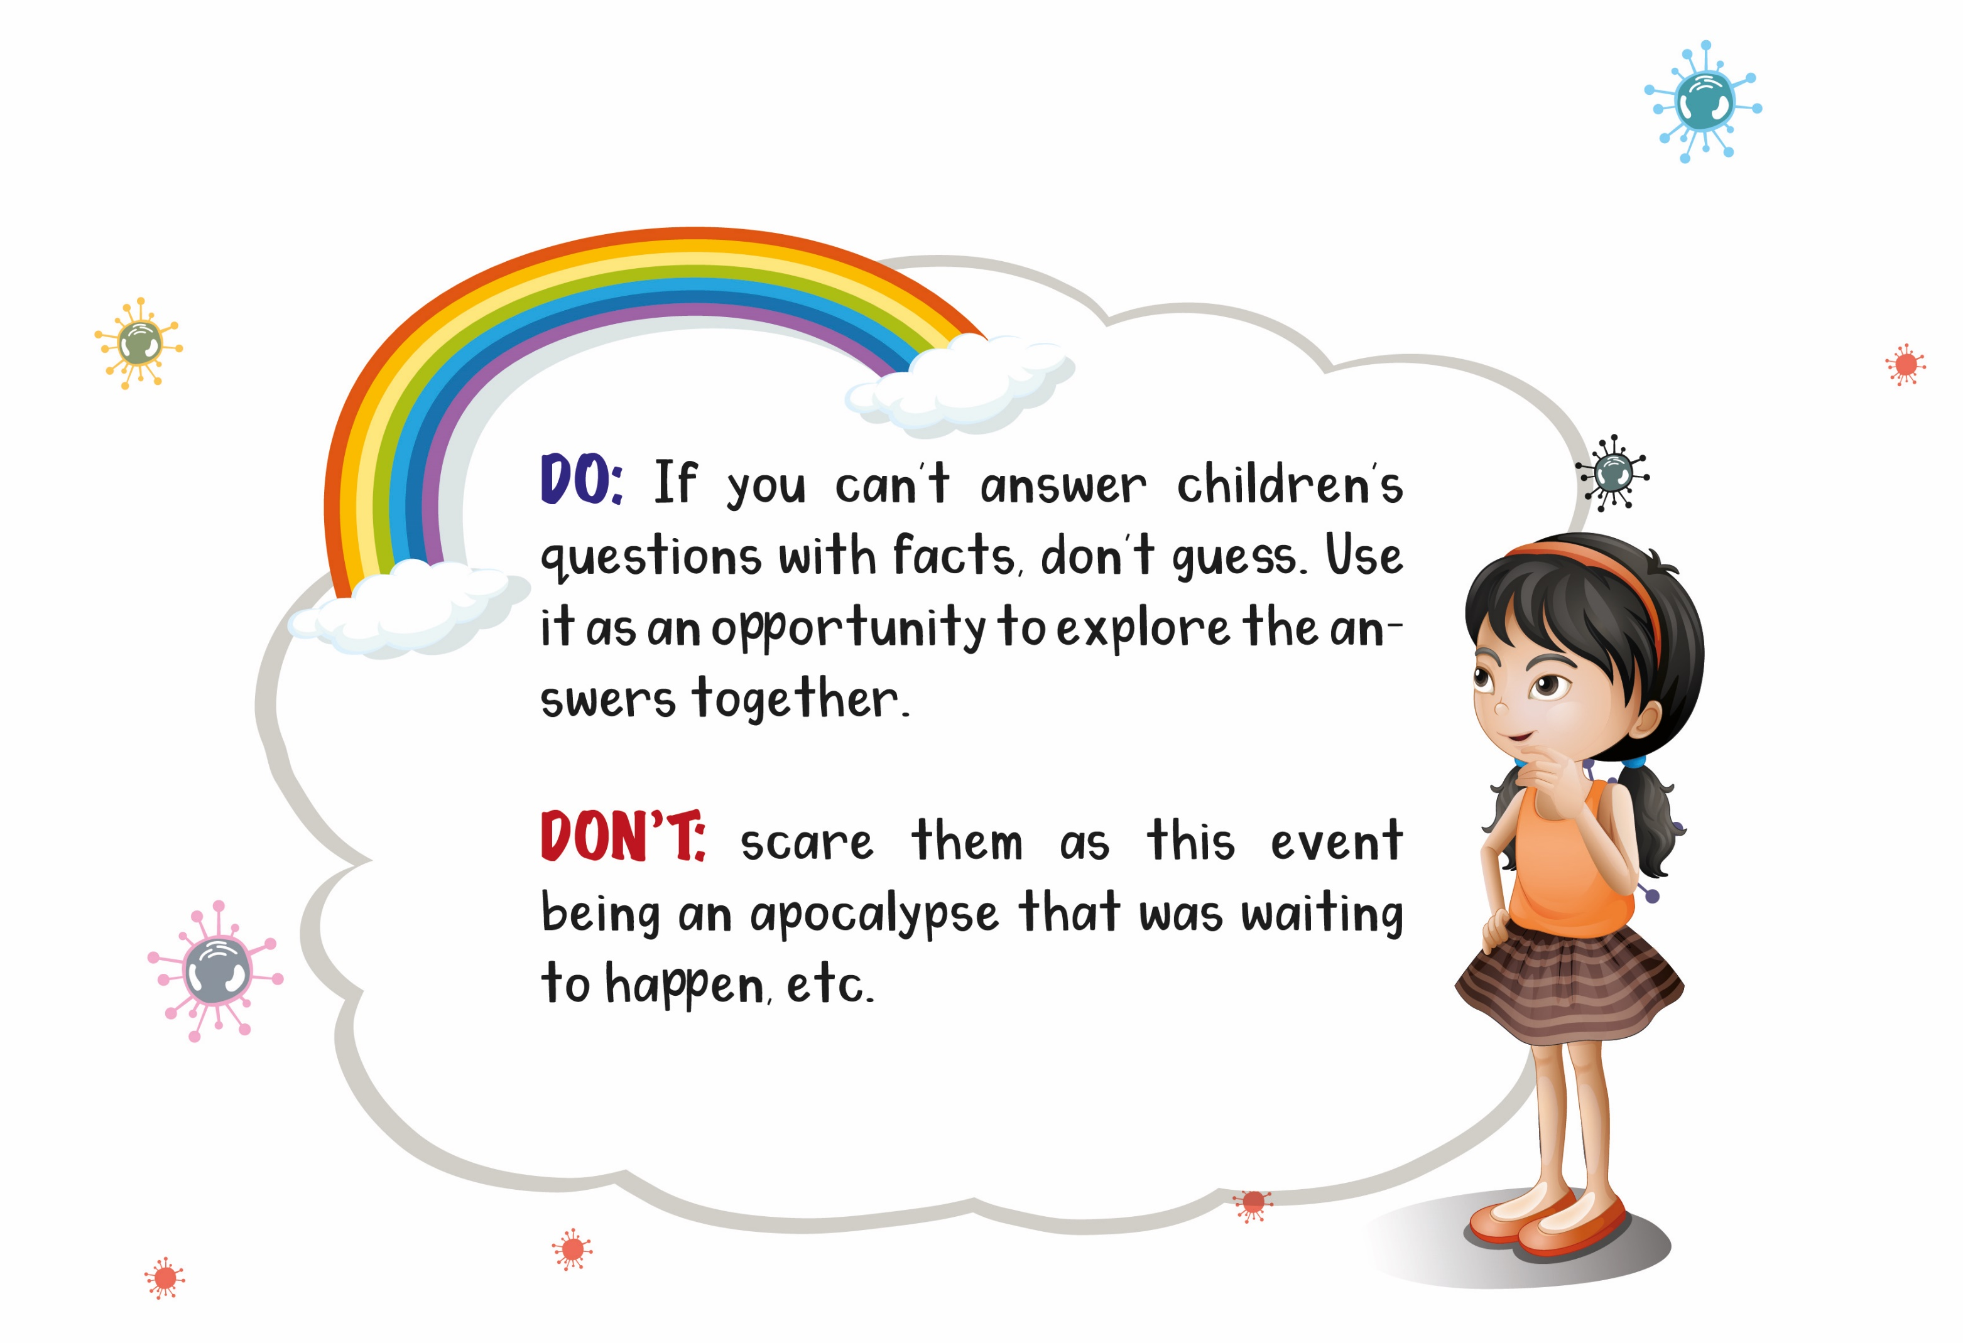

Slide 44
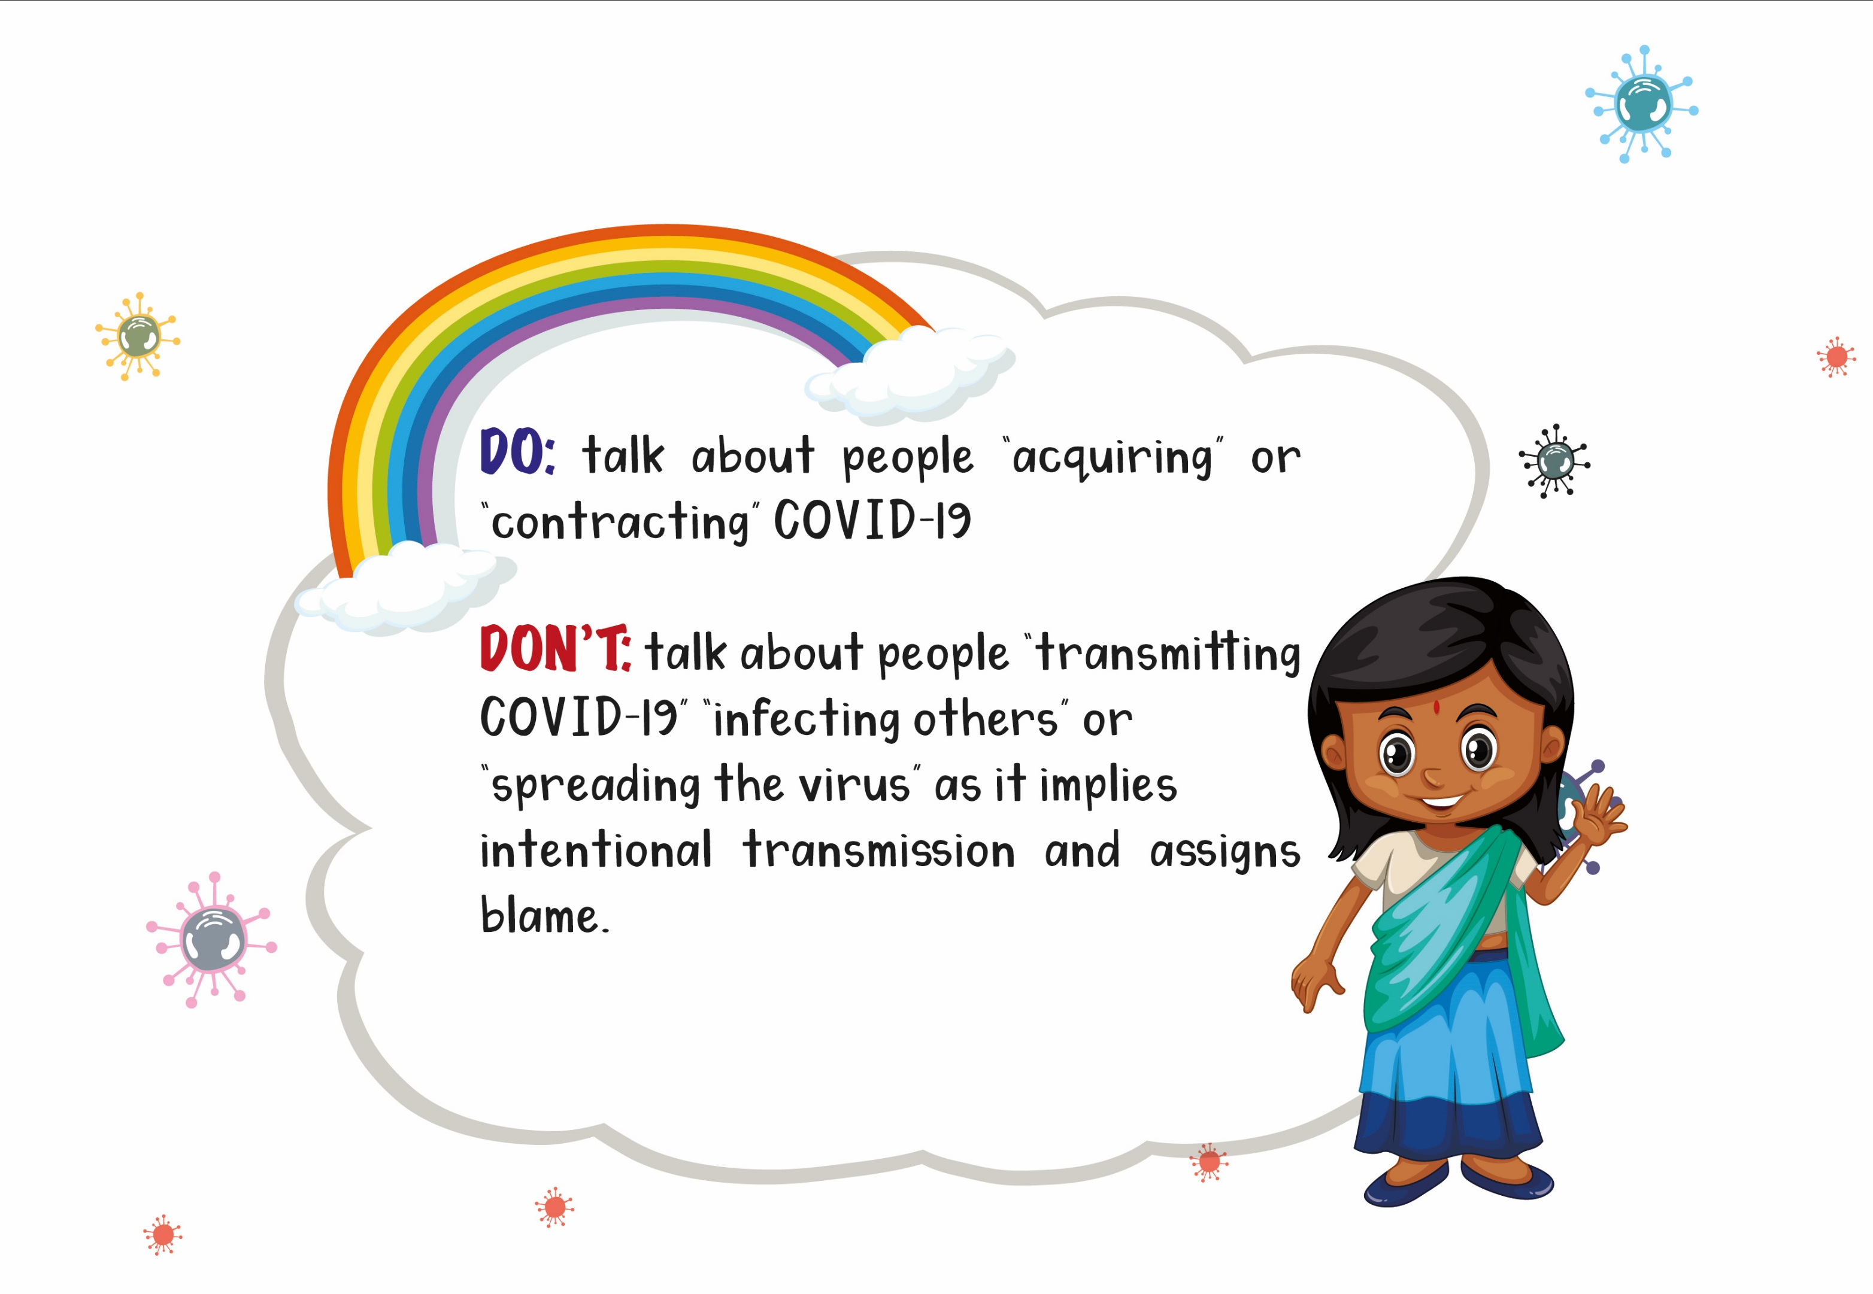

Slide 45
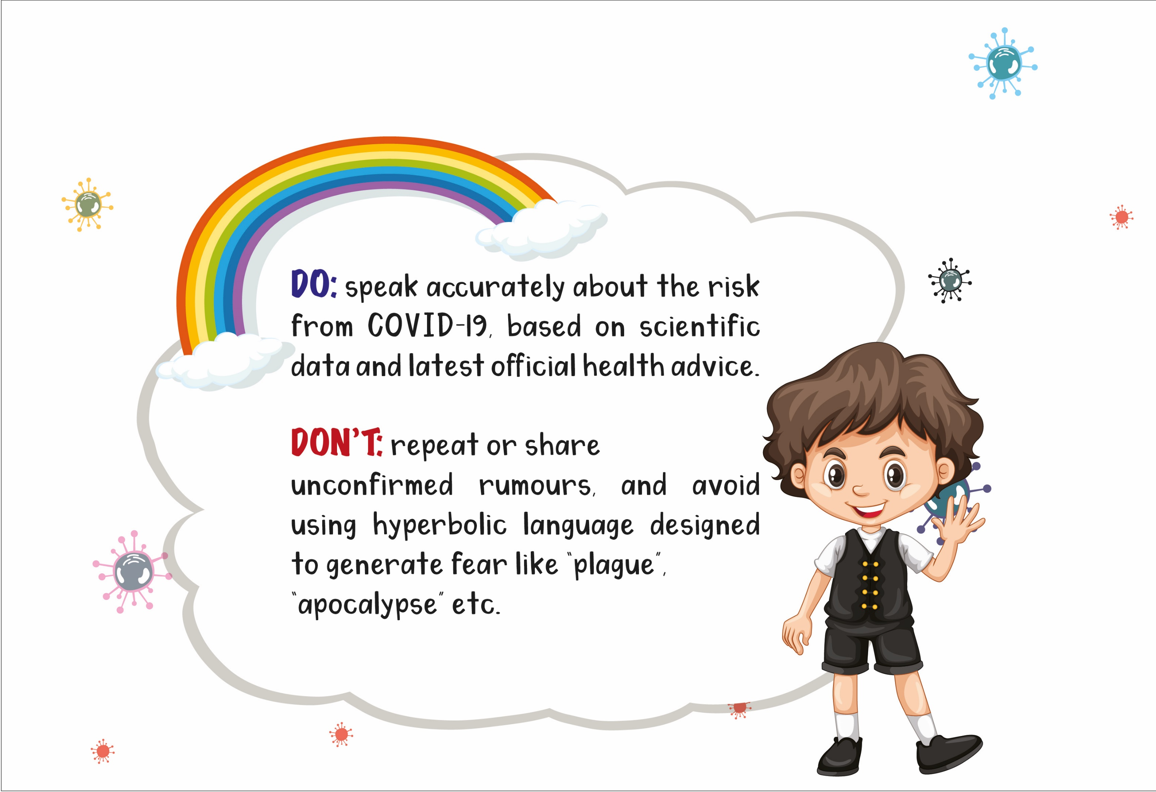

Slide 46
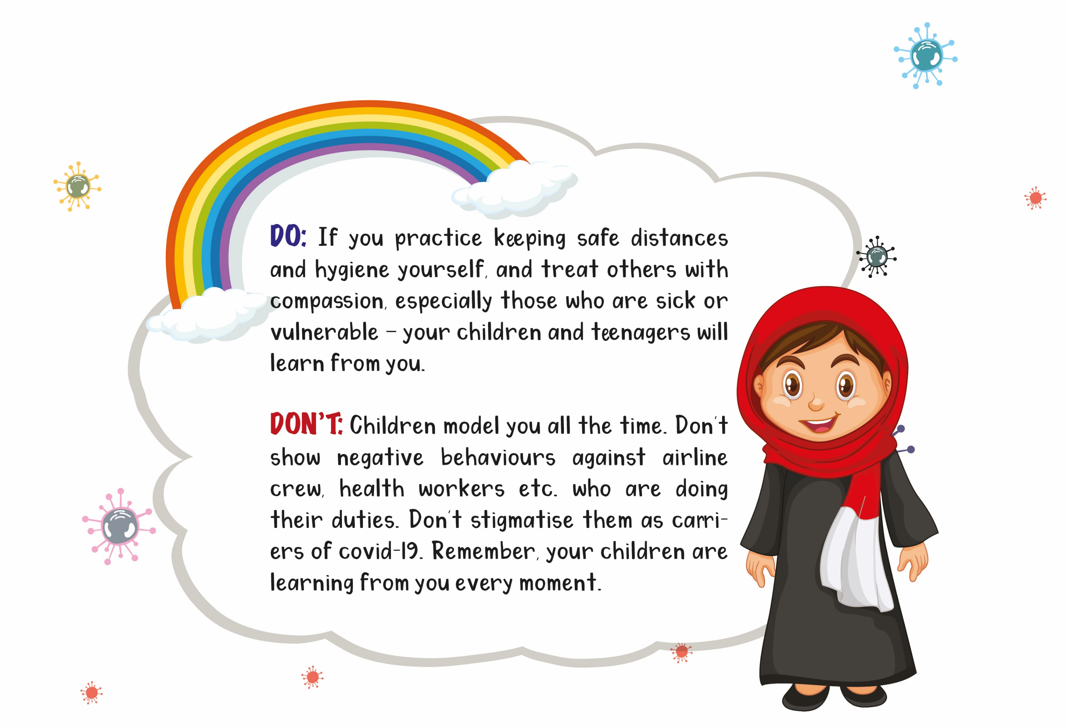

Slide 47
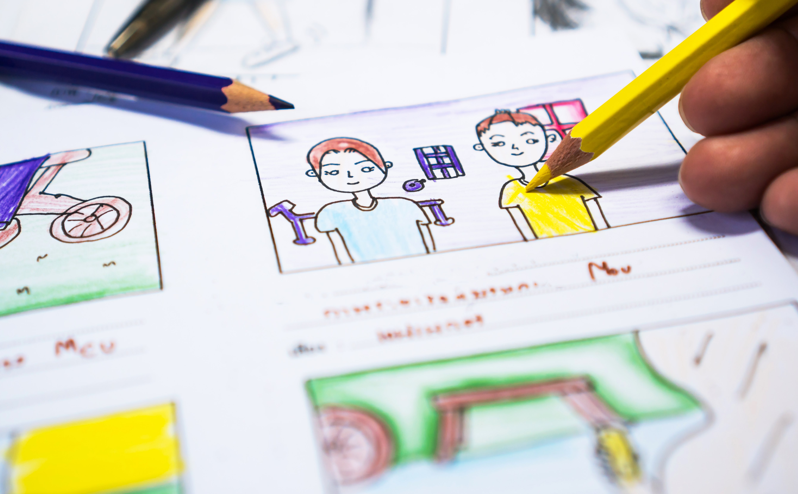
Word wizards (storytelling toolkit on covid-19)

Slide 48
Word wizards (storytelling toolkit on Covid-19)
This section contains the following resource:
One unique and original way to engage children is through storytelling activities to address their anxiety, loneliness and help them cope with stress and anxiety .
Cue for Parents & Caregivers:
Anxiety is a normal reaction to uncertainty and things that may harm us. For many of us, the coronavirus and the COVID-19 illness make for a very uncertain future. People worry about their own health and the health of their loved ones. Children may also have a lot of concerns around school or work their parents’ finances, available ration-stocks at home, their ability to take part in important hobbies, and other important parts of their lives. Children who already experience a lot of anxiety may find their anxiety worsening in these times.
Use the stories to divert children's attention, at the same time talk about issues they are facing.

Slide 49
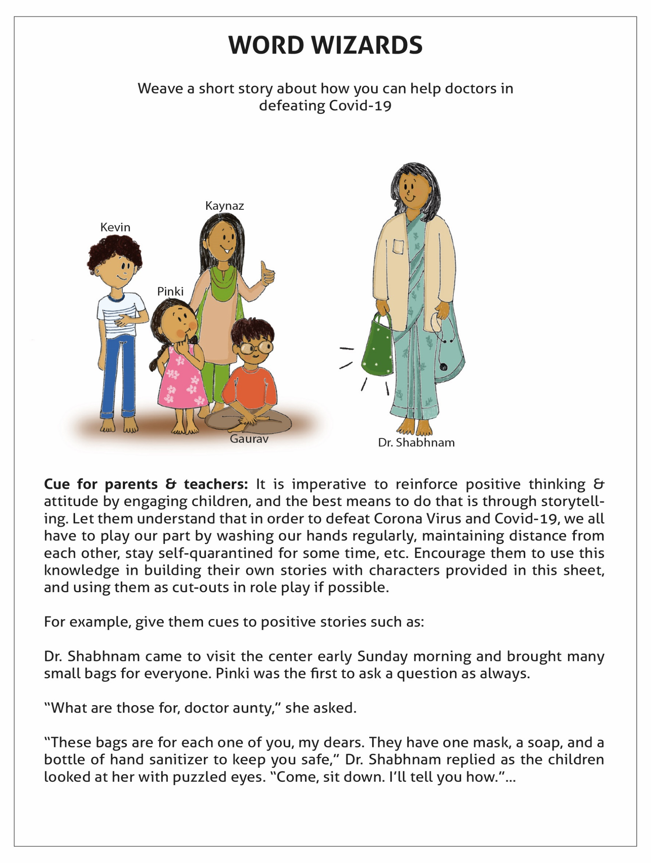
First
Story Cue
Objective:
Using positive messaging to help children understand playfully how to stay safe during the covid-19 pandemic.

Slide 50
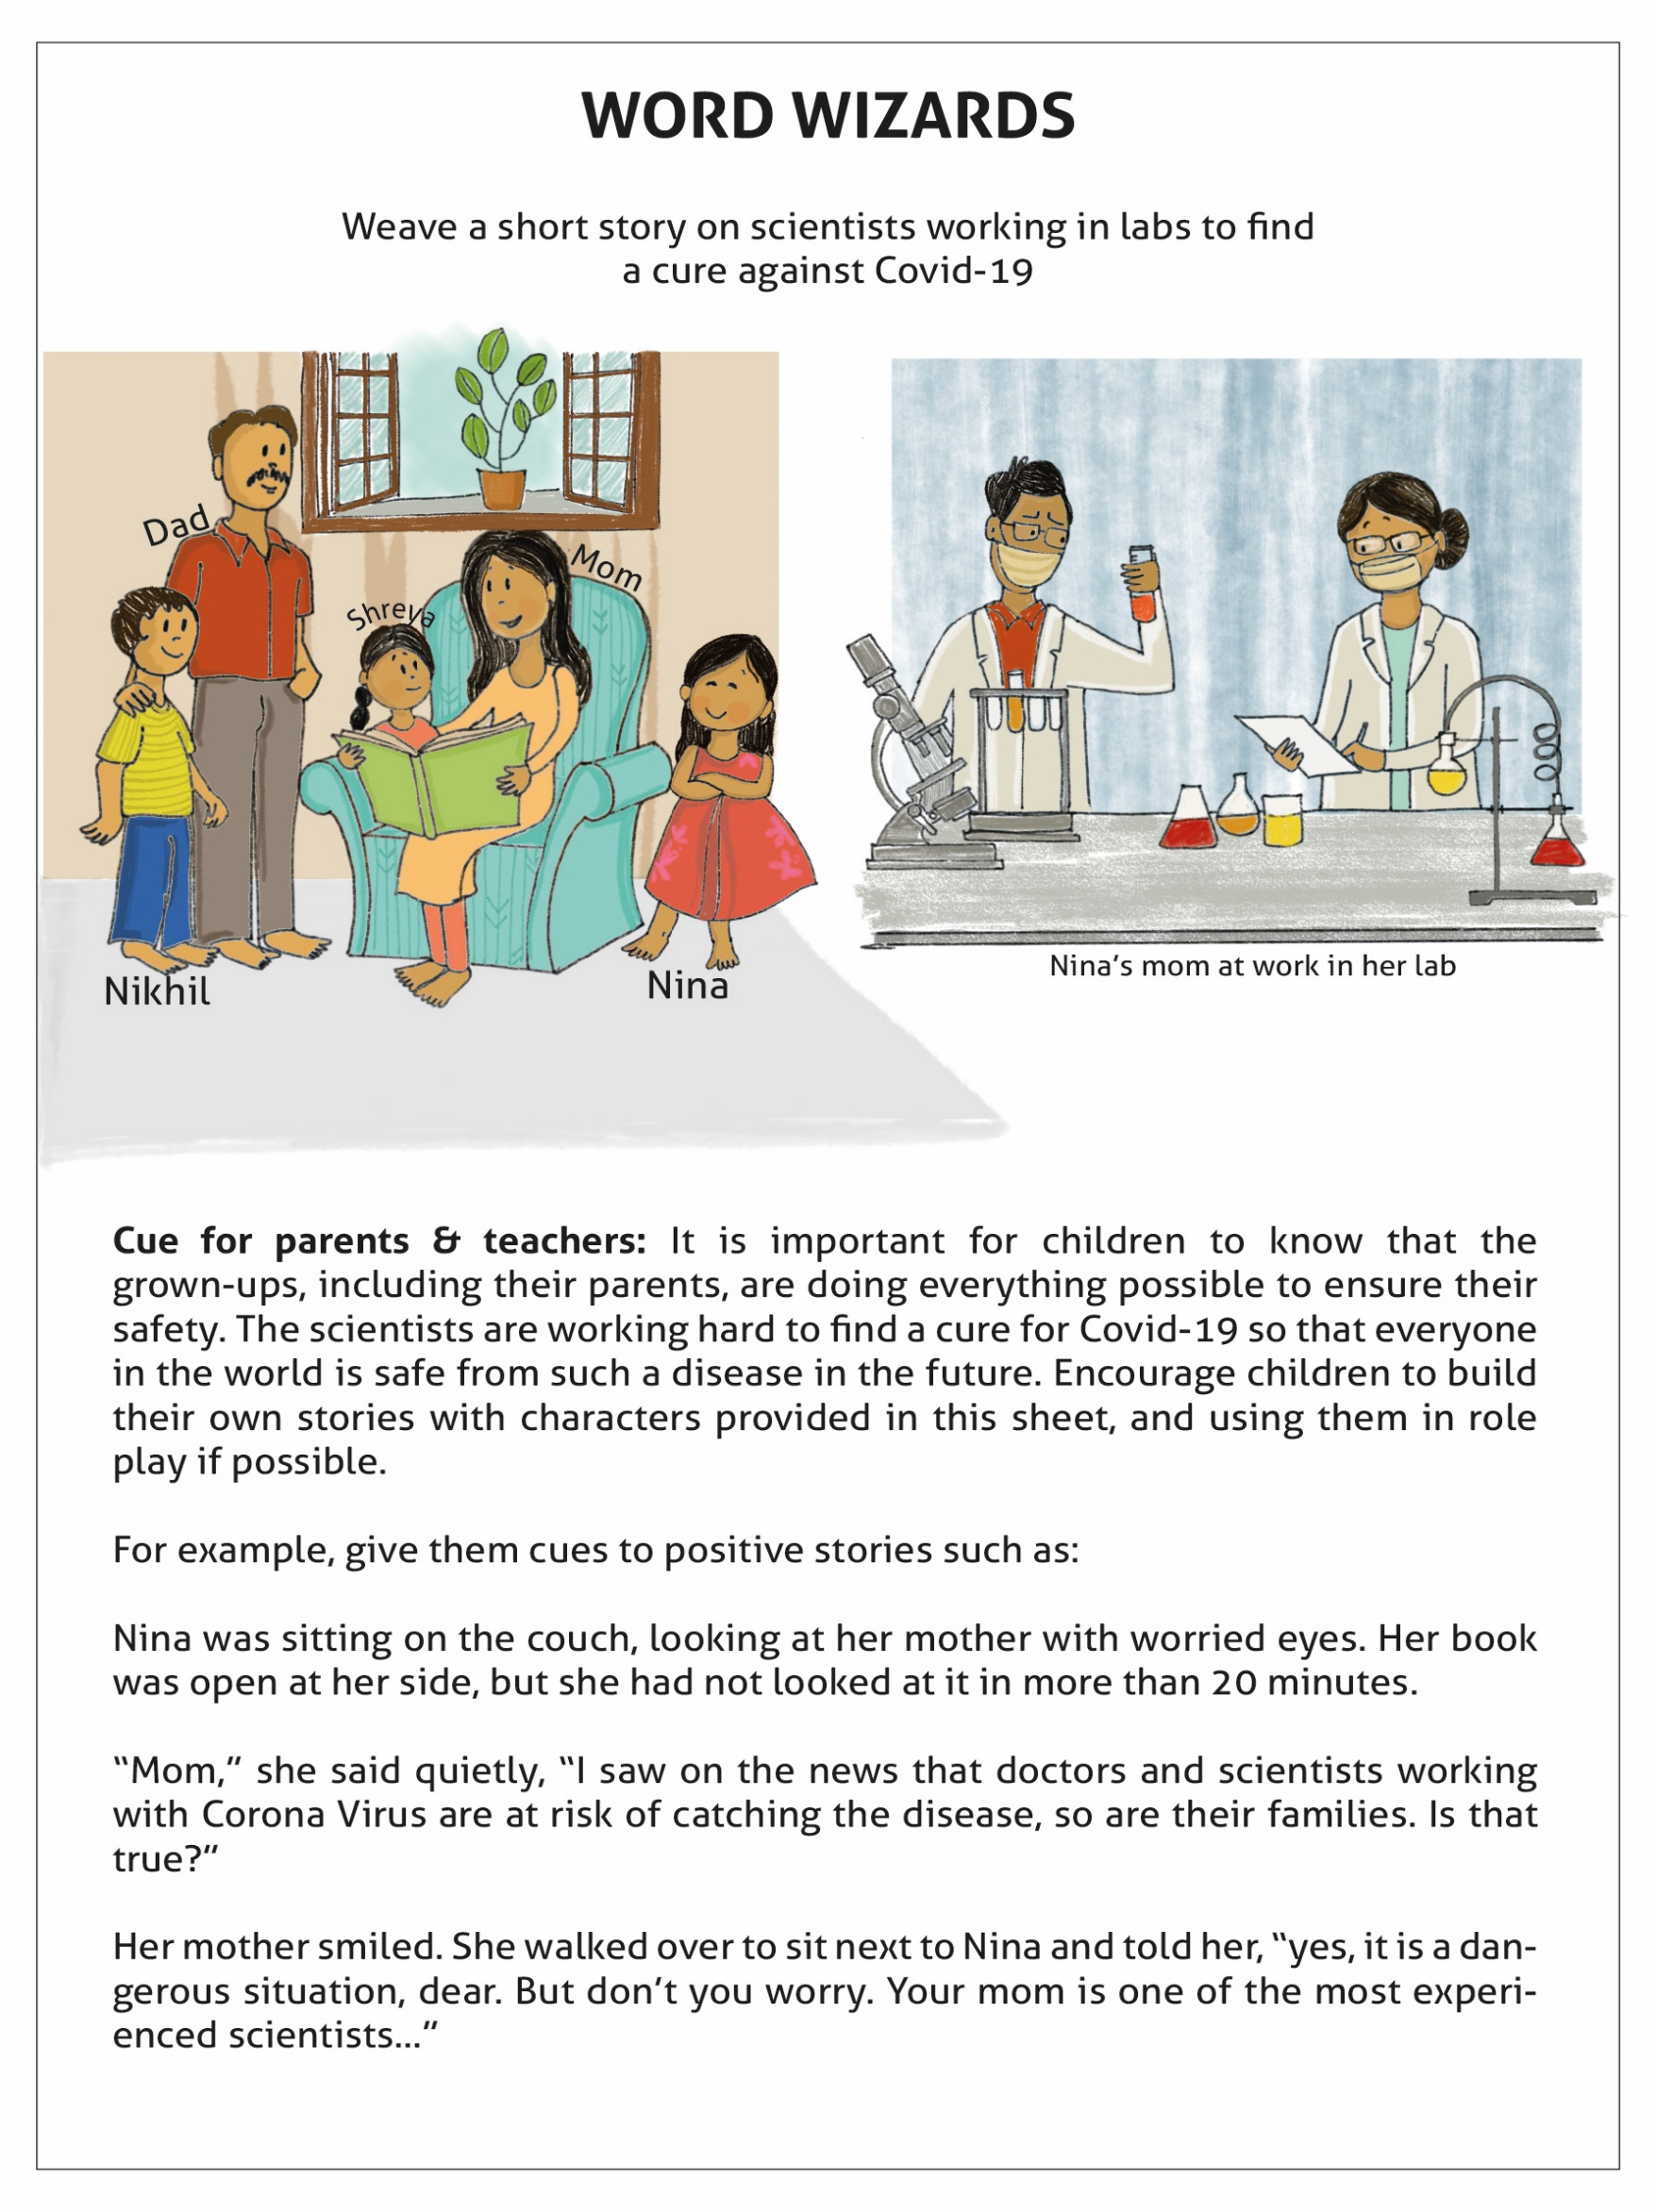
Second Story Cue
Objective:
Help children understand that adults especially the health workers and scientists are working very hard and compassionately to find a cure for Covid-19.

Slide 51
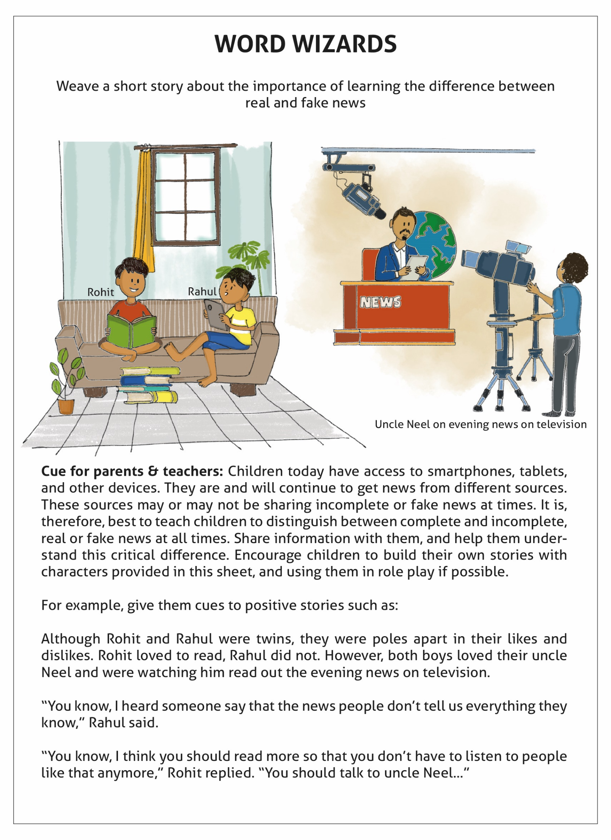
Third Story Cue
Objective:
Help children understand the harm and unnecessary panic and anxiety caused by fake news especially in this everyday evolving pandemic.

Slide 52
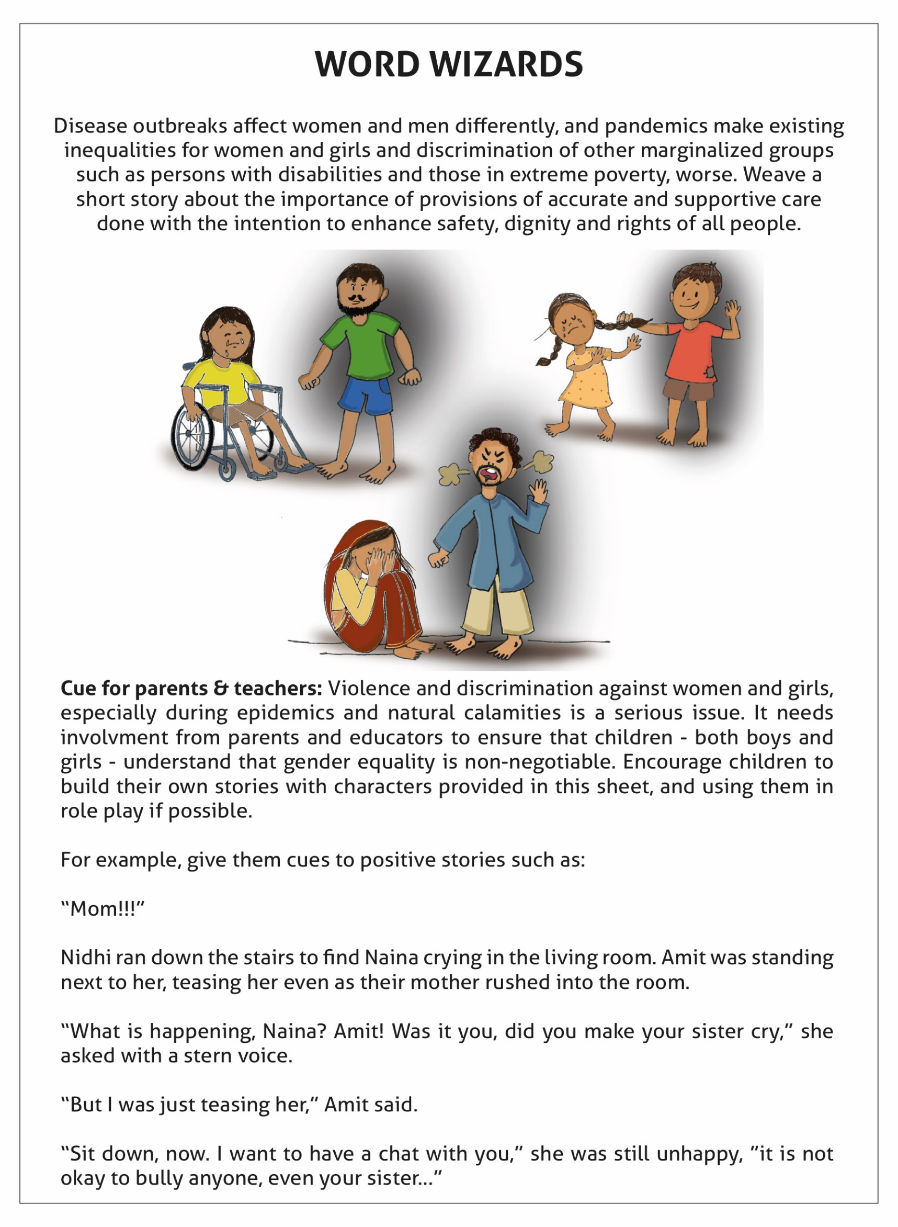
Fourth Story Cue
Objectives:
Helping children understand how disease outbreaks affect men and women differently and how pandemics make existing inequalities for women and girls and discrimination of other marginalized groups such as persons with disabilities and those in extreme poverty, worse.
Helping children understand how in times of crisis such as an outbreak, women and girls may be at higher risk of intimate partner violence and other forms of domestic violence due to increased tensions in the household.
Tell children how to seek help. They can call CHILDLINE 1098.

Slide 53
Children can use this template to create their own storyboard

Slide 54
Toolkit For Age Group 11-19 years

Slide 55
Activities You Can Do With Adolescnets
(For Age Group 11-19 years)
This segment provides the following plethora of resources to help calm the mind of the children and adolescents and help calm the stress by engaging in something that is solution oriented, future focused, and is creative and fun to engage in. The following creative activities are available in this document for engaging with adolescents aged 11-19 years.
Creative Printables With Messaging (Three Gratitude Coloring Sheets and Three Animal Powered Mandalas)
Exploring Self Management Strategies - ‘My Wellbeing Plan’

Slide 56
Cue for Parents & Caregivers: Share how health workers and scientists across the world are working to stop the outbreak and keep the community safe. It can be a big comfort for children to know that compassionate people are taking action in times of emergency. Use this workbook to help children feel better whenever they need it. Talk with them about how they feel. This set contains 3 colouring sheets that show our scientists & health workers in action to flight Covid-19. These drawings will instill positive messaging through creative engagement.
If you are unable to print the sheets, show them to adolescent and encourage them to draw and colour.

Slide 57
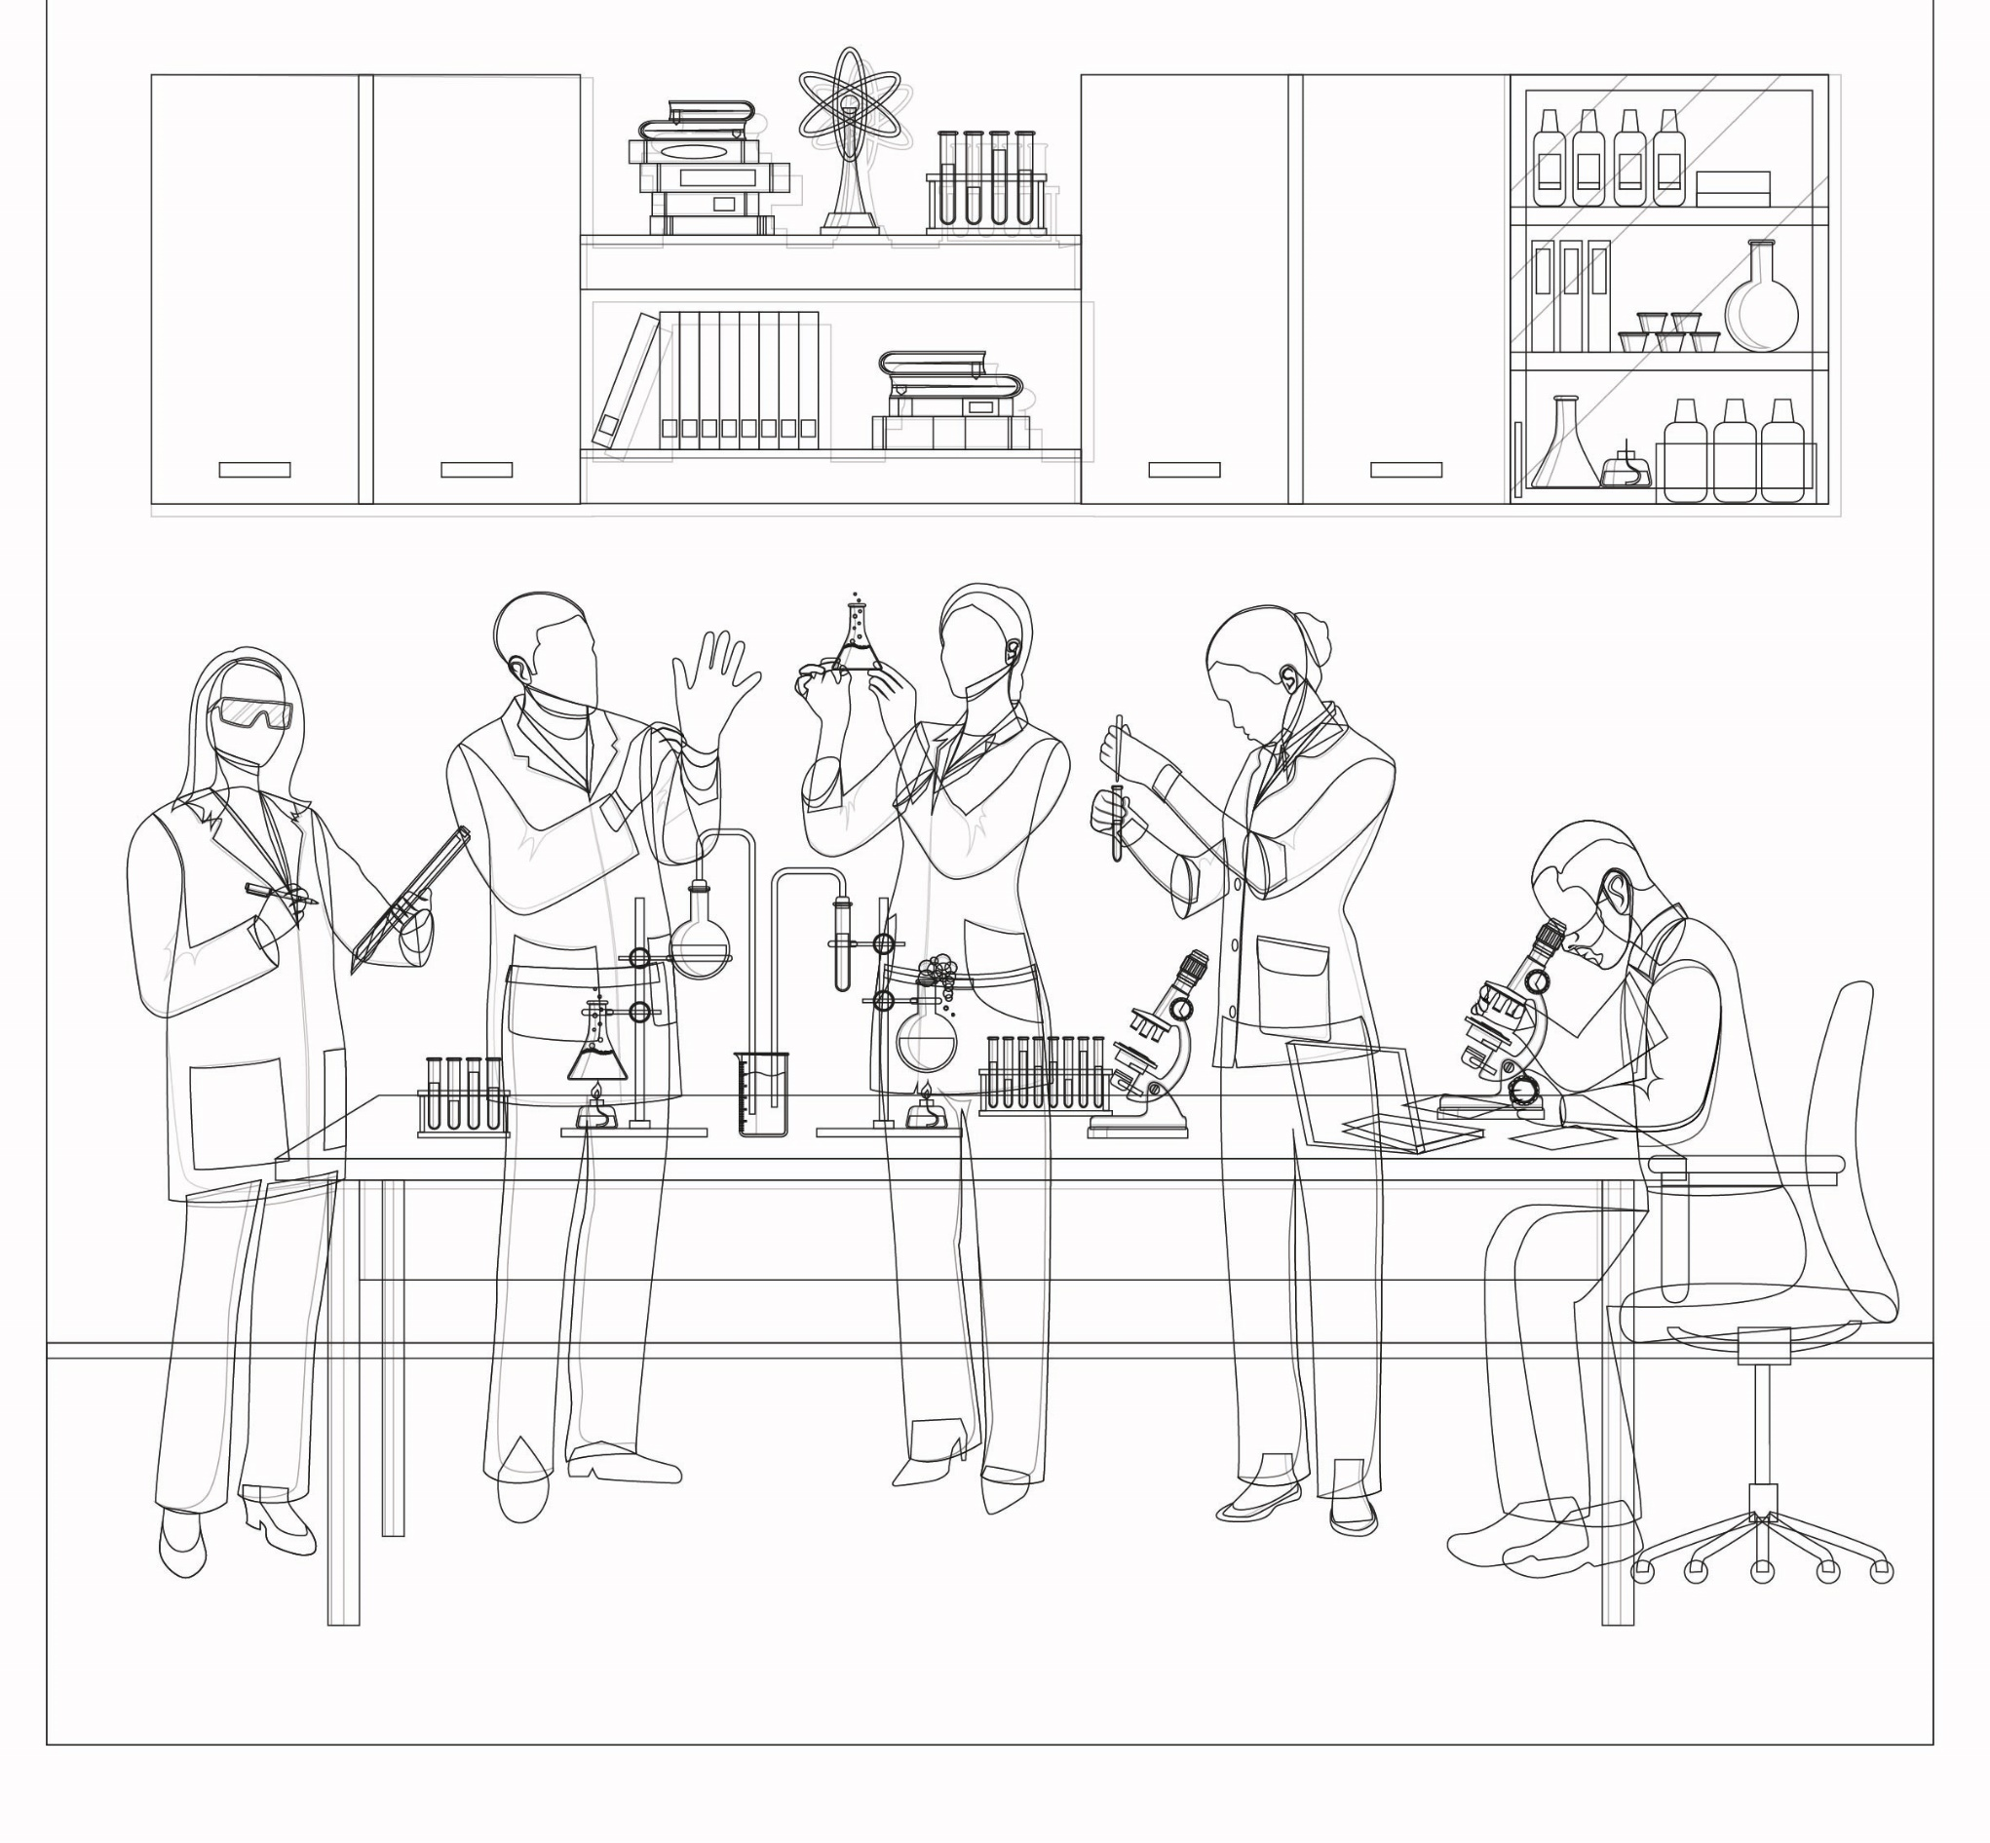
Color This Sheet and Write Your Message To The Scientists Who Are Working So Hard To Find a Cure for the Coronavirus

Slide 58
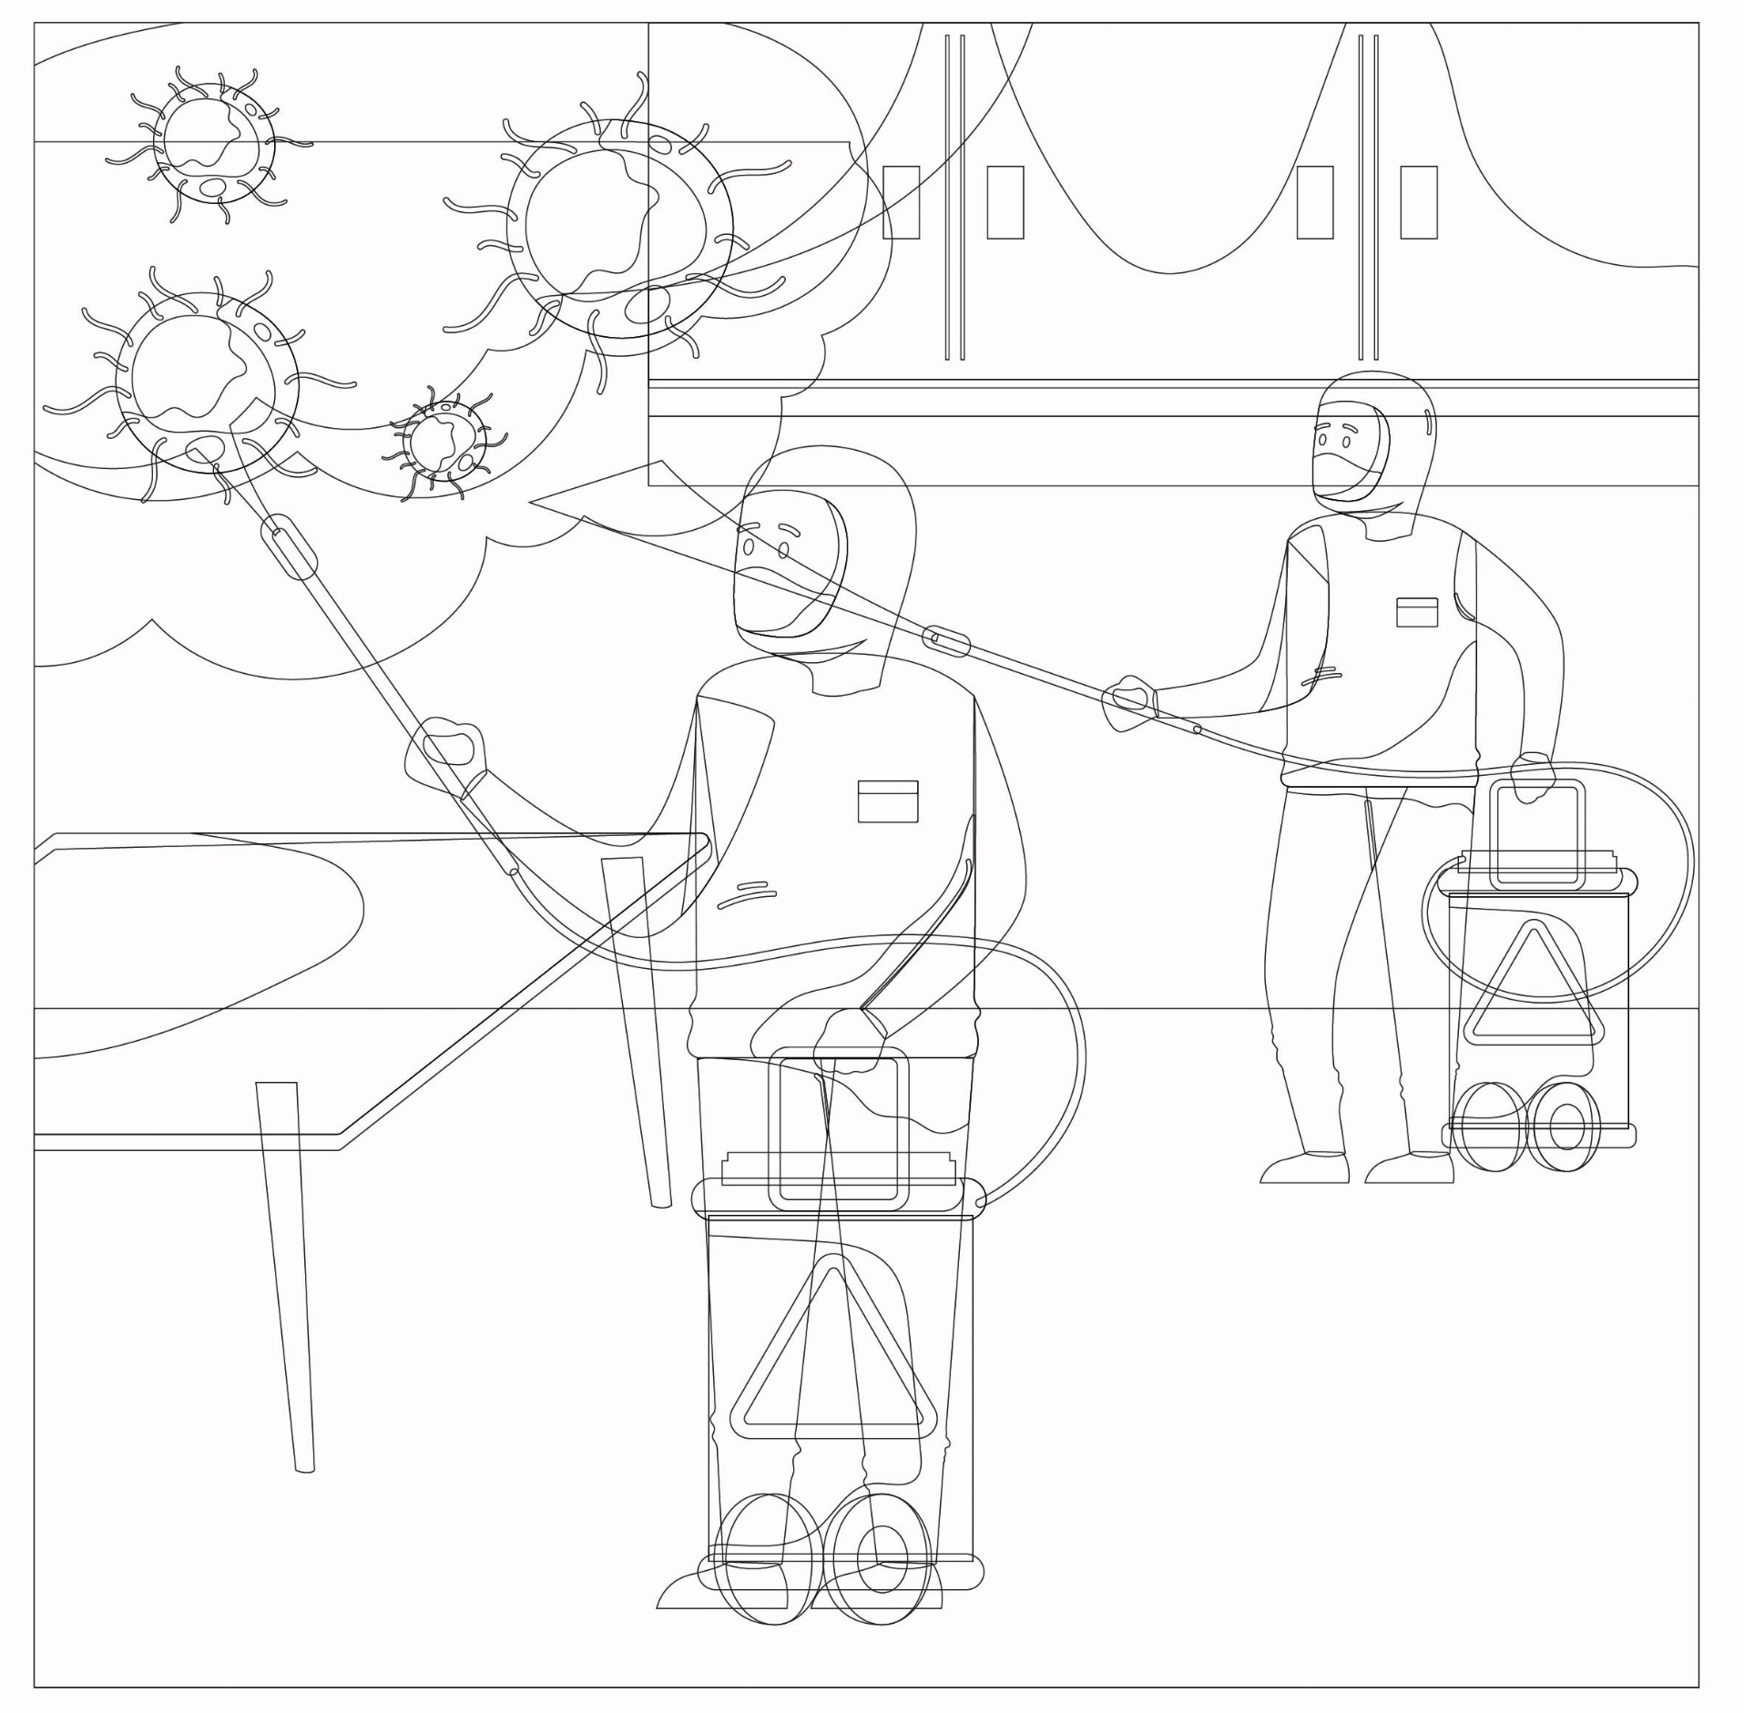
Color This Sheet and Write Your Message To The Healthcare Workers Who Are Working With Compassion to Fight Coronavirus:

Slide 59
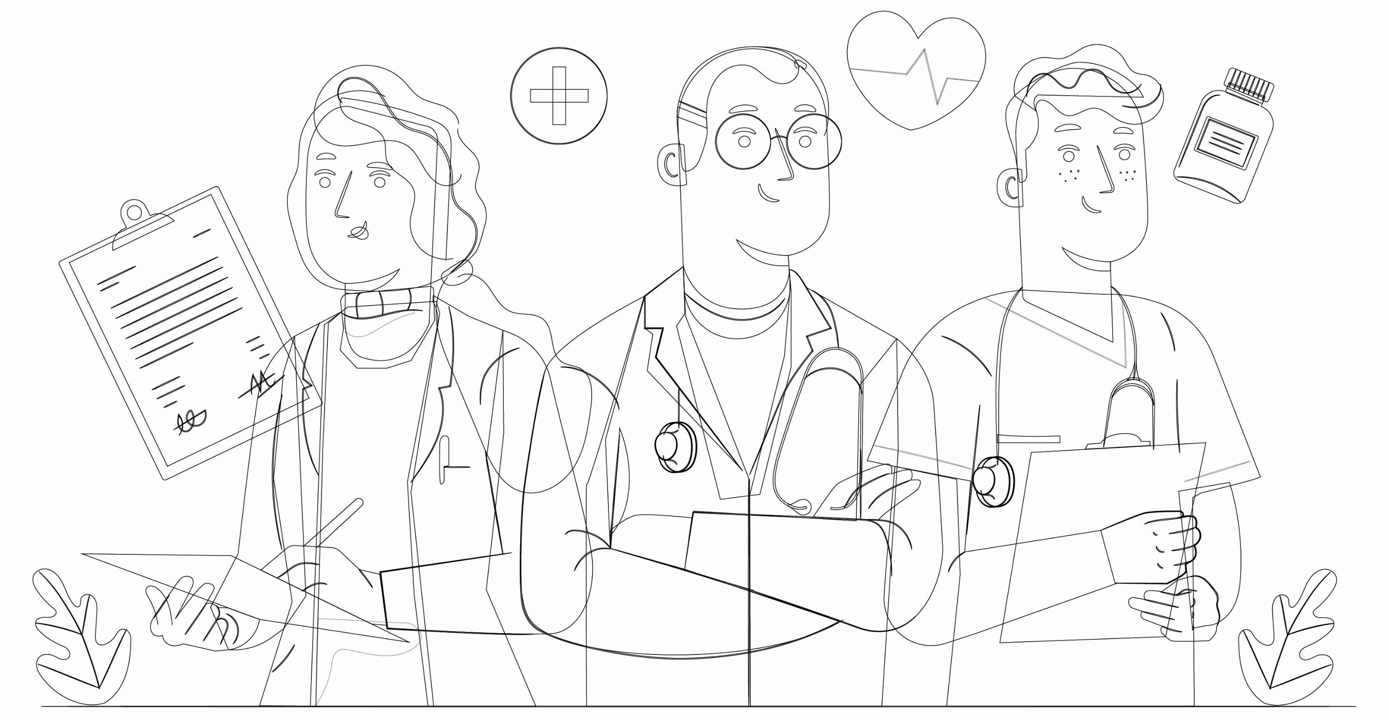
Color This Sheet and Write Your Message To The Doctors Who Are Working With Compassion to Fight Coronavirus:

Slide 60

Animal Powered Healing Mandalas
Cue for the Educators and Parents:
About the significance of using Animal Powered Healing Mandalas for colouring:
Using mandalas has a positive effect on our wellbeing because the brain responds with changing the brainwaves when focussing on geometric shapes. They naturally relax, soothe, structure and bring clarity. The effect is meditation-like – allowing for focus and at the same time for calming emotions through slowing down thought processes. Mandalas in their circular form have a very hypnotic attraction that instantly captures one’s attention and calms the mind. They imitate flower-like shapes found in nature – and we all know about the healing qualities of spending time in natural surroundings (which is related to the geometry present in naturally occurring shapes).
The animals that we’ve chosen to power the mandalas for the purpose of this kit, have been chosen carefully for the specific symbolism that is embedded in our collective memory, thus allow for easy access of positive and beneficial associations. These specifically selected animals are meant to elicit the remembrance of values that are especially relevant in times of experiencing fear, anxiety and loneliness – all emotions that create a split between us and our internal/emotional safe place. You can also use animal stories that’s specific to the cultural context of your region/state (example – Rhinos in Assam, Tiger in Bengal).
Children tend to have a close connection with animals, and at times have heart to heart communication with them, in the unconditionally loving ways that they experience at that beginning stage of life. We hope to remind them of the trust that roots in their hearts by getting them in touch with animals (in the subsequent coloring sheets), which then again will reconnect them with themselves, their core and restore the sensation of safety.
Mandalas and animals in combination open the door for working on mental and emotional levels simultaneously while also accessing the subconscious and restoring harmony within. Obviously, best would be to ensure the children to be at a peaceful and safe environment while working with them – although the little ones do have the ability to drop into their own world when being focused on something.

Slide 61
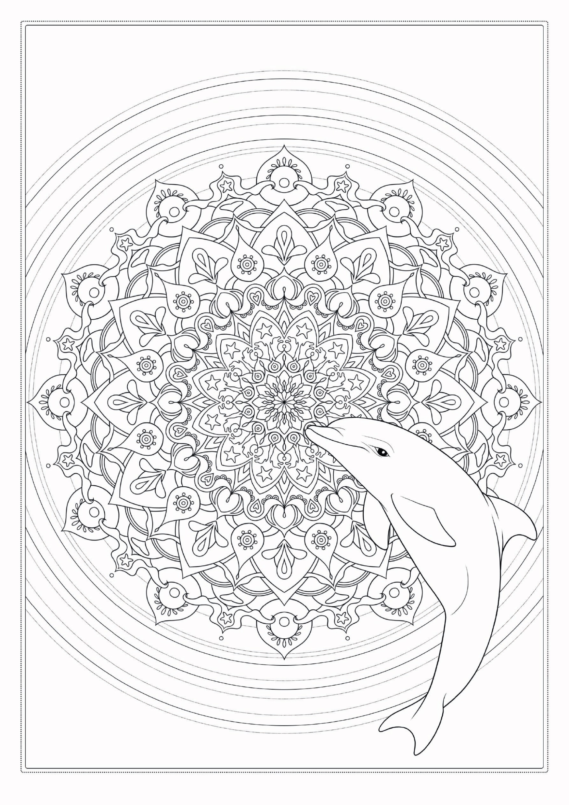
Cue for Parents and Caregivers:
Talk to the adolescent about the symbolism of the chosen animal: Dolphin
Kindness, play, power of sound, intelligence, empathy

Slide 62
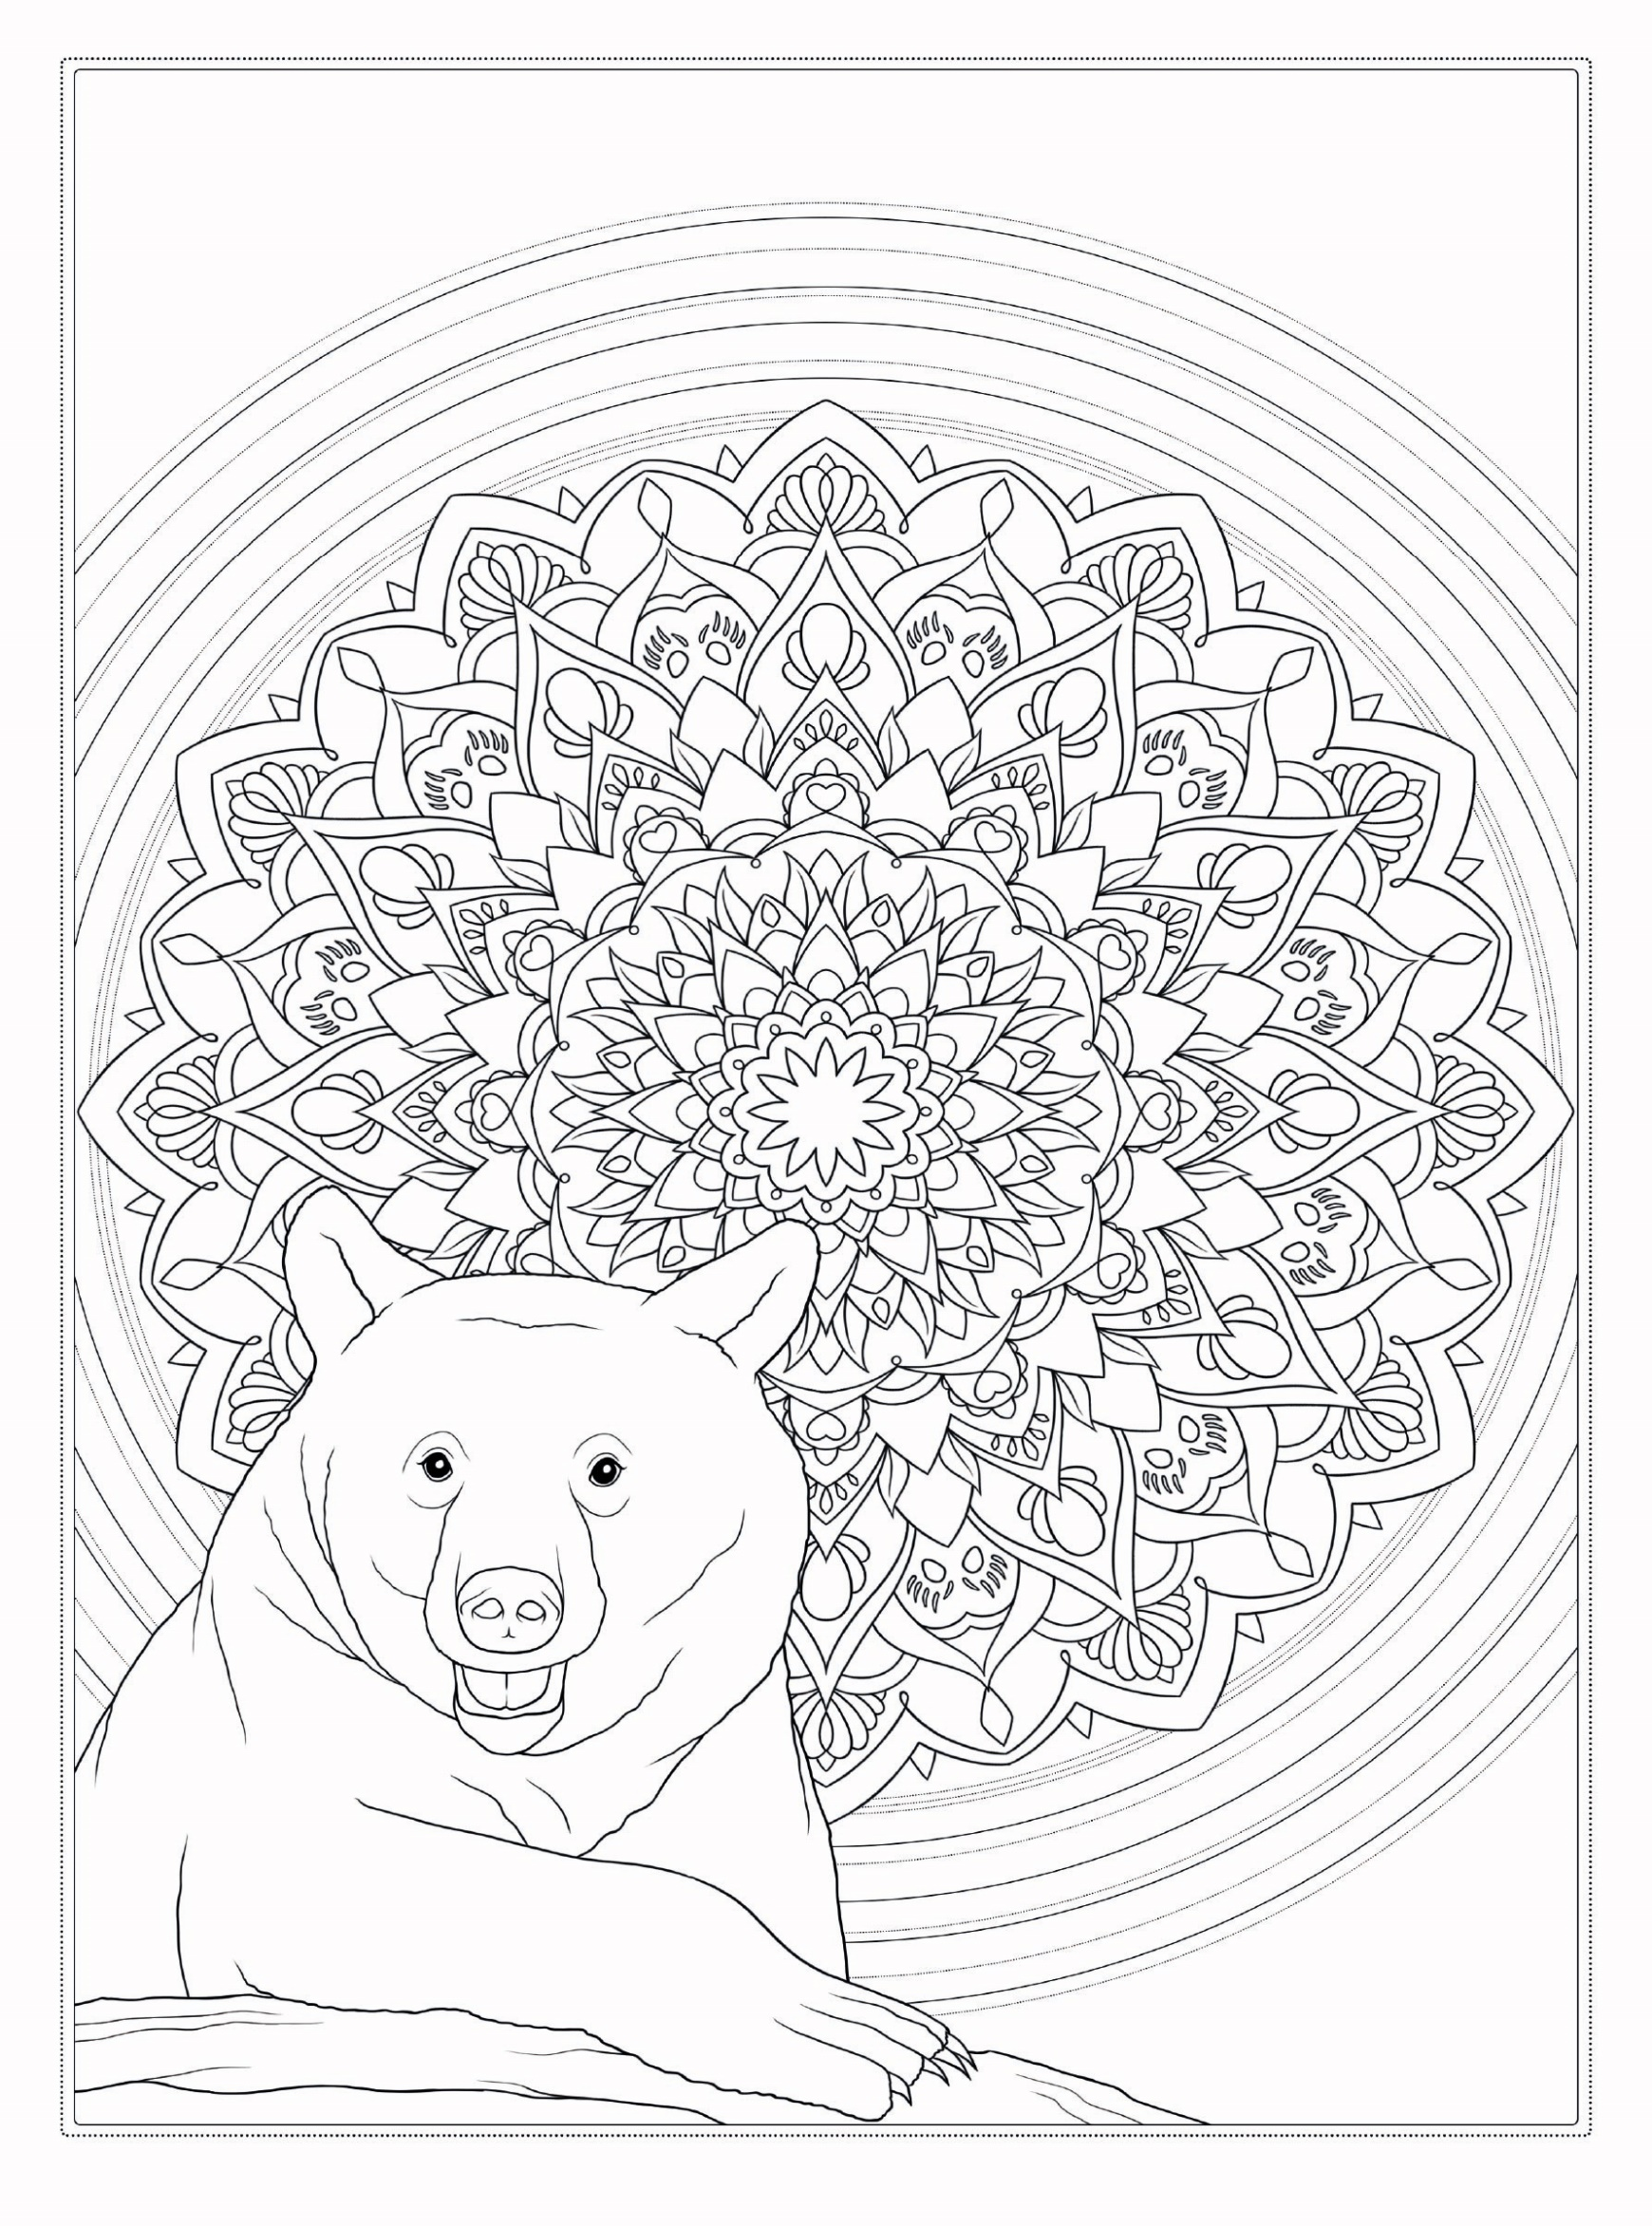
Cue for Parents and Caregivers:
Talk to the adolescent about the symbolism of the chosen animal: Bear
Physical power, Adaptability, Strength, Mobility

Slide 63

Cue for Parents and Caregivers:
Talk to the adolescent about the symbolism of the chosen animal: Deer
Gentleness, Love, Kindness

Slide 64
Exploring Self Management Strategies - ‘My Wellbeing Plan’ Template
Cue for Parents and Caregivers:
This part of the document provides an interactive four-pager tool as a ready-template for an adolescent to work on their well-being plan. The parent/caregiver can help the adolescent’s thinking process be navigated in a positive future focused direction, where the adolescent focuses on creating short-term goals, identifies their set of worries in present and what they’re grateful for even in times when things apparently may seem out of control. The objective of this activity is to enable adolescents find a structure in times of distress. This structure is embedded in the following key themes.
CONNECT & CREATE: Social relationships are critical for promoting wellbeing. The caregiver or parent can enable an adolescent to check in with loved ones through phone calls, texts, handwritten letters (which can be emailed in times of quarantine).
SELF-CARE: Regular physical activity is associated with lower rates of depression and anxiety across all age groups. Take stairs instead of lifts (also lesser risk of contagion), do yoga or simple exercises at home.
SELF-AWARENESS: Become self aware, both internally and externally. Notice if your tone of speech or actions hurts someone or if someone’s speech hurts you. Being aware of what is taking place in the present directly enhances your well-being and savouring ‘the moment’ can help to reaffirm your life priorities especially in times of home stays. Try and recognize your needs and feelings. Allow yourself to feel an emotion and remember the well being mantra : “It’s okay to fail, it’s ok to feel.”

Slide 65

Exploring Self Management Strategies - ‘My Wellbeing Plan’ Template
KEEP EXPLORING: The practice of setting goals, which is related to your learning in particular, has been strongly associated with higher levels of wellbeing. Research something you’ve always wondered about. Learn one new word in a language you want everyday.
GIVE: Create a gratitude jar at home/ child care institution. Wherever you place the box, make sure to leave small slips of paper or sticky notes nearby. Tell children/ adolescents that they can use the box to write down positive messages, thank-you notes, or messages of appreciation or encouragement to their fellow peers or the teacher, parents, grandparents or anyone they wish to thank and appreciate. They can also use a message board and stick their messages on it.

Slide 66
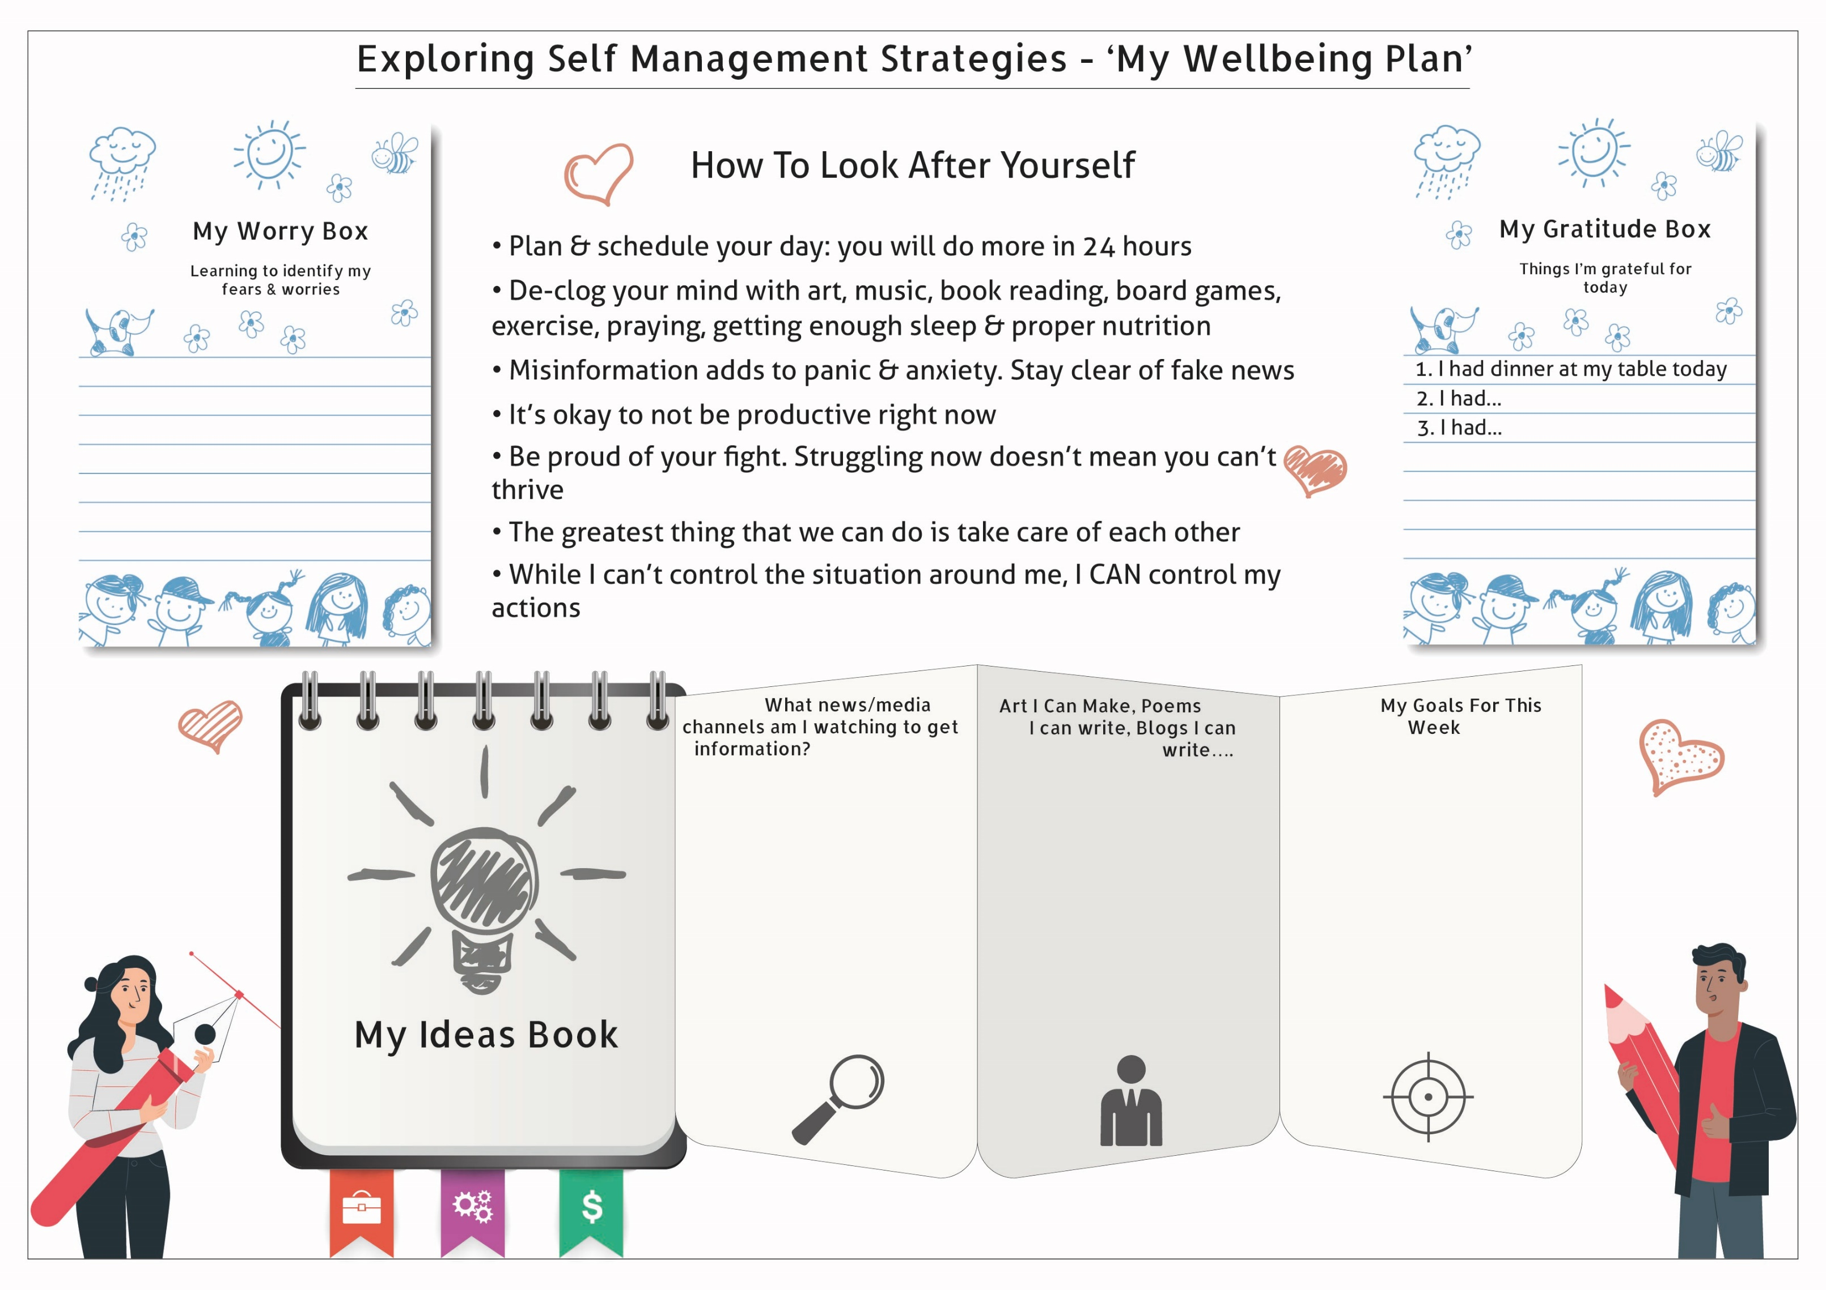

Slide 67
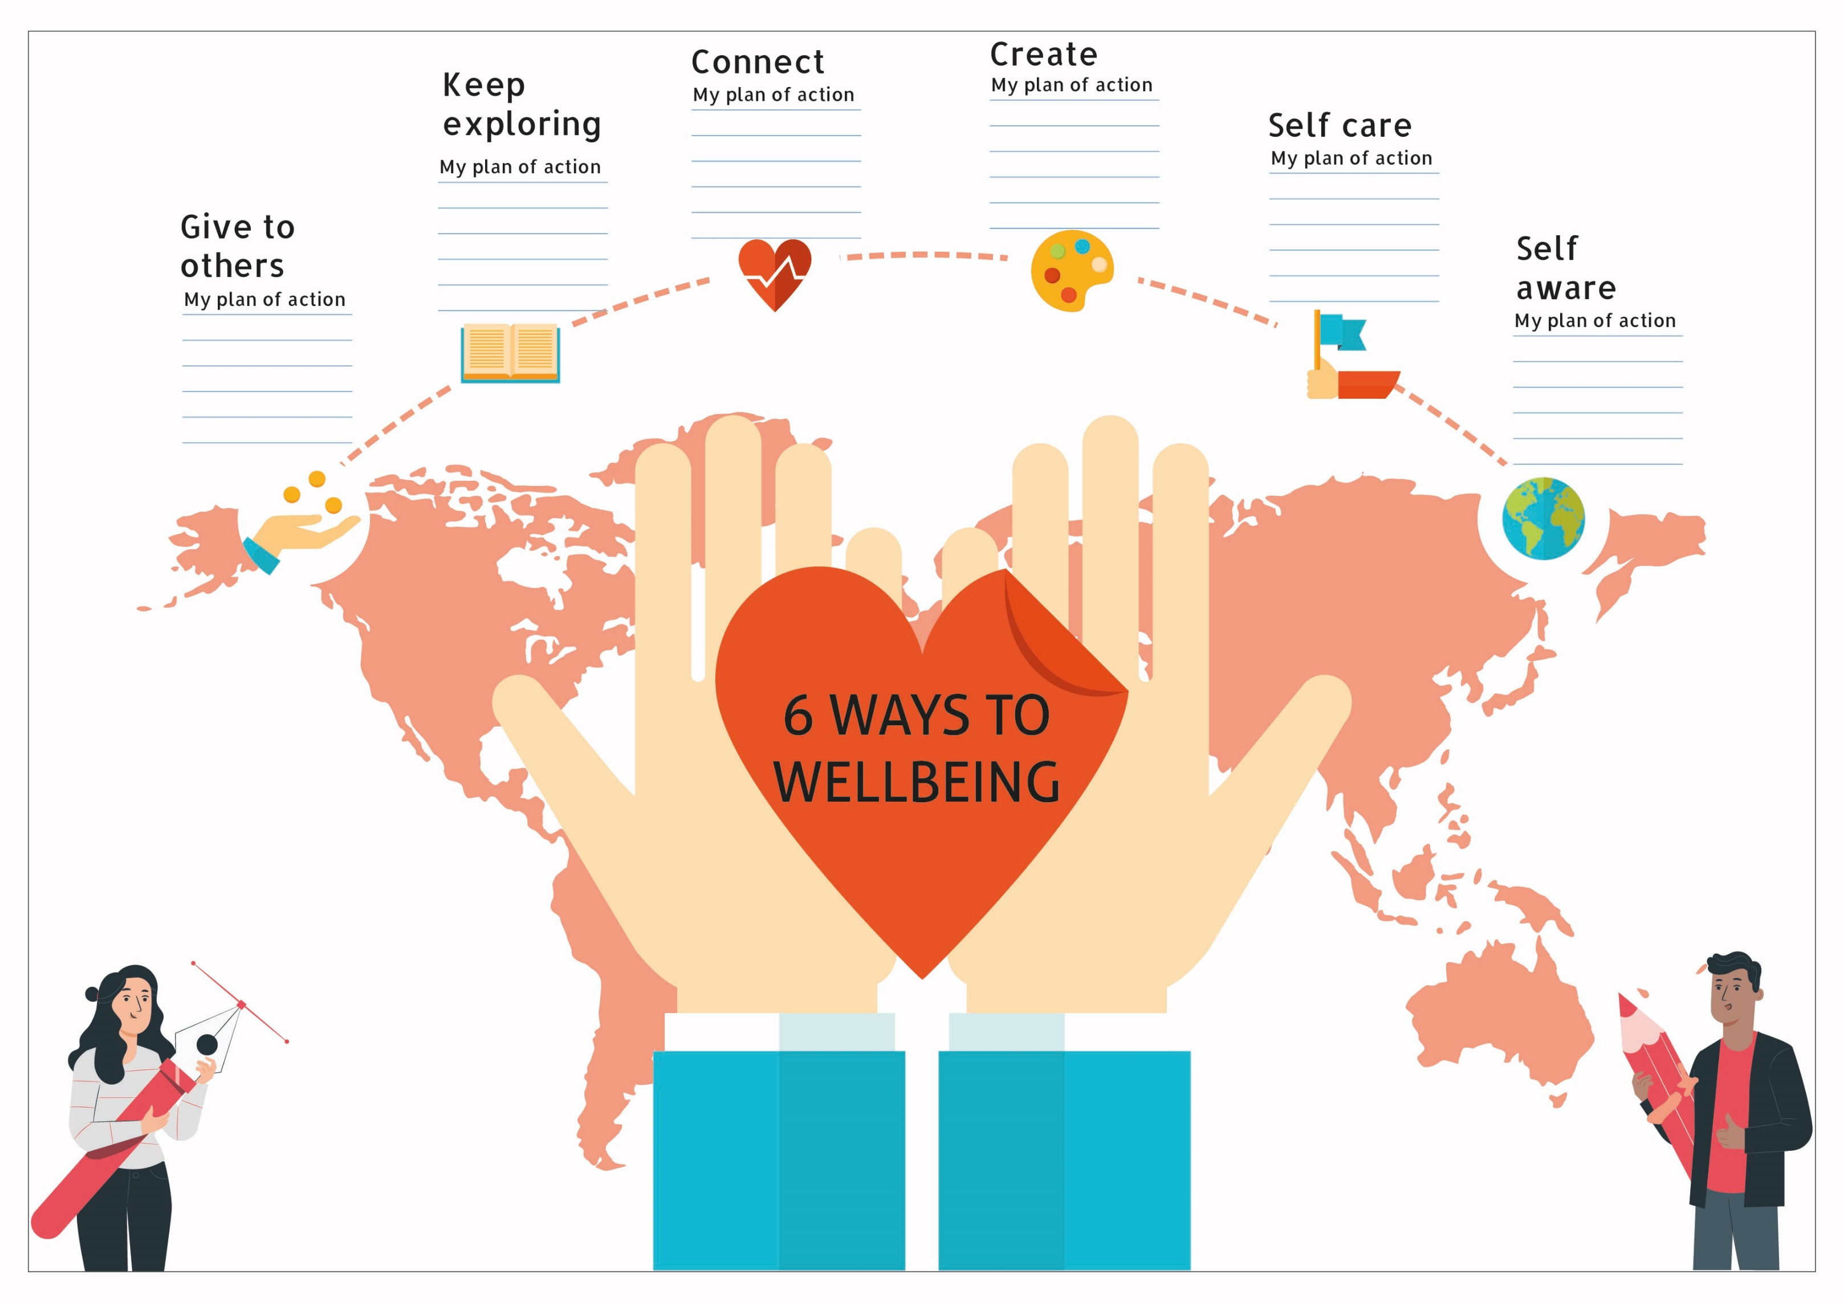

Slide 68
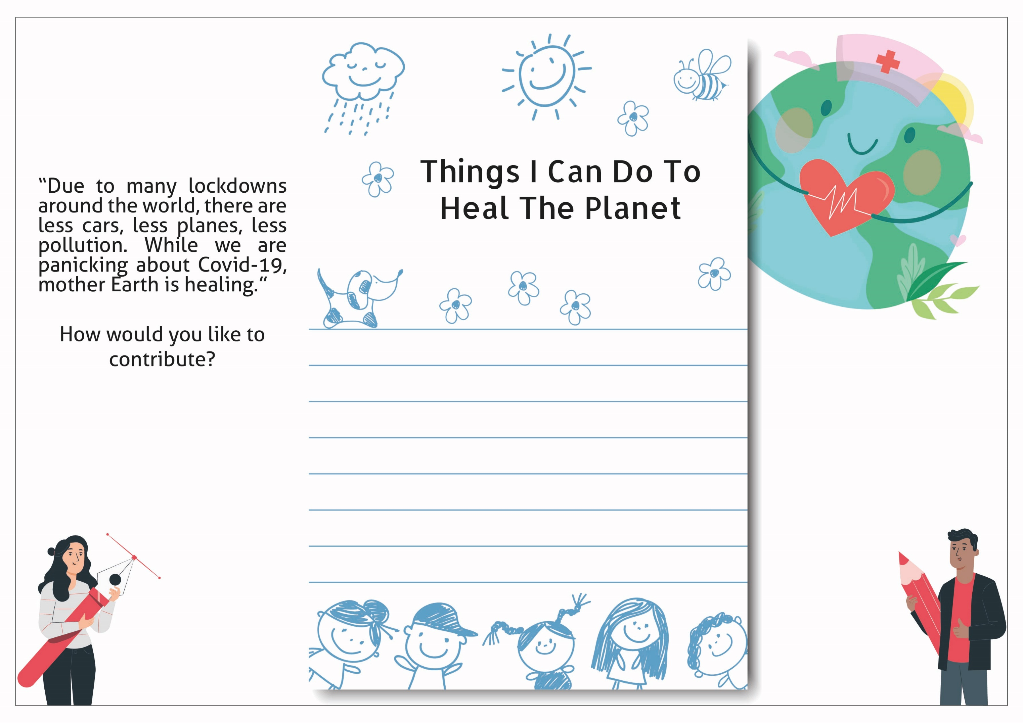

Slide 69
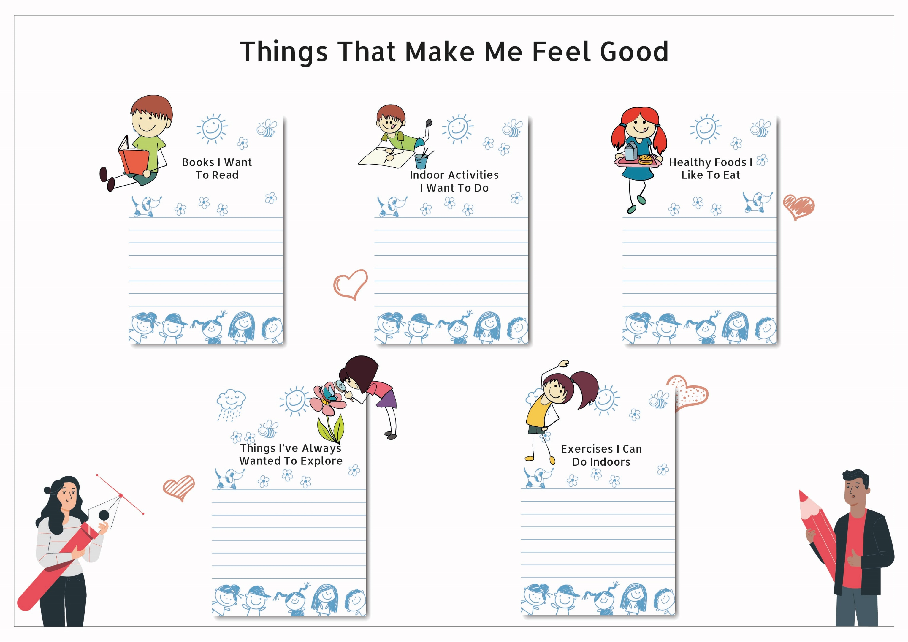

Slide 70
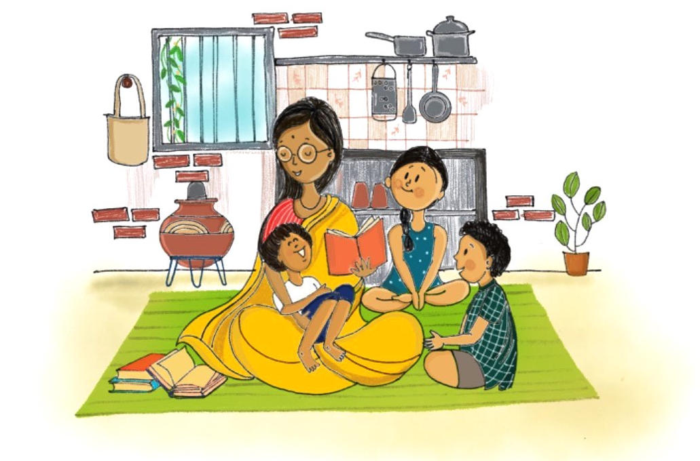
Counseling Activities and Worksheets for Children and Adolescents

Slide 71
Counseling Activities and Worksheets for Children and Adolescents
This section contains three psycho-educational worksheets to help parents and caregivers navigate a child’s/ adolescent’s understanding on courage and fear, pain, choices, differing perspectives and more through carefully curated worksheets available through online sources, acknowledgments for which are provided towards the end of this document.
Cue for Parents and Caregivers:
Facilitators can use these worksheets as verbal prompts during the sessions, as they need not be printed sheets only.. The caregiver’s approach should be child-friendly. These worksheets are self-explanatory sessions and can be carried out by the parents or caregivers. Key message to remember for caregivers and parents when working with children/adolescents is that all of their experiences are valid. Remember the golden mantra, ‘It’s okay to feel, it’s okay to fail.” Lockdowns, uncertainty about future and unfiltered exposure to television and internet can induce an inordinate fear of harm among children, and adolescents. This can effect daily functioning and sleep. Anxiety levels begin to rise with the uncertainty of it all. Therapeutic interventions, therefore, are essential to help sort through the feelings of panic, fear and anxiety, and establish self-care habits through creative activities.
Mental health and psychosocial support activities by parents and caregivers enable them to assess and identify vulnerable children and their psychosocial support needs. These activities will enable caregivers to handle a child’s stressors .

Slide 72

Activity for progressive relaxation
Cue for the parent and caregiver
Progressive muscle relaxation is a method that helps relieve that tension. In progressive muscle relaxation, you tense a group of muscles as you breathe in, and you relax them as you breathe out. The technique involves alternating tension and relaxation in all of the body's major muscle groups. You work on your muscle groups in a certain order. When your body is physically relaxed, you feel less anxious.
Find a quiet place free from distractions. Lie on the floor or recline in a chair, loosen any tight clothing, and remove glasses or contacts. Rest your hands in your lap or on the arms of the chair. Take a few slow even breaths. Now, focus your attention on the following areas, being careful to leave the rest of your body relaxed.
Forehead. Squeeze the muscles in your forehead, holding for 15 seconds. Feel the muscles becoming tighter and tenser. Then, slowly release the tension in your forehead while counting for 30 seconds. Notice the difference in how your muscles feel and the sensation of relaxation. Continue to release the tension until your forehead feels completely relaxed. Continue breathing slowly and evenly.
Neck and shoulders. Increase tension in your neck and shoulders by raising your shoulders up toward your ears and hold for 15 seconds. Slowly release the tension as you count for 30 seconds. Notice the tension melting away.
Arms and hands. Slowly draw both hands into fists. Pull your fists into your chest and hold for 15 seconds, squeezing as tight as you can. Then slowly release while you count for 30 seconds. Notice the feeling of relaxation.
Legs and feet. Slowly increase the tension in your calves and feet over 15 seconds. Squeeze the muscles as hard as you can. Then gently release the tension over 30 seconds. Notice the tension melting away and the feeling of relaxation that is left. Enjoy the feeling of relaxation sweeping through your body. Continue to breathe slowly and evenly.

Slide 73
Activity to enhance sense of identity and self-image in a child
Cue for the parent and caregiver
Self-acceptance is a specific stage in self-discovery that occurs whenever children/adolescent are ready to look at themselves objectively (with the help of an adult caregiver). When they do, they will realize that their strengths far outweigh their weaknesses. Ask your child to reflect on these questions and try to answer them honestly. This exercise can give you the opportunity to validate your child’s positive self-perception and also help her/him to build it further. A few prompts that the caregiver can use are:
What five things do I like about myself?/ What are my strengths?/ What activities can make me a better and stronger person?

Slide 74
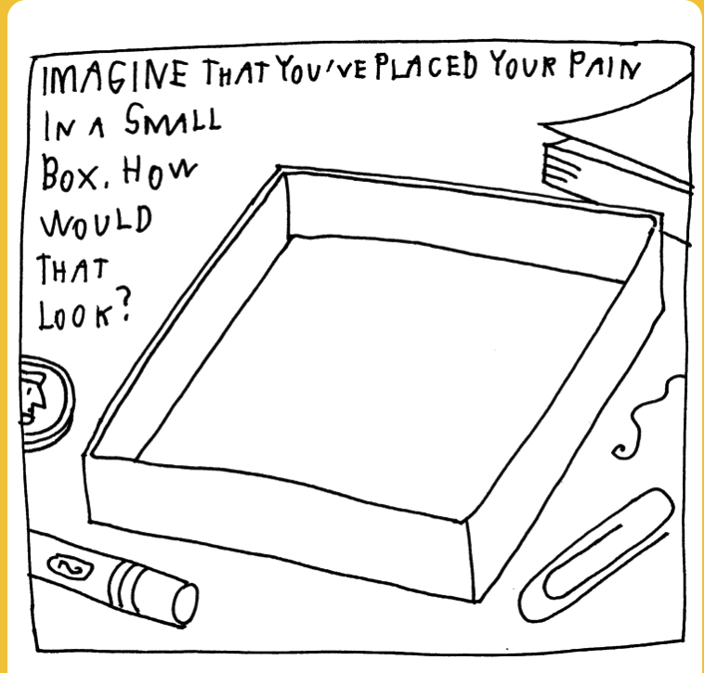
Activity to understand pain/sadness in a child’s mind/heart
Cue for the parent and caregiver
Understanding pain, whether physical or emotional, is a specific experience that can help give children closures or rationalize their feelings more coherently (with the help of an adult caregiver). When they do, they will understand themselves deeply and feel that a caregiver truly cares for them. Ask your child to reflect on these questions and try to answer them honestly. This exercise can give you the opportunity to validate your child’s understanding of pain and sadness. A few prompts that the caregiver can use are:
Imagine that you’ve placed your pain/sadness in a small box. How would that look?/ What help would you need to make it go away?
Facilitators can use these worksheets as cues/prompts during the sessions as verbal sentences, need not be printed sheets only.

Slide 75
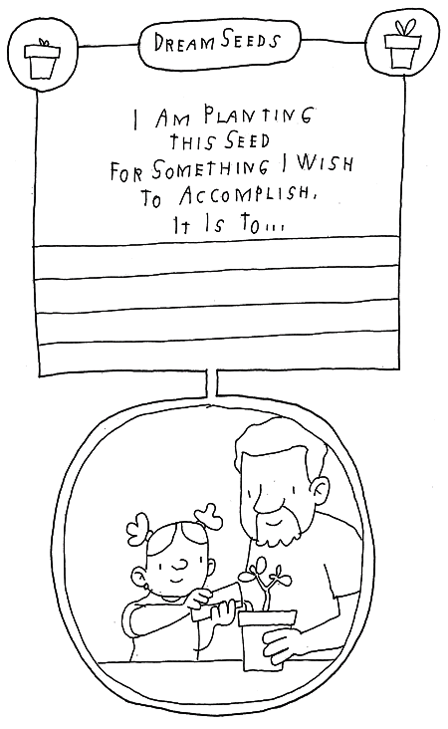
Activity to help a child move on from a difficult experience
Cue for the parent and caregiver
Helping a child move on from an adverse childhood experience/ a negative emotion/ environments of constant negative information clutter/ or any experience of trauma, can be challenging for the caregiver too. However, some simple activities like helping the child take responsibility for nurturing a plant or growing a seed with wishes and prayers to have the child’s aspirations be channeled can be particularly helpful. The caregiver can help plant a few seeds with the child and make it a fun activity. The key is to constant speak of positive words and phrases like, ‘Wow! You helped a new baby plant grow to life!” etc. can be extremely healing and reassuring for a child.
For facilitators : How can you stretch your children's imaginations when you do this or a similar activity? How did you praise your children for trying a new activity and for their positive behaviors? What other ways can you use to encourage them?

Slide 76
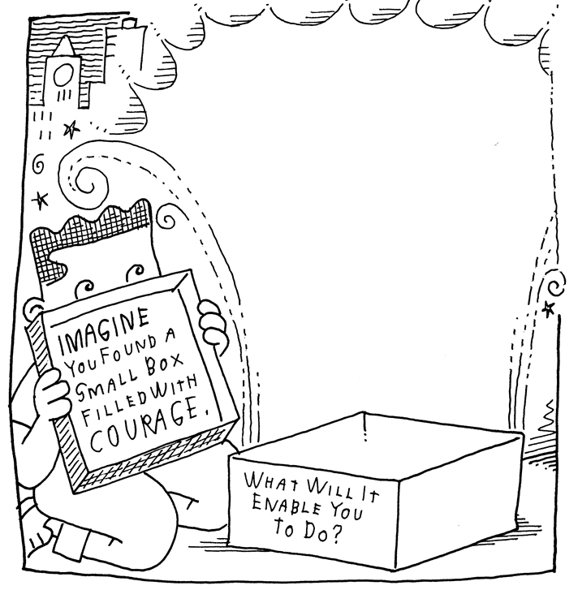
Activity to help a child find and build courage in themselves
Cue for the parent and caregiver
Help children understand that courage isn’t about something magical that happens inside us to make us ‘not scared’. It’s about something magical that happens inside us to make us push through fear, self-doubt, anxiety, and do the things that feel hard otherwise. Sometimes, courage only has to happen for a few seconds/ minutes at a time – just long enough to be brave enough, like standing up to a bully, or saying a ‘No’ to something strongly that doesn’t feel right. Explain to them that courage might also mean being kind to the new kid in class. Often, these things don’t come with praise or applause and that’s okay!
Encourage them to do activities that push them to the edges of their physical or emotional selves – theater, art, sports. Anything that will help to nurture the truth to life that they are strong, powerful, that they can cope, and that they are not as fragile as they might feel sometimes will help to nurture their brave hearts. Tell them also, it’s only human to feel weak too!
A simple self-explanatory worksheet that caregivers can use to initiate conversations on courage is given in the picture.
For facilitators : How can you stretch your children's imaginations when you do this or a similar activity? How did you praise your children for trying a new activity and for their positive behaviors? What other ways can you use to encourage them?

Slide 77
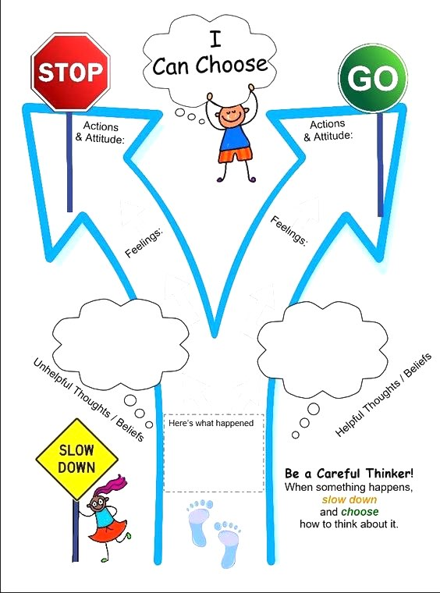
Activity to help children and adolescents to slow down and think carefully!
Cue for the parent and caregiver
Downtime helps kids relax and recharge, both of which are critical parts of being stress free and healthy. If your child seems to be taking on too much - they're irritable, show anxious or stressed body language, want to be left alone more than normal, complain about no control - here is a simple self-explanatory worksheet that caregivers can use to help older children rationally understand the situation, dig deeper to understand their behaviors and help slow down the pace.
Every child is different. Some children can handle a lot of different things. Others like doing just one. Don't assume you know how your child feels everyday just because you’re their parent or a close caregiver adult. Observe what he/she’s doing and have conversations. If your child starts to melt down from too many commitments, there’s nothing to gain by insisting he/she stick with them all. In that case, allow the child to ‘choose’ what they like to do most and support them in it. At a time when the entire country is in a lockdown and the child has limited avenues to go out and play, their mind could be beaming with a million plans. It’s critical for the caregiver to help child develop a new pace or slow down the existing pace if required.

Slide 78
Activity to help a children and adolescents understand differing perspectives!
Cue for the parent and caregiver
Perspective-taking refers to a person’s ability to consider a situation from a different point of view. It requires you to put yourself in the other person’s position and imagine what you would feel, think, or do if you were in that situation.
Help the child and adolescent understand different perspectives, and nurture their empathy for others. When a child/ adolescent has trouble with perspective-taking, he/she may have difficulty making friends or maintaining those friendships once they are made too. If the child expresses confusion or concern over a decision that someone else has made, help him/her write down the different motives that the person had that led to him making that decision. The caregiver can ask the child/ adolescent if s/he would have made the same decision in that situation or if he would have chosen something else. Here is a simple self-explanatory worksheet that caregivers can use to help older children. Another way to help children and adolescents understand ‘differing perspectives’ is by helping them through a role play between a buyer and seller of a certain product, on how the buyer and seller have different reasonings and negotiation for a certain situation.

Slide 79
Annexure 1: Domestic Violence Helpline Numbers
National Helpline 1091
Organization | Phone Number
Stree Mukti Sanghatana | 8291821061
(Mala Bolaycha Aahe) | 9870217795
 | 7767909222
 | 8692034587
 | 9970161988
 | 98332 63606
Sakhya | 9890312402
SNEHA crisis helpline | 9833052684
 | 9167535765
One-stop Crisis center at KEM Abhay helpline | (022) 24100511
Abhay helpline | 9423827818
Swayam | 9830079448
 | 9830204393
 | 9830204322
 | 9830737030
Swayam (specialised helpline) | 9830772814
Jagori | 8800996840
 | (011)26692700
Gauravi Sakhi | 18002332244
Women power line (Uttar Pradesh) | 1090
Women in Governance (Assam) | 6003214180
Shakti Shalini | (011) 24373737
 | (011) 243724379
Organization | Phone Number
Women/police helpline | 1091
 | 1291
Cehat | 9029073154
CORO | 9892632382
Urja Trust | 7045991985
 | 7045731583
Police helpline Mumbai | 103
Vishakha ( Man Samvaad) | 18001800018
Vishakha Mahila Salah Evam Suraksha Kendra | (0294) 2488339
Vishakha Mahila Salah Evam Suraksha Kendra | (0151) 2226121
Vishakha | 7425018111
iCall - TISS | 9920241248
 | 8369799513
 | 9372048501
Saheli | (011) 2461 6484
Bhumika Women's | 18004252908
Shaheen Women's Resource and Welfare | 9885050588

Slide 80
Acknowledgements
The training and resource material in this toolkit for ‘Psychosocial Support for Children during COVID-19’ has been carefully curated with inputs from the following for UNICEF India Country Office and CHILDLINE India Foundation:
Toolkit content developed, curated & designed by Ms. Sonal Kapoor and Mr. Jaswinder Singh, Protsahan India Foundation, New Delhi, India
Original Mandala art using animal symbolism contributed for this kit by artist Ms. Elena Rockinger from Germany
Original illustrations have been contributed by freelance artist Ms. Isha Tangadpalliwar, Pune, India

Slide 81
References
Inter Agency Standing Committee (IASC) ADDRESSING MENTAL HEALTH AND PSYCHOSOCIAL ASPECTS OF COVID-19 OUTBREAK. February 2020
The Alliance for Child Protection in Humanitarian Action; Technical Note: Protection of Children during the Coronavirus Pandemic
Talking With Children: Tips for Caregivers, Parents, and Teachers During Infectious Disease Outbreaks,https://store.samhsa.gov/product/Talking-With-Children-Tips-for-Caregivers-Parents-and-Teachers-During-Infectious-Disease-Outbreaks/SMA14-4886
Coping With Stress During Infectious Disease Outbreaks,https://store.samhsa.gov/product/Coping-with-Stress-During-Infectious-Disease-Outbreaks/sma14-4885C
CDC, WHO, UNICEF, MoHFW (Government of India) official websites and open source communication collateral
UNFPA technical brief on Covid-19: A Gender lens: https://www.unfpa.org/sites/default/files/resource-pdf/COVID-19_A_Gender_Lens_Guidance_Note.pdf
Counseling Activities and Sheets for Children of this toolkit have been curated with aids or adapted from Make Believe, Zimmerman et al (https://www.makebeliefscomix.com/about-creator-illustrator/), Literacy in Focus (https://www.litinfocus.com) with Protsahan India Foundation’s (https://protsahan.co.in) experience of what works best when working with children in difficult circumstances.
Freepik Premium (www.freepik.com) for illustrations and creative resources
https://www.end-violence.org/protecting-children-during-covid-19-outbreak#children
https://childmind.org/article/supporting-kids-during-the-covid-19-crisis/
https://www.verywellmind.com/how-do-i-practice-progressive-muscle-relaxation-3024400
https://www.pinterest.com/pin/129478558018942571/
https://www.polk-fl.net/community/volunteers/documents/ymConfidenceActivities.pdf

