Slide 1
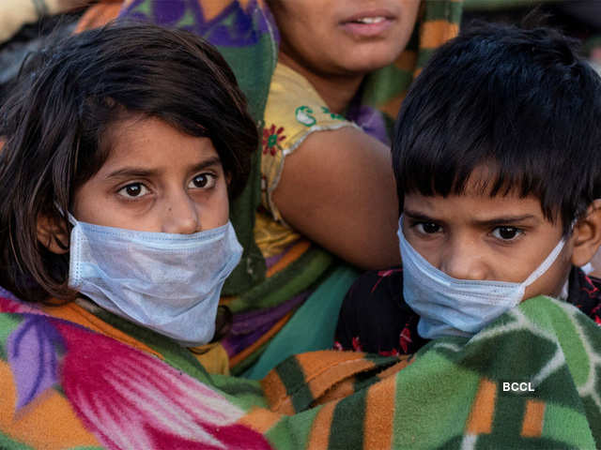

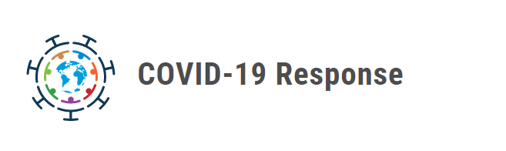
Child Protection during Covid 19

Slide 2
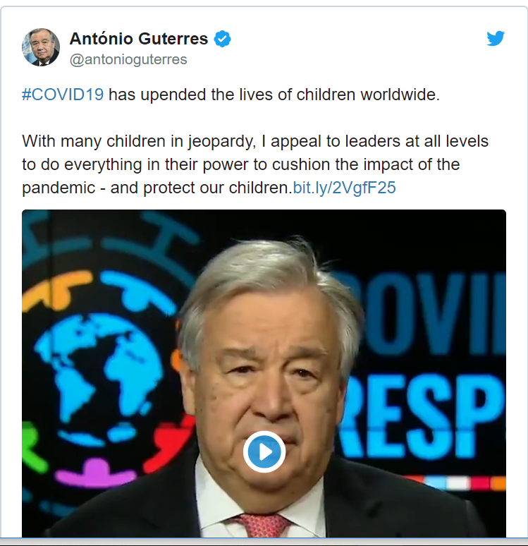
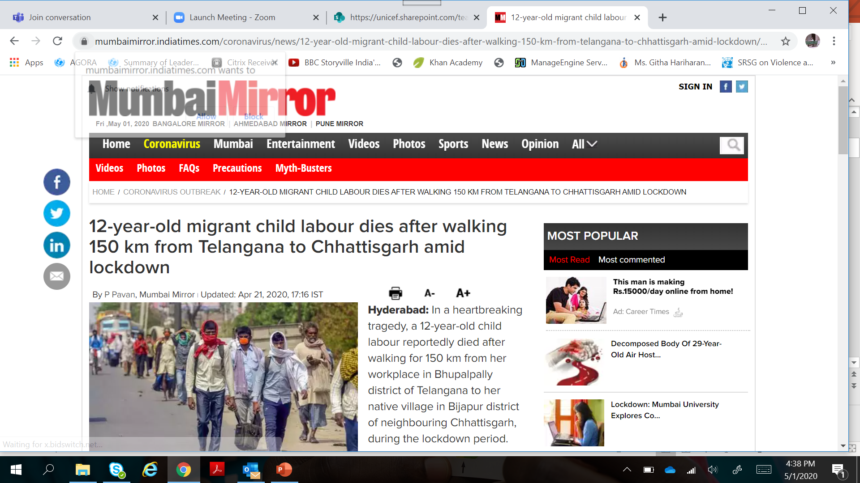
COVID-19 is a health crisis that risks evolving into a broader child-rights crisis.
The socio-economic impact of the virus is potentially catastrophic for many children.
Millions of children will likely drop out of school altogether
For children facing extreme deprivations, acute stress can trigger longer-term mental health challenges
Lockdowns come with heightened risk of children witnessing or suffering violence and abuse

Slide 3



Globally, after disasters, vulnerability of women and children rises
  After 2008 floods, child marriage and trafficking of girls went up in Bihar and Andhra Pradesh by more than 20%
  After 2015 Nepal earthquake, child marriage doubled in many villages.
  After two years of war in Syria, child marriage went up from 12% to 32%
  After Ebola (2014-16), violence against women and girls went up and in some countries, child marriage went up. Teenage pregnancies went up during the lockdown imposed in several countries
  Access for victims and survivors of violence goes down during epidemics
  In India – CHILDLINE saw a 50% increase in calls received immediately post lockdown
Notes:
CHILDLINE 1098 has responded to a total of 460,000 calls from March 20 to April 10 only. A total of 9,385 interventions were also taken up on the ground by the CHILDLINE 1098 frontline workers during this period. 20%, of these interventions were directly related to child protection issues such as preventing child marriage, physical abuse, emotional abuse, sexual abuse, trafficking, abandonment, neglect, child labour. The Minister of MWCD has reported that 894 child marriages have been prevented by CHILDLINE since the lockdown.

Slide 4



Vulnerable children
Children in Child Care Institutions/alternative care
  Without family care
  Children in conflict with law
Children on the move with migrant families or unaccompanied/separated
Children on the streets face heightened risks
Children with disabilities
Notes:
These categories are already something the child protection structures deal with. In a lockdown situation of a pandemic, this means they are more removed from services, help and outreach making them more vulnerable to abuse and exploitation

Slide 5
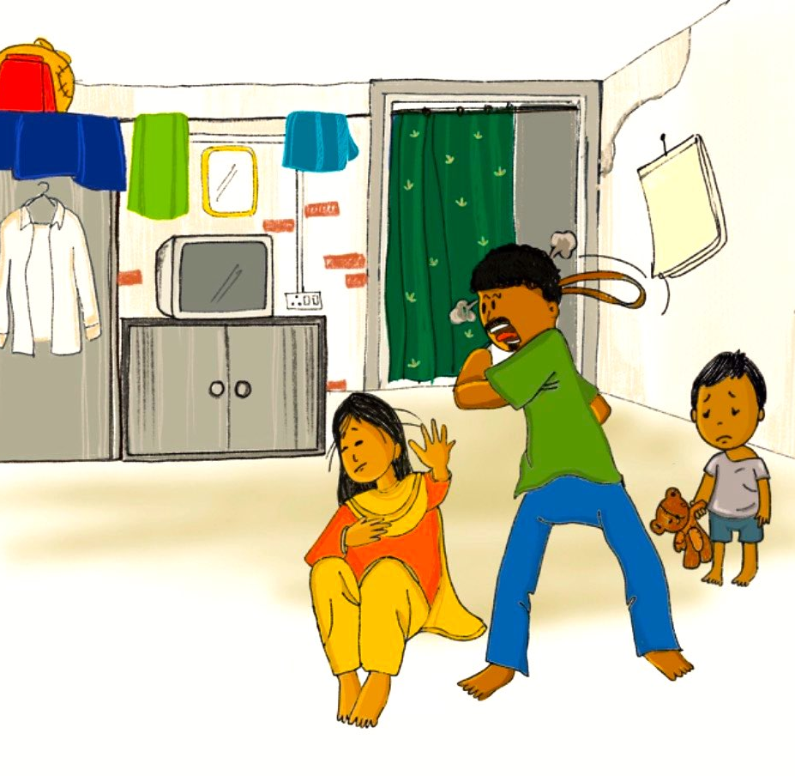
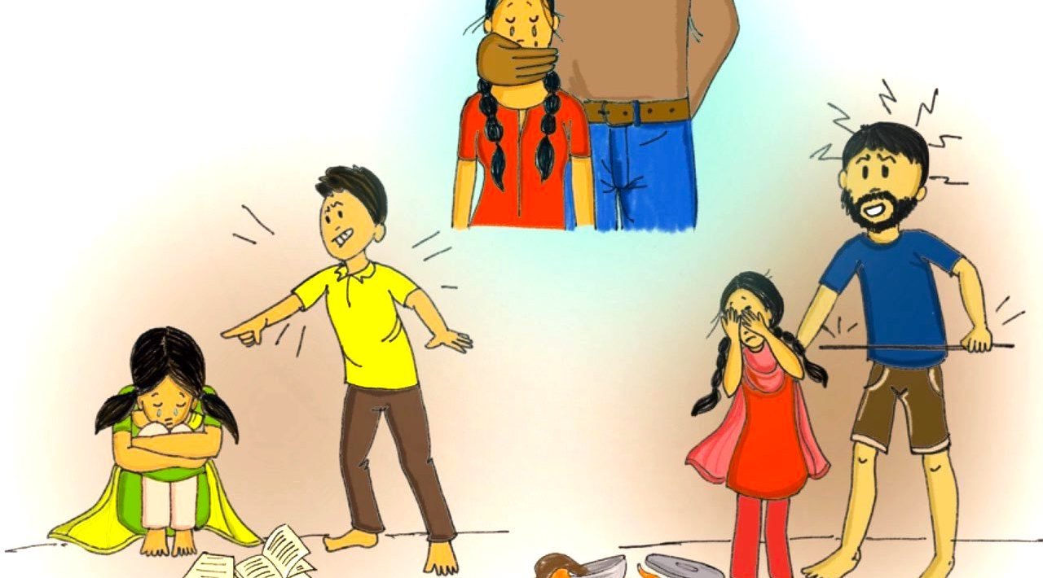
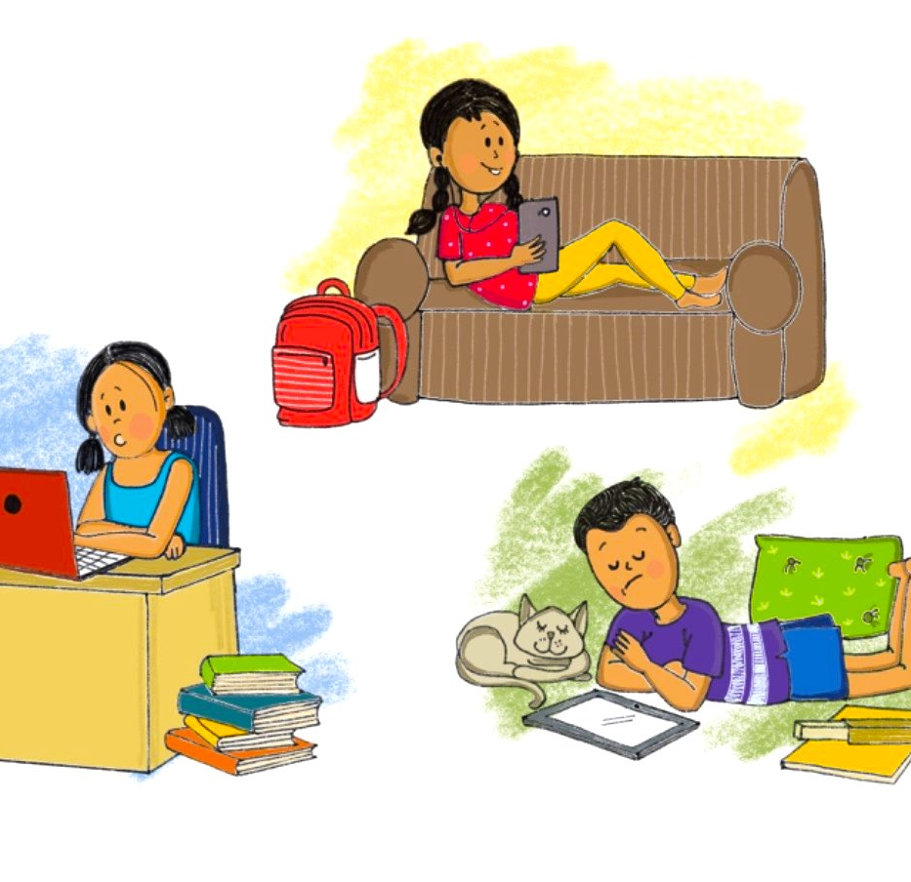
Increased risk of violence
Child Sexual Abuse
Gender Based Violence- DV
Child Maltreatment
Child Online Safety
Notes:
It is natural for children to feel stress, anxiety, grief, and worry during an ongoing pandemic like COVID-19 disease. Fear and anxiety about their own health and the health of loved ones can be overwhelming and cause strong emotions. In today’s digital world, children also access different kinds of information and news through social media and digital platforms, some of them may not be factually true, causing further stress and anxiety. It is enhanced when children are not able to go out, play, attend school or interact freely. For those children and families who are subjected to mandatory quarantine or isolation there may be an increased risk of violence and abuse. When stress levels go up for adults and children, there is a greater risk of Gender-Based-Violence and Violence against Children.
Children in quarantine or isolation may be away from adult supervision
High stress in family due to social isolation, economic hardship and loss of livelihood increase risks of domestic violence and child abuse, including corporal punishment
School closures and movement restrictions means children are forced to spend much more time at home with adults and caregivers who are already stressed and worried
Children spend more of their time online – and exposed to online sexual abuse and grooming for sexual exploitation, cyberbullying and other online threats

Slide 6

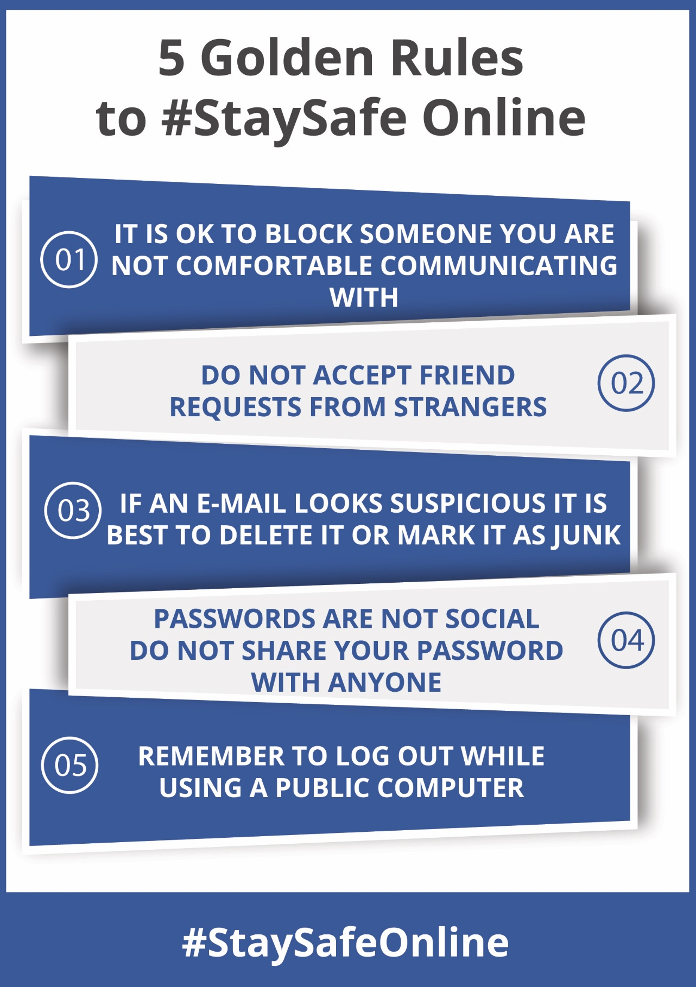
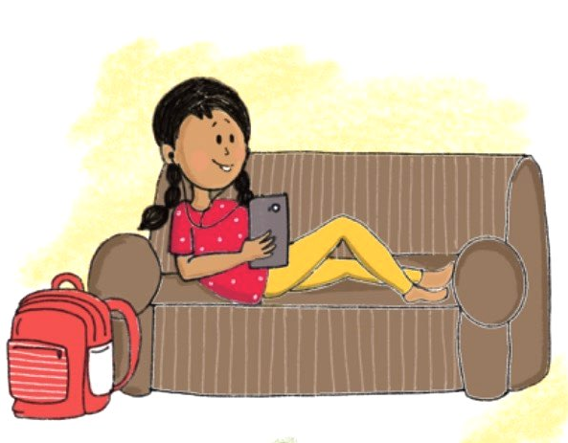
Let children be online, connect with friends!
Teach children these 5 golden rules to keep safe online.

Slide 7
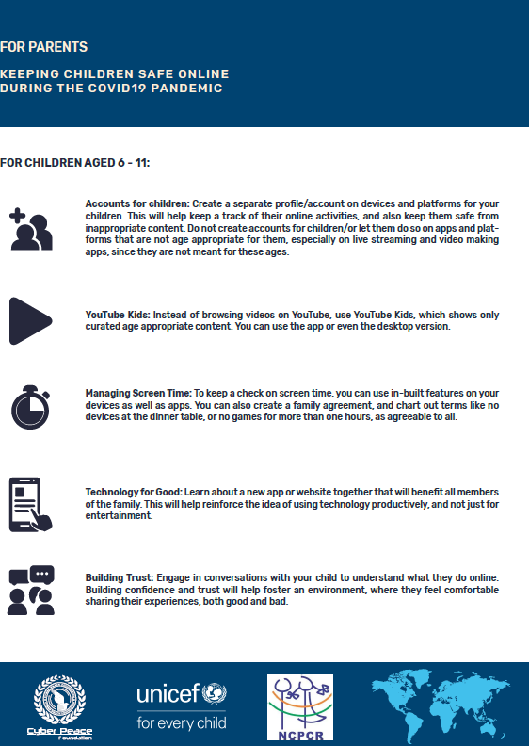
Online safety has emerged as a critical issue. A recent global compilation of reports done by NCMEC of child sexual abuse material (CSAM) found online, India stands right on top of the list, with 11.7% of the total reports.

Slide 8
Role of Police
Rescue and Rehabilitation of Children in Street Situations
Rescue and Rehabilitation of Children of Migrant Workers and Unaccompanied Adolescent Workers
In the case of quarantine camps, Police can ensure that the safety and protection of children in these camps is ensured
Safety of children affected by Covid 19 and in quarantine/ isolation
Covid 19 and Violence Prevention
Awareness on ChildLine Services and on Psychosocial Services to vulnerable children
Implementation of Supreme Court Guidelines dated 03 April 2020 on child protection in the context of Covid
Notes:
Police department is playing exemplary and critical role in the implementation of lockdown guidelines, identification and rescue of vulnerable women and children, ensuring safe places for migrant workers and their children.

Slide 9

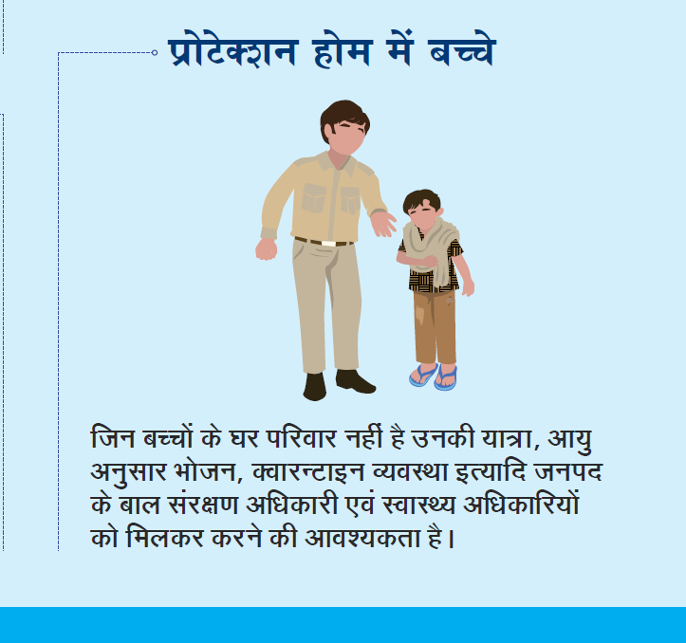
Role of Child Protection Structures
Directions from Hon’ble Supreme Court – 3rd April, 2020
Outline very clearly the roles in Covid risk management – both prevention and response
Child protection concerns related to children in need of care and protection and conflict with law – encouraging bail
Stress on mental health and well being of children with useful tips especially for CCIs
Notes:
The Supreme Court order is very specific in recommendations to be taken for the safety and security as well as well being of children in the care of the State- CNCP and CICL. It provides guidance on the prevention mechanisms for CCIs. And also directions for response should there be some cases in CCIs. In addition it encourages CCI caregivers to think about the mental health and well being of children and suggests actions for that. For CWCs and JJBs, it encourages online sittings etc and telephonic follow ups for children who have been sent back home. It encourages these bodies to look at institutionalization as the last resort to reduce crowding. For JJBs/Children’s courts it gives specific directions on bail as well
Interestingly the order also points to children in foster care and kinship care that need to be monitored. A key theme across all this is the availability of counselling services and urging state governments to consider ways in which this can be done online or via phone

Slide 10
Extended impact on children – Role of Police
Missing/
unaccompanied children
Violence – prevention and response
Child labour, Trafficking, early marriage
Notes:
In the long run, issues like increased child labour, child marriage and trafficking can be expected due to economic distress
Particular attention needs to be kept on missing children
The migration crisis can have long term impact on social security of children including their education and create a cycle of depreivation

Slide 11
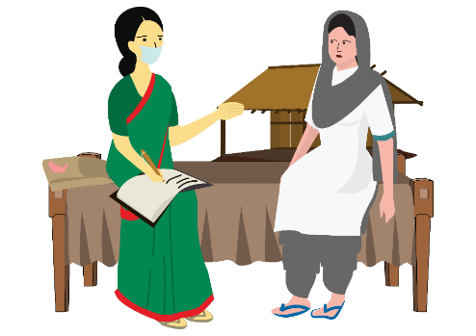


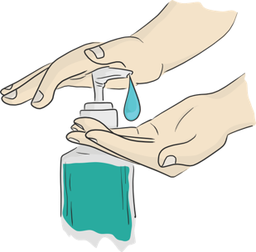


PRECAUTION AND SAFETY MEASURE FOR ALL FUNCTIONARIES
FROM MOHFW ADVISORY TO FLWs
When moving around the community
Immediately on reaching home
Maintain distance of at least 1 meter from people when you are communicating
Use a three layered mask to cover your face. Make sure it is properly worn.(while contact tracing)
Avoid touching your face (eyes, nose, mouth) at all times
Wash your hands with soap and water frequently, or use alcohol based hand-rub
Avoid touching or direct physical contact
Carefully remove and dispose off your face mask by soaking in bleach solution and then throwing it in a covered dustbin. (See: MASK MANAGEMENT).
Wash your hands with soap and water or alcohol based hand-sanitizer before you touch anything else.
If you get any symptoms like fever, dry cough or Difficulty in breathing REPORT TO the nearest Government Facility or District Surveillance Officer immediately.
34
Notes:
How to take care of yourself and carry on with your duties as a ICPS and allied workforce?
Take all preventive measures that you are talking about in the community such as keeping safe distance, washing hands frequently or use 70% alcohol-based hand rub including before and after home/community visits. Carry your own soap or 70% alcohol-based hand rub if necessary
If you are visiting or accompanying a suspected case to any health facility, make sure to cover both your mouth and nose with N95 mask. Maintain 1-meter distance.
Maintaining safe distances for those living in crowded areas or the homeless is going to be difficult. Even then you should inform them about preventive measures and provide what support is possible.
Self-monitor for signs of illness and report to the Medical Officer, immediately if any symptoms develop.
Remember persons over the age of 60 are at higher risk, so take special care to visit their homes and ensure that they have the provisions and support they need so that they don’t have to leave the house more than is necessary.
Continue to pay special attention to the marginalized and vulnerable populations, as is your routine practice. Ensure that they follow the DEW protocol especially in night shelters, slums etc.
Also, as a disaster response worker, try to reassure people that while those with symptoms and high risk need close attention, for others, prevention measures will decrease the risk of getting the disease.

Slide 12
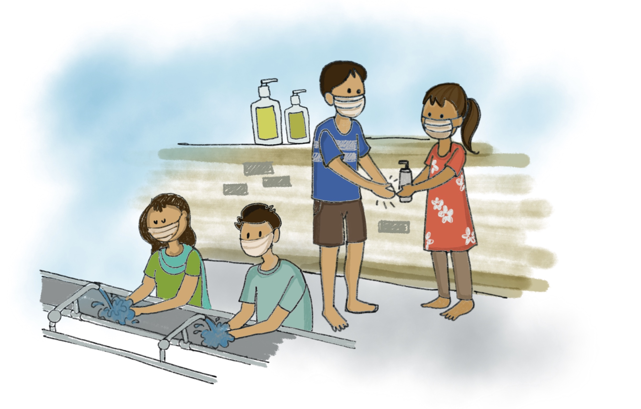
THANK YOU

