Slide 1



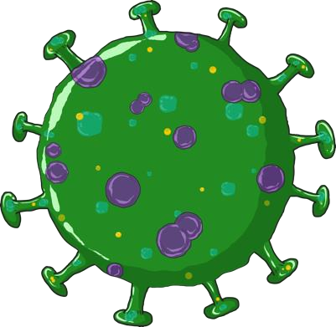




C VID SENSITIVE MESSAGES

Slide 2






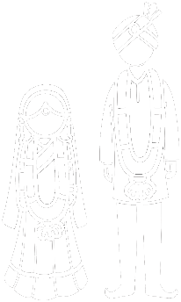



COVID SENSITIVE CARING: CHILDREN & ADOLESCENTS
Parenting Adolescents
Online Safety
Psycho-social Support
Children without adequate family care
Ending violence
against children
Child Labour
Child Marriage
Child Trafficking
Children on
Move

Slide 3


COVID Sensitive : Parenting Adolescents
Engage
Connect
with friends
Key behaviours:
Create a routine
Create
together
Listen, talk openly and comfort children
Do creative activities together, indoor games, housework together
Provide an abuse & violence free home environment
Internet hygiene
Ensure
safety
Ensure parental guidance to keep your child safe online
Co-create a routine, and provide positive acknowledgement of all outcomes - successes, efforts and failures – at the end of the day
Information
on COVID 19
COVID safety measures
Call CHILDLINE 1098 for any support for children

Slide 4


COVID Sensitive messaging on
Online Safety
Internet hygiene
Key behaviours:
Talk openly and discuss about online dangers
Usage Guidelines
Ensure parental guidance and privacy setting on devices and apps are active
Comprehensively orient adolescent on digital citizenship, online safety
Being Safe online
Trust adolescent to use online space safely
Be vigilant of an abuse free safe space online
Check regularly on internet usage in a participatory way Call CHILDLINE 1098 for any support for children
Positive Parenting

Slide 5


COVID Sensitive: Psycho-social Support
Understand emotional needs
Observe
Key behaviours:
Listen, talk openly and comfort children
Comfort and Engage
Regular routine
Look out for signs of prolonged boredom, dullness, irregular sleep, eating patterns and nervousness
Ensure an abuse and violence free environment and safe space online
Being Safe
COVID safety measures
Call CHILDLINE 1098 for any support for children

Slide 6


COVID Sensitive: Children without adequate family care
Key behaviours:
Health care & nutrition support
Foster care
Provide every child with family care as the first option
Identify and set up support mechanism among relatives and friends
Build community measure for care for children (orphaned or in need of care and protection)
Kinship
Community care
Encourage foster care and kinship care as the first option
Access information to avail social protection schemes and entitlements
Entitlements
Call CHILDLINE 1098 for any support for children

Slide 7


COVID Sensitive messaging on Ending Violence against Children
Helpline
information
Safe environment
Key behaviours:
Protecting Self
Speak out
Encourage conversations on personal safety
Inform parents that children may express psychological distress (anxiety, sadness Parents need to be patient and not resort to violent disciplining.
Empower
Community vigil mechanisms
Discuss GBV, Create safe space for children and women to speak
Be informed that violence, abuse and deprivation do increase in emergency situations, encourage to seek help, counselling and protection
Say NO to GBV
Positive parenting
Be vigilant and take action and report violence. Create a safe surroundings and develop mechanism such as neighbourhood and community watchdogs
Call CHILDLINE 1098 for any support for children
Gender differential treatment

Slide 8


COVID Sensitive: Child Labour
Multi-sectoral actions
Continued Education
Key behaviours:
All children should complete school education instead or being engaged in labour, sibling care, household chores or even marriage
Social protection Schemes
Vocational skills with education
Access information to avail social protection schemes and entitlements
Parents, PRI and community should ensure all children go to school and complete school education
Evidence generation
Convergence
Participate in regular SMC and PTA meetings
Call CHILDLINE 1098 for any support for children
Engage communities

Slide 9

COVID Sensitive: Child Marriage
Multi-sectoral actions
Continued Education
Multi-sectoral actions
Key behaviours:
All children should complete school education instead or being engaged in labour, sibling care, household chores or even marriage
Social protection Schemes
Vocational skills with education
Access information to avail social protection schemes and entitlements
Parents, PRI and community should ensure no child marriage
Evidence generation
Convergence
Develop mechanism such as neighbourhood and community watchdogs
Call CHILDLINE 1098 for any support for children
Engage communities

Slide 10

COVID Sensitive: Child TRAFFICKING
Key behaviours:
Multi-sectoral actions
Personal Safety
Develop mechanism such as neighbourhood and community watchdogs
Inform and educate children about child trafficking
Social protection Schemes
Convergence
Parents, PRI and community members should be vigilant of touts/strangers who are involved in trafficking
Access information to avail social protection schemes and entitlements
Evidence generation
Engage communities
Call CHILDLINE 1098 or Police 100 for any support for children

Slide 11


COVID Sensitive: Support to Children on the move
Health care & nutrition support
Education
Key behaviours:
Keep a vigil against child sexual abuse, violence and exploitation
Say NO to Child Marriage
Child care facility/measures
All children should complete school education instead or being engaged in labour, sibling care and household chores
Ensure child health and nutritional requirements are fulfilled
Safety
Social Protection
Always listen, talk openly and comfort children
Access information to avail social protection schemes and entitlements
Say NO to Child Labour
Entitlements
Call CHILDLINE1098 for any support for children
COVID safety measures

Slide 12
Thank You

