Slide 1


CHILDLINE 1098, India’s safety net for children
VS
COVID 19
CHILDLINE India Foundation

Slide 2


Slide 3

CHILDLINE locations in the Country
Locations as of now - 570
RCLS - 128
102 NCRB & 100 Aspirational Districts covered

Slide 4
Zone wise District CHILDLINE coverage

Slide 5
Zone wise Railway CHILDLINE coverage
List of 263 Railway CHILDLINEs finalised
Ongoing - 128

Slide 6
Calls to 1098 – 20th – 31st March 2020

Slide 7
Calls to 1098 – 20th – 31st March
Details | Total Number
Number of calls Offered* | 4,37,519
Average Offered calls per day | 36,460
Number of calls Answered | 3,07,018
Average Answered calls per day | 25,585
Number of intervention calls transferred to Intervention Unit, including Outreach cases | 4,857
Total Corona case | 237
Total Information related Corona calls | 1677

Slide 8
States calling 1098

Slide 9
Information seeking on Corona

Slide 10
Impact of COVID 19 on 1098 services

Slide 11
1098 Emergency Services & COVID
Post lockdown - for CHILDLINE 1098 -responding, reaching out & preventing abuse continues
Call volumes to 1098 have gone up by 50%
300-500 Calls on a daily basis
largest category of calls received for Protection against Abuse & Violence at 30%
  Physical Health at 11%
  Child Labor 8%
  Missing & Run Away 8%
  Homeless 5%
5% to 10% callers asking help for Shelter and Food
We anticipate Covid related Call rise

Slide 12
1098 Emergency Services & COVID
Standard Script updated to pass relevant information's on Social Distancing, Hygiene Practices, helpline numbers
Mobility, transport, food, personal safety, fears & discrimination issues being addressed
Remote technical support from technology partner slower
Advisories issued for all CHILDLINE teams within CIF & across networks
Difficulties in dealing with certain cases
Working with reduced human & other resources at CHILDLINE Contact Centre & Partners

Slide 13
Key Resource
Over 10,000 personnel in the CHILDLINE network are on stand-by, to rush to the aid of children in distress
childline flooded with calls for food – police, civil society networks helped for transport, material –Gujarat (Gandhinagar provided a vehicle), Madhya Pradesh, Kerala
Working with State Governments & districts to help provide personal protection material & food –West Bengal declares it an essential service, Odisha outreach to tribal, most marginalized, Malda railway CHILDLINE, Cuttack Railway CHILDLINE
Raising awareness, disseminating information focusing on vulnerable populations – Gujarat
Doing online learning activities with children in CCIs – Kerala, Telangana outreach to identify vulnerable families & educate
Personal safety - Thermal screening of childline volunteers – Uttar Pradesh, Rajasthan – multi stakeholder approach
Case management, restoration, mapping of vulnerable populations

Slide 14
1098 Emergency Services & COVID
Provision to register a case on website created
https://www.childlineindia.org/a/report/case
Website resource corner for material on COVID 19 & dealing with children
https://www.childlineindia.org/a/covid19
E - letter on work on the ground
Campaigns launched to cheer teams on
Reaching out to all stakeholders for support & collaboration at National, State & district level – Govt./Corporate/Institutions

Slide 15
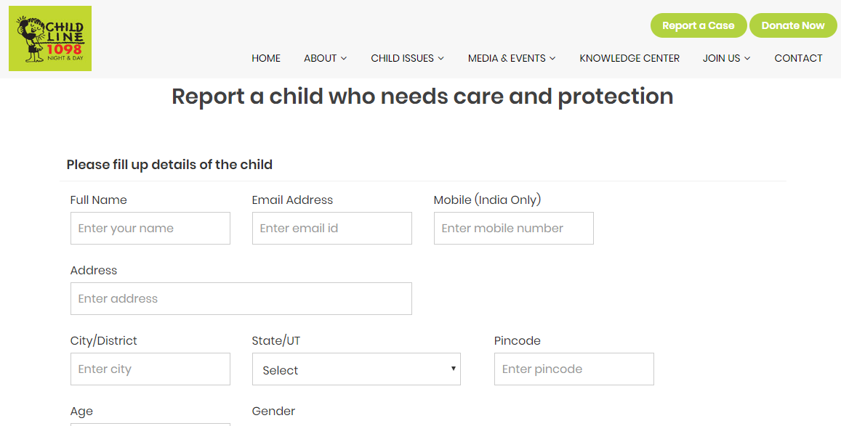
Report a case online
https://www.childlineindia.org/a/report/case

Slide 16

CHILDLINE 1098

Slide 17
Support required
1098 should be declared an essential service
Mobility intra and inter -district
Equipping Personnel with Appropriate Personal Protection Equipment & and Oher resources such as sanitizers, masks, gloves, hazmat suits (when rescuing or restoring covid infected children)
Build capacities of CHILDLINE to handle crisis – e-learning
Self care of caregivers
1
Insurance Cover Protection for 3 years
2
Transportation, Food & Other Logistic Support
3
Inadequate resources – human & financial
4
Provision of Appropriate Personal Protection Equipment
Immediate Emergency Relief Packets for Children & Families
5

Slide 18
Thank You…
Like us on │Follow us on │Subscribe on
Call 1098 if you see any Child in Distress or in Crisis.
Contact Us:
www.childlineindia.org.in
dial1098@childlineindia.org.in

Slide 19
COVID-19
Declared as Pandemic by WHO on March 11, 2020
Claimed Over 73,608 Lives and Infected over 13,23,641 worldwide
Government of India Declared Health emergency & Lockdown for 21 days – 24th March midnight
India Confirmed 4780 infected cases and 130 deaths
Maharashtra, Tamil Nadu, Delhi, Telangana, Kerala, UP, AP – 70% cases from these states
Mumbai, Delhi, Indore, Hyderabad, Pune – 30% cases reported nationwide
Chennai, Kasargod, Jaipur, Thane & Ahmedabad next 5 – 10 cities account for 41% cases

