Slide 1

Parenting Adolescents PACKAGE
Roll Out GUIDE

Slide 2

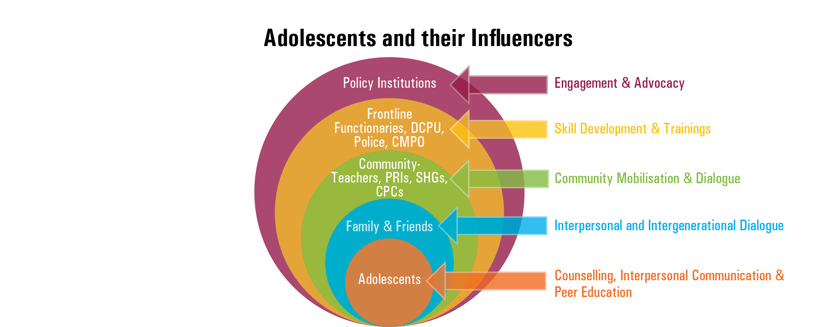


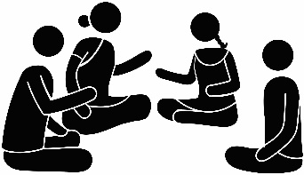
RESPONSIVE PARENTING – THE CONTEXT
Socioecological Model
Adolescence – a challenging yet remarkable transition. Adolescents require care, protection and support to make this transition successfully
Responsive parenting refers to family interactions in which parents are aware of their children's emotional and physical needs and respond appropriately and consistently.
Responsive parents are thus, “in tune” with their children.
Parents must be senstised and capacitated in the area of responsive parenting
Social and Behaviour Change Communication is key to promote responsive parenting for adolescents

Slide 3




PARENTING ADOLESCENTS – THE STRATEGY
Adolescent Empowerment
SBCC
Improved communication between parents and adolescents
Changing harmful norms, violence, gender discrimination, child marriage
Promoting gender equity
Care, protection and development of adolescents
Responsive Parenting
Frontline workers
Parent networks
Media and partnerships
SBCC
Responsive Parenting
Parents and caregivers
Shift in strategy during C VID-19
Focus on reaching and supporting parents through different platforms:
1. Use of electronic and digital media 2. Community level platforms 3. Limited home visits by front line workers

Slide 4
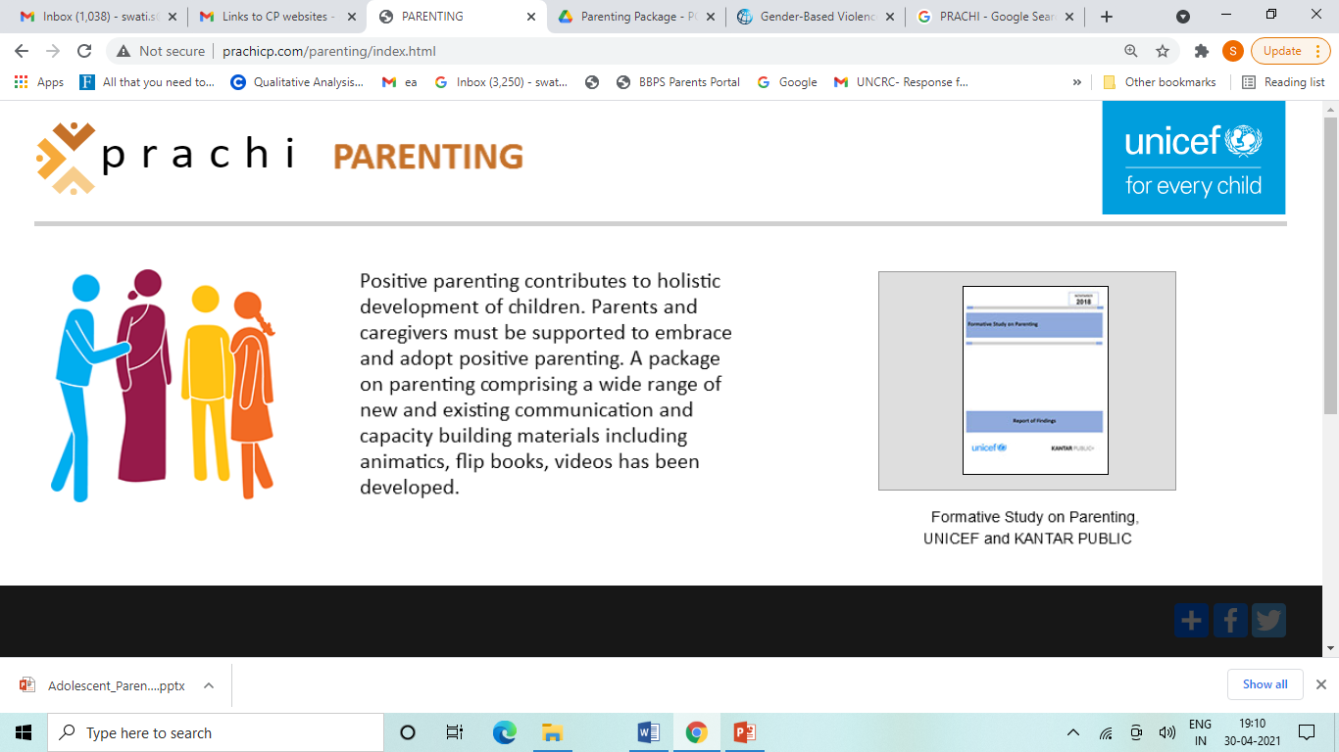
PARENTING ADOLESCENTS - PACKAGE
Comprises print and audio-visual materials to assist development workers, frontline functionaries, parents and caregivers and community at large to recognise importance of and embrace gender-responsive parenting practices
Contains existing and new resources developed by UNICEF and its partners
The Package has been developed with following key objectives:
To create discussions around and establish importance of gender responsive parenting for adolescents at household, neighbourhood and community levels
To enhance understanding of parents, frontline functionaries and development workers and community on gender responsive parenting
To capacitate above stakeholders in adopting and/or embracing gender responsive parenting practices
1
2
3

Slide 5
Intended Users of THE PACKAGE
FRONTLINE WORKERS AND IMPLEMENTING PARTNERS
AWW – Integrated Child Development Service (ICDS) centres and Adolescent Girls’ Scheme
PARENT AND CAREGIVER NETWORKS
Parents/caregivers
MEDIA & PARTNERSHIPS
Electronic media – TV, radio
Small and medium scale trade federations (KVIC)
Digital media – social media
PRIs
Farmers cooperatives
Print media
Community media
ASHA – VHND, AHD and one to one sessions
Peer Educators
Teachers
Community based groups
Implementing partners
SHGs

Slide 6





COMMUNICATION APPROACHES AND USES
COMMUNICATION APPROACHES
USES – DIALOGUES AND DISCUSSIONS
      Internal personal communication (IPC) – one to one and in-depth discussions
      Group communication (GC) – engaging with small group of parents, caregivers and adolescents
      Social mobilisation and advocacy (SMA) – collectivising and garnering support of community members, PRIs and
      Parents/caregivers and FLWs, development workers and teachers
      Family members and FLWs, development workers and teachers
      Parents/caregivers and adolescents
      Community members and FLWs, development workers and teachers
      Community members and parents/caregivers
      Community members and adolescents
      Peer to peer dialogue among parents/ caregivers
      Peer to peer dialogue among adolescents
All the above will foster intergenerational dialogue between adolescents and parents/caregivers
COVID appropriate behaviour of social distancing, wearing mask and maintaining face & hand hygiene to be maintained at all times
https://www.mohfw.gov.in/pdf/Illustrativeguidelineupdate.pdf & https://www.who.int/emergencies/diseases/novel-coronavirus-2019/advice-for-public

Slide 7


PLATFORMS to BE LEVERAGED
PLATFORMS FOR IPC
PLATFORMS FOR GC
PLATFORMS FOR SMA
Home visits by AWWs & ASHAs
One to one counselling sessions at AFHCs
One to one interaction by Peer Educators under RKSK, SHWP, SAG
Interactions between teachers and parents – PTA
One to one engagement by civil society organisations, youth groups - NYKS, NCC and NSS
Virtual interaction with parents and adolescents - tele counselling
Monthly meetings at AWCs
Group meetings conducted by PEs under RKSK
SMC meetings
Parents teachers’ meetings
Student group meetings including Meena Manch, Gargi Manch, Raju Manch, Kanyashree clubs, student councils
Meetings of community groups and networks (SHGs, youth groups, NYKS, NSS, farmers’ groups)
Meetings at Common Service Centres
Virtual interactions with group of parents and adolescents
Gram Sabha meetings, Chaupals
VHSND and Poshan Maah celebrations
Adolescent Health Days
Community celebrations and events
School celebrations and events
Community radio
Display/Screening at CSCs and other prominent places in villages and panchayats
Digital circulation of all materials on WhatsApp groups, Facebook and other similar platforms

Slide 8












Parenting Adolescents – KEY THEMES
Importance of parenting adolescents and the challenges
Raising adolescents with values and embracing diversity (adolescents with disabilities)
Growth and changes in early adolescence
Knowing adolescents’ friends and friendship with opposite sex
Understanding adolescent’s developmental needs and gender sensitive support
Psychosocial support particularly during COVID-19
Independence and responsibility
Understanding gender identity, promoting gender equity and addressing gender-based violence
Parental engagement in adolescents’ study
Making life choices – career, marriage; and ending child marriage
Disciplining by striking a balance
Communicating with adolescents
Use of media and online safety

Slide 9
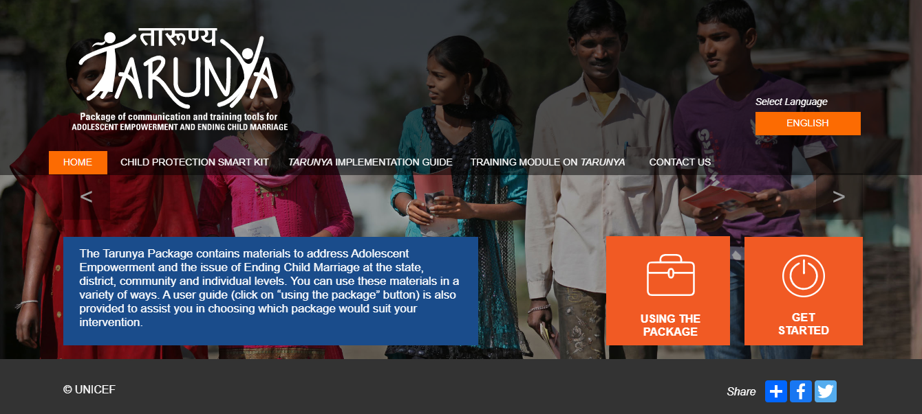
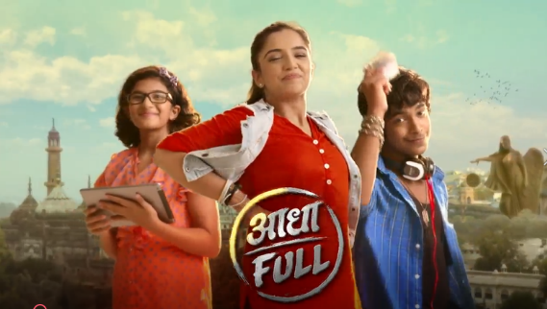
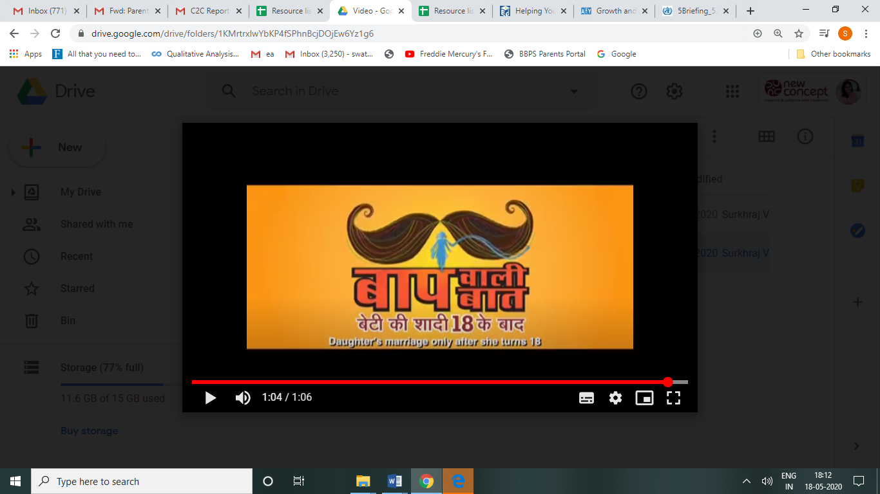
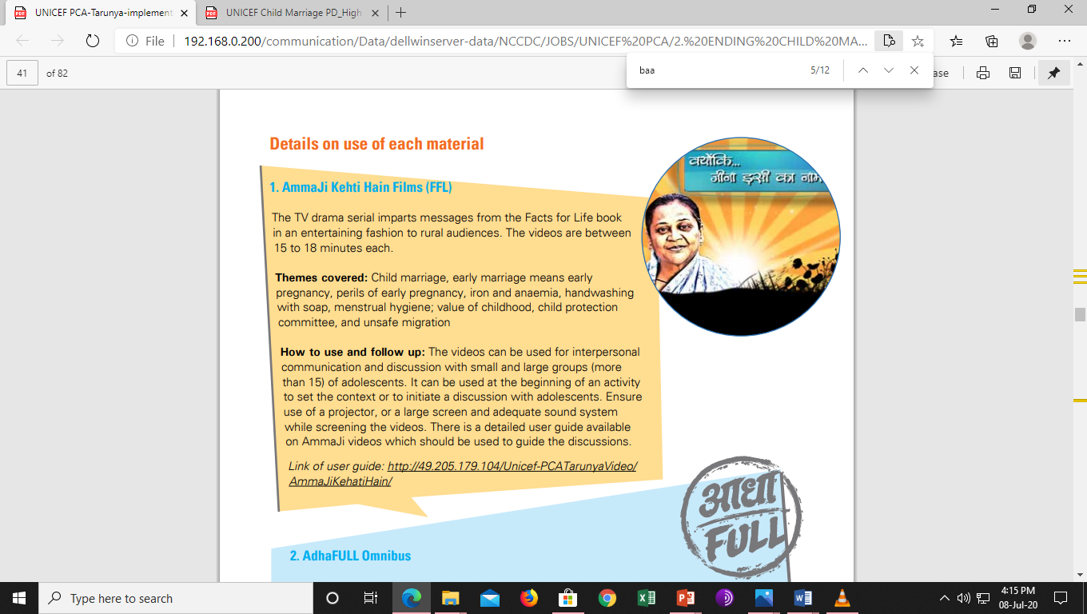
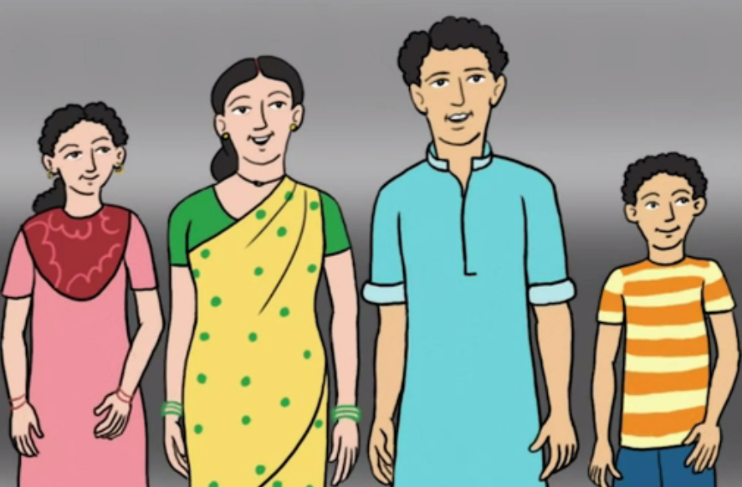
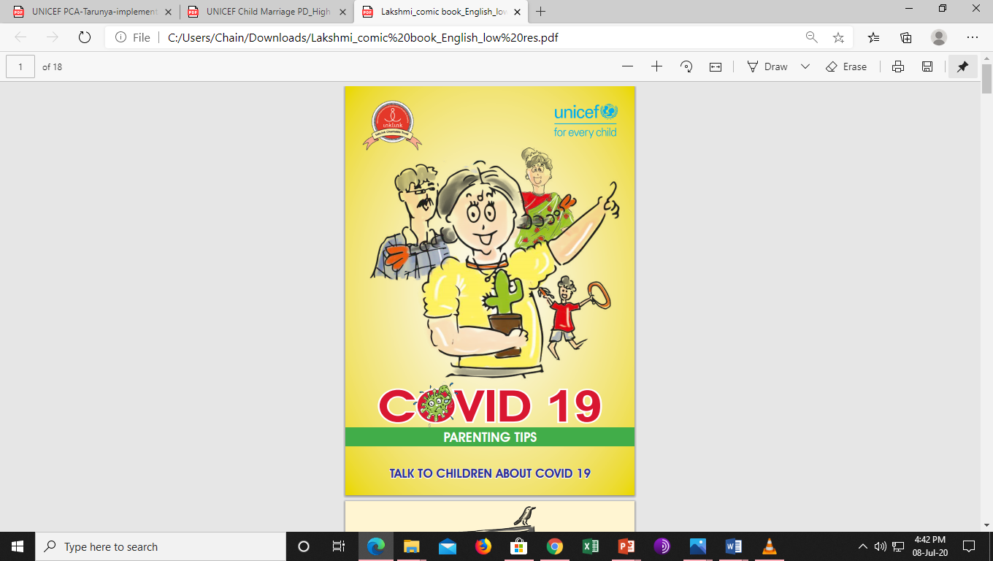
UNPACKING THE PACKAGE CONTENTS
Tarunya Online Repository
AdhaFULL Omnibus
Baapwali Baat Package
Amma Ji Kehti Hain Videos
Parenting Adolescents Animatics
Comic Book on Parenting Tips during COVID

Slide 10

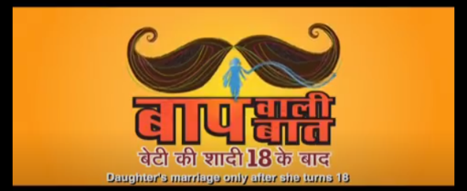
UNPACKING THE PACKAGE CONTENTS
Title | Author | Type | Description | Language
Tarunya Online Repository | UNICEF | Print, audio visual | Repository contains materials to address Adolescent Empowerment and the issue of Ending Child Marriage at the state, district, community and individual levels. It includes posters, flipbooks, booklets, films, radio spots among others. | Hindi, English, Tamil and Bengali
AdhaFULL Omnibus | BBC Media Action and UNICEF | Audio visual | AdhaFULL Omnibus is a 78-episode TV drama series - a whodunit with three teenagers who come together in a make believe town called Badlipur to solve one case per week. Each episode is of around 30-45 minutes. | Hindi
Baapwali Baat Package | UNICEF | Print and audio visual | Baapwali Baat Package contains poster, hoarding, wall painting, two TV commercials of one minute each and two radio spots of 30 seconds each. It focuses on encouraging girls’ education and changing harmful gender norms. It appreciates fathers who choose education over marriage for their daughter. | Hindi
Ammaji Kehti Hain Films | UNICEF | Audio visual | The TV drama serial imparts messages from the Facts for Life book in an entertaining fashion to rural audiences. Themes covered include child marriage, value of childhood, child protection committee, and unsafe migration. | Hindi

Slide 11
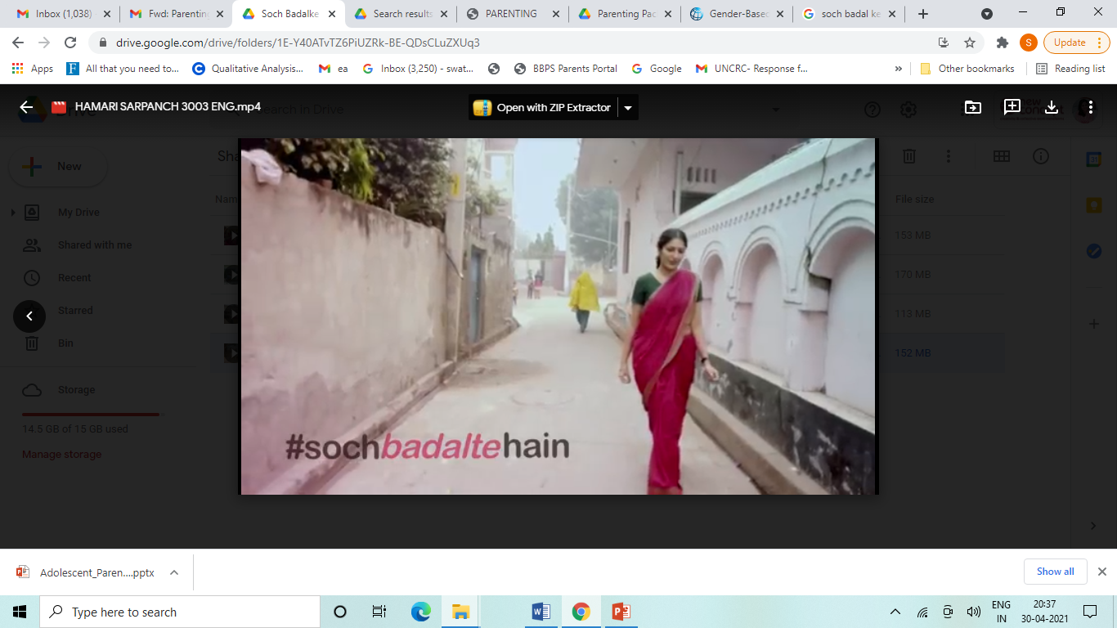
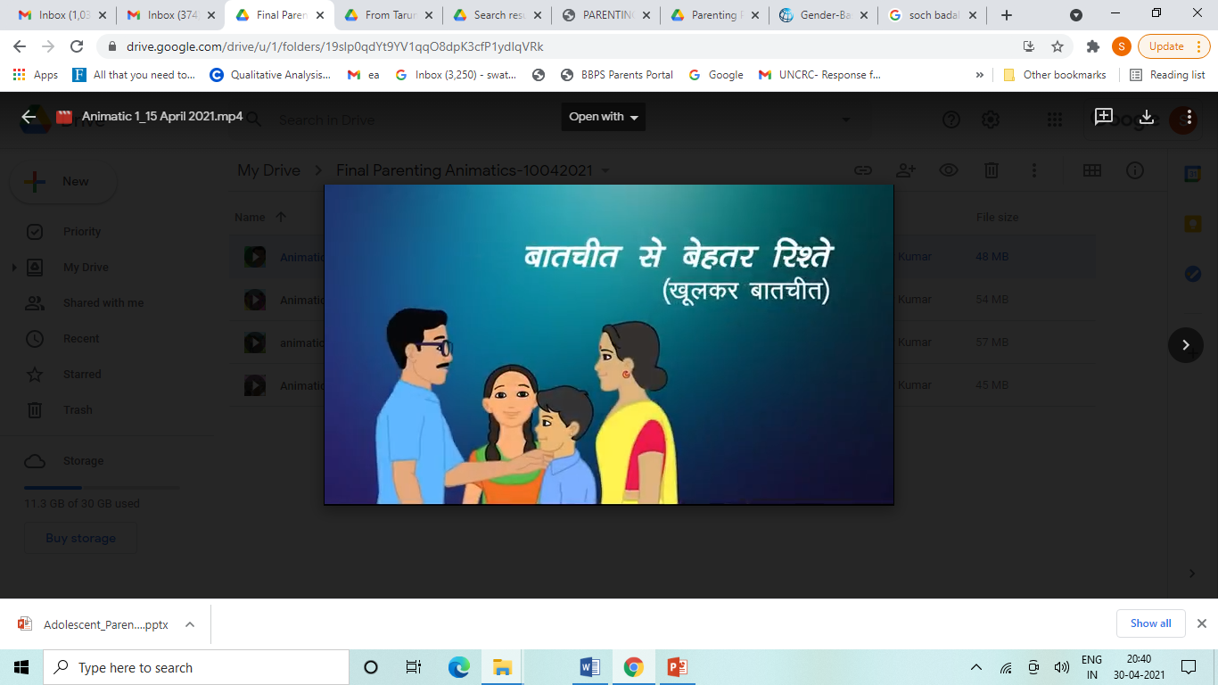
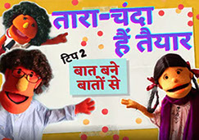
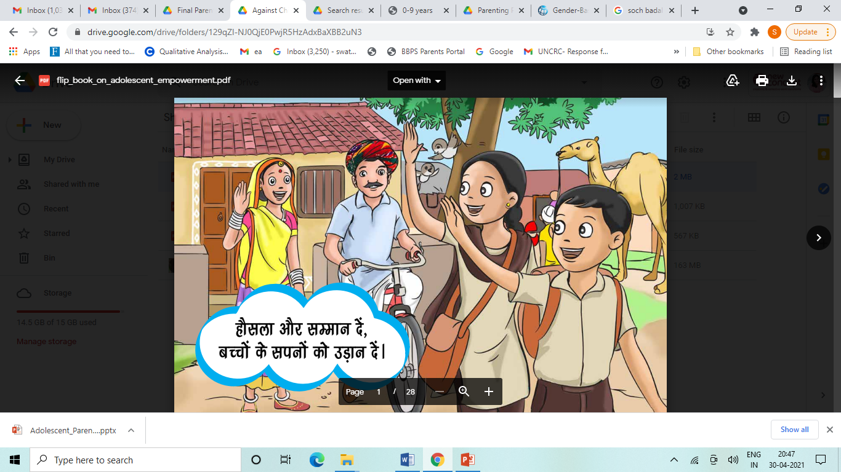
UNPACKING THE PACKAGE CONTENTS
Title | Author | Type | Description | Language
Soch Badalte Hain | UNICEF | Audio visual | Soch Badalte hai comprises a set of four videos focusing on themes of challenging gender stereotypes, gender equity and gender-sensitive parenting. | Hindi
Parenting Adolescents Animatics | UNICEF | Audio visual | Parenting Adolescents is a engaging series of 15 animatics focusing on different responsive parenting themes with a strong gender lens. Themes covered include importance of parenting, communicating effectively with adolescents, meeting developmental needs of adolescents. | Hindi and English
Tara Taiyar Hai | Govt of UP, UNICEF, The Puppeterians | Audio visual | The videos revolve around Tara - an affable muppet and her family. These videos on adolescent life skills depict various challenges and issues faced by adolescents including cyber stalking and online safety. They depict how parents can talk about these issues with their children. | Hindi
Package Ending Child Marriage | Saajha Abhiyan | Print audio visual | The package contains a film, situation cards, flip book and story card on ending child marriage and promoting girl’s education. | Hindi

Slide 12
UNPACKING THE PACKAGE CONTENTS
Title | Author | Type | Description | Language
Soch Badalte Hain | UNICEF | Audio visual | Soch Badalte hai comprises a set of four videos focusing on themes of challenging gender stereotypes, gender equity and gender-sensitive parenting. | Hindi
Parenting Adolescents Animatics | UNICEF | Audio visual | Parenting Adolescents is a engaging series of 15 animatics focusing on different responsive parenting themes with a strong gender lens. Themes covered include importance of parenting, communicating effectively with adolescents, meeting developmental needs of adolescents. | Hindi and English
Tara Taiyyar Hai | Govt of UP, UNICEF, The Puppeterians | Audio visual | The videos revolve around Tara - an affable muppet and her family. These videos on adolescent life skills depict various challenges and issues faced by adolescents including cyber stalking and online safety. They depict how parents can talk about these issues with their children. | Hindi
Package Ending Child Marriage | Saajha Abhiyan | Print audio visual | The package contains a film, situation cards, flip book and story card on ending child marriage and promoting girl’s education. | Hindi

Slide 13
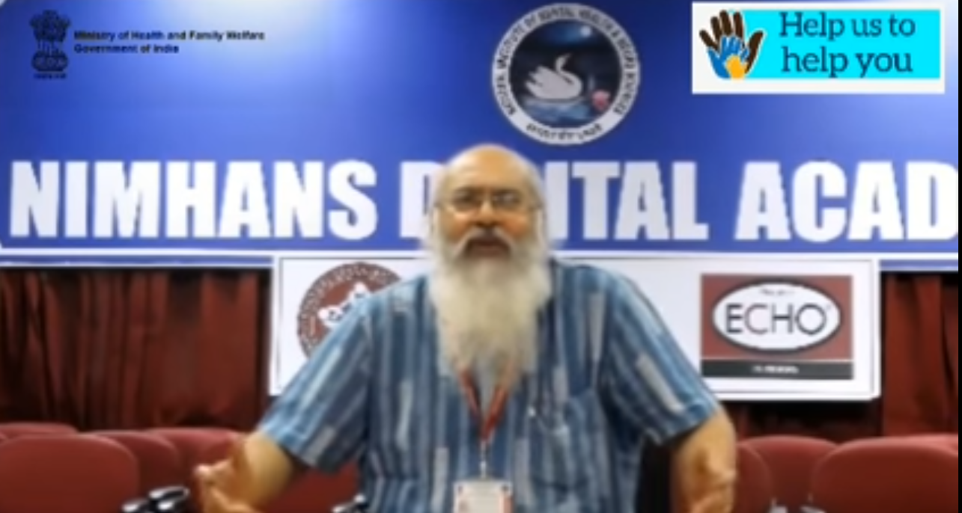
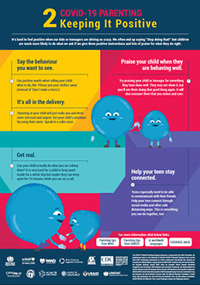
UNPACKING THE PACKAGE CONTENTS
Title | Author | Type | Description | Language
Connecting with Lil Ones during COVID-10 by Dr. Shekhar P Sheshadri | NIMHANS | Audio visual | The video provides simple parenting tips to engage with children effectively during COVID-19. | Hindi and English
Lakshmi Comic Book | UNICEF | Print | The comic book follows the story of Lakshmi and her parents during COVID-19. The comic book provides parenting tips for adolescents including how to talk to children about COVID-19, allaying their fears doubts and myths and providing them psychosocial support. | Hindi, English and Tamil
Global Resources on Parenting during COVID-19 | WHO | Print | The global resources comprise a set of colourful posters on simple yet effective parenting tips during COVID-19. | English

Slide 14
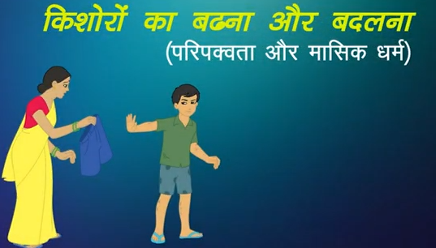
Sample Session 1: Talking to adolescent girl’s mother about menstruation
Setting: One to one home visit by an AWW to an early adolescent girls’ mother
Suggested Material: Parenting Adolescent Animatics – Animatic 2 Growth and Changes in Adolescence (Puberty)
Approach and Use: IPC and intergenerational dialogue maintaining social distance and CAB
Material required: Parenting Adolescent Animatics should be saved/or easily accessible on AWW’s smart phone (sufficiently charged)
Key Pointers for Use
Meet and greet the mother maintaining social distance, wearing mask and no physical contact
Mention about her daughter stepping into adolescence and her likelihood of experiencing various physical & psychological changes
Highlight preparing girls for menstrual hygiene management (MHM) and giving them psychological support is critical
Sometimes it could be both awkward and daunting for children to discuss this with parents, however, informed and aware parents can prepare their daughters well to address the issue of menstruation
Encourage father to join and participate in the session
Tell the parents that you will show them an animatic about a mother facing similar situation
Post the screening discuss the dilemma faced by the mother in the animatic and how she overcame the challenge by taking the initiative of talking to her daughter
Reiterate the key messages around menstruation and hygiene practices

Slide 15
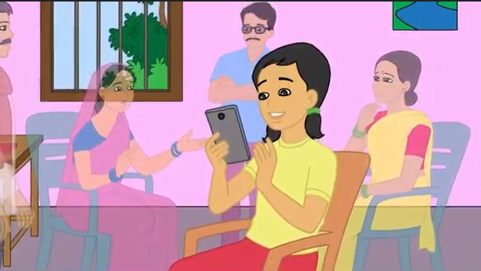
Sample Session 2 Talking to parents about use of technology and online safety
Setting: Parent Teacher Meeting at School
Suggested Material: Tara Taiyar Hai video and Parenting Adolescent Animatics – Animatic 10 Digital Gadgets – User or loser?
Approach and Use: Small group communication maintaining social distancing and CAB
Material required: Tara Taiyar Hai video and Parenting Adolescent Animatics should be saved/easily accessible on teacher’s laptop
Key Pointers for Use
Meet and greet the parents maintaining social distance, wearing masks and no physical contact, talk about how they are
Mention how during COVID-19 school closure phase children’s use of technology has increased
Emphasise that technology is indeed a boon but it poses children and us at various online risks too
It is important that parents and children must be aware of steps that can be taken to ensure online safet
Tell parents that you will show them a video about a muppet family where a girl/boy is getting unwanted calls & messages & she is feeling hesitant to talk about this with her/his parents

Slide 16
Sample Session 2 Talking to parents about use of technology and online safety
Key Pointers for Use
Discuss the dilemma faced by the parents in the video and how they overcame the challenge of talking to the daughter/son
Reiterate key messages on create an environment where children can talk to their parents about things which are bothering them
Following this, tell them that you will be showing them another animatic where parents like them are struggling to find ways to keep children safe online and a number of them go to the school teacher for advice
Upon completion of screening, ask parents about their views on the online safety measures suggested in the animatic
Request them to suggest more ways of keeping their children and themselves safe in the online environment
Conclude the discussion by reiterating the golden rules of children’s online safety

Slide 17




Monitoring INDICATORS
Simple indicators for monitoring of Package use to be included in users’ existing monitoring framework and checklists
Outcome indicators
No. of parents who have changed a harmful norm/or practice at home level
Proportion of parents/adults reporting adoption of gender responsive parenting practices
Proportion of adolescents reporting improved communication with their parents
Proportion of parents who convince others about gender equity
Output indicators
No. of audience/ stakeholders (parents, teachers, community representatives) reached using the package
Proportion of parents/adults who know/understand the importance of gender responsive parenting practices
No. of parents who are confident of ensuring gender equity
Process indicators
No. of government functionaries able to use Package contents in their communication activities
No. of implementing partners (CSOs) able to use the Package in their communication activities
No. of sessions conducted with parents using the package
Input indicators
No of trainers trained on use of the package
No of functionaries trained on use of the package

Slide 18
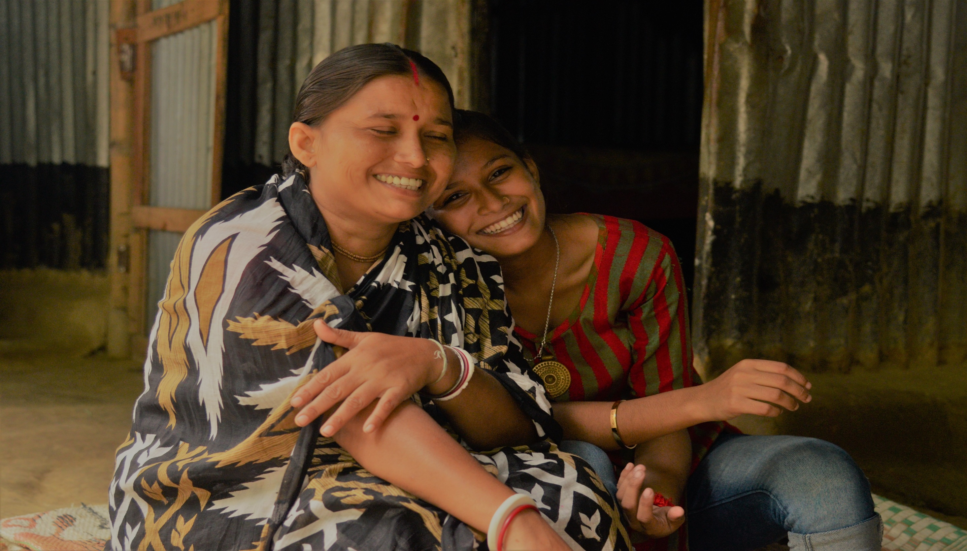

THANK YOU

Slide 19
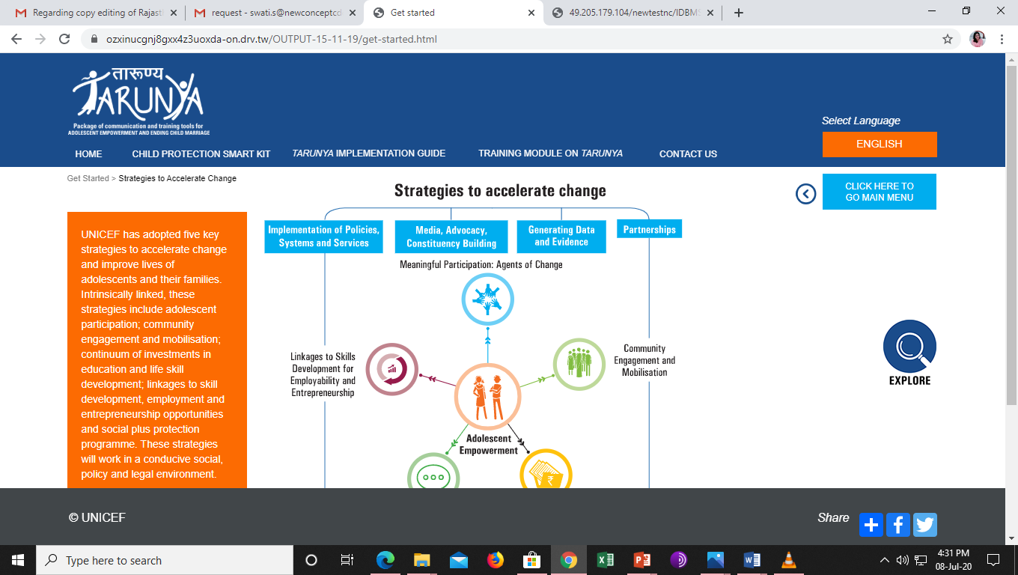
TARUNYA ONLINE REPOSITORY

Slide 20
ADHAFULL OMNIBUS

Slide 21
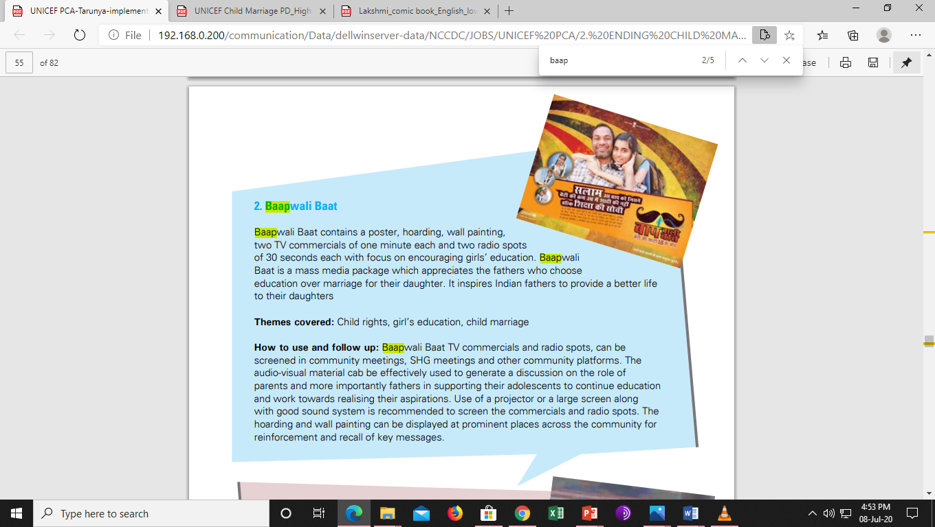
BAAPWALI BAAT PACKAGE

Slide 22
Amma Ji Kehti Hain Videos

Slide 23
soch Badalte Hain

Slide 24
PARENTING ADOLESCENTS ANIMATICS

Slide 25
TaRA HAI TAIYYAR

Slide 26
LAKSHMI COMIC BOOK

Slide 27
Connecting with Lil Ones during COVID-10 by Dr. Shekhar P Sheshadri

Slide 28
PACKAGE ON ENDING CHILD MARRIAGE

Slide 29
Global Resources on Parenting during COVID-19

