Slide 1
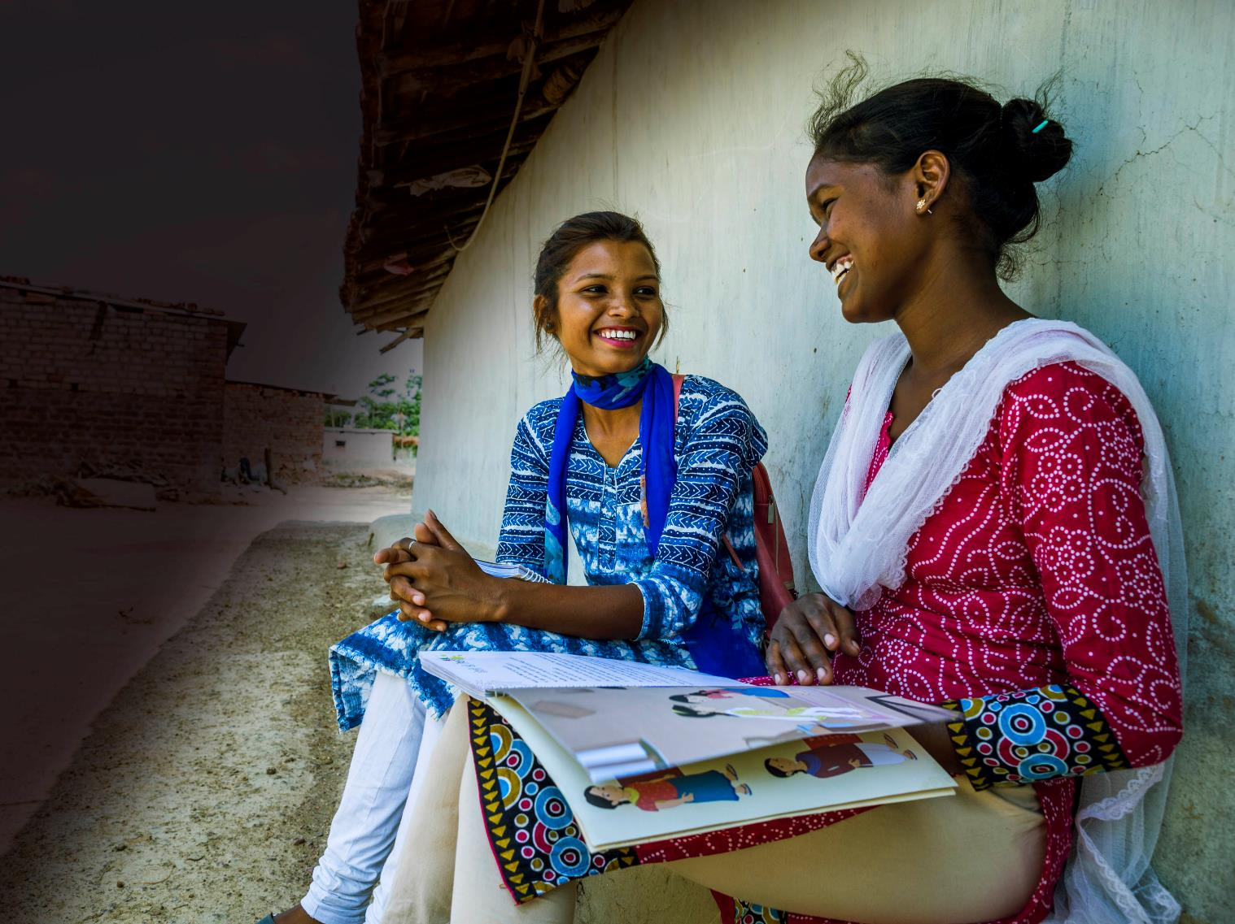



JAN ANDOLAN FOR A
SAFE NEIGHBOURHOOD
Ministry of Women and Child Development
JANUARY 2020 | NEW DELHI

Slide 2
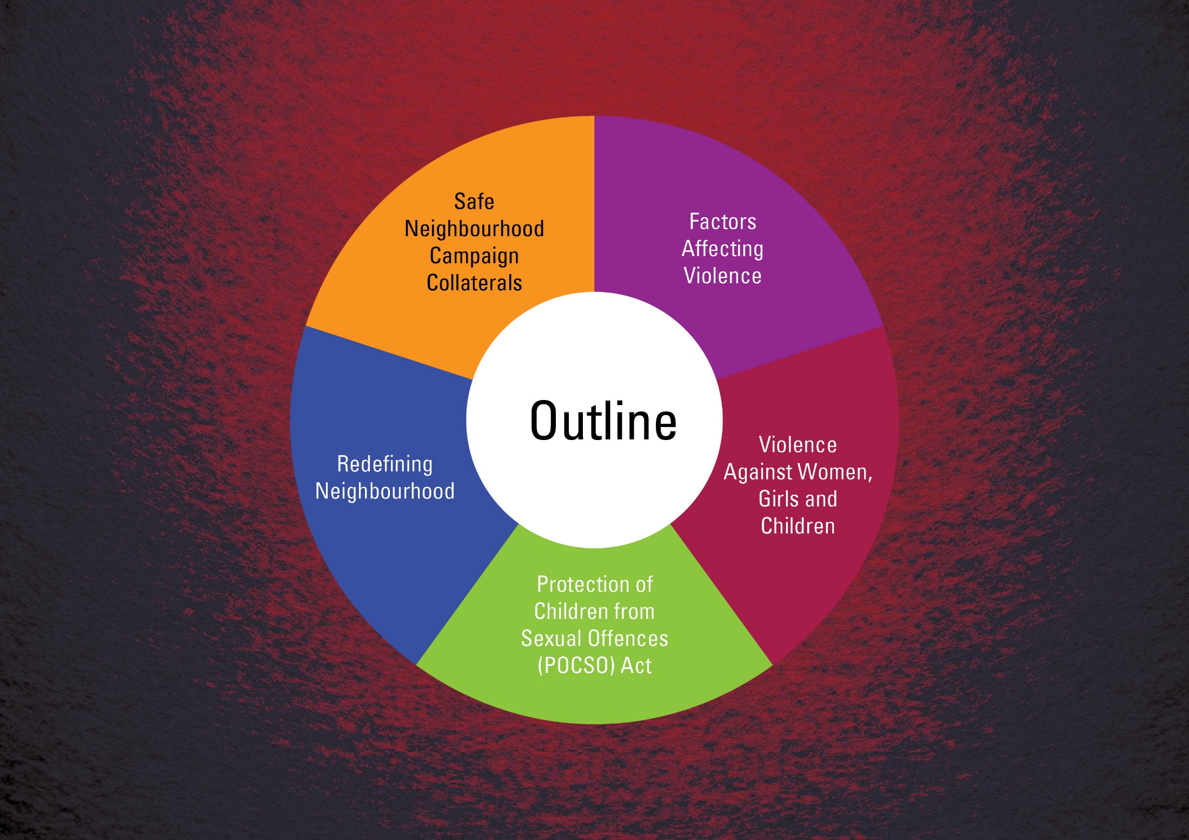

Slide 3
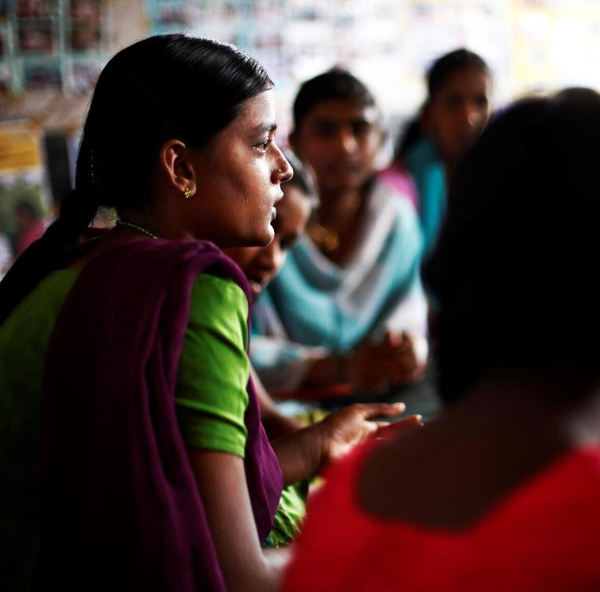
Factors
Affecting Violence

Slide 4
Violence is widespread across all socio-economic groups
All forms of violence – age and gender no bar
SC/ST are more vulnerable
WEALTH does not appear
to be a significant factor affecting violence
Violence has no relationship with education or socio - economic status
Minor girls
Illiterate/less educated
Children exposed to violence at home can end up being perpetrators of violence

Slide 5
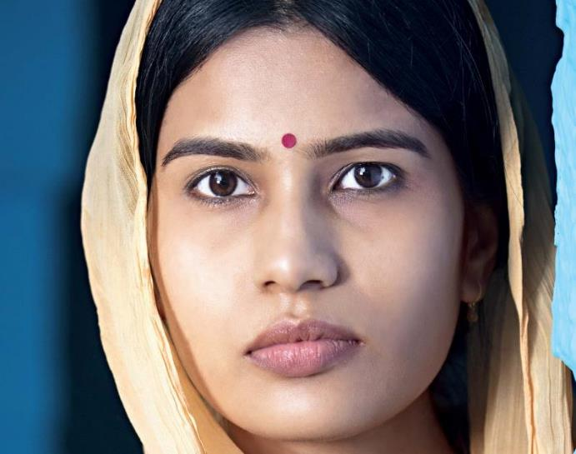
Violence Against Women, Girls and Children

Slide 6
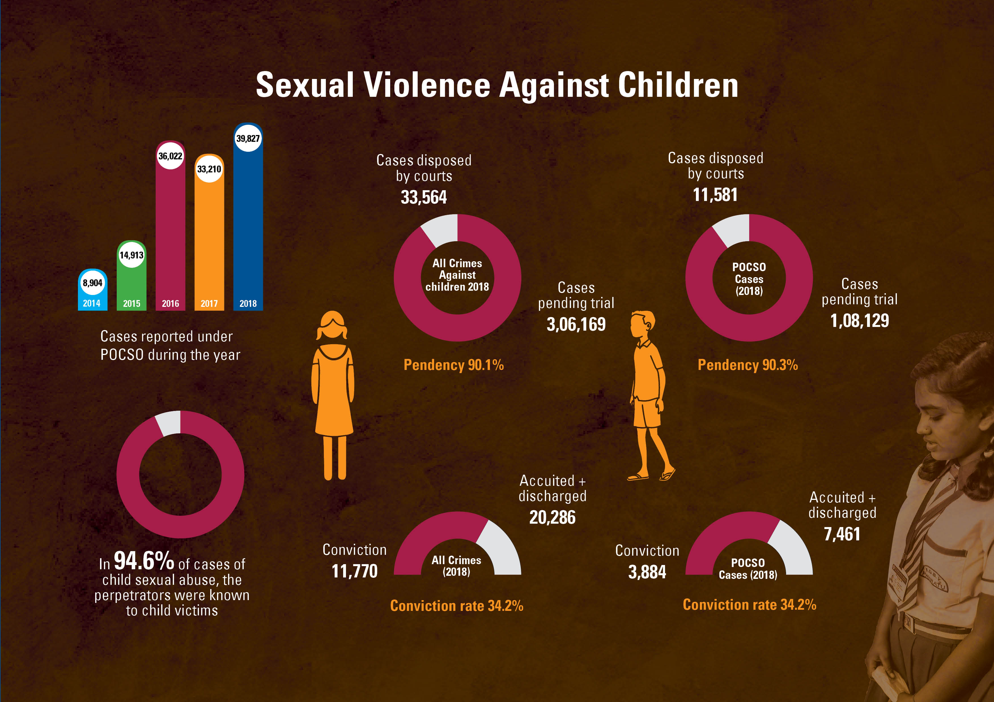

Slide 7
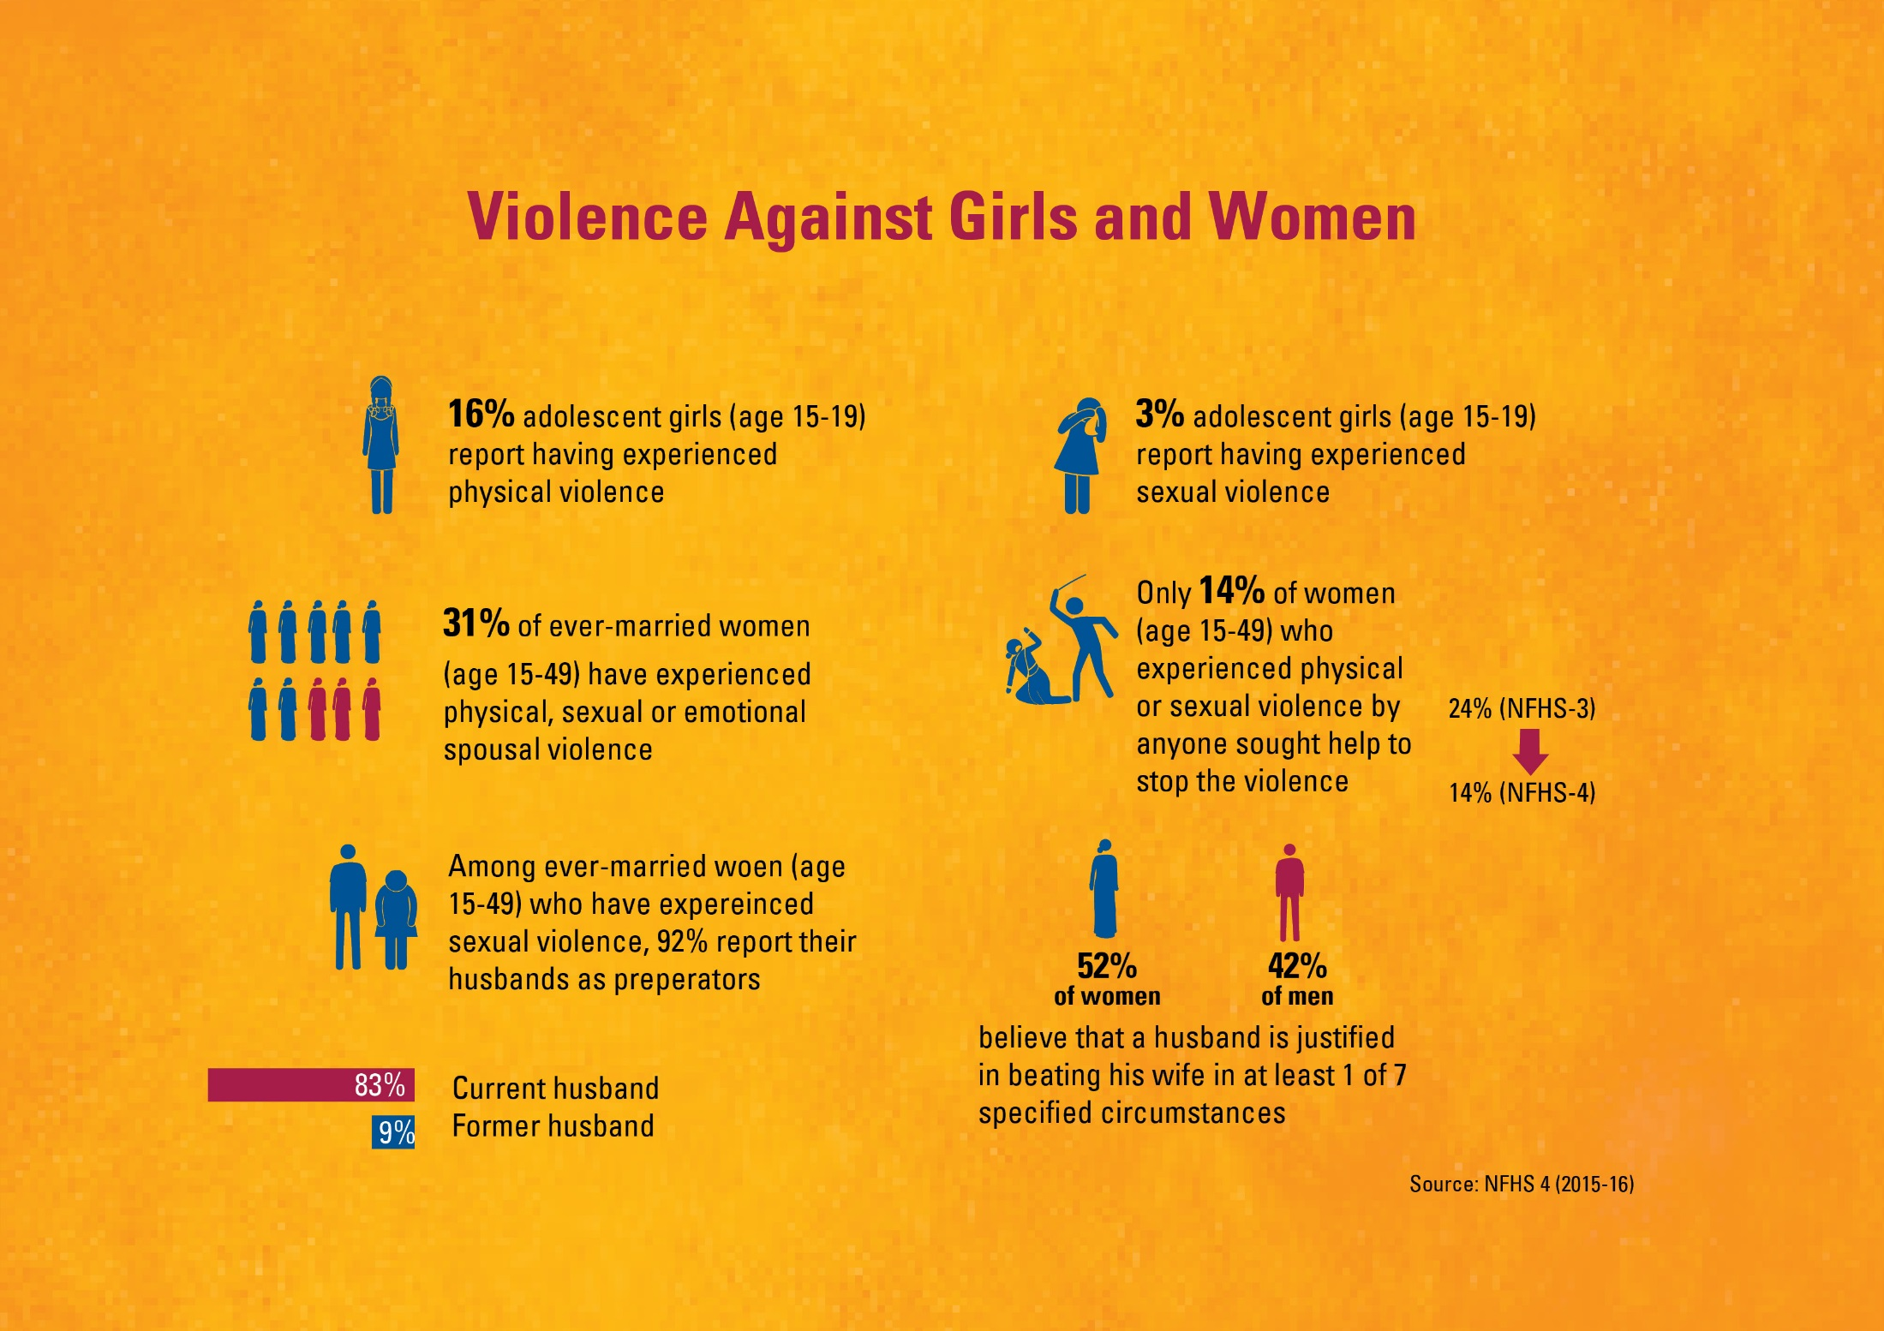

Slide 8
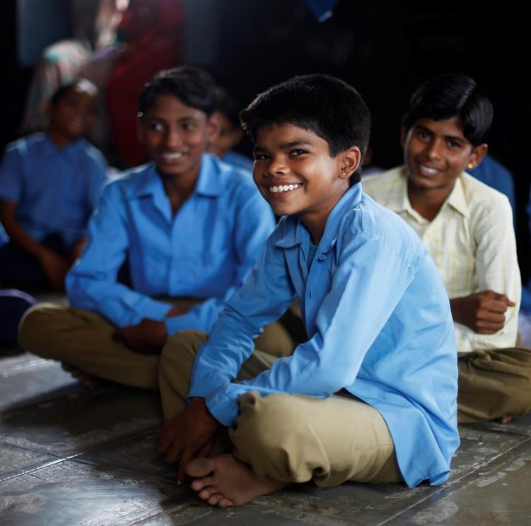
Protection of Children from Sexual Offences (POCSO) Act

Slide 9
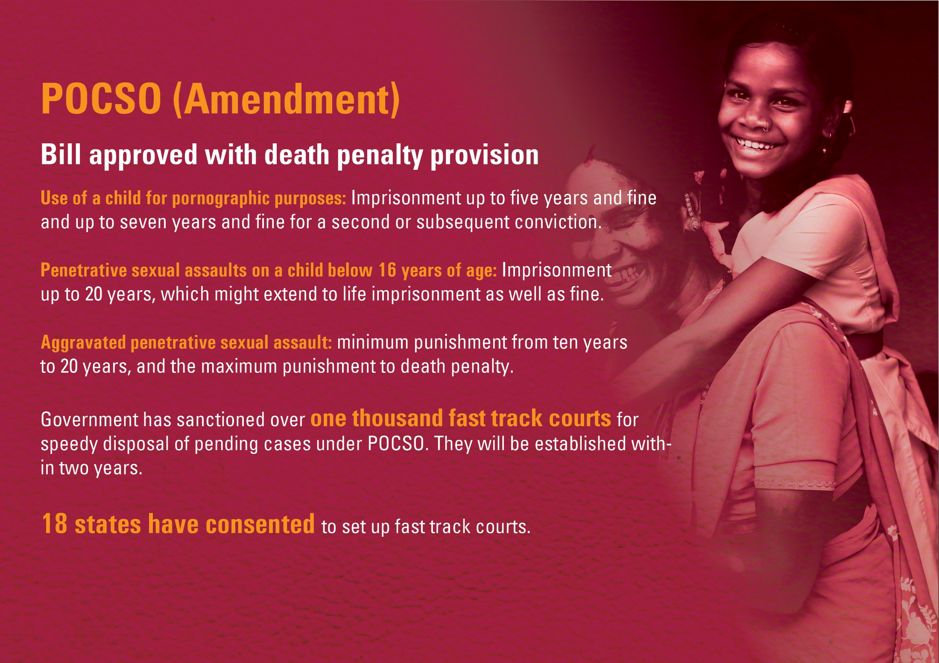
Source: RSTV (http://newsonair.nic.in/Main-News-Details.aspx?id=369465)

Slide 10
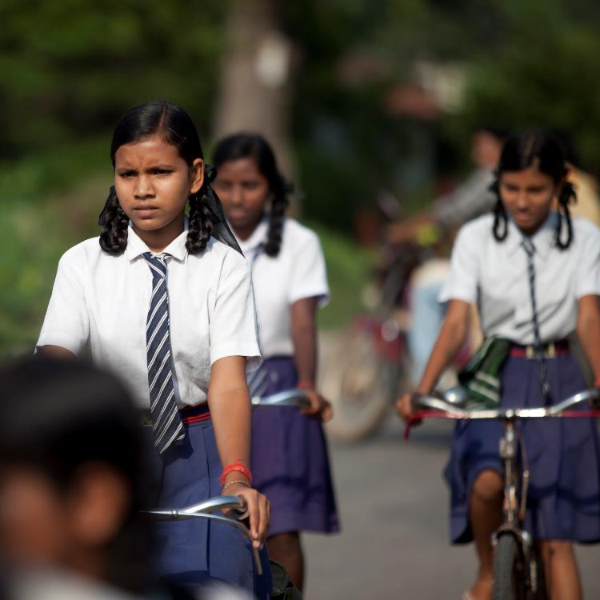
Redefining Neighbourhood

Slide 11
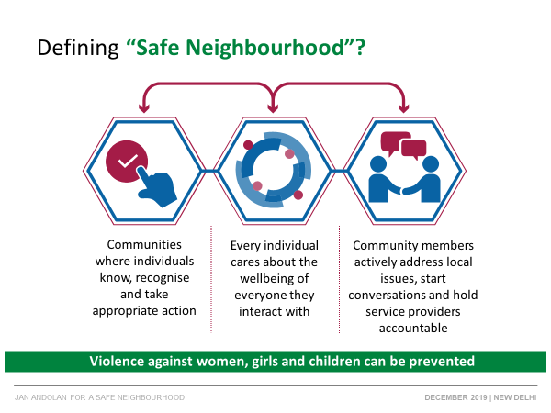
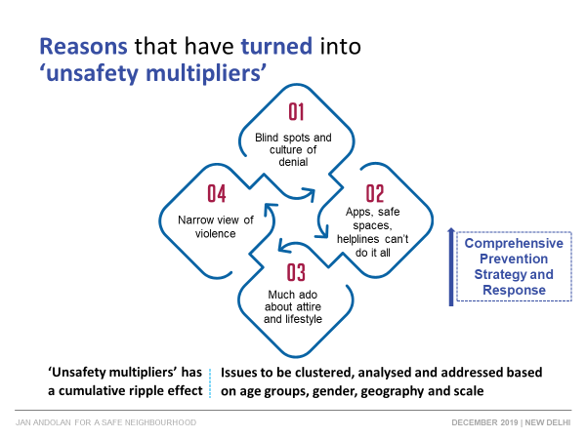

Slide 12
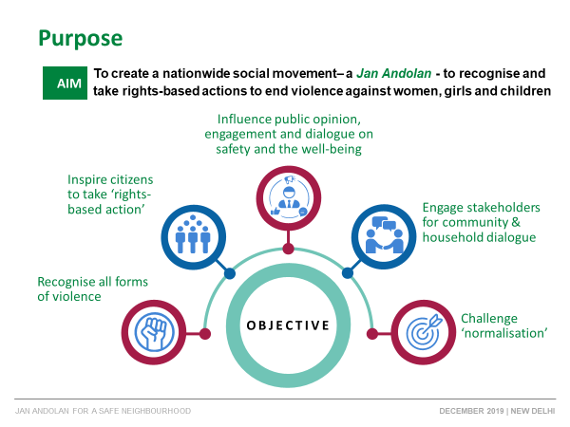
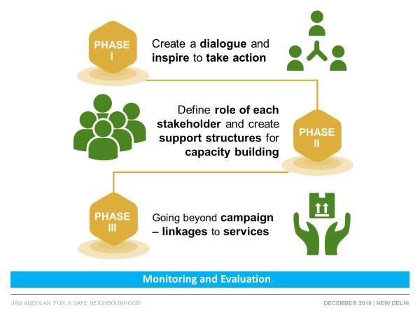

Slide 13








Safe Neighbourhood Campaign:
monitoring the coverage, knowledge and awareness
Selected number of close ended questions
  Sent to the targeted participants on a pre-determined date and time
  Questions are rotated and revised as the campaign progresses
Possible modalities for monitoring
SMS based reporting (illustrated here)
CIF partners on the ground
Workforce (frontline functionaries, youth volunteers)
Administrative data systems of Ministries / flagship programmes

Slide 14
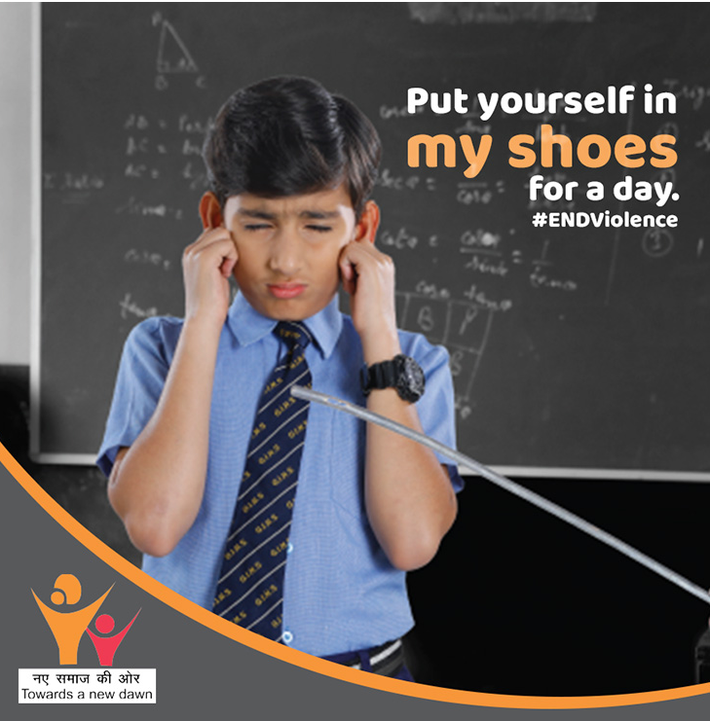
Campaign Collateral

Slide 15
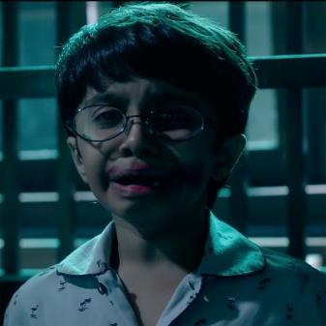
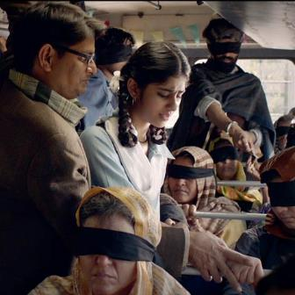
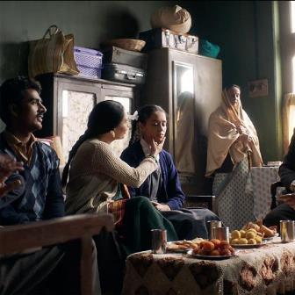
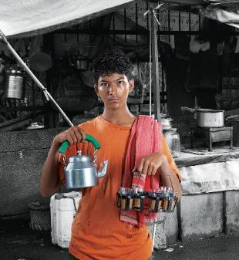
Radio Spots around gender discrimination, performance pressure, bullying and sexual harassment (Assamese, Gujarati, Hindi, Kannada, Marathi, Odiya , Tamil and Telugu)
TVCs around bullying, sexual abuse and Child marriage (Bengali, Gujarati, Hindi, Kannada, Marathi, Odiya , Tamil and Telugu)

Slide 16
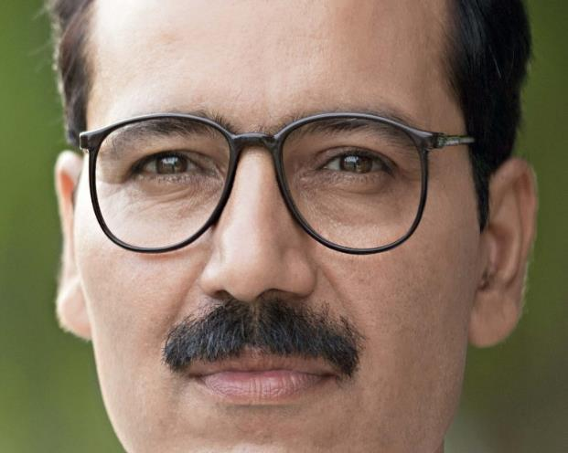




Paper Advertisements "Kab Tak Andekha Karenge" (Hindi, Bengali, Gujarati, Kannada, Marathi, Telugu, Tamil, Odiya, Bengali)

Slide 17
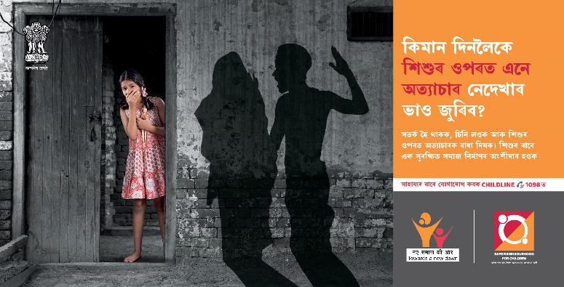
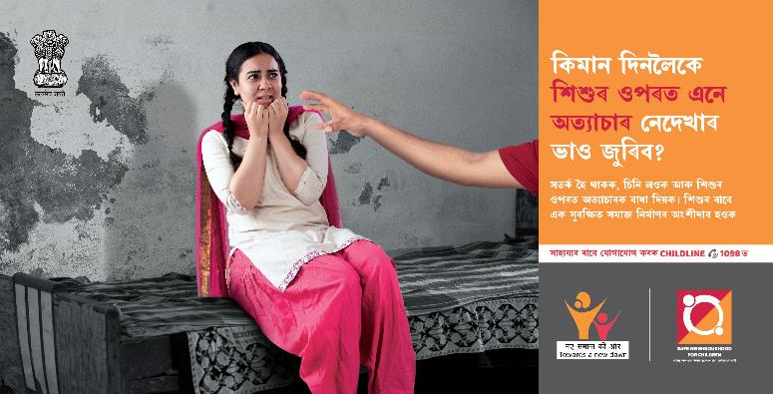
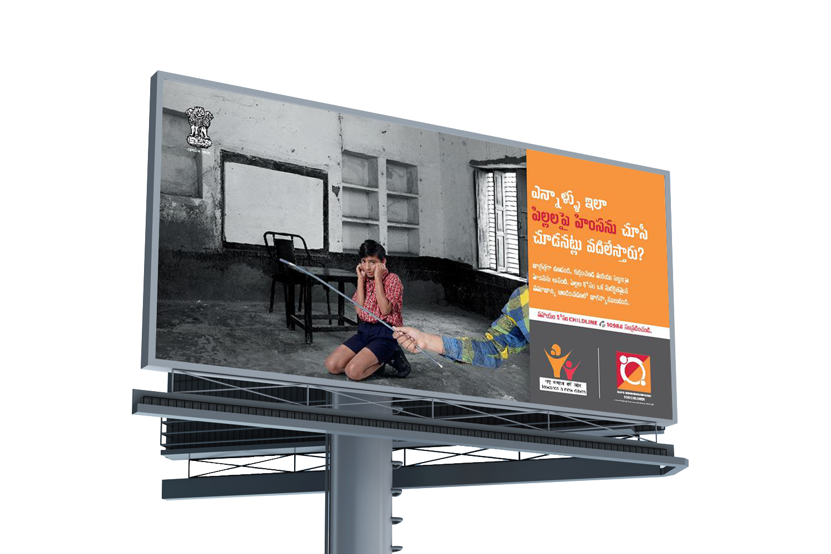

Slide 18
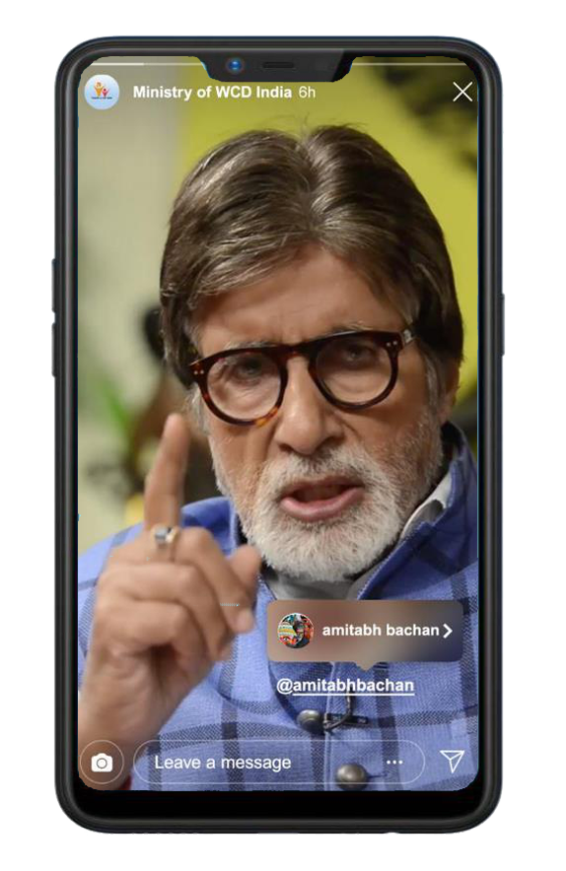
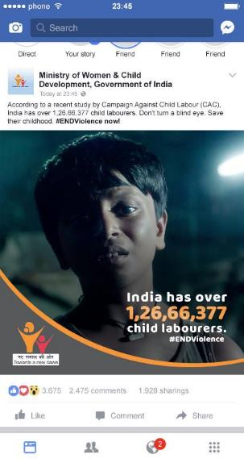
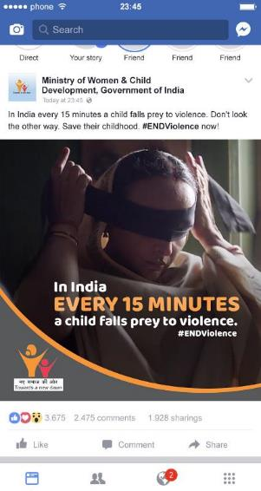
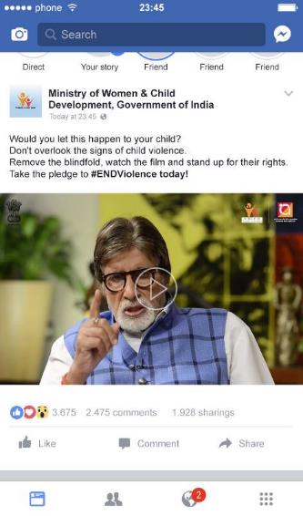

Social media posts and influencer videos (No blindfold, pledge to prevent) using #ENDViolence

Slide 19
Thank You

