Slide 1





‘Bal Vivah Evam Dahej Mukt Hamara Bihar’ Campaign
The Journey So Far…… (2017–2020)

Slide 2

Systemic efforts
to promote adolescent empowerment

Slide 3



The adolescent landscape in Bihar
Bihar has made progress in reducing child mortality and increasing children’s access to primary education but thousands are still lost in transition. Bihar has a huge adolescent population which is a tremendous asset. Adolescence is an age of opportunity with enormous potential and demographic dividend which must be unlocked.
Adolescent population
22.47% of total population (Census 2011) of which 59.5% are 10–14 years old and 40.5% are 15–19 years old. Females comprise 46% and males 54% of adolescent population.
Child marriage: Dropped to 42.5% (NFHS 2015–16) from 60% (NFHS 2005–06) among women below 18 years of age
Incidence of early marriage and childbearing
Nearly 4 in 10 women (42.5%) in the 20–24 years age group were married below 18 years (NFHS 2015–16) and 12.2% in 15–19 years age group began childbearing

Slide 4



The adolescent landscape in Bihar
Literacy
Women who are literate increased to 49.2% (NFHS 2015–16) from 37% (NFHS 2005–06)
School enrolment
School enrolment rates are high at elementary level (81.45%, UDISE, 2018–19) but plummet sharply at secondary level (12.97%, UDISE, 2018–19)
Dowry deaths
Bihar was 2nd in India after Uttar Pradesh with 1,127 dowry death cases reported in 2019 under Dowry Prohibition Act in Bihar (NCRB, 2019)

Slide 5


Concerted efforts towards girls’ empowerment
Policy
The Bihar Empowerment Policy – 2015 for women’s and girls’ empowerment aims at creation of equal opportunities in all spheres of life including health, education, nutrition, protection and representation
Legislations
Implementation of progressive legislations – Prohibition of Child Marriage Act (PCMA), 2006; Dowry Prohibition Act, 1961; Protection of Women from Domestic Violence Act (PWDVA), 2005
Bihar Prohibition of Child Marriage Rules, 2010, mandate responsibilities of Child Marriage Prohibition Officer (CMPO), Block Development Officer (BDO), Police Station or Sarpanch of the Gram Panchayat to take necessary action on receiving reports about a child marriage.

Slide 6

Concerted efforts towards girls’ empowerment
Implementation of women friendly schemes like Mukhya Mantri Kanya Uthan Yojana ensuring all-round development of girls.
Progressive measures: Zero-tolerance approach to offences, urging members of political parties to refrain from attending lavish weddings, restricting sale of alcohol
  Protection schemes Mukhyamantri Kanya Vivah Yojana, Mukhyamantri Naari Shakti Yojana, Intercaste Marriage Promotion Scheme
  Health and nutrition schemes
  Janani Suraksha Yojana (JSY), Prerna strategy on responsible parenthood, Jansankhya Sthirata Kosh, Scheme for Adolescent Girls (SAG)
Educational schemes
Mukhyamantri Balika Cycle Yojana, formation of Meena Manch in middle and high schools, Mukhyamantri Balika Poshak Yojana, Sakshar Bharat, Kasturba Gandhi Balika Vidyalayas (KGBVs), Free Book Distribution Scheme, Mukhyamantri Balika Pratibha Protsahan Yojana, Girls’ hostels at secondary level, Jagjagee Kendras for adolescents and drop-out girls, Ekal Balika Yojana, Bihar Student Credit Card Scheme

Slide 7
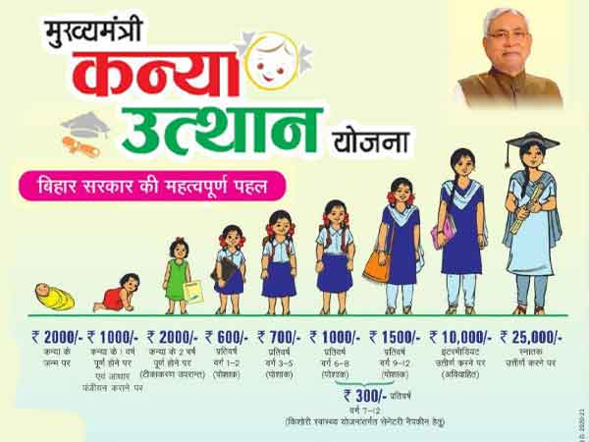
Mukhya Mantri Kanya Uthan Yojana
A scheme for all-round development of girls
The scheme provides support for development and empowerment of girls throughout the lifecycle through conditional cash transfers.

Slide 8
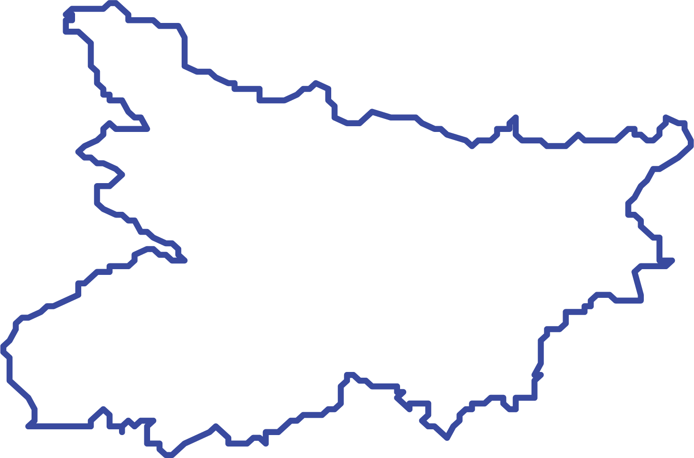
Accelerating action to end child marriage
In 2016, Government of Bihar (GoB) and UNICEF, Bihar initiated implementation of pilot models
The pilots hinged on community dialogue and mobilisation, capacity development, awareness building and policy advocacy for convergence around ending child marriage
These pilots were carefully monitored to track and follow up on cases of child marriage in the community
Building on their success, the State Action Plan and Strategy to End Child Marriage and Dowry were developed by the Women’s Development Corporation (WDC) with support from UNICEF, Breakthrough and Praxis; in line with Hon’ble Chief Minister’s 7-point agenda (Saat Nishchay)
5 districts
Gaya, Vaishali, Nawada, Samastipur and Darbhanga
17 blocks
320 Gram Panchayats

Slide 9
The multi-pronged campaign
‘Bal Vivah Evam Dahej Mukt Hamara Bihar’

Slide 10
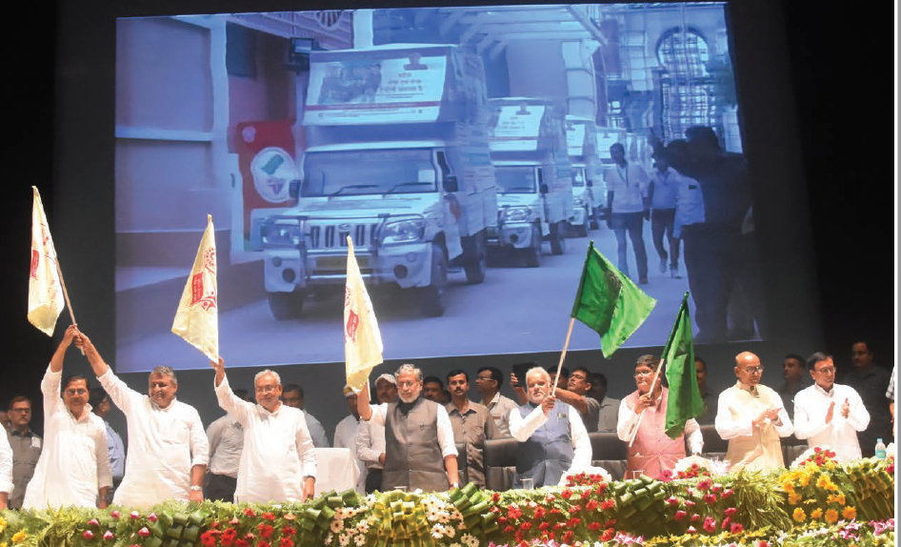
Catalysing social change through the campaign
A 3-phase state-wide multipronged campaign ‘Bal Vivah Evam Dahej Mukt Hamara Bihar’ was launched by Hon’ble Chief Minister on Oct 2, 2017 in Patna
An oath was taken by 5,000 JEEViKA and WDC workers, WSHG members and media persons during the campaign
Campaign was webcasted simultaneously across the state reaching 24.2 million people
10 multimedia vans and folk art groups to generate awareness on child marriage and dowry were flagged off

Slide 11



5 strategic campaign pillars
Strategy 1 – Leading from the front with planning, dedication and commitment
Generating the highest level of political commitment for synergy between concerned departments
Creating comprehensive SBCC and advocacy package
Roll-out of state-wide 360 degree multimedia advocacy initiative throughout the year.
Strategy 2 – Developing a costed State Action Plan (SAP)
Mapping of existing schemes and budgetary analysis to understand current situation
Operationalisation of SAP post meetings with policymakers and concerned Ministries chaired by CM
Formation of State Task Force chaired by Chief Secretary and concerned departments to implement SAP.
Strategy 3 – Capacity development of line departments
Finalising comprehensive set of Standard Operating Procedures (SOPs) along with capacity development materials
Formation of State, District, Block and Panchayat Level Resource Groups
Following a cascade approach to create a cadre of master trainers.

Slide 12



5 strategic campaign pillars
Strategy 4 – Implementing Consolidated Cash Transfer (CCT) programme
Building on Haryana cash transfer scheme GoB launched CCT for girls
Scheme showed favourable results in resource constrained settings, improved condition of girls as they met age related milestones
Driven by strong implementation structures including Panchayats, teachers and school management committees (SMC).
Strategy 5 – Implementing multimedia communication initiative
Multimedia communication package developed to create awareness and knowledge
Capacity development of key functionaries on child marriage and dowry to mobilise relevant stakeholders
Reiteration of key messages and monitoring at regular intervals.

Slide 13
Campaign activities

Slide 14




Leading from the front
Chief Secretary directed Home Department to fast track and chargesheet pending investigations for all cases of child marriage, dowry tortures and deaths
Detailed SOP on child marriage and dowry prevention, rehabilitation and rescue developed for 7 line departments
  Departments include Home, Panchayati Raj, Health, Education, Scheduled Caste and Scheduled Tribe Welfare, Rural Development and Social Welfare
  Modules to operationalise SOPs are currently being finalised
Task Forces have been constituted at the district (38), block (534), sub-divisional (101) and panchayat level (8,400)
  Tasked with prevention, rehabilitation and rescue in cases of child marriage and dowry
  Guidelines for their operations are under development
Institutionalisation of Menstrual Hygiene Management (MHM) as a gateway behaviour into the educational calendar for classes 9–12

Slide 15
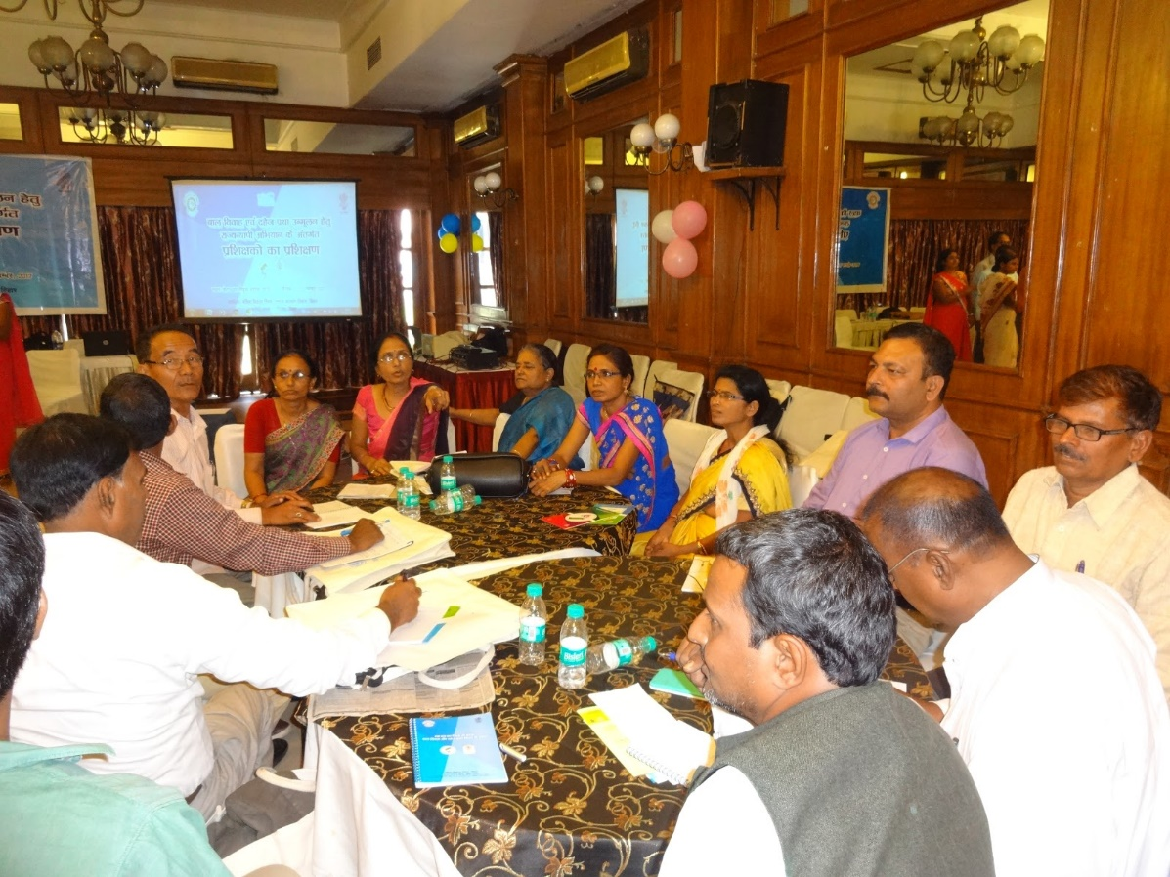
Thorough capacity building of line departments
Every department was made to understand their roles and responsibilities in ending child marriage and dowry and Task Forces were formed to lead activities at all levels
532 state level department functionaries trained in ToT round to operationalise SOPs
  District pools of 14 Master Trainers each created
38 district level, 554 block level, 101 sub-divisional level and 5,400 Panchayat-level Task Forces formed
Partnership with Bihar Mahadalit Vikas Mission (SC and ST Department, GoB)
Training of line departments

Slide 16
Thorough capacity building of line departments
District and block officials oriented
  101 Sub-Divisional Officers (SDOs), 38 District Welfare Officers (DWOs), 18 District Programme Managers (DPMs), 534 Block Development Officers (BDOs)
Police personnel trained in Dec 2019
  9 trainee IPSs, 65 Deputy Superintendents (DSPs) and 200 Sub-inspectors (SIs)
Capacity building of 5,726 Nodal Teachers across state for Menstrual Hygiene Management (MHM)
Capacity building of District Coordinators on Tarunya Communication Package
Monitoring learning evaluation workshop conducted between 21–22 Nov 2019 to strengthen MIS reporting

Slide 17
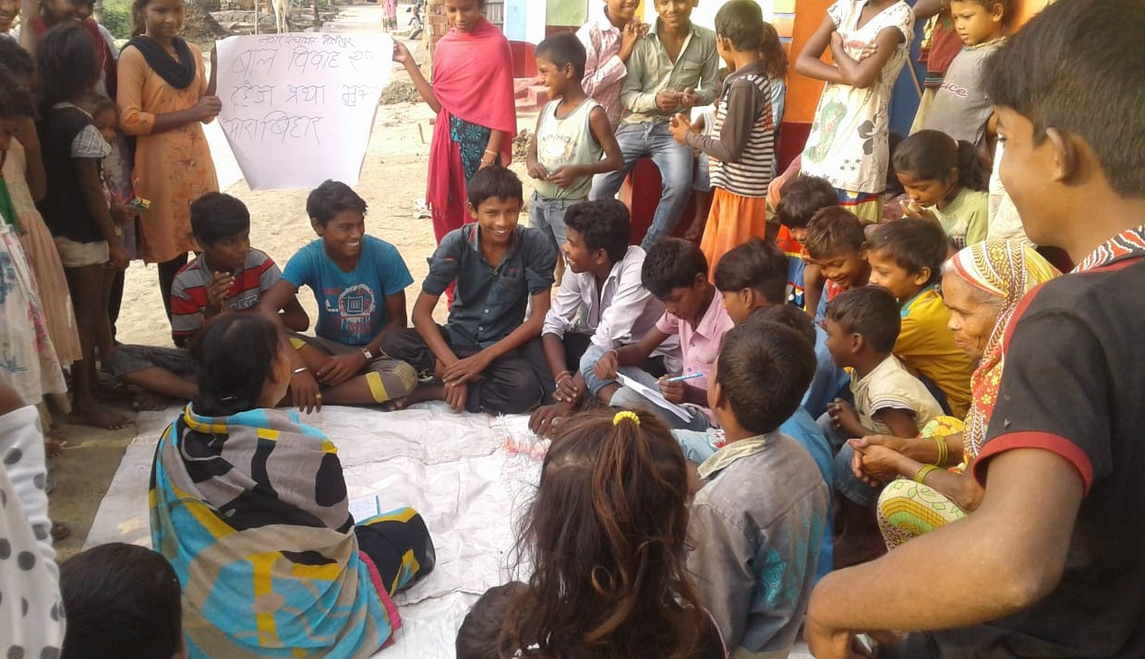
Fostering participation through adolescent platforms & ensuring commitment from key stakeholders
Adolescent groups were formed to advocate for their rights.
Community leaders, SHGs, Vikas Mitras gave their commitment to the campaign and were oriented on harmful effects of child marriage and dowry and legal provisions.
24.2 million people pledged to end child marriage and dowry on the day of the campaign launch – Panchayat representatives, students, government officials, NGO representatives, community members
Adolescent groups formed across the state
  31,778 groups formed with 3,78,507 members (target to form 37,600 groups with approx. 5,64,000 members)
  (Source: Vikas Register)
  1,600 adolescent girls reached in a conclave (Dec 2017–Jan 2018)
Adolescent group meeting

Slide 18
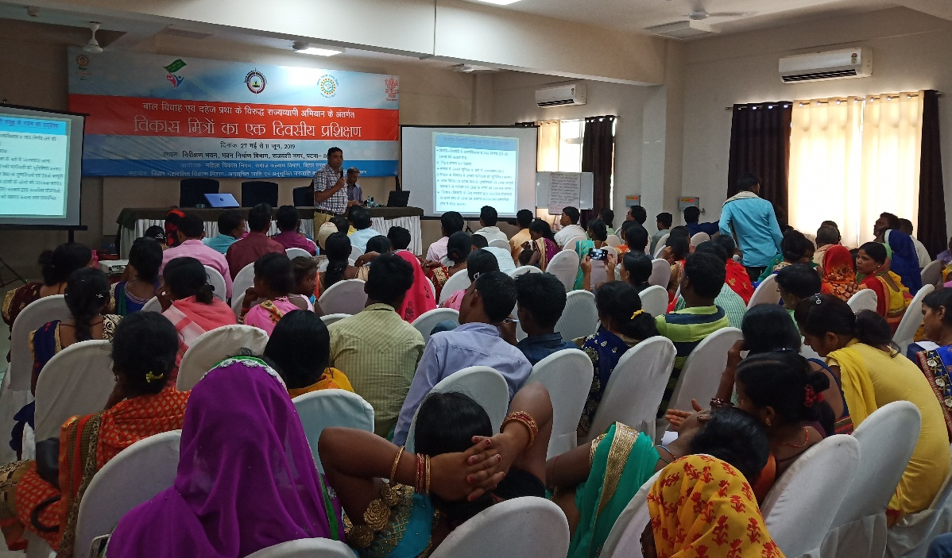
Fostering participation through adolescent platforms & ensuring commitment from key stakeholders
Pledge by faith leaders, PRI members and Sarpanches not to support child marriage
  1,500 faith leaders oriented in state conclave
  900 Mukhiyas and Sarpanchs oriented in 22 districts in Mar 2018
9,622 Vikas Mitras oriented
8,464 Gram Sabhas organised across the state reaching 40 lakh families
Training of Vikas Mitras

Slide 19
Building awareness through multi-pronged communication
Communication package disseminated through mass media, print, outdoor, mid-media and social media.
Culturally-specific messaging and media advocacy emphasised.
Advocacy
Letter issued by Chief Minister (CM) to all MPs, MLAs and PRI members to support the campaign
Intensive work in 13 High Burden Districts through 13 District Coordinators of Action Aid and 36 Block Coordinators.
Media advocacy
  380 journalists from vernacular and national media sensitised through divisional level workshops
  Hindustan Times, Telegraph, Times of India and Dainik Jagran contributing to outreach (‘Adhira’ knowledge kit on child marriage and dowry developed and disseminated by Dainik Jagran)

Slide 20
Building awareness through multi-pronged communication
Use of diverse media channels
Mid media
534 blocks reached through Mobile Vans
16,932 street plays/Nukkad Nataks reached 9,41,450 people across 8,466 Panchayats in 13 districts
Outdoor media
1,068 hoardings at block level, 185 hoardings at district level and 25 hoardings in Patna
54,000 tin plates
8,46,600 wall writings with slogans on child marriage
10,200 posters with 5 different messages per district

Slide 21


Building awareness through multi-pronged communication
Print media
32,000 brochures and leaflets distributed
Mass media
3 radio channels and 3 TV channels telecast spots and films

Slide 22

Building awareness through multi-pronged communication – Leveraging community based events
Diwali – Programmes organised in 5 Mahadalit hamlets in every district
Chhat Puja – Hoardings displayed in prominent places; 8 LCD screens installed at 6 chhat ghats and videos and songs were played
Children’s Day – Cycle rallies and pedestrian rallies with participation from 90,000 adolescents and outreach to 38,000 Mahadalit families
Independence Day – Flag hoisting and debate competitions with outreach to 2,67,000 people in 1,068 Mahadalit hamlets
Teacher’s Day – Painting competitions with outreach to 5,34,000 students in 2,136 hamlets
Festivals and other events for outreach

Slide 23
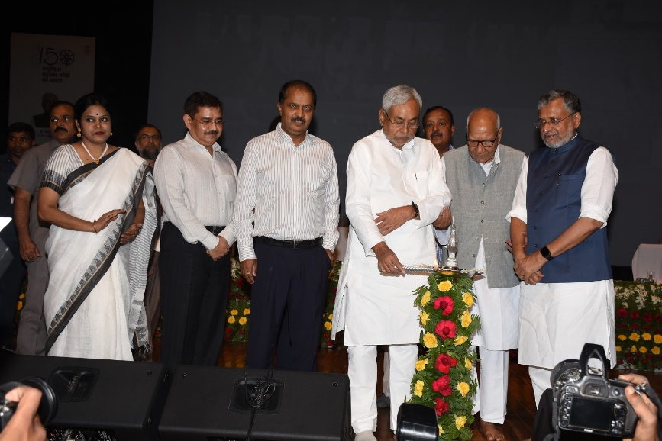
Building awareness through multi-pronged communication – Leveraging community based events
On 2 Oct 2018, anniversary of campaign launch was celebrated. Around 1 crore people resolved to end child marriage & dowry
Sandhya Chaupals organised by SDOs with outreach to 5,340 Mahadalit hamlets In 10 Panchayats of every block in Aug 2018
Anniversary of campaign, 2 Oct 2018

Slide 24
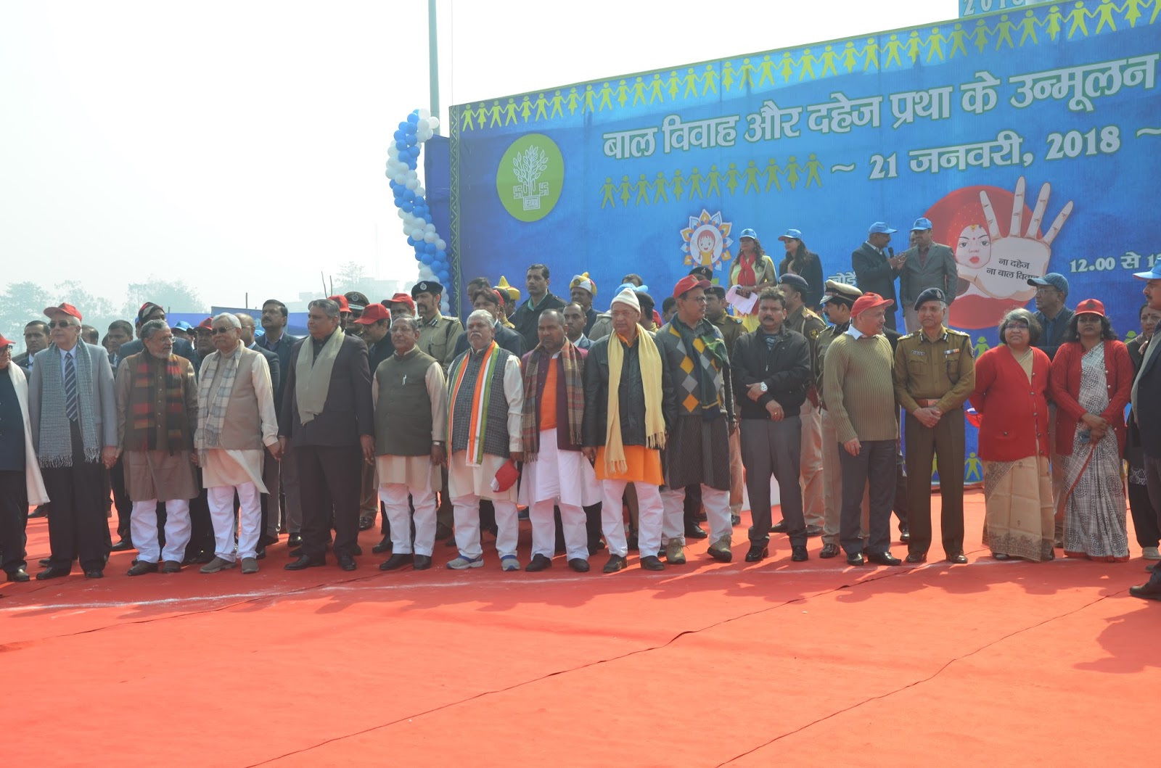
Building awareness through multi-pronged communication – Leveraging community based events
  Human chains
  On 21 Jan 2018, 14,006 km. long human chain formed with participation from 3.27 crore people (radio jingles and video spots were broadcast, banners, paper jackets and caps sent to all districts and hoardings and wall writings displayed)
  On 19 Jan 2020, over 5.16 crore people participated in 18,034 km. long human chain in support of Jal Jeevan Hariyali, Prohibition of Child Marriage & Dowry and the Liquor Ban.
Human chain, 21 Jan 2018

Slide 25
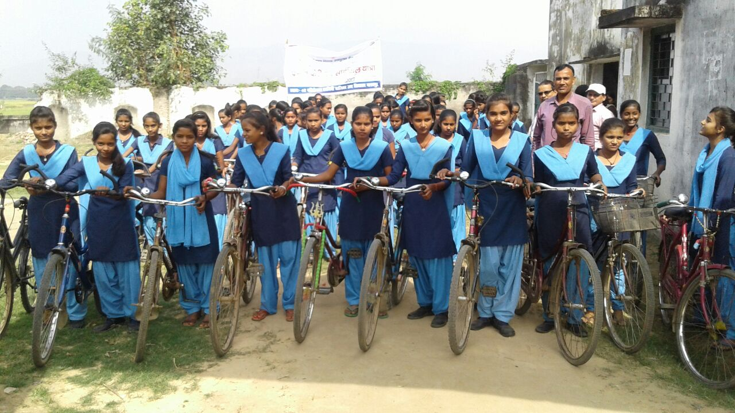
Building awareness through multi-pronged communication – Leveraging community based events
In Jan 2019, 9,898 adolescents participated in races, painting and debate competitions in schools
Cycle rally

Slide 26
Adolescents’ Summit on Safe & Violence-free Bihar
Organised in Patna on 19 and 20 Nov 2019 to mark 30th anniversary of United Nations Convention on the Rights of the Child
600 adolescent delegates (girls and boys) participated from across 11 high burden districts (Gaya, Nawada, Sheikhpura, Jamui, Supaul, Madhepura, Sitamarhi, Sheohar, Khagaria, Begusarai, Samastipur)
  Prior to the State summit, 11 district summits were organised by WDC with Pravah/CYC between 13 and 16 Nov 2019.
Summit aimed at bringing to the fore adolescents’ vision and views on creating a safe and violence-free environment in the four spaces where they spend most of their time – homes, schools, public spaces and communities
On 20 Nov 2019, children presented their Charter of Demands before the Deputy CM and ministers from SC and ST Welfare Department, Department of Social Welfare

Slide 27

Children’s Charter of Demands
School as a safe space
There should be a suggestion box in our school where we can put in our complaints and suggestions without hesitation. The box should be opened once a month by a government official and our grievances addressed
There should be a counsellor appointed in the school whom we, the students, can access to express our concerns and receive support to address our challenges
Our school space should support us to become our rights, laws and policies for children that we can use for our protection. Information about this can be written on the school walls which can be seen by our parents, teachers, and friends
There should be weekly patrolling by the local police en route to school and back home for us to feel safe and confident while we continue our education
Important information on available schemes and benefits for children should be communicated in a quick and easy way using different media including WhatsApp, which can be shared with more children’s groups, teachers and parents.

Slide 28

Children’s Charter of Demands
Family as a safe space
To help our parents create a safe space for us at home by treating sons and daughters equally, listening to our needs, giving us the freedom to experiment, learn from our experiences and build our aspirations
Parents should be made aware and counselled to increase their understanding and actions on issues like child marriage, child labour and other forms of violence on children. They should be supported to take action on issues happening in their own homes and other children in their community
Focus on strengthening parent-child relationship by creating platforms in schools that can be a space for celebration, sharing of positive change stories and creating a strong parent group that can support each other. An example of such a day is the bi-annual Parents’ Day hosted by schools
Including our fathers and other elderly family figures in the dialogue through community meetings. Creating platforms where fathers can access a space to share their own concerns and be developed as advocates to prevent violence against children

Slide 29

Children’s Charter of Demands
Community as a safe space
To control eve-teasing in the community and to feel safe, there need to be street lights and CCTV cameras on roads used by us, boys and girls on transit to coaching classes and markets
Construct functional and well-lit toilets within every 2 kms to ensure mobility and safety of girls in the community’
There is a need for one point of contact at the community level (preferably a didi like ASHA/ANM) for us girls to be able to apprise about violence that we are unable to share at home
To ensure that there is a Soochna Adhikari to be appointed at the village level to share details regarding schemes, benefits and their provision
To fight social evils like child marriage
Marriage registration process should include Aadhar information to validate age of marriage
Guest, government officials, duty bearers (Panchayat Pradhan or ward member) to be fined if child marriage takes place in their village/ward
SHG members, school teachers and Panchayat members to organise campaigns at village level on various provisions and punitive measures in case of breach of law.

Slide 30
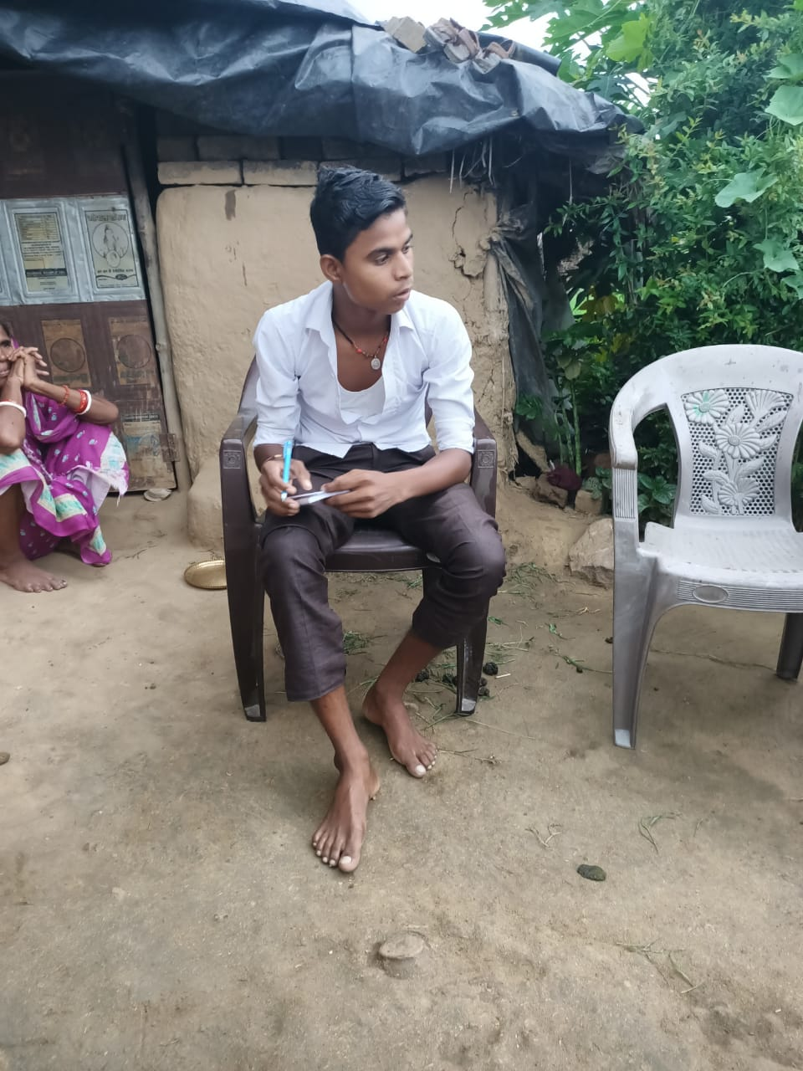
Stories of resilience
Kajal, Katihar district
Kajal is an intelligent girl from a very poor household. Her father is a washerman and her mother is a domestic help. Her elder sister was married at the age of fifteen and soon gave birth to a malnourished baby boy. Her younger sister and two brothers are studying in the village primary school. Kajal wants to become a teacher.
14-year-old Santosh Kumar
Bajnathpur tola, Sirdala block, Nawada district
Santosh hails from a hardworking family of masons and has six brothers. His distant relative had suggested a prospective match for him. But fortunately, through the street plays, TV and radio spots, he had learnt about the ill effects of
Because of the street play, she understands the harmful effects of child marriage and has seen this firsthand with her elder sister‘s experience. In July 2018, she overheard her parents talking about getting her married to a boy from Ramganj in West Bengal through a neighbour’s recommendation.
Kajal immediately called 1098 using her classmate’s mobile phone and filed a complaint. 1098 transferred the call to the District Women's Helpline. Through them, the BDO and local police officials convinced her parents about the ill effects of child marriage and about its legal implications. They agreed to stop the marriage and today, Kajal happily continues with her studies.
early marriage. He told his family that he did not want to get married so early but did not agree. Finally Santosh went to the village Mukhiya who was advocating against child marriage to intervene. Along with the SDO, the Mukhiya persuaded Santosh’s father to reconsider. His parents finally agreed and pledged not to get Santosh or his brothers married before the legal age. Santosh is thrilled to be continuing his studies. He wants to do social work, especially around elimination of child marriage and dowry.

Slide 31


Impact of campaign
Prioritisation of ending child marriage interventions and adolescent empowerment in state policies and programmes along with fund allocation
Greater convergence of line departments on addressing issues of child marriage and dowry
Increased awareness and participation of adolescents and community members in ending child marriage
1,122 child marriages have been stopped from the campaign launch till Feb 2019

Slide 32
What next?

Slide 33

Way forward
Redesigning and re-strategising ECM SBCC Strategy for post-pandemic implementation
MHM state action plan
Skills enhancement for Adolescent Life Skills
Dissemination of Tarunya Package

Slide 34
Thank You

