Slide 1

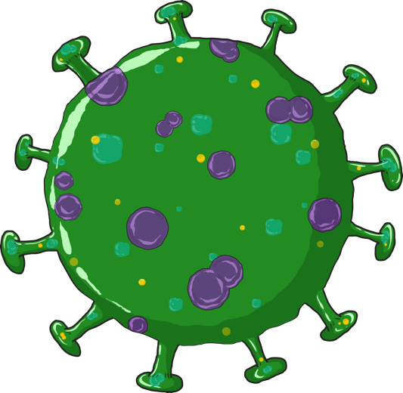

COVID-19
Response and Containment Measures
TRAINING OF COVID WARRIORS
This guide for utilisation of members from; The Ministry of Youth Affairs & Sports, National Cadet Corps, The Indian Red Cross Society & The Ministry of AYUSH.

Slide 2


SESSION 1
Communication for Response and Containment Measures
01

Slide 3
SESSION OBJECTIVES
Participants will be able to recall role of the COVID Warriors on COVID-19
Participants will be able to explain what is COVID-19 and who should test
01

Slide 4



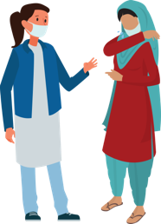
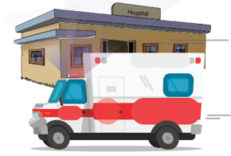
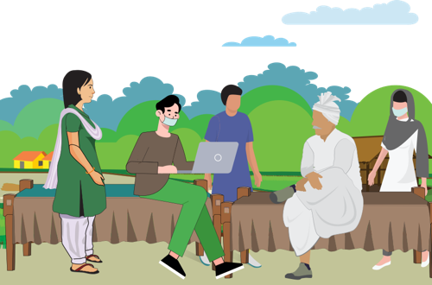
WHAT ARE WE GOING TO LEARN?
ROLE OF THE COVID Warriors
This session talks about the role that COVID Warriors plays and what s/he needs to understand about COVID-19
COVID-19
COMMUNITY SURVEILLANCE
Session discusses the contact tracing protocol, how to identify the contact, what are the guidelines for supporting people who are suspected, symptomatic or asymptomatic cases
1
3
INFORMATION TO THE COMMUNITY
This section talks about the information and knowledge that the COVID Warriors will give to the community on Hand washing, Cough hygiene, Social distancing and HRG
2
02
Notes:
1. What role will he/she play in helping to deal with COVID-19. 2. What is the information that community needs to keep themselves safe and how does the COVID Warriors give this information to the community. 3. What is community surveillance and how to conduct community surveillance, who is a person who shows the signs and symptoms and who is one who is infected but does not show the signs of infection. 4. What is Stigma and why is there stigma and how to help 5. How to help people during home quarantine, what care should family members take. 6. Personal safety of COVID Warriors

Slide 5
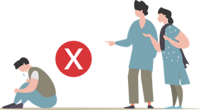
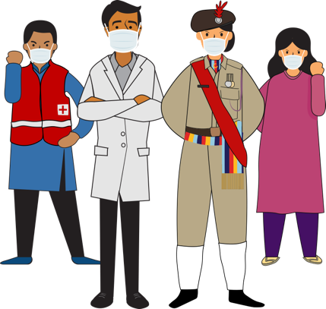

WHAT ARE WE GOING TO LEARN?
STIGMA & DISCRMINATION
This session deals with the myths and misconceptions around Coronavirus and many fears that result in stigmatising behaviours at various level. What is the role of the
COVID Warrior and
what can s/he do
COVID-19
4
6
Personal Safety
COVID Warriors will work to
reach out the message to
thousands of directly or indirectly
affected community members.
However they also need to take
care of their own personal safety
5
supportive public health services: community & HH
What is the role that community networks play in addressing COVID in the community, what are the services required: home care , home quarantine in urban and rural areas
02
Notes:
1. What role will he/she play in helping to deal with COVID-19. 2. What is the information that community needs to keep themselves safe and how does the COVID Warrior give this information to the community. 3. What is community surveillance and how to conduct community surveillance, who is a person who shows the signs and symptoms and who is one who is infected but does not show the signs of infection. 4. What is Stigma and why is there stigma and how to help 5. How to help people during home quarantine, what care should family members take. 6. Personal safety of COVID Warriors.

Slide 6
Role of NSS Volunteers
National NSS Volunteers
As per job outlined by the District Collector/ Municipal Commissioner/Civil Surgeon
Reporting Chain
Support Health Supervisor in house to house surveillance including
    Identification of HRG and probable cases
    Psychosocial care and; stigma and discrimination.
Community awareness through inter-personal communication
    Uptake of preventive and control measures including social distancing, home care and home quarantine
    Addressing myths and misconceptions;
Personal Safety and Precautions
03

Slide 7
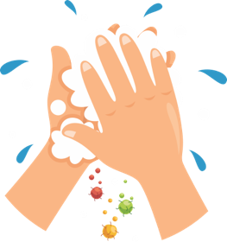

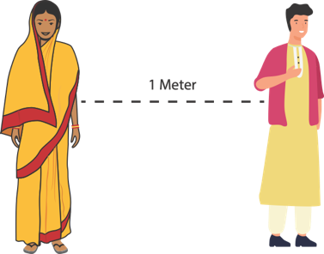

SESSION 2
PREVENTION: SAFE PRACTICES IN THE COMMUNITY
HAND
HYGIENE
RESPIRATORY
HYGIENE
SOCIAL
DISTANCING
HIGH RISK
GROUP
05

Slide 8
Learning outcome
Participants will be able to explain prevention practices in the community and households
Participants will be able to give a checklist of preventive actions to be taken at home and in public places to avoid spread of COVID-19.
05

Slide 9
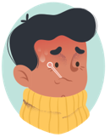
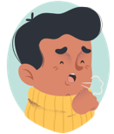
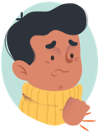
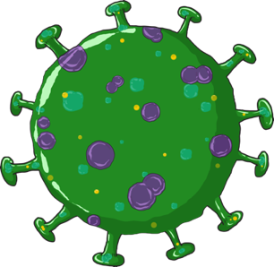
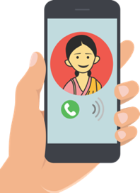
LET US UNDERSTAND ABOUT COVID-19
WHAT ARE THE
COMMON SYMPTOMS
OF COVID-19
COVID-19 is
Coronavirus Disease-2019
The symptoms of covid-19
Are fever, cough, and
Difficulty in breathing
If you have these and
you are a contact of A Laboratory confirmed positive case immediately Call the state helpline number or ministry of Health & family
welfare, government of India 24x7 helpline
011-2397 8046, 1075 Or your ASHA/ANM.
It is caused by a
Coronavirus
named as SARS-CoV-2
06
Notes:
The name of the disease is COVID-19. THIS IS CORONA VIRUS DISEASE – discovered in 2019. The name of the organism that causes the disease is SARS-CoV-2. This stands for Severe (because it is serious) Acute Respiratory Syndrome- Coronavirus (the name of the family of viruses) 2. Coronaviruses cause several similar diseases including SARS, HINI (Swine flu) and the common cold and Influenza.
Symptoms of COVID-19 are fever, cough and difficulty in breathing
If a person sees these symptoms, the person must immediately contact the government helpline numbers given in this slide.
If you know that the person with whom you have been in contact has been identified as positive for COVID-19, then the person must contact on the helpline numbers immediately.

Slide 10
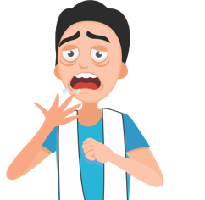



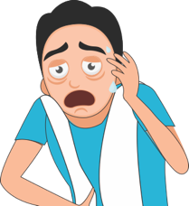


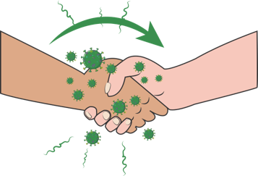

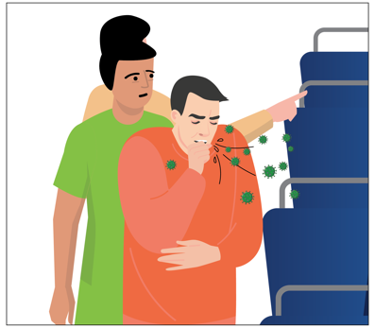
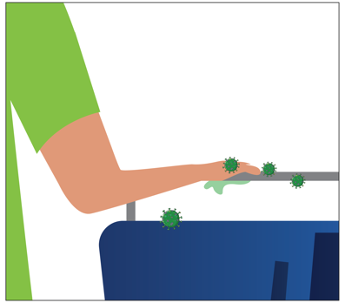
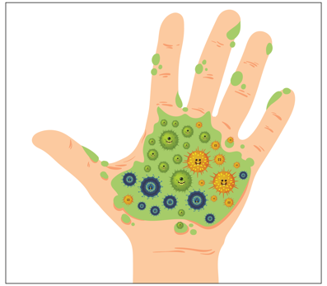
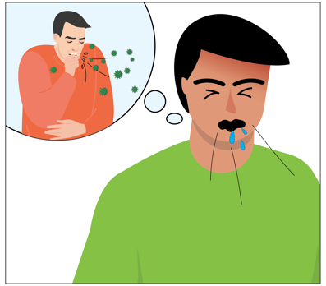
MODES OF TRANSMISSION
SNEEZE/ COUGH
BY INFECTED PERSON
INFECTED DROPLETS
INFECTED DROPLETS
GET ON YOUR HAND
AND WHEN TOUCH
ANY SURFACE OR PERSON
VIRUS
TRANSFERRED!!
SNEEZE/ COUGH
BY INFECTED PERSON
INFECTED DROPLETS
INFECTED DROPLETS
GET ON YOUR HAND
VIRUS
TRANSFERRED!!
07
Notes:
How do you get infected ?
The virus travels through the respiratory droplets of an infected person. When the person sneezes or coughs, the virus is deposited on the person’s hand if the hand covers the mouth, or droplets fall on a surface when the mouth/nose is not covered.
From the surface/hand, the virus will get transferred to an uninfected person’s hand and when that hand coms in touch with the nostril, eyes or mouth the virus gets inside the system.
We do not have the knowledge of how long this virus lives once it is out of the body. But keeping hands clean and not touching them to the face is the most important way of preventing this infection . We are going to learn about this.

Slide 11
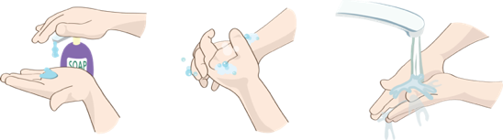
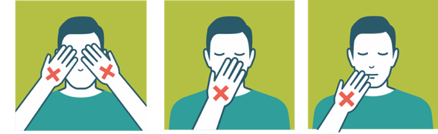
HAND HYGIENE
PREVENTION - WHAT TO DO?
Hand hygiene is a way of cleaning one's hands that substantially reduces potential pathogens (harmful germs) on the hands.
Hand hygiene procedures include hand washing with soap and water for at least 20 secs or use of 70% alcohol-based hand rubs
Wash your hands often with soap and water for 20 seconds especially after you have been in a public place, or after blowing your nose, coughing, or sneezing.
Use a hand sanitiser (at least 70% alcohol based) if soap and water not available cover all surfaces of your hands and rub them together until they feel dry.
DO
DO
NOT
Touch your eyes, nose, and mouth with unwashed hands.
Touch surfaces like door knobs and door bells, elevator buttons, handrails, support handles, chair backs, atm surfaces, mobiles, jeep handles etc
08
Notes:
We spoke about transmission in the earlier slide. Let us now look at how we can prevent this transmission.
Washing of hands with soap and water will kill the virus. Similarly sanitizing with 70% alcohol based sanitizer. We need to wash with soap for a particular time which is 20 secs. It takes that much time for the cell wall to be rubbed off. Similarly with Alcohol. If you do not rub your hand, the virus coat does not fall off and no harm comes to the virus
As we spoke earlier the infected droplets can get transferred via shaking hands with an infected person who may have the bacteria on his hands to an uninfected person or through touching of surfaces which may have the bacteria. That is why we need to have these hand hygiene practices.

Slide 12
PREVENTION: RESPIRATORY HYGIENE
Respiratory Hygiene is a combination of measures taken to stop the spread of germs through respiratory behaviours like coughing or sneezing
DO
DO NOT
DO USE a handkerchief or a tissue to cover your face while coughing or sneezing
DO THROW the used tissue immediately into a closed dustbin
DO COVER your sneeze into your bent upper arm in case you are not carrying a tissue or a kerchief.
DO WASH hands immediately after you have covered your sneeze or cough
DO NOT use other ways of covering your face like the pallu of the sari of the chunni or the gamcha
DO NOT spit in the open, always use a spittoon or wash basin for spitting
09
Notes:
And because we do not want the infected droplets to go out into the air and infect more people, we have to maintain what is called as respiratory hygiene at all times .
Never use the saree pallu or gamcha for sneezing into as you may use these for wiping your hands and the germs will get transferred from your hand to your nose, mouth or eyes.

Slide 13
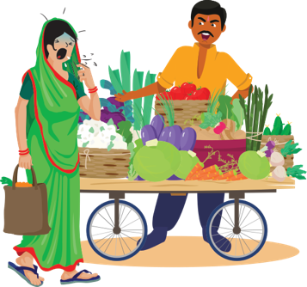
CASE STUDY
ANSWERS
Smita has gone out to buy vegetables. She has a sore throat and is often coughing without covering her face. You are in the shop when she comes and suddenly she has a fit of cough. Everyone instantly moves away from her and the shopkeeper says angrily “Don’t come into my shop if you are coughing.”
It is good for people to move away and keep a distance.
As a fellow customer give a polite advice to follow correct respiratory hygiene.
It is wrong for the shopkeeper to have shouted at Smita. Though everyone is scared, being rude is not helpful.
As an AYUSH Student my job will be:
Counsel Smita that she must cover her face with a handkerchief when coughing. Suggest her to get medication at the PHC
Counsel the shopkeeper that anyone can have a cough and it need not be COVID-19 infection.
Shopkeeper can also counsel people on respiratory hygiene
Question 1: if you were there as a customer; what would you have done?
Question 2: if you were the shopkeeper, what would
you have done?
Question 3: As an COVID Warrior what would be your Advise / counsel?
10

Slide 14
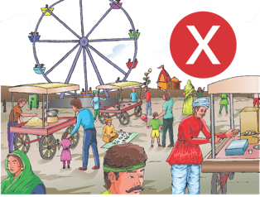
PREVENTION: SOCIAL DISTANCING
SOCIAL DISTANCING : deliberately increasing the physical space between people to avoid spreading illness. Staying at least ONE meter away from other people lessens your chances of catching COVID-19.
Stay at home unless absolutely necessary
Keep a distance of at least one meter between yourself and another person
DO
DO
NOT
Do not hold events where people have to gather (even if it is a corner meeting with three or four friends, or an evening chat on the chaupal)
Do not go to crowded places like markets, shopping, melas, parties.
Do not use public transport.
11
Notes:
Social Distancing is keeping a distance between you and other people so that you do not come in contact with their infected droplets in case they are carrying an infection. This does not mean that every person you come across is infected. But it is necessary being careful.
Social distancing also means that you avoid crowded, you do not organize events where people have to get together. All these are ways by which a virus can travel from one person to another. Be aware that the virus cannot live for long when it is out of the human body. It will require to find a human body to grow and survive. If it does not, it will die. When people have been around, used places, touched things, the virus can get transmitted from one person to another. That is why it is necessary to decrease human to human contact in this period.

Slide 15
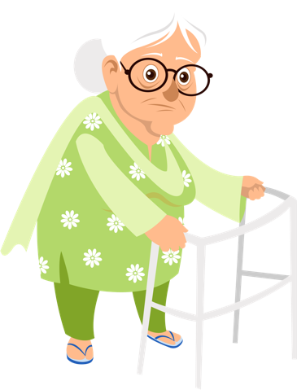

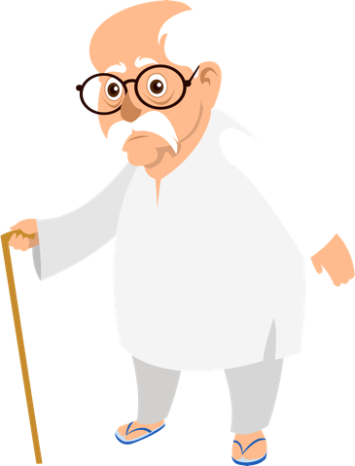
PREVENTION: HIGH RISK GROUP
High Risk Groups are people who are at A higher risk from severe illness if they get COVID-19. This includes:
people who have underlying medical conditions like:
  Heart disease
  Diabetes
  Lung disease
  Kidney disease
  On cancer medication
PREGNANT WOMEN
(AS WE DO NOT KNOW THE IMPACT OF THE DISEASE ON PREGNANCY AS OF YET, IT IS BETTER TO TAKE CARE)
older adults
12
Notes:
Though the infection can happen to anyone, the infection becomes severe when it happens in old people or people who already have an illness. This is because the immune systems of such people is weak and cannot defend the body when it is attacked by disease causing organisms. Now you will understand the importance of immunizations which prepare our bodies for attacks from viruses and bacteria.

Slide 16
POLL QUESTION

Slide 17

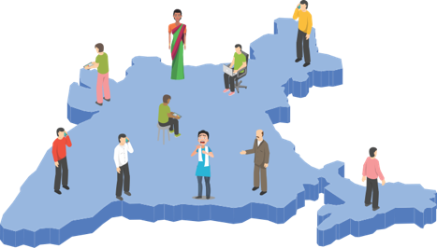
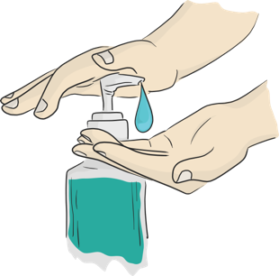

SESSION 3
COMMUNITY SURVEILLANCE
TYPES OF
CONTACTS
COMMUNITY SURVEILLANCE SoP
ADVISORY
COMMUNICATION
13

Slide 18
LEARNING OUTCOME
Participants will be able to explain who is a Suspect and who is a Contact
Participants will be able to list the types of contacts and their risk levels
Participants will be clear on giving information on services that are provided for symptomatic and asymptomatic cases
13

Slide 19
DEFINITIONS – Suspect/Probable infected person
A person with acute respiratory illness (fever and at least one sign/symptom of respiratory disease (eg. Cough, shortness of breath) AND
A history of travel to or residence in a country/area or territory reporting local transmission of COVID-19 disease during the 14 days prior to symptom onset OR
A person with any acute respiratory illness AND having being in contact with a confirmed COVID-19 case in the last 14 days prior to onset of symptoms OR
A person with severe acute respiratory infection {fever and at least one sign/symptom of respiratory disease (eg., Cough, shortness of breath)} AND requiring hospitalisation AND with no other etiology that fully explains the clinical presentation OR
A case for whom testing for COVID-19 is inconclusive.
DEFINITIONS - who is a contact
A contact is a person who is involved in any of the following:
providing direct care without proper personal protective equipment (PPE) for COVID-19 patients
staying in the same close environment of a COVID-19 patient (including workplace, classroom, household, gatherings).
traveling together in close proximity (less than 1 m) with a symptomatic person who later tested positive for COVID-19.
14
Notes:
In this slide we have two simple definitions, though they may look very complicated here. It tells you who is a suspect? 1.
Let us remember that the suspect needs to have any one of the 5 things:
Any kind of fever, cough or a difficulty in breathing.
If the person has traveled from any place or area which has been an outbreak area for COVID in the last 14 days
If the person has been in close contact of another person who is positive for COVID
A person who has tested but has not got the results
A person who may not have the symptoms but the lab reports come as positive.
Now a Contact is:
Someone who is providing direct care to a person who is confirmed to be positive for COVID
Someone who has stayed together with a person who has been tested as positive for COVID
Someone who has travelled together for more than 6 hours in close space with a person who later becomes positive for COVID

Slide 20
TYPES OF CONTACTS
High Risk
Touched body fluids of the patient (Respiratory tract secretions, blood, vomit, saliva, urine, feaces)
Had direct physical contact with the body of the patient, shook hands, hugged or took care of.
Touched or cleaned the linen, clothes, or dishes of the patient.
Lived in the same household as the patient.
Anyone in close proximity (less than one meter) of the confirmed case without precautions.
Passenger traveling in close proximity (less than one meter) for more than 6 hours with a symptomatic person who later tested positive for COVID-19.
Low risk
Shared the same space (same class for school/worked in same room/similar and not having a high risk exposure to confirmed or suspect case of COVID-19).
Travelled in same environment (bus/train/flight/any mode of transit) but not having a high-risk exposure.
15
Notes:
The types of contacts can then be further divided into contact who are at a high risk and those who are at low risk
The high risk are those who have directly been in touch with the patient or any body fluids or the patient while taking care during home quarantine, traveled with a patient, been in the same room/house and shared utensils, etc with the patient.
A low risk contact is someone who would have been in the same place but well outside the range of one meter, may have travelled in the same bus or train or flight but three seat difference with the person who tested positive.

Slide 21
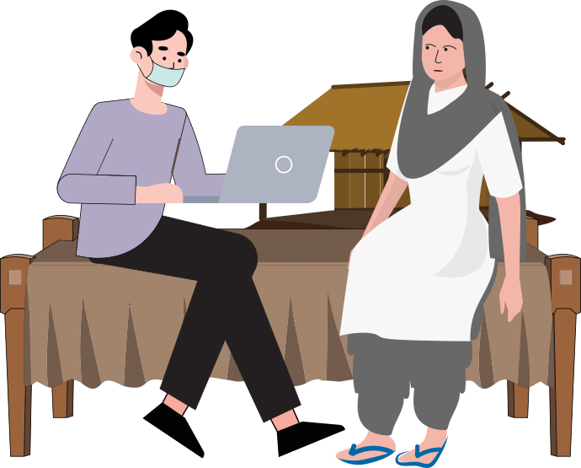
COMMUNITY BASED SURVEILLANCE
ARI Surveillance in the cluster Containment zone:
The containment zone will be divided into sectors with 50 houses each (30 houses in difficult areas).
Supervisory officers (Medical officers/lhv) in the containment zone in a ratio of 1:4
The District Collector/District Magistrate will be Nodal person for cluster containment in their respective districts.
Daily house to house visit by COVID Warriors in the earmarked sector.
Search clinically suspect cases:
        Ask for developing any symptoms (like fever, cough, shortness of breath, difficulty in breathing etc.) in the last 14 days
        Ask for any contact with COVID-19 confirmed case
        Ask for travel to any COVID affected country or within country in the last 14 days
16
Notes:
This slide tells you the simple process for surveillance. You will be given the Surveillance form by your immediate supervisor and the areas where you need to conduct the surveillance. Using this format you must visit the households, introduce your self and the purpose of your visit and then ask the questions from the format.
While completing the format, you must take care of the following:
Communication: Always introduce your self and the purpose, be ready to answer the questions they may have
Preparation: Carry your own pens, pads, books. Also carry sanitizers and masks. Always wear your mask when you are doing surveillance. Do not take the mask off and let it hang from your neck and then put it back again. Do not touch the mask several times
Who should we collect information about? People who have been identified as contacts. We must monitor them for fever, cough, breathing difficulty for at least 28 days.
We have to give the contacts information about home quarantine and what care should be taken during home quarantine
We must also take details of contacts of contacts (people who the person has interacted with in the last 28 days).
Write out all your information clearly on the format. Do not leave the work to later as you will need addresses, names and telephone numbers in order to trace contacts when needed.
Make sure that you maintain a distance of one meter between yourself and the person you are interviewing.
Do not sit in crowed rooms. If possible sit in the open.
Make sure you sanitize your hands every time by washing with soap and water for 20 secs or using a 70% alcohol based sanitizer.

Slide 22
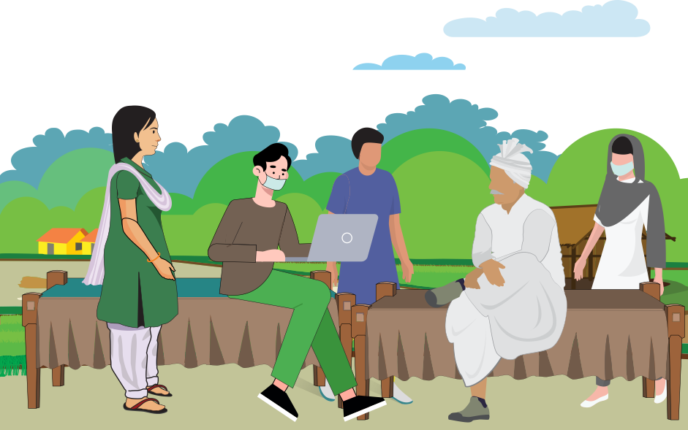
COMMUNITY BASED SURVEILLANCE
ARI Surveillance in the cluster Containment zone:
Maintain line list of suspect/ confirmed cases and contacts
Inform Supervisory Medical Officer about suspect cases and contacts
After confirming symptoms, immediately call for the ambulance and ensure transfer of the patient to identified hospital after ensuring on the basic precautions
Create awareness among community about disease prevention, home quarantine, common signs and symptoms and need for reporting suspect cases by distributing fliers, pamphlets and also by inter-personal communication.
16
Notes:
This slide tells you the simple process for surveillance. You will be given the Surveillance form by your immediate supervisor and the areas where you need to conduct the surveillance. Using this format you must visit the households, introduce your self and the purpose of your visit and then ask the questions from the format.
While completing the format, you must take care of the following:
Communication: Always introduce your self and the purpose, be ready to answer the questions they may have
Preparation: Carry your own pens, pads, books. Also carry sanitizers and masks. Always wear your mask when you are doing surveillance. Do not take the mask off and let it hang from your neck and then put it back again. Do not touch the mask several times
Who should we collect information about? People who have been identified as contacts. We must monitor them for fever, cough, breathing difficulty for at least 28 days.
We have to give the contacts information about home quarantine and what care should be taken during home quarantine
We must also take details of contacts of contacts (people who the person has interacted with in the last 28 days).
Write out all your information clearly on the format. Do not leave the work to later as you will need addresses, names and telephone numbers in order to trace contacts when needed.
Make sure that you maintain a distance of one meter between yourself and the person you are interviewing.
Do not sit in crowed rooms. If possible sit in the open.
Make sure you sanitize your hands every time by washing with soap and water for 20 secs or using a 70% alcohol based sanitizer.

Slide 23
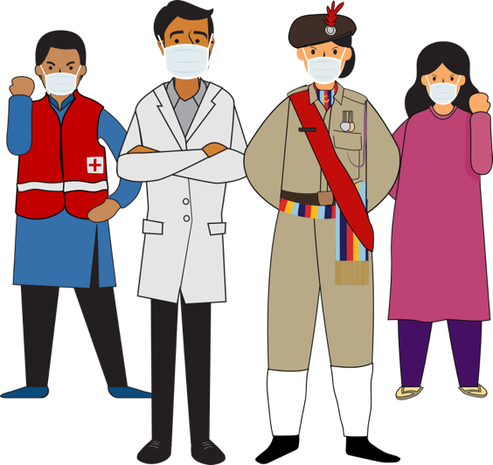
COMMUNITY BASED SURVEILLANCE
Contact tracing
SURVEILLANCE done by visiting the local residence of the contact(s) by Health Personnel Telephone may be used in certain circumstances or for follow-up.
Introduce yourself, explain purpose of SURVEILLANCE, collect data in prescribed format.
Contacts of confirmed cases traced and monitored daily for at least 28 days after the last exposure to the case patient for evidence of COVID-19 symptoms as per case definition.
Information about contacts can be obtained from: Patient, his/her family members, persons at patient’s workplace or school associates, or others with knowledge about the patient’s recent activities and travels.
16
Notes:
This slide tells you the simple process for surveillance. You will be given the Surveillance form by your immediate supervisor and the areas where you need to conduct the surveillance. Using this format you must visit the households, introduce your self and the purpose of your visit and then ask the questions from the format.
While completing the format, you must take care of the following:
Communication: Always introduce your self and the purpose, be ready to answer the questions they may have
Preparation: Carry your own pens, pads, books. Also carry sanitizers and masks. Always wear your mask when you are doing surveillance. Do not take the mask off and let it hang from your neck and then put it back again. Do not touch the mask several times
Who should we collect information about? People who have been identified as contacts. We must monitor them for fever, cough, breathing difficulty for at least 28 days.
We have to give the contacts information about home quarantine and what care should be taken during home quarantine
We must also take details of contacts of contacts (people who the person has interacted with in the last 28 days).
Write out all your information clearly on the format. Do not leave the work to later as you will need addresses, names and telephone numbers in order to trace contacts when needed.
Make sure that you maintain a distance of one meter between yourself and the person you are interviewing.
Do not sit in crowed rooms. If possible sit in the open.
Make sure you sanitize your hands every time by washing with soap and water for 20 secs or using a 70% alcohol based sanitizer.

Slide 24
ADVISORY FOR CONTACTS
ASYMPTOMATIC
IF SYMPTOMATIC
Home quarantine for 14 days after the last exposure with the case.
Initiate self-health monitoring for development of fever or cough.
Active monitoring (eg. Daily visits or telephone calls) for 28 days after the last exposure shall be done by COVID Warriors
Direct and high-risk contacts of a confirmed case should be tested once between day 5 and day 14 of coming in his/her contact
If symptoms develop (fever, cough, difficulty in breathing), use mask, self-isolate and immediately inform ANM / ASHA/COVID Warriors the identified local health official by telephone
17
Notes:
The contacts will be of two types.
1. Those who do not show any symptoms of fever, cough or breathing difficulty. You have to give advise of home quarantine, self-isolation and active monitoring to both the caregiver and the person.
2. In case the contact shows symptoms of fever, cough and breathing difficulty then the advise to be given is a) immediate isolation, b) use of mask and c) contacting the nearest health facility and reporting .

Slide 25
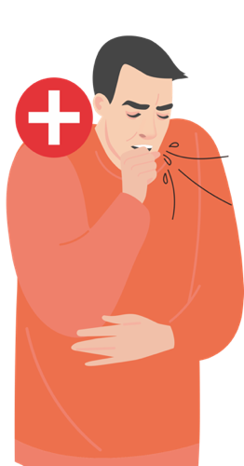
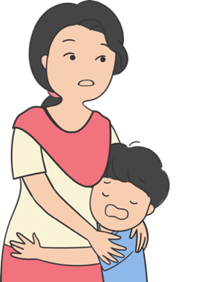
CASE SCENARIO
ANSWERS
Sunil is a young man of 30 years. He works in mumbai as a teacher in a small school and has returned back home for holi. Sunil has been confirmed with COVID-19 and now his family is worried.
Ensure that all members in the family have been given the advise to follow
Follow up if any help needed
Organise for the families to have support when they are on quarantine for getting their daily supplies like groceries or vegetables.
Check on hand hygiene and respiratory hygiene understanding
Check if all clothes and household materials used by confirmed family member have been disinfected.
Talk to the family often even if only on the mobile and encourage other friends of the family to talk on the phone. This is to help them manage the feeling of being isolated.
QUESTION: What will you do?
18

Slide 26
POLL QUESTION

Slide 27

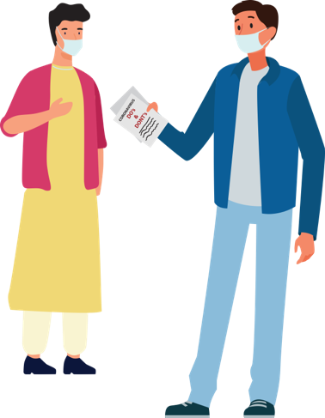
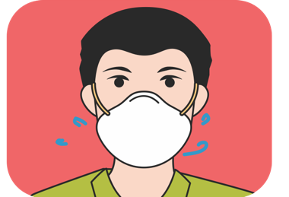
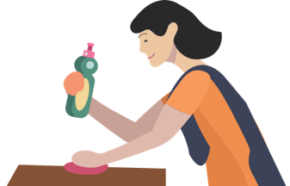
SESSION 4
SUPPORTIVE PUBLIC HEALTH SERVICES: COMMUNITY HOUSEHOLDS
HOME
QUARANTINE -SELF
HOME
QUARANTINE-
FAMILY MEMBERS
HOME CARE
CREATE
SUPPORTIVE
ENVIRONMENT
19

Slide 28
Learning outcome
Participants will be able to understand how to create community support for COVID-19
Participants will understand and be able to give information on services to be provided for home care and home quarantine for suspected case and family members.
19

Slide 29
Response and containment– Create a Supportive environment
Talk to and
involve Influencers
Fight discrimination
PLAN COMMUNITY
SUPPORT FOR HIGH RISK
COORDINATE WITH
THE EXISTING COMMUNITY
NETWORKS FOR SUPPORT
HELP DEVELOP HOUSEHOLD
EMERGENCY CONTACT LIST
  Make a list of high risk groups in the village
  Identify people they meet or talk to; share preventive measures with these people and request them to keep communicating these measures to the high risk people
  Take care of older people or people with co - morbidities like hypertension, diabetes, lung or kidney disease.
  Take care of children whose parents may be in quarantine for issues of education and/or care.
  Make a list of local influencers (Gram Pradhan, Religious Leaders, Teachers, any other)
  Explain & discuss the situation and protocols/orders/notifications to be followed and seek their support in giving key messages.
  Identify community networks and keep them ready with information
  Coordinate with the ASHA/ANM on the roles assigned for emergency planning, distribution of services like food/grocery delivery for quarantined households, midday meals medicine etc.
  Share emergency contact details as directed
  Share coordinating details of Child protection committees for addressing issues of trauma and violence in children.
  Ensure each household has a current list of emergency contacts for family, friends, neighbours, essential services contact numbers like food, medicines, medical help
20

Slide 30
CASE STUDY
ROLE OF AN INFLUENCER
QUESTION 1: Is this the right thing to do?
Babulal has been renting out his tractor for the last several years and many people know him in the community. Recently people have stopped taking babaulal’s tractors on rent and you come to know that this is because Babulal has been having symptoms of cold and flu. When you speak with Babulal he tells you that when he is walking people cross over on the other side of the street and do not even talk to him or his family members, including his children even on the phone. He has decided to go to his city house so he does not have to bear this behaviour
QUESTION 2: What will you do as A COVID WARRIOR
Check who can help in influencing the local landowners.
Use the key influencers in giving the communication on what is covid-19 and what are the symptoms.
Talk to the ASHA/ANM for discussing the SYMPTOMS OF COVID-19 with Babulal and if he is a contact what advisory should be given to him
21

Slide 31
HOME QUARANTINE: STAY SAFE FOR PROBABLE INFECTED PERSON RESTRICTED MOVEMENT FOR COVID-19 SUSPECTS
KEEP DISTANCE
AVOID VISITORS IN THE HOUSE
  Stay in a well ventilated specific room and away from other people in your home. Restrict movement
  If available, use a separate bathroom
If you are infected, you can spread infection to others
SEEK HEALTH CARE AND NOTIFY
AVOID GOING TO PUBLIC AREAS
If you have fever, cough or breathing difficulty and suspecting contact, wear a mask and immediately notify nearest health facility
Avoid using public transport
Do not go to markets, schools or other public areas
WEAR A MASK
Wear a mask correctly when you are around other people
Wear a mask when you are visiting the health facility
22

Slide 32
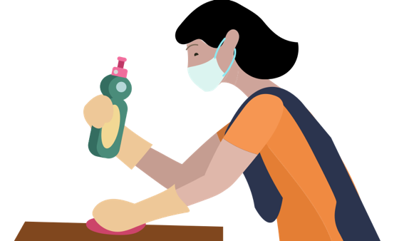
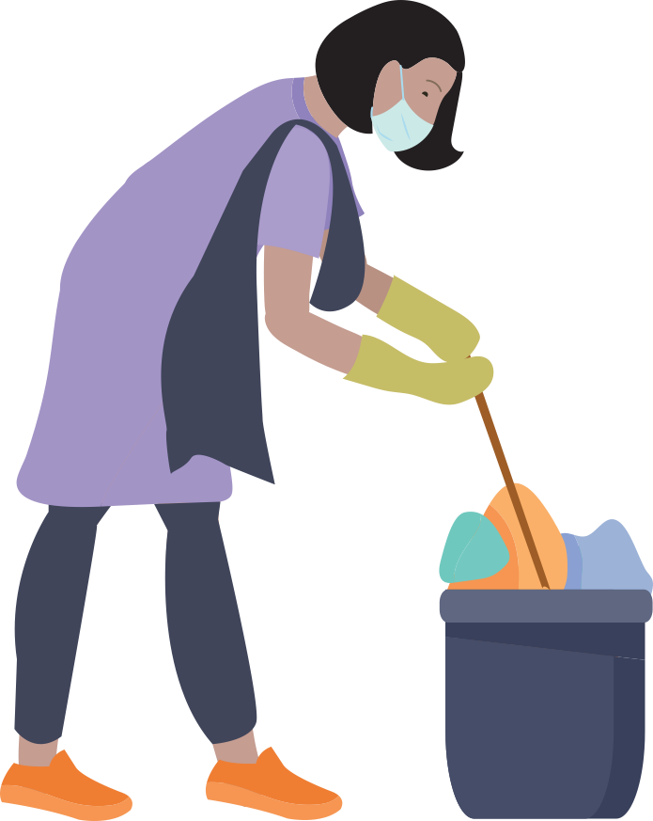
HOME CARE: KEEP ENVIRONMENT SAFE
PRECAUTIONS TO BE TAKEN BY THE HOUSEHOLD WHERE THERE IS A SUSPECTED CASE
Wash laundry thoroughly and avoid shaking soiled linen
  Immediately remove and wash clothes or bedding that have blood, stool, or body fluids on them. Keep away from body.
  Wash and disinfect linen in warm water and soap, dry in sun
  Washing machine: use disinfectant, soap, warm water, dry in sun
  Linen can be soaked in hot water and soap in a large drum, using a stick to stir, avoiding splashing (soak linen in 1% chlorine for approximately 30 minutes. Finally, rinse with clean water and let linen dry fully in the sunlight.
  Place all used disposable gloves, facemasks, and other contaminated items in a lined container before disposing of them with other household waste.
  Note: infected person may be ambulatory or bed-ridden
Support: Assigned family member to take care of infected person helping them follow doctor’s instructions for medication(s) and care.
Wash hands: with soap and water for at least 20 seconds or, if soap and water are not available, clean your hands with an alcohol-based hand sanitizer that contains at least 70% alcohol. Wash often and especially after touching
Clean and Disinfect: all “high-touch” surfaces, such as tabletops, doorknobs, bathroom fixtures, toilets, phones, every day. Also, wipe any surfaces that may have blood, stool, or body fluids on them. using bleaching powder solution (4 TSP of household bleach in 4 cups of water
23

Slide 33
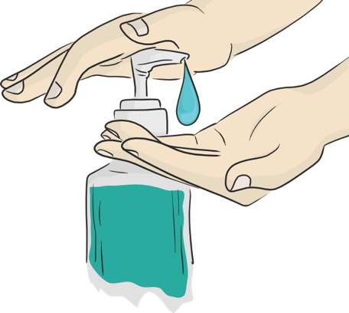
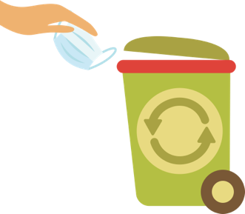
HOME QUARANTINE: STAY SAFE FOR FAMILY MEMBERS
Household members should stay in another room or be separated from the patient as much as possible.
Household members should use a separate bedroom and bathroom, if available.
Avoid sharing household items e.g. Dishes, drinking glasses, cups, eating utensils, towels, bedding, or other items with other people at home.
Wash hand as often thoroughly with soap and water (20 secs) or with 70% alcohol-based hand sanitizer
When in contact with the person who is quarantined, the family members should wear a three layered mask at all the times. Disposable masks are never to be reused.
Used mask should be considered as potentially infected. Dispose mask by soaking in home bleach solution and then throwing in a dustbin.
Do not let small children play with the masks.
24

Slide 34
POLL QUESTION
Q & A

Slide 35
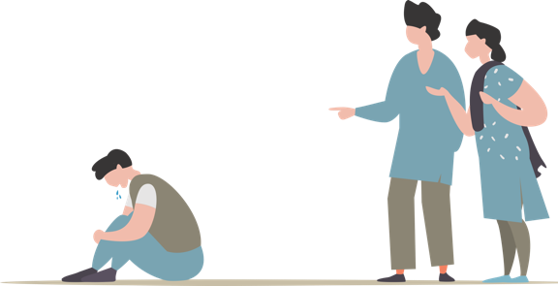
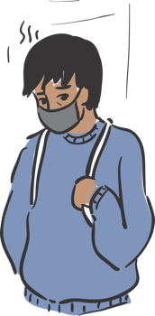
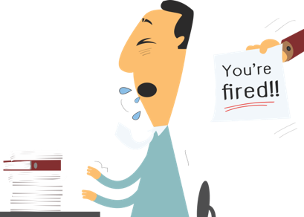
SESSION 5
STIGMA AND DISCRIMINATION
WHAT IS
STIGMA?
WHY IS THERE
STIGMA?
WHAT DOES
STIGMA DO?
WHAT CAN
FLW DO?
25

Slide 36
LEARNING OUTCOME
Participants will be able to define stigma and understand why COVID-19 causes a stigma in society.
Participants will know how stigma affects their work and what they can do to address it.
25

Slide 37
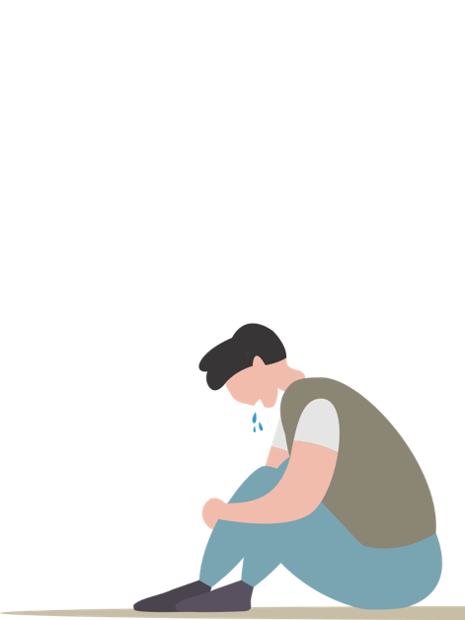
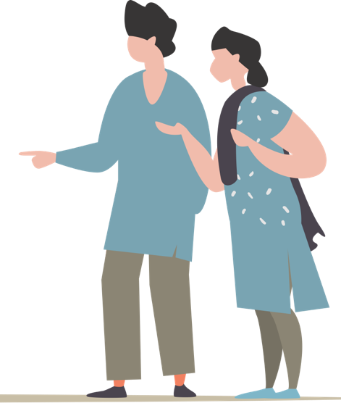
WHAT IS STIGMA?
In any Epidemic, it is common for individuals to feel stressed and worried because they fear:
Falling ill and dying
Avoiding approaching health facilities due to fear of becoming infected while in care
Fear of losing livelihoods, not being able to work during isolation, and of being dismissed from work
Fear of being socially excluded/placed in quarantine because of being associated with the disease
Feeling powerless in protecting loved ones and fear of losing loved ones because of the virus or being separated during quarantine
Feelings of helplessness, boredom, loneliness and depression due to being isolated and not working towards caring for a dependent
Stress is caused due to the above fears and being treated as an outcaste or blamed for spreading the disease
26

Slide 38
WHY IS THERE STIGMA?
The level of stigma associated with COVID-19 is based on three main factors:
COVID-19 is a new disease about which many things are still being discovered.
When something is unknown people are worried which leads to fear
Rumours or fake news give wrong information and spreads the fear.
27

Slide 39

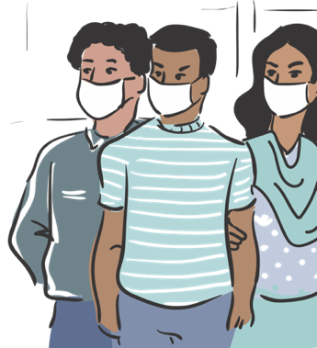
RECOGNISING STIGMA?
WHAT WILL YOU FEEL LIKE IF YOU WERE
BABULAL, RANI, SUKHRAM, BEAUTY?
You are in the grocery shop. There are several people who are wearing a mask. You see Babulal the store owner going red in his face as he tries to suppress a cough.
Sukhram has come back from Pune where he works as a taxi driver. They stay in a joint family and you have taken his contact history as advised by your Supervisor. You come to know that Sukhram’s family members have asked him to leave the house
Beauty works in Delhi as a house maid. Recently she has come back and you have been told that Beauty’s employers have asked her to leave as she had a cold.
Surali is a young girl of 11 years. She and her 8 year old brother are staying with an aunt as their parents have been asked to go in for isolation. Surali’s aunt keeps on complaining to you that the children are a big burden on the family’s resources.
THE STIGMA
Babulal has Simple cough. But he is too scared to cough in front of people as he will loose the customers.
Sukhram needs family support to help him stay in isolation. If everyone takes proper precautions the infection need not spread.
Beauty has a seasonal cold but she has been asked to leave by her employers.
Surali and her brother are two small children who need to be supported and this kind of incidence can cause mental stress even in the future. CPC should be approached for appropriate measures for helping children in difficult situations
28

Slide 40
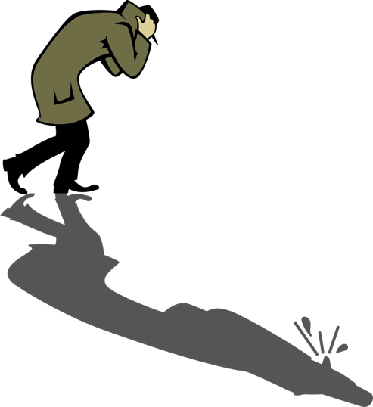
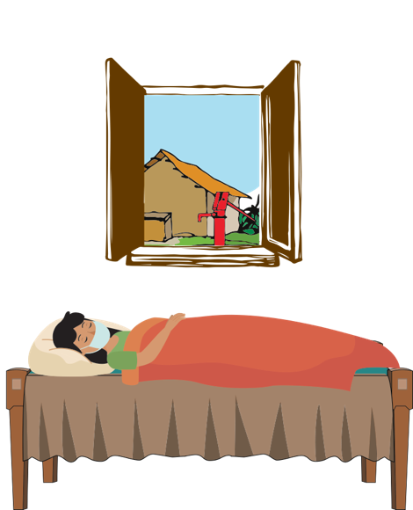
WHAT DOES STIGMA DO?
Discourages them &
may at times prevent
them from adopting
healthy behaviours
Makes people hide
their problems
Keeps people away
from accessing
health services and
seeking help
29

Slide 41
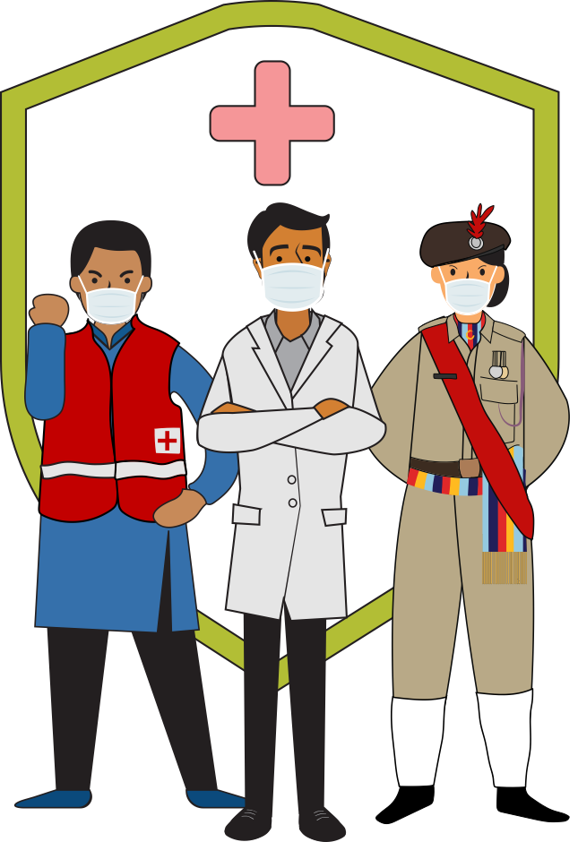
WHAT CAN THE COVID WARRIOR DO?
Sensitize people and help them to understand that it is a simple infection and 80% of the cases are mild cases
Make special efforts to reach out to high risk groups including senior citizens and younger children
Ask people to stay away from watching negative things on the TV and also fake news
Guide WhatsApp groups to help in giving hope and positive news to help people handle stress
Advise people to engage in relaxing activities like indoor games, reading, gardening, home-cleaning, etc
Engage community influencers , Share correct information on COVID-19 with them. Brief them on specific support required by you
Publicly, use terms like people who have COVID-19 instead of “COVID-19 cases” or “victims”. Similarly, use terms like people who may have COVID-19 instead of “suspected cases”
Emphasize that most people do recover from COVID-19, amplify the good news about local people; who have recovered from COVID-19 or supported a loved one through recovery
30

Slide 42
Case from PIPLI: What Can COVID WaRRIORS do?
Suresh was under home quarantine when his wife, developed labour pains. The ASHA took her to the hospital for delivery. She assured Suresh that his wife will be taken care of while he should remain isolated within the house as advised. The ASHA called the COVID Warrior and requested him to support Suresh. She reminded him to take precautions while giving food. She then called the convener of local mothers’ group and a member of village health and nutrition committee (VHSNC) member and apprised both of them of the situation requesting them to arrange for Suresh’s food and home-care requirements. The VHSNC member requested the COVID Warriors for help to support Suresh at-least for next 72 hours till his wife returns.
1. What are the positive actions taken by ASHA?
ASHA has proactively formed community support groups and planned in case of emergency
2. What should be done?
She informed her neighbour to give food and COVID Warriors for help in supporting
3. Which groups and /or people were involved by ASHA to provide supportive environment?
The Youth Volunteer, VHSNC
4. If you were the ASHA what would you have done additionally?
31

Slide 43
POLL QUESTION

Slide 44
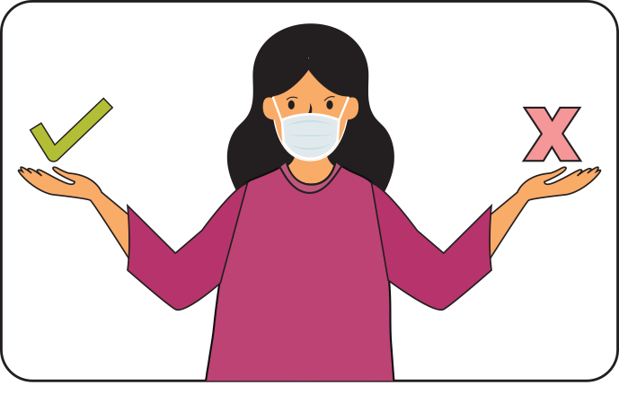



SESSION 6
COMMUNICATION AND PERSONAL SAFETY
WHAT TO
COMMUNICATE
MASK
MANAGEMENT
PRECAUTIONS
HOW TO
COMMUNICATE?
32

Slide 45
LEARNING OUTCOME
Participants will be able to list what to communicate and how to communicate
Participants will demonstrate self-protection measures
Participants will be able to prepare a checklist of safety measures to be taken during home visits and contact tracing procedures.
32

Slide 46



what to communicate and communication platforms
HAND HYGIENE
Share mobisodes
Display IEC materials at appropriate places
Use essential services (like garbage collection vans, milk supply, etc.) For miking
Share WhatsApp messages on groups
Use pocket book for giving key messages
RESPIRATORY
HYGIENE
Social Distancing
Home Care & Home Quarantine
MONITORING
SYMPTOMS
33
Notes:
We have seen each of these topics before. Let us recall the main points that we have learnt in each of these topics. Refer to your Pocket Reference book for what are the 5 points that you must remember in each of these. In this period of social distancing, the COVID Warriors must use appropriate platforms for giving out the messages. While some of the messages can be given to families when you are doing the contact tracing or monitoring, other messages can be given through WhatsApp groups or sharing of mobisodes with key groups, displaying IEC materials where people are allowed to go for buying essential services like grocery stores, milk, pharmacies etc and using miking on essential services like garbage collection, ambulances, or any other that is being used during the lock down /social distancing period. Police vans may be requested to play the miking messages when they are on beat duty

Slide 47
communication: how?
Always be polite. Anyone can get the infection. Do not discriminate, shout, or use rude language.
Be aware that suspected and confirmed cases, and any visitors accompanying them, may be stressed or afraid. So, the most important thing you can do is to listen carefully to questions and concerns.
When you meet people, avoid touching or direct physical contact. This is true for passing on infection either way. Maintain distance of more than 1 meter when you interact.
Be very specific with your questions and confirm they have understood you
Do not preach or give news that is not confirmed by your immediate Supervisor, ASHA/ANM
If there are questions and you have the answers, you must share this with the community member. However if you do not have the answer, do not hesitate to say so. A lot is still unknown about COVID-19
34

Slide 48



mask management
Use a Mask Correctly:
Unfold pleats, facing down, place over nose, mouth and chin.
Fit nose piece over nose-bridge. tie strings upper string tied - top of head above ears lower string at the back of the neck.
Leave no gaps on either side of the mask, adjust to fit.
Do not pull the mask down or hang from the neck
Avoid touching the mask while in use.
Replace masks with a new clean, dry mask as soon as they become damp/humid, 6 -8 hours
Use a mask if and only when:
You develop fever, cough or difficulty in breathing
You visit a health care facility.
You are caring for an ill person
When contact tracing
Removing and Disposing the Mask
Do not re-use single-use masks
Do not touch other surfaces of the mask while removing.
To remove mask first untie the string below and then the string above and handle the mask using the upper strings. Other surfaces may be potentially contaminated
Remove the mask by using appropriate technique (i.e. do not touch the front but remove the lace from behind)
After removal or whenever you inadvertently touch a used mask, clean hands by washing with soap and water for 20 Secs or using a 70% alcohol-based hand rub
Discard single-use masks after each use and dispose of them immediately upon removal
35

Slide 49




PRECAUTION AND SAFETY MEASURE FOR SERV
When moving around the community
Immediately on reaching home
Maintain distance of at least 1 meter from people when you are communicating
Use a three layered mask to cover your face. Make sure it is properly worn.(while contact tracing)
Avoid touching your face (eyes, nose, mouth) at all times
Wash your hands with soap and water frequently, or use alcohol based hand-rub
Avoid touching or direct physical contact
Carefully remove and dispose off your face mask by soaking in bleach solution and then throwing it in a covered dustbin. (See: MASK MANAGEMENT).
Wash your hands with soap and water for 20 secs or 70% alcohol based hand-sanitiser before you touch anything else.
Wipe down what you have carried like your purse and mobile with home based disinfectant (4 tsps Of household bleach in 4 cups of water)
If you get any symptoms like fever, cough or Difficulty in breathing REPORT TO the nearest Government Facility or District Surveillance Officer immediately.
36

Slide 50
myths & Facts
Statement: With the summers coming up, the Coronavirus will be killed
FACT: COVID-19 has been detected in ALL AREAS, including areas with hot and humid weather. The best way to protect yourself against COVID-19 is by frequently washing your hands with soap and water, covering your coughs and sneezes and avoiding crowded places.
Statement: Having a bath with hot water will kill the virus
FACT: The virus lives inside the body where the temperature is maintained at 37ºC and is not affected by a hot water bath that you have.
Statement: Getting the pneumonia vaccine will protect you against the virus
FACT: While vaccines for Pneumonia will certainly protect you against other organisms that cause pneumonia, The vaccine for Novel Coronavirus is under development.
Statement: Spraying alcohol or disinfectant over your body can prevent infection
FACT: Spraying with alcohol or sanitizer on clothes and body will not prevent you from getting infection. Infection spreads when the virus enters the body through nose or mouth. Cleaning and wiping hands with alcohol is to prevent the germ from entering your system through infected hands when you touch your mouth or you eat food with infected hands.
Statement: Regularly rinsing the nose with saline will prevent the infection
FACT: Rinsing nose with saline has in few cases helped in containing common cold, but has no evidence to suggest it is effective against the Novel Coronavirus infection
37

Slide 51
myths & Facts
Statement: Coronavirus can be passed through chicken and meat
FACT: No! There is no such evidence of Coronavirus spreading through meat and poultry products. However it is always advised to have properly cooked meat and chicken.
Statement: A person with Coronavirus can recover fully and be no more infectious.
FACT: 80% of the people have recovered from the disease without needing special treatment. But information on the virus treatment is still being researched
Statement: Eating raw garlic, sesame seeds will protect you against the virus
FACT: Garlic is a healthy food that has other benefits but does not protect you against the Coronavirus.
Statement: The virus can die easily once it is out of the body
FACT: We do not know about this particular virus as of now. Similar viruses (SARS, MERS) survive from 8 to 24 hours depending on types of surfaces.
Statement: You can get COVID-19 through mosquito bites
FACT: The Coronavirus cannot be spread through the bite of a mosquito. It is spread thorough droplets spread when an infected person sneezes or coughs
38

Slide 52
POLL QUESTION

Slide 53


LET'S EXPOSE THE VIRUS
correct information and behaviours is the way to defeat the infection.
Let’s play the game to uncover the virus and tackle it through our information
Let’s play a recap game: In each square you will find a statement
39

Slide 54

































let’s hear
your
answers.
40

Slide 55
SESSION 7
How to meet special communication needs in urban areas
SAFE
PRACTICES
STIGMA & DISCRIMINATION
ACTIVATING
SUPPORT
41
Notes:
In this session we are covering the community support practice to be used in urban setting. Urban areas will pose different challenges which will have to be addressed

Slide 56
LEARNING OUTCOME
• Participants will be able to discuss special activities needed in urban areas
41

Slide 57
ACTIVATING SUPPORT
Community support should involve key stakeholders identified in the area and trained to given safe inputs and support
ADVISE COMMUNITY MEMBERS TO
Volunteer for supporting the Community help-desk set up by local municipality
Support the task of distributing masks in the community, ensuring that they are given to those who most require. Mask management to be taught while distribution
Community representative to ensure that community cleaning and disinfection drive to be taken up regularly by the Municipal corporation
Give information through local political and religious leaders involvement
Give information out through common essential services like garbage vans, milk supply van etc.
Free distribution of bleach/sodium hypochlorite solution and use of the disinfectant to be planned in the community
42

Slide 58
ACTIVATING SUPPORT
Remember urban areas are densely populated with limited health staff. You need to develop community support to
keep everyone and yourself safe.
Identify the high risk groups in the community and help them to isolate themselves to protect them from getting infected
Be in touch with the government services to organise to get the mid-day meals delivered to the children’s homes.
Get key influencers who can help you with vigilance and tracking people who may possibly be infected and report it for referral.
Community level cadre to be trained to ensure compliance of protocols during lock down period
Community level structure to be identified to transform into quarantine facilities
43

Slide 59
PRACTICING SAFE BEHAVIOURS
Remember many daily wage / unorganized sector workers with severe economic hardship would go to work despite
restrictions increasing their vulnerability
Reach out to specific group of people such as labourers, housemaids, shelter home migrants and daily wage workers and advise them to follow:
      Frequent handwashing with soap and water for 20 seconds especially after coming from outside, before eating food and after going to toilet.
      Change clothes and if possible wash oneself using soap after coming from outside. Avoid touching eyes, nose and mouth.
      Avoid spitting in open places and use only a wash basin or spittoon
      Maintain a distance of minimum 1 meter from others
      Contact community help-desk/ health facility if they develop fever, cough or difficulty in breathing or need any information
44

Slide 60
Stigma and Discrimination
Remember urban areas are densely populated with limited health staff. You need to develop community support to
keep everyone and yourself safe.
Resident Welfare Associations
Many of the societies have stopped maids and other helpers from entering. While this is correct as this will keep people at home, the way of managing this distancing is stigmatizing
Words like “They will bring this disease to us” “The disease will spread because of them” etc are stigmatizing
Work with the local influencers and key decisionmakers of the area to sensitize people
Use the mass media clips to sensitize
Use government orders to show why housing societies should not discriminate against the working class like car cleaners, maids etc.
45

Slide 61
POLL QUESTION
Q & A

